Slide 1
Lecture 1 Logistic Regression
Most material from Andrew NG’s course at Coursera

Slide 2
Table of Contents
Binary Classification
Notation
Logistic Regression Model
Logistic Regression Cost function
Gradient Descent
Logistic Regression Code

Slide 3

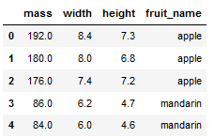
Binary Classification
1 (apple) vs 0 (non apple)
x=

Slide 4
Notation
(x, y)
m =
X =
Y =

Slide 5
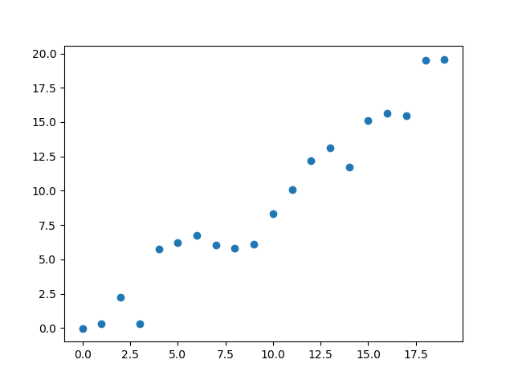
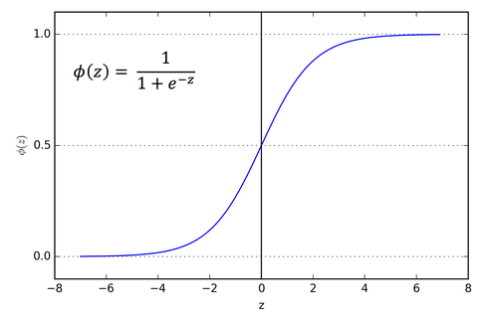
Logistic Regression Model
Given x
Machine learning format

Slide 6
Logistic Regression cost function
$\hat{y} = σ\left(w^{T}x +b\right)$, where $σ\left(z\right)=\frac{1}{1+e^{−z}}$
Given $\left\{{(x}^{(1)},y^{(1)}\text{)}\text{,}\text{…}\text{,}{(x}^{(m)},y^{(m)}\text{)}\right\},$want ${\hat{y}}^{(i)}≈y^{\left(i\right)}$.
Loss (error) function:

Slide 7
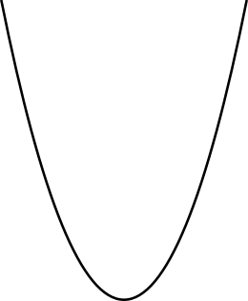
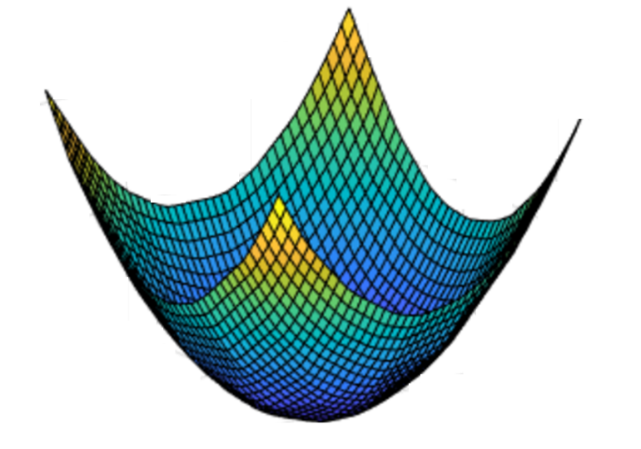
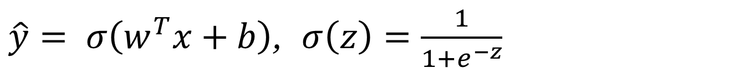

Gradient Descent
$\hat{y}= σ\left(w^{T}x+b\right)$, $σ\left(z\right)=\frac{1}{1+e^{−z}}$
$$\frac{1}{m}\sum_{i=1}^{m}{ }$$
$ℒ({\hat{y}}^{\left(i\right)},y^{(i)})$ $=$
$$−\frac{1}{m}\sum_{i=1}^{m}{ }$$
$$J\left(w,b\right)=$$
$y^{(i)}\log{{\hat{y}}^{\left(i\right)}}$+ $({1−y}^{(i)})\log{(1 −{\hat{y}}^{\left(i\right)})}$
Want to find $w,b$ that minimize $J\left(w,b\right)$
$$J\left(w,b\right)$$
$$b$$
$$w$$

Slide 8









Logistic regression derivatives
$$z= w^{T}x+b$$
$$\hat{y}=a= σ(z)$$
$$ℒ\left(a,y\right)=−(y\log{(a)+(1−y)\log{(1−a))}}$$
$$x_{1}$$
$$w_{1}$$
$$x_{2}$$
$$z= w_{1}x_{1}+w_{2}x_{2}+b$$
$$a= σ(z)$$
$$ℒ(a,y)$$
$$w_{2}$$
b

Slide 9
Logistic regression on m examples
$$\frac{1}{m}\sum_{i=1}^{m}{ }$$
$ℒ({\hat{y}}^{\left(i\right)},y^{(i)})$ $=$
$$−\frac{1}{m}\sum_{i=1}^{m}{ }$$
$$J\left(w,b\right)=$$
$y^{(i)}\log{{\hat{y}}^{\left(i\right)}}$+ $({1−y}^{(i)})\log{(1 −{\hat{y}}^{\left(i\right)})}$

Slide 10

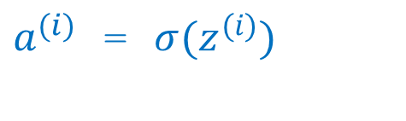
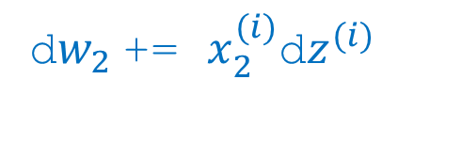
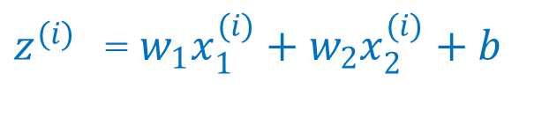
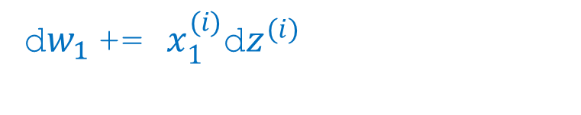
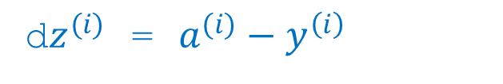
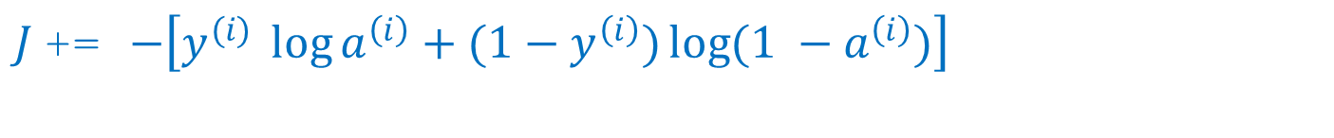
Logistic regression(pseudo code)
for epoch in range(n_epochs):
J = 0, dw1 = 0, dw2 = 0, db = 0
for i = 1 to m:
$z^{(i)}$ =${ w}_{1}x_{1}^{(i)}+w_{2}x_{2}^{(i)}+b$
$a^{(i)}$ = $σ{(z}^{(i)})$
$J$+= $−\left[y^{(i)} \log{a^{\left(i\right)}+({1−y}^{\left(i\right)})\log{(1 −a^{\left(i\right)})}}\right]$
d$z^{(i)}$ = $a^{(i)}−y^{\left(i\right)}$
d${w_{1}}^{ }$+= $x_{1}^{(i)}\text{d}z^{(i)}$
d${w_{2}}^{ }$+= $x_{2}^{(i)}\text{d}z^{(i)}$
db += d$z^{(i)}$
J = J/m; d$w_{1}$ = d$w_{1}$/m; d$w_{2}$ = d$w_{2}$/m; db = db/m;
$w_{1}$ = $w_{1}$-αd$w_{1}$; $w_{2}$ = $w_{2}$-αd$w_{2}$; b = b - αdb;

Slide 11
Questions?

