Slide 1
Lecture 2:
Vectorization
Most material from Andrew NG’s course at Coursera
Pooya Mohammadi Lecture 2 - 1 Winter-2020

Slide 2
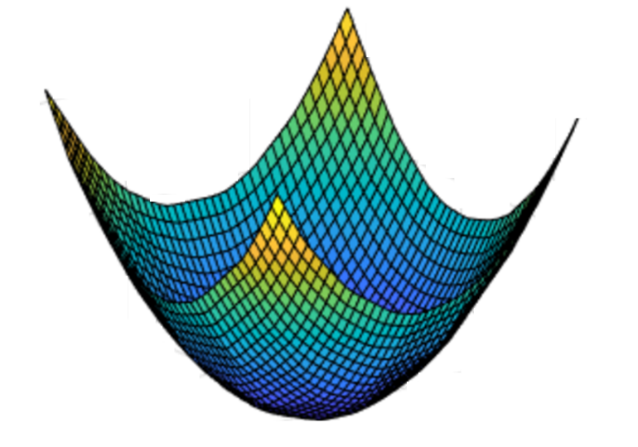
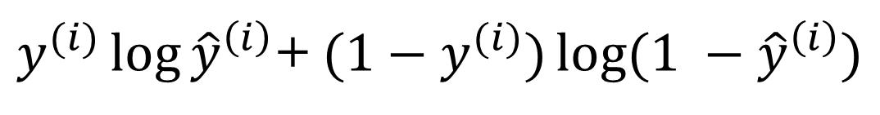
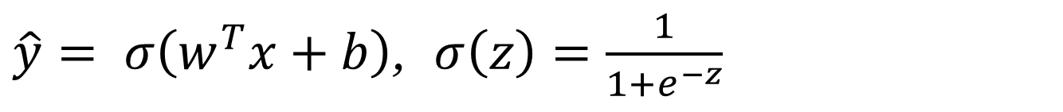
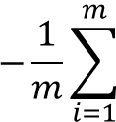
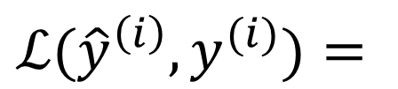
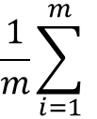

Last time: Binary Classification
Model:
$\hat{y}= σ\left(w^{T}x+b\right)$, $σ\left(z\right)=\frac{1}{1+e^{−z}}$
Loss:(Cross Entropy)
$$\frac{1}{m}\sum_{i=1}^{m}{ }$$
$ℒ({\hat{y}}^{\left(i\right)},y^{(i)})$ $=$
$$−\frac{1}{m}\sum_{i=1}^{m}{ }$$
$$J\left(w,b\right)=$$
$y^{(i)}\log{{\hat{y}}^{\left(i\right)}}$+ $({1−y}^{(i)})\log{(1 −{\hat{y}}^{\left(i\right)})}$
Gradient Descent:
$$J\left(w,b\right)$$
$$b$$
$$w$$
Pooya Mohammadi Lecture 2 - 2 Winter-2020

Slide 3









Last time
$$x_{1}$$
$$w_{1}$$
$$x_{2}$$
$$z= w_{1}x_{1}+w_{2}x_{2}+b$$
$$a= σ(z)$$
$$ℒ(a,y)$$
$$w_{2}$$
b
$$x_{1}$$
$$\hat{y}$$
$$x_{2}$$
Pooya Mohammadi Lecture 2 - 3 Winter-2020

Slide 4

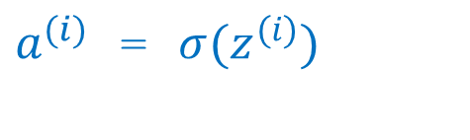
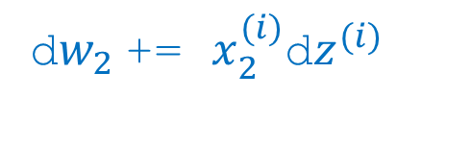
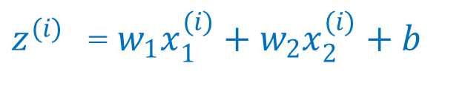
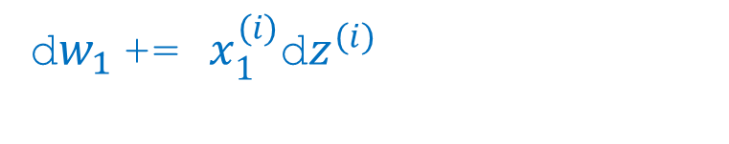
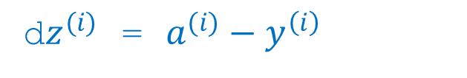
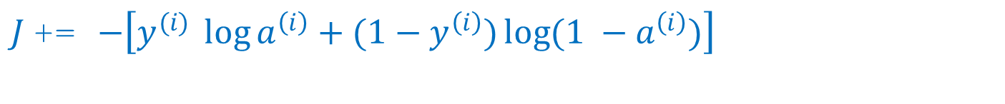
Last time
Code:
for epoch in range(n_epochs):
J = 0, dw1 = 0, dw2 = 0, db = 0
for i in range(m):
$z^{(i)}$ =${ w}_{1}x_{1}^{(i)}+w_{2}x_{2}^{(i)}+b$
$a^{(i)}$ = $σ{(z}^{(i)})$
$J$+= $−\left[y^{(i)} \log{a^{\left(i\right)}+({1−y}^{\left(i\right)})\log{(1 −a^{\left(i\right)})}}\right]$
d$z^{(i)}$ = $a^{(i)}−y^{\left(i\right)}$
d${w_{1}}^{ }$+= $x_{1}^{(i)}\text{d}z^{(i)}$
d${w_{2}}^{ }$+= $x_{2}^{(i)}\text{d}z^{(i)}$
db += d$z^{(i)}$
J = J/m; d$w_{1}$ = d$w_{1}$/m; d$w_{2}$ = d$w_{2}$/m; db = db/m;
$w_{1}$ = $w_{1}$-αd$w_{1}$; $w_{2}$ = $w_{2}$-αd$w_{2}$; b = b - αdb;
Pooya Mohammadi Lecture 2 - 4 Winter-2020

Slide 5
Today
Vectorization
TensorFlow 2
Binary Classification(Implementation)
Pooya Mohammadi Lecture 2 - 5 Winter-2020

Slide 6
What is vectorization?
Pooya Mohammadi Lecture 2 - 6 Winter-2020

Slide 7
Logistic regression
for epoch in range(n_epochs):
J = 0, dw1 = 0, dw2 = 0, db = 0
for i = 1 to m:
$z^{(i)}$ =${ w}_{1}x_{1}^{(i)}+w_{2}x_{2}^{(i)}+b$
$a^{(i)}$ = $σ{(z}^{(i)})$
$J$+= $−\left[y^{(i)} \log{a^{\left(i\right)}+({1−y}^{\left(i\right)})\log{(1 −a^{\left(i\right)})}}\right]$
d$z^{(i)}$ = $a^{(i)}−y^{\left(i\right)}$
d${w_{1}}^{ }$+= $x_{1}^{(i)}\text{d}z^{(i)}$
d${w_{2}}^{ }$+= $x_{2}^{(i)}\text{d}z^{(i)}$
db += d$z^{(i)}$
J = J/m; d$w_{1}$ = d$w_{1}$/m; d$w_{2}$ = d$w_{2}$/m; db = db/m;
$w_{1}$ = $w_{1}$-αd$w_{1}$; $w_{2}$ = $w_{2}$-αd$w_{2}$; b = b - αdb;
Pooya Mohammadi Lecture 2 - 7 Winter-2020

Slide 8

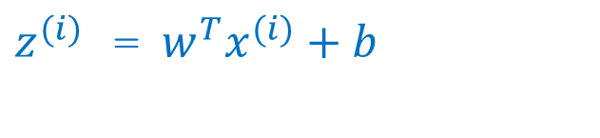
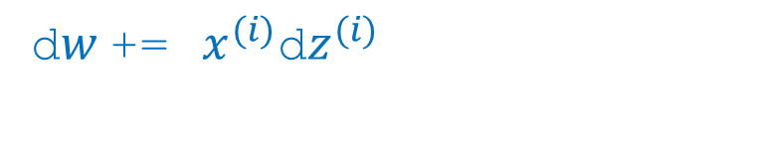
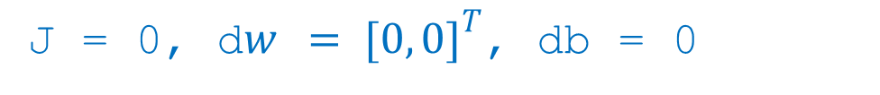



Logistic Regression Vectorization
for epoch in range(n_epochs):
J = 0, d$w { = [0, 0]}^{T}$, db = 0
for i = 1 to m:
$z^{(i)}$ =$w^{T}x^{(i)}+b$
$a^{(i)}$ = $σ{(z}^{(i)})$
$J$+= $−\left[y^{(i)} \log{a^{\left(i\right)}+({1−y}^{\left(i\right)})\log{(1 −a^{\left(i\right)})}}\right]$
d$z^{(i)}$ = $a^{(i)}−y^{\left(i\right)}$
d$w$+=${ x}^{(i)}\text{d}z^{(i)}$
db += d$z^{(i)}$
J = J/m, d$w$ = d$w$/m, db = db/m
$w$=$w$-αdw$;$ b=b-αdb;
Pooya Mohammadi Lecture 2 - 8 Winter-2020

Slide 9
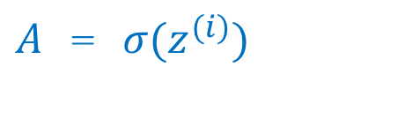
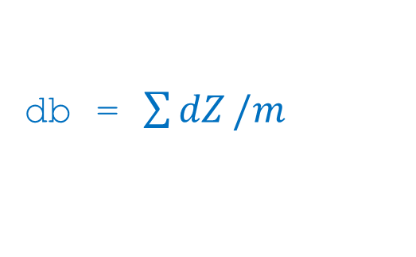
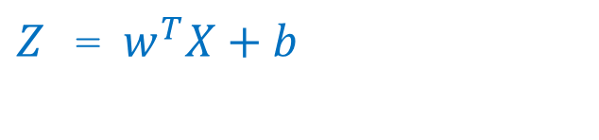
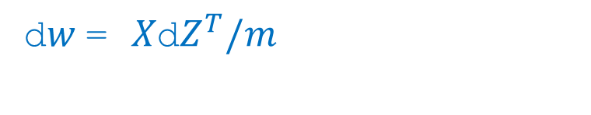

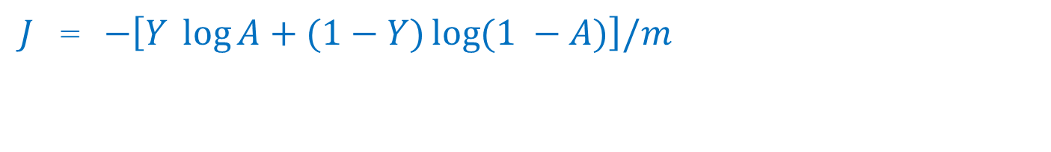
Logistic Regression Vectorization
for epoch in range(n_epochs):
$Z$ =$w^{T}X+b$
$A$ = $σ{(z}^{(i)})$
$J$= $−\left[Y \log{A+(1−Y)\log{(1 −A)}}\right]/m$
d$Z$ = $A−Y$
d$w$= $X\text{d}Z^{T}/m$
db = $\sum{dZ}/m$
$w$=$w$-αdw$;$ b=b-αdb;
Pooya Mohammadi Lecture 2 - 9 Winter-2020

Slide 10
Questions??
Pooya Mohammadi Lecture 2 - 10 Winter-2020

