Slide 1
Lecture 8:
Transfer Learning,
Image Segmentation
Most material from Fei Fei Li’s course at Standford University
Pooya Mohammadi Lecture 8 - 1 Winter-2020

Slide 2
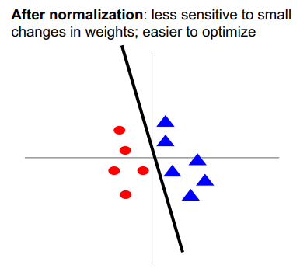
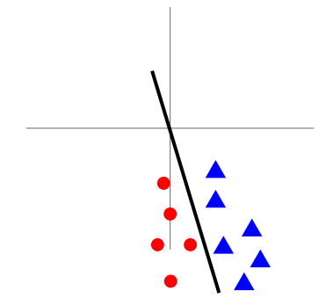
Last time: Data Preprocessing
Before normalization: classification loss is very sensitive to changes in weight matrix; hard to optimize
After normalization: Less sensitive to small changes in weights; easier to optimize
Pooya Mohammadi Lecture 8 - 2 Winter-2020

Slide 3
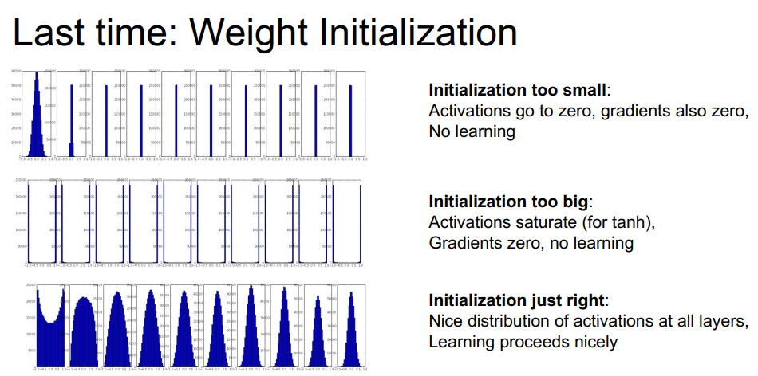
Last time: Weight Initialization
Initialization too small:
Activation go to zero, gradient also zero, No learning
Initialization too big:
Activation saturate (for tanh),
Gradients zero, no learning
Initialization just right:
Nice distribution of activations at all layers, Learning proceeds nicely
Pooya Mohammadi Lecture 8 - 3 Winter-2020

Slide 4
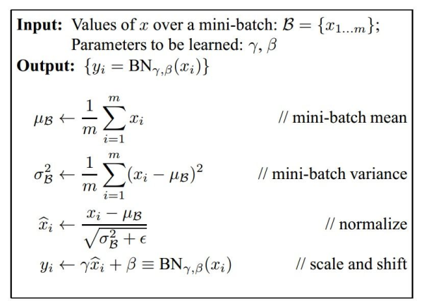
Last time: Batch Normalization
- Improves gradient flow through the network
- Allows higher learning rates
- Reduces the strong dependence on initialization
- Acts as a form of regularization in a funny way, and slightly reduces the need for dropout, maybe
[loffe and Szegedy, 2015]
Pooya Mohammadi Lecture 8 - 4 Winter-2020

Slide 5
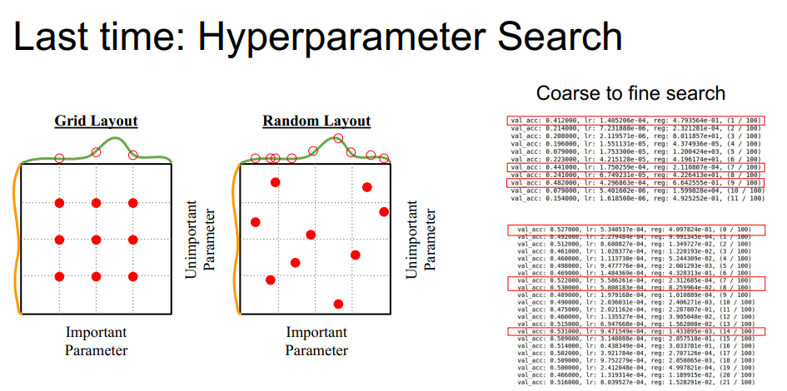
Last time: Hyper-Parameter Search
Pooya Mohammadi Lecture 8 - 5 Winter-2020

Slide 6
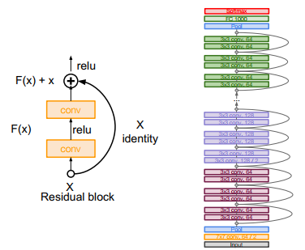
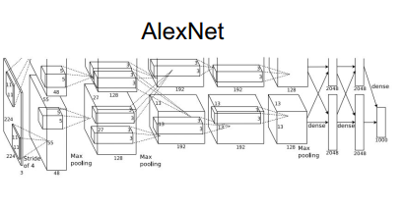
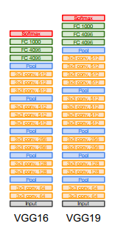
Last time: CNN Architecture
ResNet
AlexNet
Pooya Mohammadi Lecture 8 - 6 Winter-2020

Slide 7
Today:
Transfer Learning
Image Segmentation
Pooya Mohammadi Lecture 8 - 7 Winter-2020

Slide 8
Transfer Learning
Pooya Mohammadi Lecture 8 - 8 Winter-2020

Slide 9
Transfer Learning:
Busted
“ You need a lot of data if you want to train/use CNNs”
Pooya Mohammadi Lecture 8 - 9 Winter-2020

Slide 10
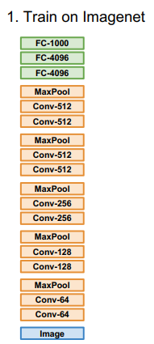
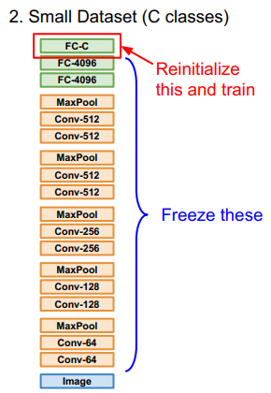
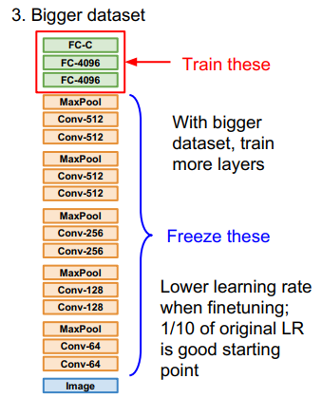
Transfer Learning:
Pooya Mohammadi Lecture 8 - 10 Winter-2020

Slide 11
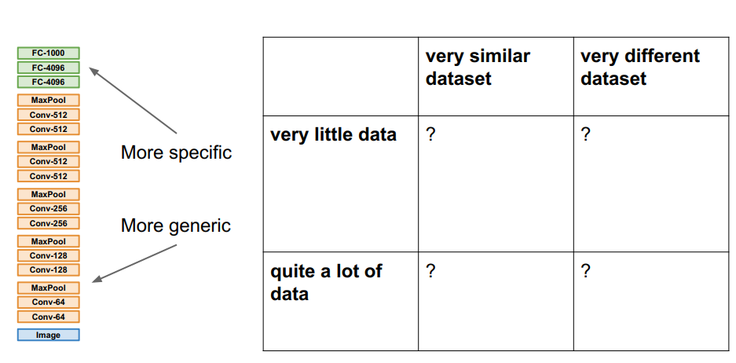
Transfer Learning:
Pooya Mohammadi Lecture 8 - 11 Winter-2020

Slide 12
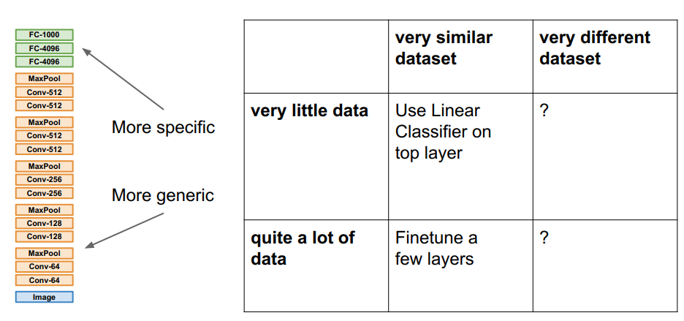
Transfer Learning:
Pooya Mohammadi Lecture 8 - 12 Winter-2020

Slide 13
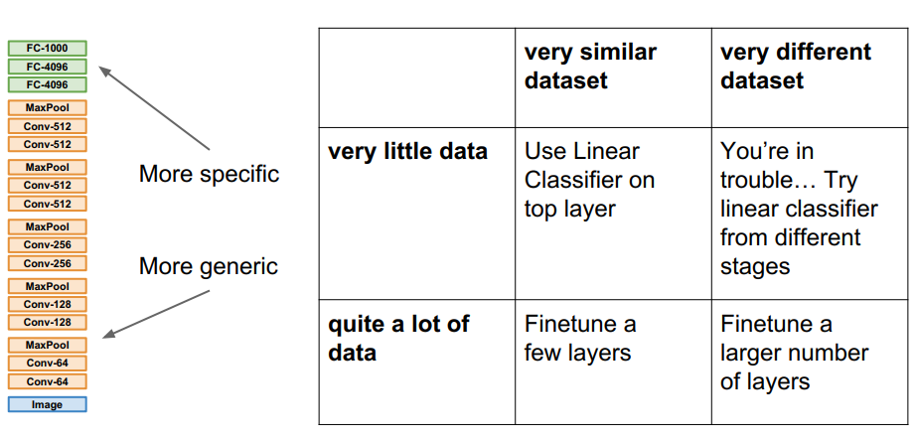
Transfer Learning:
Pooya Mohammadi Lecture 8 - 13 Winter-2020

Slide 14
Image Segmentation
Pooya Mohammadi Lecture 8 - 14 Winter-2020

Slide 15
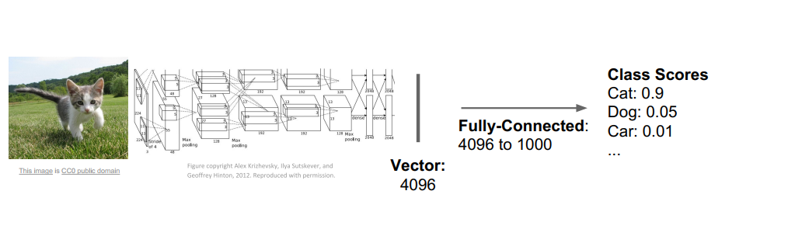
Image Segmentation:
So Far: Classification
Pooya Mohammadi Lecture 8 - 15 Winter-2020

Slide 16
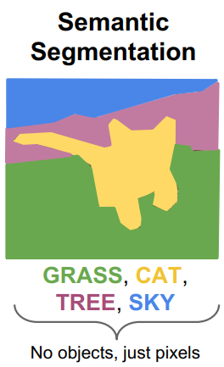
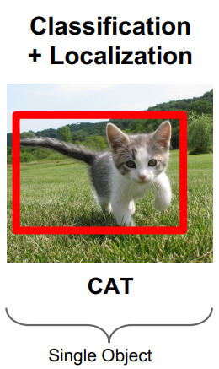
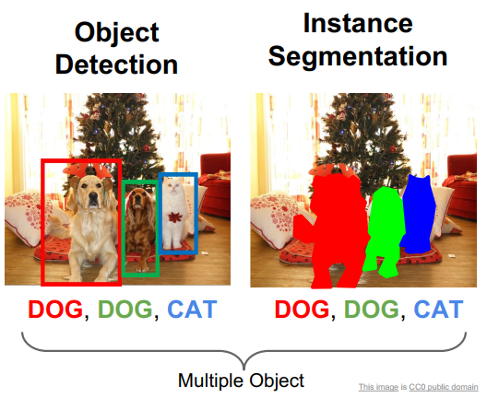
Image Segmentation: Other Computer Vision Tasks
Pooya Mohammadi Lecture 8 - 16 Winter-2020

Slide 17
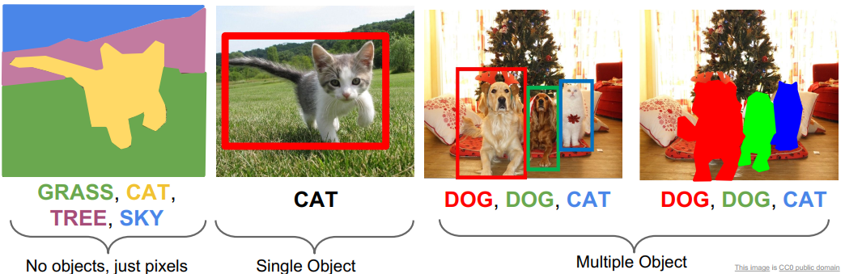
Image Segmentation:
Semantic Segmentation
Pooya Mohammadi Lecture 8 - 17 Winter-2020

Slide 18
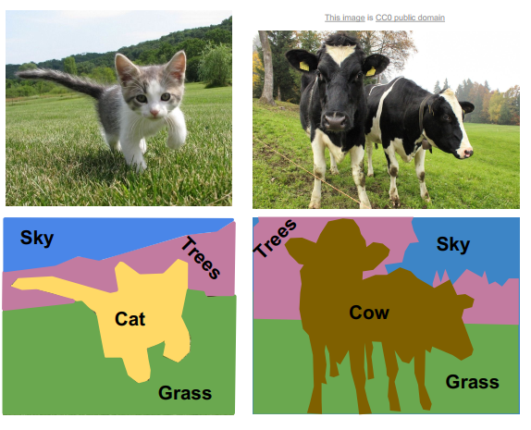
Semantic Segmentation:
Label each pixel in the image with a category label
Don’t differentiate instances, only care about pixels
Pooya Mohammadi Lecture 8 - 18 Winter-2020

Slide 19
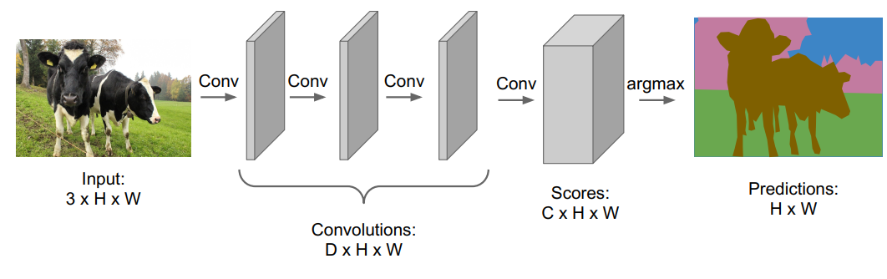

Semantic Segmentation: Fully Convolutional
Design a network as a bunch of convolutional layers to make predictions for pixels all at once!
Pooya Mohammadi Lecture 8 - 19 Winter-2020

Slide 20
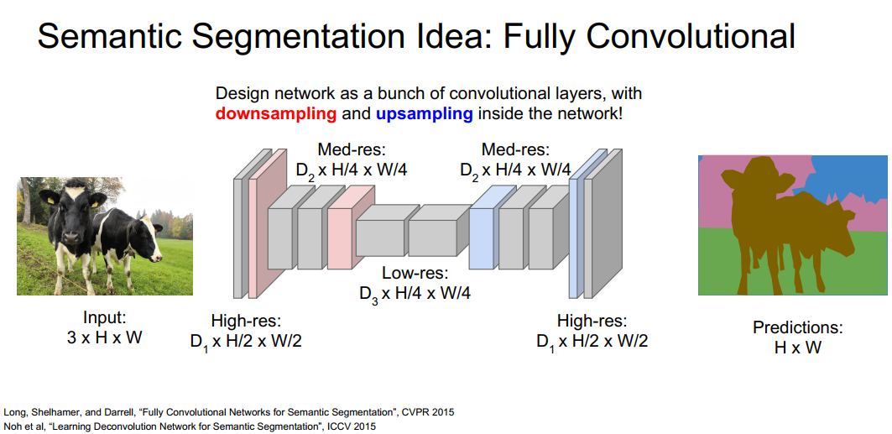
Semantic Segmentation:
Downsampling:
Pooling, Strided Convolution
Design a network as a bunch of convolutional layers, with downsampling and upsampling inside the network!
UpSampling
???
Next Lecture…
Long, Shelhamer, and Darrell, “Fully Convolutional Networks for Semantic Segmentation”, CVPR 2015 Noh et al, “Learning Deconvolution Network for Semantic Segmentation”, ICCV 2015
Pooya Mohammadi Lecture 8 - 20 Winter-2020

Slide 21
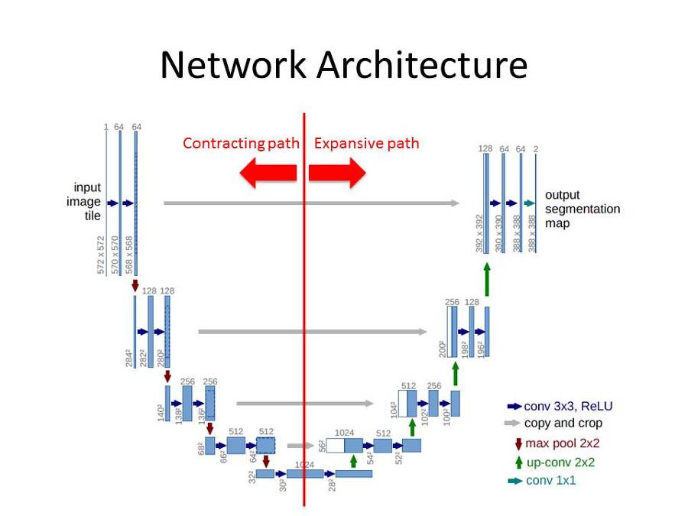
Image Segmentation: UNet
filters=1
Padding=Same
Dropout=0.5
Roneberger et al, “U-Net: Convolutional Networks for Biomedical Image Segmentation”, MICCAI 2015
Pooya Mohammadi Lecture 8 - 21 Winter-2020

Slide 22
Image Segmentation: Unet Notes
The left hand side is the contraction path (Encoder) where we apply regular convolutions and max pooling layers
In the decoder, the size of the image gradually increases and the depth gradually decreases
In the Encoder, the size of the image gradually reduces while the depth gradually increases.
The Decoder recovers the “WHERE” information (precise localization) by gradually applying up-sampling
Network learns the “WHAT” information in the image, however it has lost the “WHERE” information
To get better precise locations, at every step of the decoder, skip connections by concatenating the output of the Upsample layers with the feature maps from the Encoder has been used
Droput 0.5 is used to prevent over-fitting
The right hand side is the expansion path (Decoder) where Upsampling, along with regular convolutions are applied
After every concatenation two consecutive regular convolutions are applied so that the model can learn to assemble a more precise output
Roneberger et al, “U-Net: Convolutional Networks for Biomedical Image Segmentation”, MICCAI 2015
Pooya Mohammadi Lecture 8 - 22 Winter-2020

Slide 23
Question??
Pooya Mohammadi Lecture 8 - 23 Winter-2020

