Slide 1
Lecture 4:
Neural Network
Pooya Mohammadi Lecture 4 - 1 Winter-2020

Slide 2
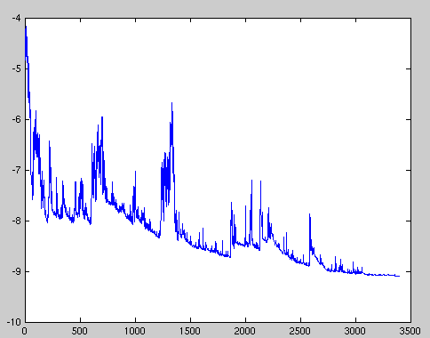



Last time: GD Variants
Batch or Deterministic
Stochastic or Online
Mini-batch Stochastic(stochastic)
a) reduces the variance of the parameter updates
b) can make use of highly optimized matrix optimizations
Pooya Mohammadi Lecture 4 - 2 Winter-2020

Slide 3
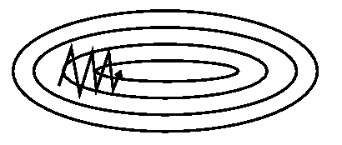
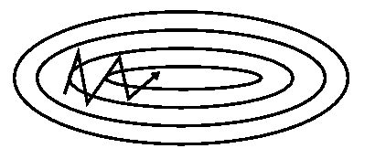
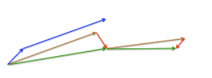
Last time: GD Optimizations(Speed up)
Without momentum
With momentum
Nesterov
Pooya Mohammadi Lecture 4 - 3 Winter-2020

Slide 4


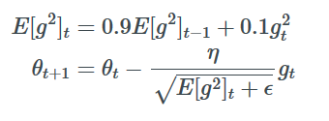
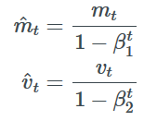
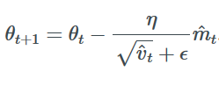
Last time: GD Optimizations(Adaptive lr)
Frequently occurring features
Low learning rate
Infrequently occurring features
High learning rate
Adagrade:
Adam:
RMSProp:
Pooya Mohammadi Lecture 3 - 4 Winter-2020

Slide 5
Last Time: Optimizer Behavior(Saddle Point)
Pooya Mohammadi Lecture 4 - 5 Winter-2020

Slide 6
Today
Neural Network
Multi-Classification
Regularization
Pooya Mohammadi Lecture 4 - 6 Winter-2020

Slide 7
Neural Network
Most material from Andrew NG’s course at Coursera
Pooya Mohammadi Lecture 4 - 7 Winter-2020

Slide 8
What is a Neural Network?
$$x_{1}$$
x
$$x_{2}$$
$$\hat{y}$$
w
$$z=w^{T}x+b$$
$$a=σ(z)$$
$$ℒ(a,y)$$
$$x_{3}$$
b
$$x_{1}$$
$$x_{2}$$
$$\hat{y}$$
x
$$x_{3}$$
$$W^{[1]}$$
$$z^{[1]}=W^{[1]}x+b^{[1]}$$
$$a^{[1]}=σ(z^{[1]})$$
$$z^{[2]}=W^{[2]}a_{ }^{[1]}+b^{[2]}$$
$$a^{[2]}=σ(z^{[2]})$$
$$ℒ(a^{[2]},y)$$
$$b^{[1]}$$
$$W^{[2]}$$
$$b^{[2]}$$
Pooya Mohammadi Lecture 4 - 8 Winter-2020

Slide 9
Neural Network Representation
$$x_{1}$$
$$x_{2}$$
$$\hat{y}$$
$$x_{3}$$
Pooya Mohammadi Lecture 4 - 9 Winter-2020

Slide 10
Activation functions
Given x:
$$x_{1}$$
$$z^{\left[1\right]}=W^{\left[1\right]}x+b^{\left[1\right]}$$
$$a^{\left[1\right]}=σ(z^{\left[1\right]})$$
$$x_{2}$$
$$\hat{y}$$
$$z^{\left[2\right]}=W^{\left[2\right]}a^{\left[1\right]}+b^{\left[2\right]}$$
$$x_{3}$$
$$a^{\left[2\right]}=σ(z^{\left[2\right]})$$
Pooya Mohammadi Lecture 4 - 10 Winter-2020

Slide 11
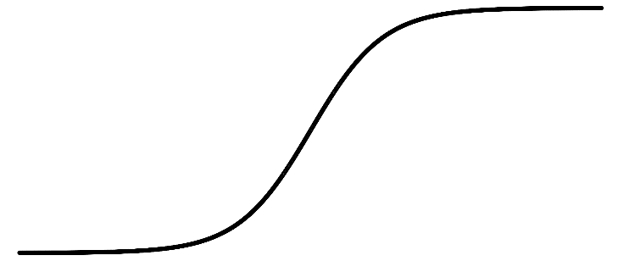
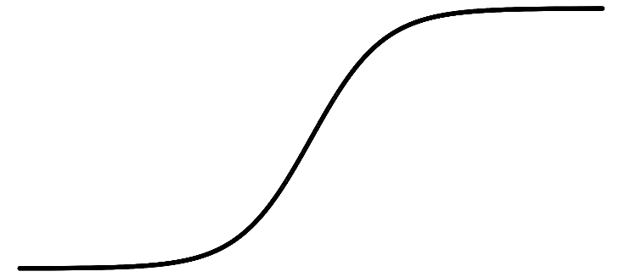

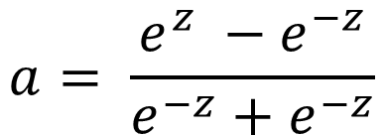

Pros and cons of activation functions
a
a
x
z
$$a= \frac{1}{1+e^{−z}}$$
$$a= \frac{e^{z} −e^{−z}}{e^{−z}+e^{−z}}$$
sigmoid:
tanh:
a
a
z
z
ReLU:
$$a=max⁡(0,z)$$
Leaky ReLU:
$$a=max⁡(kz,z)$$
Pooya Mohammadi Lecture 4 - 11 Winter-2020

Slide 12
Random initialization
$$x_{1}$$
$$a_{1}^{[1]}$$
$$a_{1}^{[2]}$$
$$\hat{y}$$
$$x_{2}$$
$$a_{2}^{[1]}$$
Pooya Mohammadi Lecture 4 - 12 Winter-2020

Slide 13
Representation Learning
The representations are formed by the composition of multiple non-linear transformations of the input data with the goal of yielding abstract and useful representations for tasks like classification, prediction, etc.
Pooya Mohammadi Lecture 4 - 13 Winter-2020

Slide 14
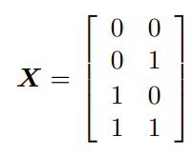

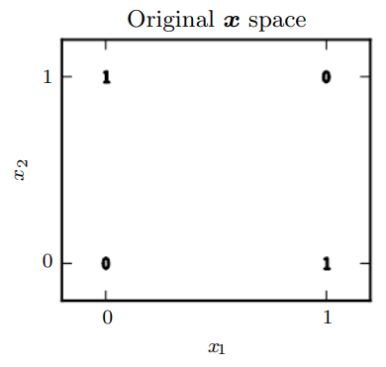


XOR Example
$$x_{1}$$
$$h1$$
$$y$$
$$Y=$$
$$x_{2}$$
$$h2$$
Pooya Mohammadi Lecture 4 - 14 Winter-2020

Slide 15
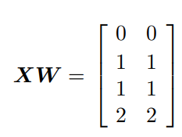
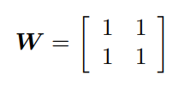
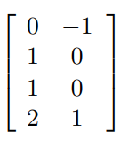
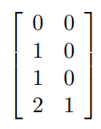



XOR Example
$$XW+c=$$
$$ReLU=\max\left(0, XW+c\right)=$$
Pooya Mohammadi Lecture 4 - 15 Winter-2020

Slide 16
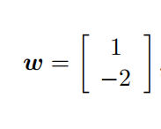
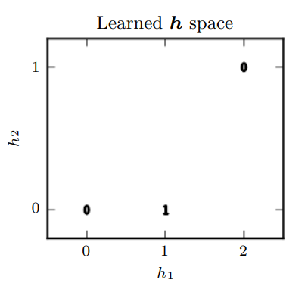



XOR Example
$$b = 0$$
$$\max\left(0, XW+c\right)w+b=$$
$$Hidden layer:$$
Pooya Mohammadi Lecture 4 - 16 Winter-2020

Slide 17
Multi-Classification
Pooya Mohammadi Lecture 4 - 17 Winter-2020

Slide 18
Different Classification
Binary Classification
Multi-Class Classification
Multi-label Classification
Pooya Mohammadi Lecture 4 - 18 Winter-2020

Slide 19
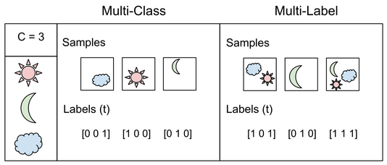
Different Classification
Pooya Mohammadi Lecture 4 - 19 Winter-2020

Slide 20
Multi-Output Neural Network
$$x_{1}$$
$$x_{2}$$
$$x_{3}$$
Pooya Mohammadi Lecture 4 - 20 Winter-2020

Slide 21
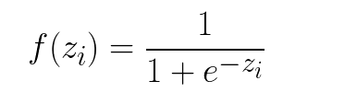
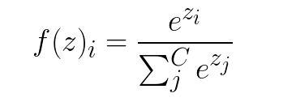
Activation functions(last layer)
Binary Classification
Sigmoid
Multi-Classification
Soft-max
Pooya Mohammadi Lecture 4 - 21 Winter-2020

Slide 22
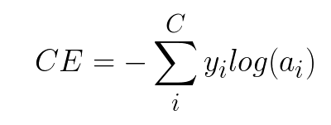
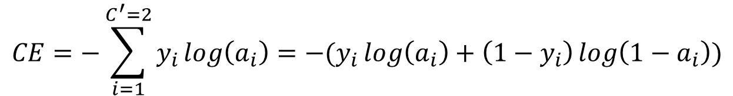
Loss Functions
Cross-Entropy loss
$$CE=−\sum_{i=1}^{C^{′}=2}{y_{i}\log\left(a_{i}\right)=−(y_{i}\log\left(a_{i}\right)+\left(1−y_{i}\right)\log\left({1−a}_{i}\right))}$$
Binary Cross-Entropy loss
Pooya Mohammadi Lecture 4 - 22 Winter-2020

Slide 23

Categorical Cross-Entropy loss
Pooya Mohammadi Lecture 4 - 23 Winter-2020

Slide 24
One-hot Encoding
A one hot encoding is a representation of categorical variables as binary vectors.
This first requires that the categorical values be mapped to integer values.
Then, each integer value is represented as a binary vector that is all zero values except the index of the integer, which is marked with a 1.
Pooya Mohammadi Lecture 4 - 24 Winter-2020

Slide 25
Example
Data: ['red', 'red', 'green‘]
Representation:
Pooya Mohammadi Lecture 4 - 25 Winter-2020

Slide 26
Why One-hot?
Many machine learning algorithms cannot work with categorical data directly.
Could we use an integer encoding directly?
Ordinal relationships: labels for temperature ‘cold’, warm’, and ‘hot’.
Non ordinal relationships: labels ‘dog’ and ‘cat’
Pooya Mohammadi Lecture 4 - 26 Winter-2020

Slide 27
Mnist Dataset
Pooya Mohammadi Lecture 4 - 27 Winter-2020

Slide 28
Regularization
Pooya Mohammadi Lecture 4 - 28 Winter-2020

Slide 29
Questions??
Pooya Mohammadi Lecture 4 - 29 Winter-2020

