Slide 1
Vectorization
Most material from Andrew NG’s Course at coursera

Slide 2
What is vectorization?

Slide 3
Neural network programming guideline
Whenever possible, avoid explicit for-loops.

Slide 4
Vectors and matrix valued functions

Slide 5


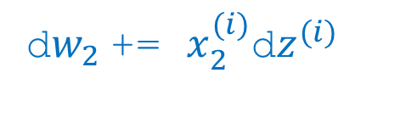
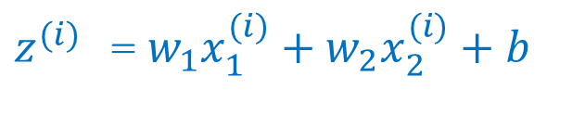

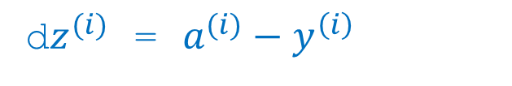
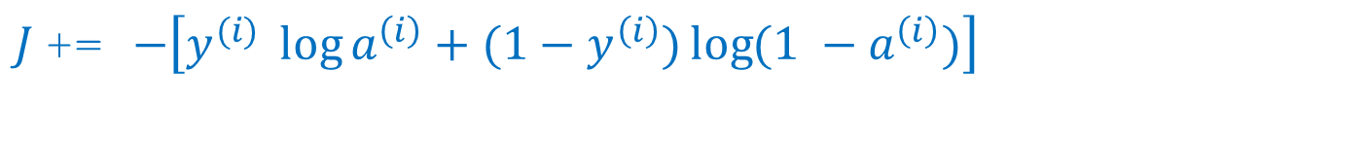

Logistic regression
J = 0, dw1 = 0, dw2 = 0, db = 0
for i = 1 to m:
$z^{(i)}$ =${ w}_{1}x_{1}^{(i)}+w_{2}x_{2}^{(i)}+b$
$a^{(i)}$ = $σ{(z}^{(i)})$
$J$+= $−\left[y^{(i)} \log{a^{\left(i\right)}+({1−y}^{\left(i\right)})\log{(1 −a^{\left(i\right)})}}\right]$
d$z^{(i)}$ = $a^{(i)}−y^{\left(i\right)}$
d${w_{1}}^{ }$+= $x_{1}^{(i)}\text{d}z^{(i)}$
d${w_{2}}^{ }$+= $x_{2}^{(i)}\text{d}z^{(i)}$
db += d$z^{(i)}$
J = J/m, d$w_{1}$ = d$w_{1}$/m, d$w_{2}$ = d$w_{2}$/m, db = db/m

Slide 6

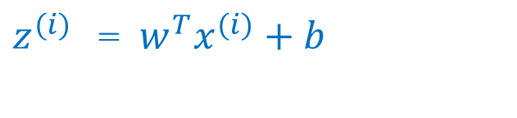
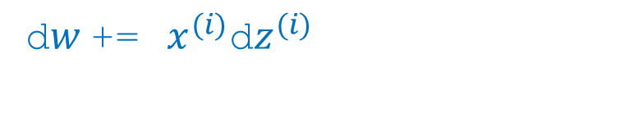
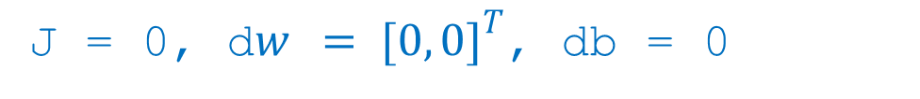
Logistic Regression Vectorization
J = 0, d$w { = [0, 0]}^{T}$, db = 0
for i = 1 to m:
$z^{(i)}$ =$w^{T}x^{(i)}+b$
$a^{(i)}$ = $σ{(z}^{(i)})$
$J$+= $−\left[y^{(i)} \log{a^{\left(i\right)}+({1−y}^{\left(i\right)})\log{(1 −a^{\left(i\right)})}}\right]$
d$z^{(i)}$ = $a^{(i)}−y^{\left(i\right)}$
d$w$+=${ x}^{(i)}\text{d}z^{(i)}$
db += d$z^{(i)}$
J = J/m, d$w$ = d$w$/m, db = db/m

Slide 7
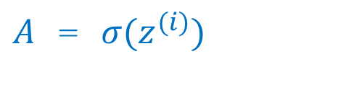
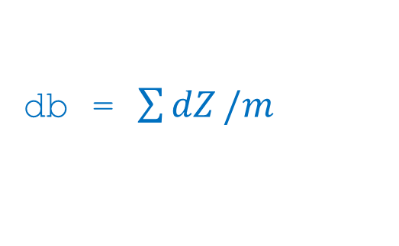
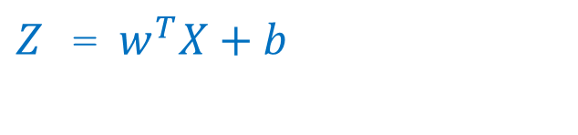
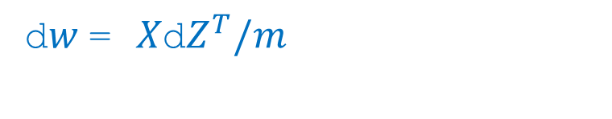

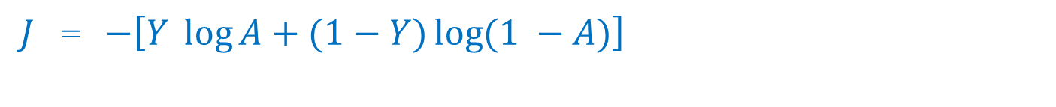
Logistic Regression Vectorization
$Z$ =$w^{T}X+b$
$A$ = $σ{(z}^{(i)})$
$J$= $−\left[Y \log{A+(1−Y)\log{(1 −A)}}\right]$
d$Z$ = $A−Y$
d$w$= $X\text{d}Z^{T}/m$
db = $\sum{dZ}/m$

