Slide 1
Gradient Descent
An overview of gradient descent optimization algorithms(Sebastian Ruder)
Deep Learning - MIT press

Slide 2
Gradient Descents Variants

Slide 3
Batch or Deterministic
Stochastic or Online
Mini-batch Stochastic(stochastic)

Slide 4
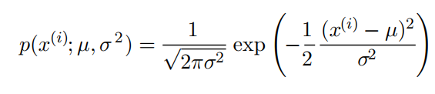
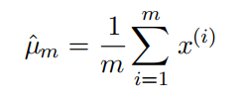
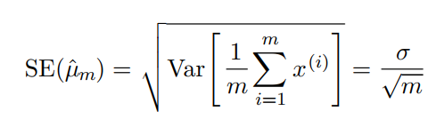
Gaussian Distribution:
Mean parameter
The standard error of mean is given by:

Slide 5
Mini-batch sizes are generally driven by the following factors:
Larger batches provide a more accurate estimate of the gradient, but with less than linear returns.
Use some absolute minimum batch size, below which there is no reduction in the time to process a mini-batch.
If all examples in the batch are to be processed in parallel (as is typically the case), then the amount of memory scales with the batch size. For many hardware setups this is the limiting factor in batch size.
Some kinds of hardware achieve better runtime with specific sizes of arrays. Especially when using GPUs, it is common for power of 2 batch sizes to offer better runtime. Typical power of 2 batch sizes range from 32 to 256, with 16 sometimes being attempted for large models.
Small batches can offer a regularizing effect (Wilson and Martinez, 2003), perhaps due to the noise they add to the learning process.

Slide 6
Challenges
Vanilla mini-batch does not guarantee good convergence
Choosing a proper learning rate can be difficult
Learning rate schedules try to adjust the learning rate during training. These schedules have to be defined in advance.
The same learning rate applies to all parameter updates. It’s preferred to perform large update for rarely occurring features.
Saddle points and surrounding plateau of the same error

Slide 7
Gradient Descent Optimization Algorithms

Slide 8
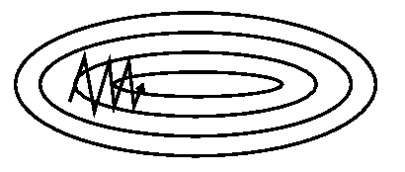
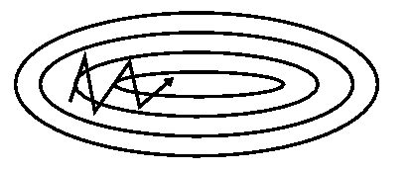
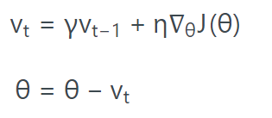
Momentum
SGD has trouble navigating ravines.
Without momentum
Without momentum
Formula:
is set to 0.9

Slide 9
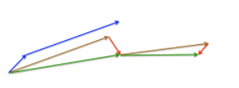
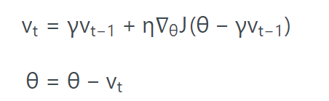
Nesterov update

Slide 10
Now that we are able to adapt our updates to the slope of our error function and speed up SGD in turn, we would also like to adapt our updates to each individual parameter to perform larger or smaller updates depending on their importance.

Slide 11

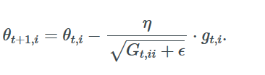

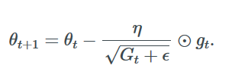
Adagrad
Frequently occurring features
Low learning rate
Infrequently occurring features
High learning rate
contains the sum of the squares of the past gradients
Default learning rate is 0.01

Slide 12
Since while using Adagrad, every added term is positive, the accumulated sum keeps growing during training. This in turn causes the learning rate to shrink and eventually become infinitesimally small, at which point the algorithm is no longer able to acquire additional knowledge.

Slide 13

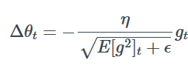


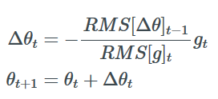
Adadelta
Frequently occurring features
Low learning rate
Infrequently occurring features
High learning rate
We don’t need default learning rate
Like momentum set gamma to 0.9

Slide 14
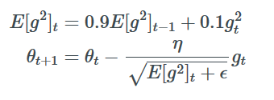
RMSProp
Frequently occurring features
Low learning rate
Infrequently occurring features
High learning rate
RMSprop is an unpublished, adaptive learning rate method proposed by Geoff Hinton
RMSProp and Adadelta both try to resolve the Adagrad's radically diminishing learning rates
Like momentum set gamma to 0.9
Good default learning is 0.001

Slide 15

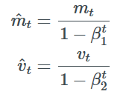
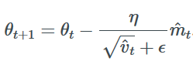
Adam Adaptive Momentum Estimation
Adam adds Momentum to RMSProp
Initial values of mt and vt are zero vectors and these values are biased to zero at initial steps…
Default parameters
β1: 0.9
β2: 0.999
η: 0.001
ϵ: 1e-8

Slide 16
Optimization Behavior

Slide 17
optimization on loss surface contours

Slide 18
optimization on saddle point

Slide 19
Which optimizer to use?

Slide 20
References:
Blog address: http://ruder.io/optimizing-gradient-descent/
Deep Learning: http://www.deeplearningbook.org/

