Slide 1
Neural Network
Most material from Andrew NG’s Course at coursera

Slide 2












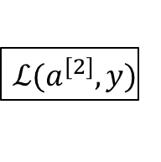







What is a Neural Network?
$$x_{1}$$
$$x_{2}$$
$$\hat{y}$$
$$x_{3}$$
x
w
$$z=w^{T}x+b$$
$$a=σ(z)$$
$$ℒ(a,y)$$
b
$$x_{1}$$
$$x_{2}$$
$$\hat{y}$$
$$x_{3}$$
x
$$W^{[1]}$$
$$z^{[1]}=W^{[1]}x+b^{[1]}$$
$$a^{[1]}=σ(z^{[1]})$$
$$z^{[2]}=W^{[2]}a_{ }^{[1]}+b^{[2]}$$
$$a^{[2]}=σ(z^{[2]})$$
$$ℒ(a^{[2]},y)$$
$$b^{[1]}$$
$$W^{[2]}$$
$$b^{[2]}$$

Slide 3




Neural Network Representation
$$x_{1}$$
$$x_{2}$$
$$\hat{y}$$
$$x_{3}$$

Slide 4








Activation functions
$$x_{1}$$
$$x_{2}$$
$$\hat{y}$$
$$x_{3}$$
Given x:
$$z^{\left[1\right]}=W^{\left[1\right]}x+b^{\left[1\right]}$$
$$a^{\left[1\right]}=σ(z^{\left[1\right]})$$
$$z^{\left[2\right]}=W^{\left[2\right]}a^{\left[1\right]}+b^{\left[2\right]}$$
$$a^{\left[2\right]}=σ(z^{\left[2\right]})$$

Slide 5
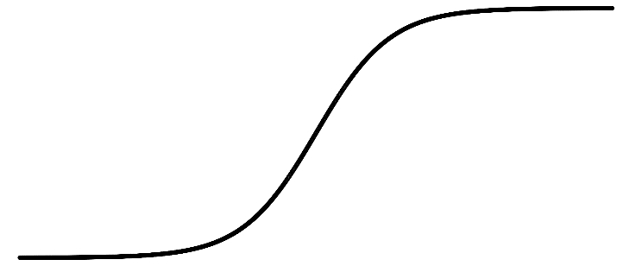
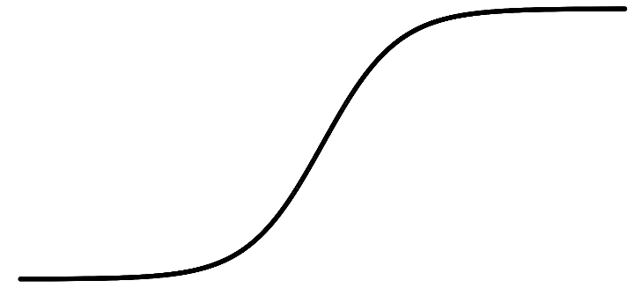

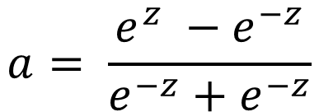

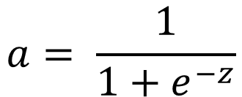
Pros and cons of activation functions
a
a
x
z
$$a= \frac{1}{1+e^{−z}}$$
sigmoid:
$$a= \frac{e^{z} −e^{−z}}{e^{−z}+e^{−z}}$$
tanh:
a
a
z
z
ReLU:
$$a=max⁡(0,z)$$
Leaky ReLU:
$$a=max⁡(kz,z)$$

Slide 6






Random initialization
$$x_{1}$$
$$a_{1}^{[1]}$$
$$a_{1}^{[2]}$$
$$\hat{y}$$
$$x_{2}$$
$$a_{2}^{[1]}$$

Slide 7
Representation Learning
The representations are formed by composition of multiple non-linear transformations of the input data with the goal of yielding abstract and useful representations for tasks like classification, prediction etc

Slide 8
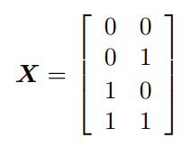

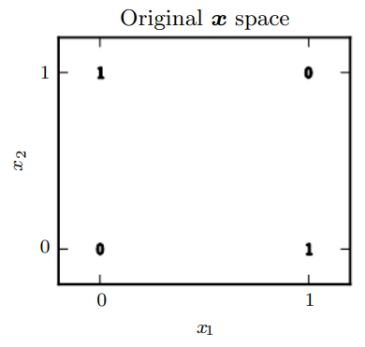







XOR Example
$$x_{1}$$
$$h1$$
$$y$$
$$Y=$$
$$x_{2}$$
$$h2$$

Slide 9
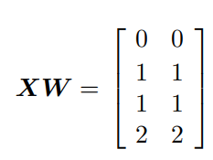
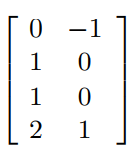
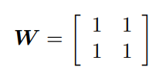

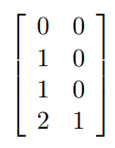


XOR Example
$$XW+c=$$
$$ReLU=\max\left(0, XW+c\right)=$$

Slide 10
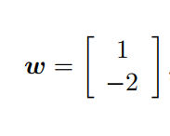
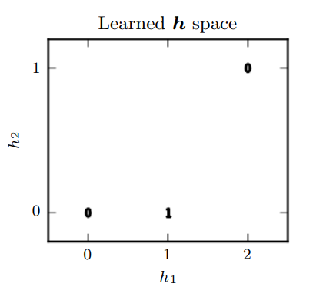

XOR Example
b = 0
$$\max\left(0, XW+c\right)w+b=$$
Hidden layer :

Slide 11
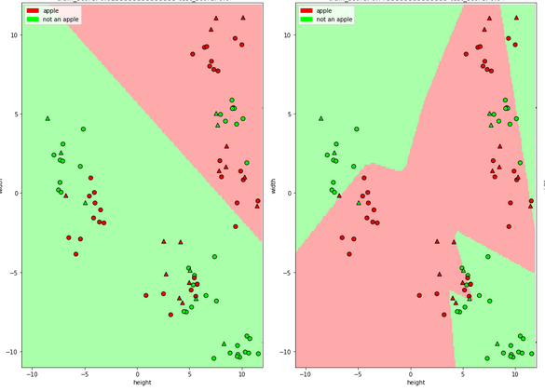
Difference between logistic and neural network
Logistic Regression
Neural network

