Slide 1
Multi-Classification

Slide 2
Binary Classification
Multi-Class Classification
Multi-label Classification

Slide 3
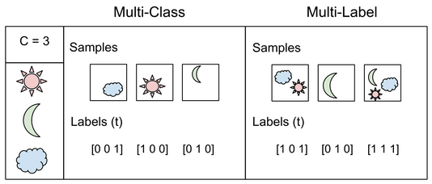

Slide 4

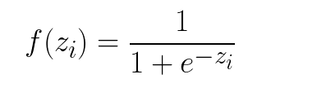
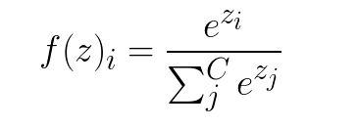
Sigmoid
Soft-max

Slide 5
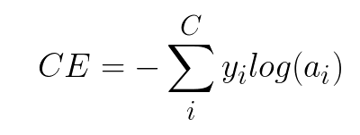

Loss Functions
Cross-Entropy loss
Binary Cross-Entropy loss

Slide 6

Categorical Cross-Entropy loss

Slide 7
One-hot Encoding
A one hot encoding is a representation of categorical variables as binary vectors.
This first requires that the categorical values be mapped to integer values.
Then, each integer value is represented as a binary vector that is all zero values except the index of the integer, which is marked with a 1.

Slide 8

Example
data: ['red', 'red', 'green‘]
Representation:

Slide 9
Why One-hot?
Many machine learning algorithms cannot work with categorical data directly.
We could use an integer encoding directly?
Ordinal relationships: labels for temperature ‘cold’, warm’, and ‘hot’.
non ordinal relationships: labels ‘dog’ and ‘cat’

Slide 10
Mnist Data-set

