Slide 1
Regularization

Slide 2
Table of Contents
What is Regularization?
How does Regularization help in reducing Overfitting?
Different Regularization techniques in Deep Learning
L2 and L1 regularization
Dropout
Data augmentation
Early stopping

Slide 3
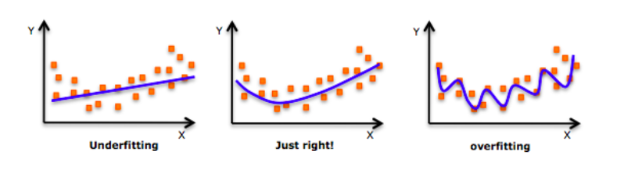
What is regularization?

Slide 4
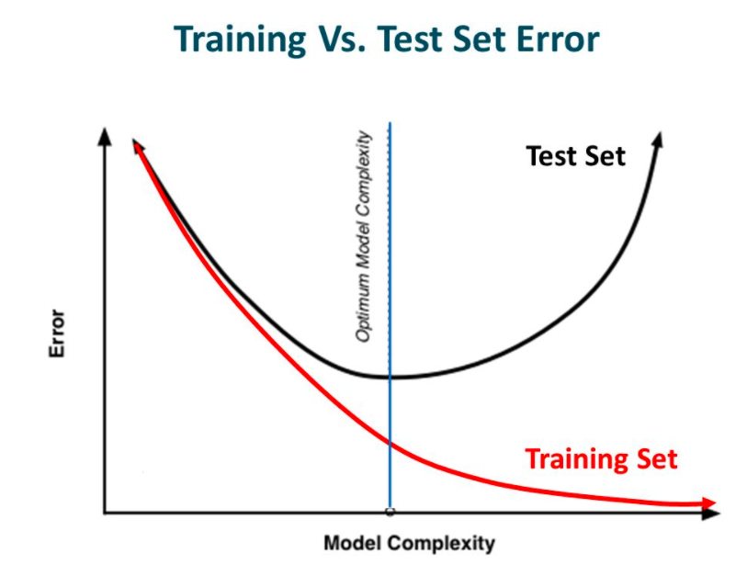
What is regularization?

Slide 5
What is regularization?
Regularization is a technique which makes slight modifications to the learning algorithm such that the model generalizes better. This in turn improves the model’s performance on the unseen data as well.

Slide 6
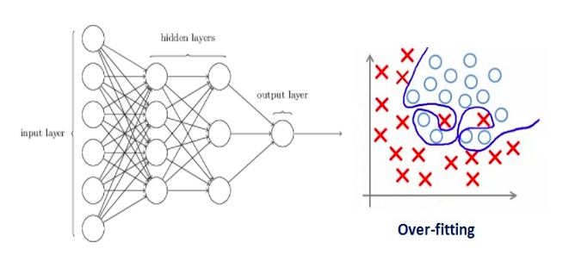
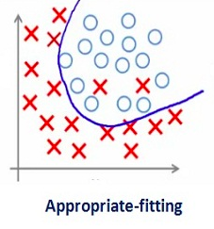
How does Regularization help reduce Over-fitting?
In machine learning, regularization penalizes the coefficients. In deep learning, it penalizes the weight matrices of the nodes.

Slide 7


Different Regularization Techniques in Deep Learning
L2(Weight Decay):
L1:

Slide 8
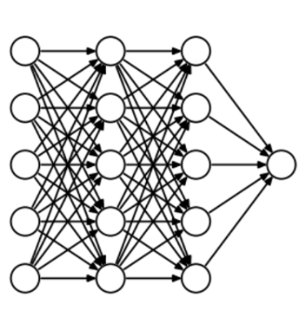
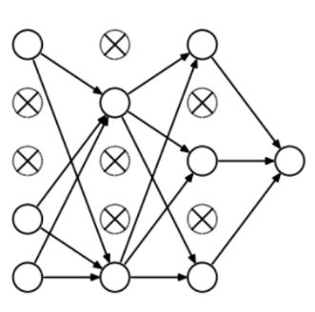
Different Regularization Techniques in Deep Learning
Dropout(An Ensemble model)

Slide 9
Different Regularization Techniques in Deep Learning
Dropout(An Ensemble model)

Slide 10
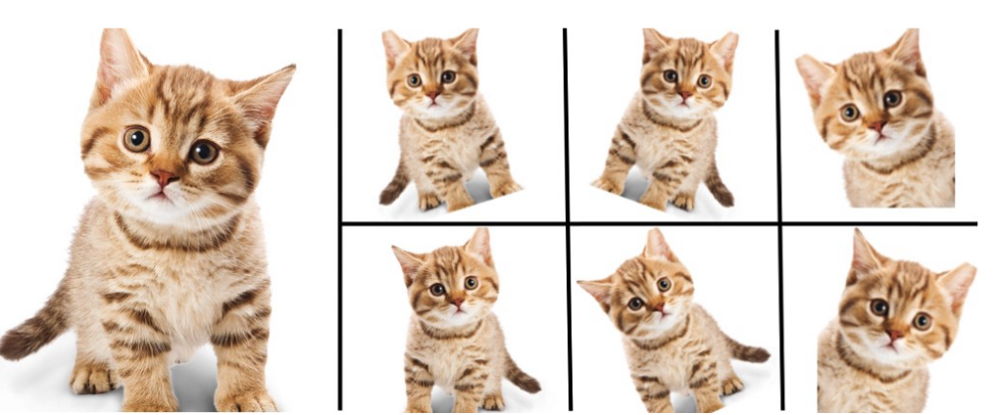
Different Regularization Techniques in Deep Learning
Data Augmentation

Slide 11
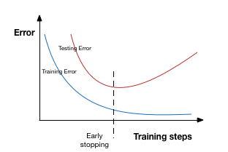
Different Regularization Techniques in Deep Learning
Early Stopping

