Slide 1
Metrics

Slide 2
Table of Contents
Classification Accuracy
Confusion Matrix
Area under Curve
F1 Score
Mean Absolute Error
Mean Squared Error
Multi-classification

Slide 3

Classification Accuracy
$$Accuracy=\frac{Number of Correct prediction}{Total number of predictions made}$$
It works well only if there are equal number of samples belonging to each class.

Slide 4
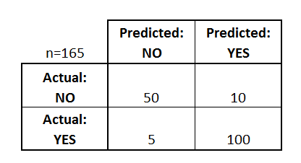
Confusion Matrix
Confusion Matrix as the name suggests gives us a matrix as output and describes the complete performance of the model.
Binary classification

Slide 5
Confusion Matrix
There are 4 important terms:
True Positives : The cases in which we predicted YES and the actual output was also YES.
True Negatives : The cases in which we predicted NO and the actual output was NO.
False Positives : The cases in which we predicted YES and the actual output was NO.
False Negatives : The cases in which we predicted NO and the actual output was YES.

Slide 6

Confusion Matrix
Confusion Matrix forms the basis for the other types of metrics:
Accuracy
$$Accuracy=\frac{TruePositives+TrueNegatives}{Total number of samples}$$

Slide 7
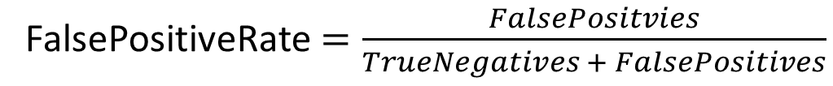
True Positive Rate (Sensitivity)
TruePositiveRate$=\frac{TruePositives}{TruePositives + FalseNegatives}$
False Positive Rate (Specificity)
FalsePositiveRate$=\frac{FalsePositvies}{TrueNegatives + FalsePositives}$

Slide 8
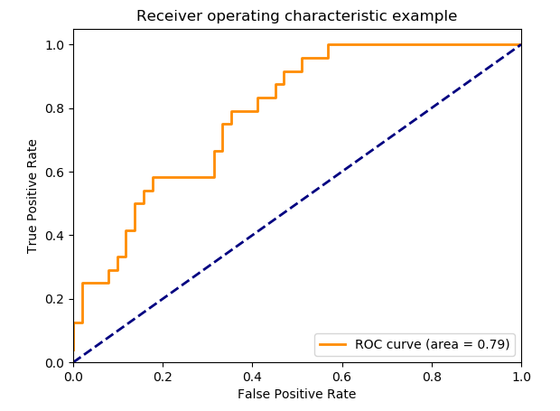
Area Under Curve
An ROC curve plots TPR vs. FPR at different classification thresholds.
Lowering the classification threshold classifies more items as positive, thus increasing both False Positives and True Positives.
AUC of a classifier is equal to the probability that the classifier will rank a randomly chosen positive example higher than a randomly chosen negative example.

Slide 9
Precision
P$recision =\frac{TruePositives}{TruePositives +FalsePositive}$
Recall
R$ecall=\frac{TruePositives}{TruePositives + FalseNegatives}$

Slide 10
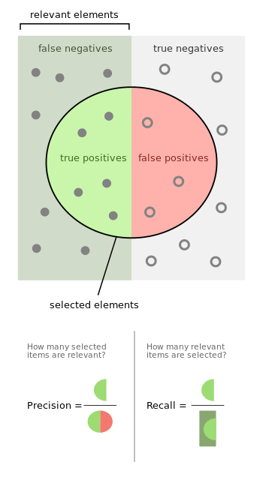
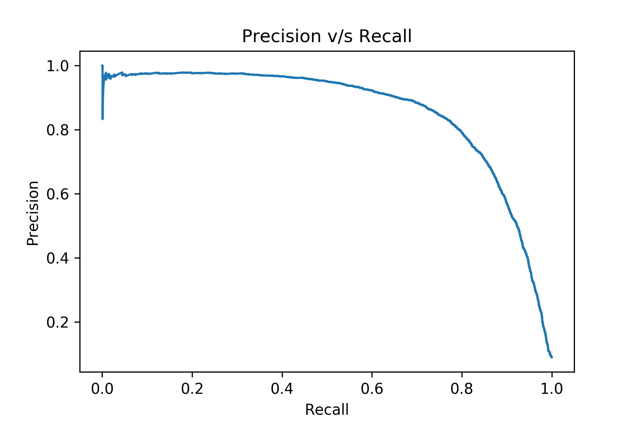
Precision v/s Recall

Slide 11
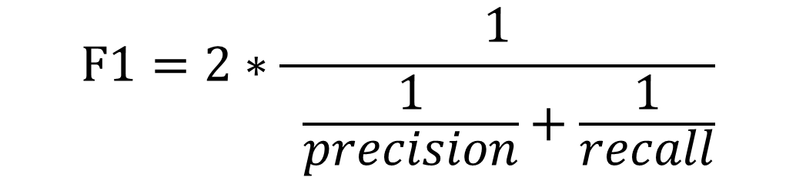
F1 Score
$$F1=2∗\frac{1}{ \frac{1}{precision}+\frac{1}{recall}}$$
F1 Score is the Harmonic Mean between precision and recall
F1 Score tries to find the balance between precision and recall.
F1 does not miss a significant number of instances

Slide 12
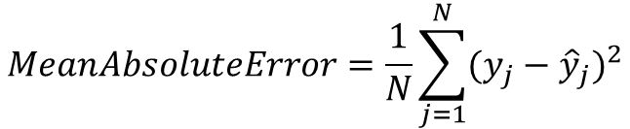
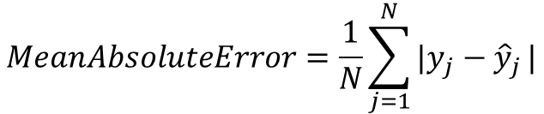
Mean Absolute Error
$$MeanAbsoluteError=\frac{1}{N}\sum_{j=1}^{N}{|y_{j}−{\hat{y}}_{j}}|$$
Mean Squared Error
$$MeanAbsoluteError=\frac{1}{N}\sum_{j=1}^{N}{(y_{j}−{\hat{y}}_{j}})^{2}$$

Slide 13
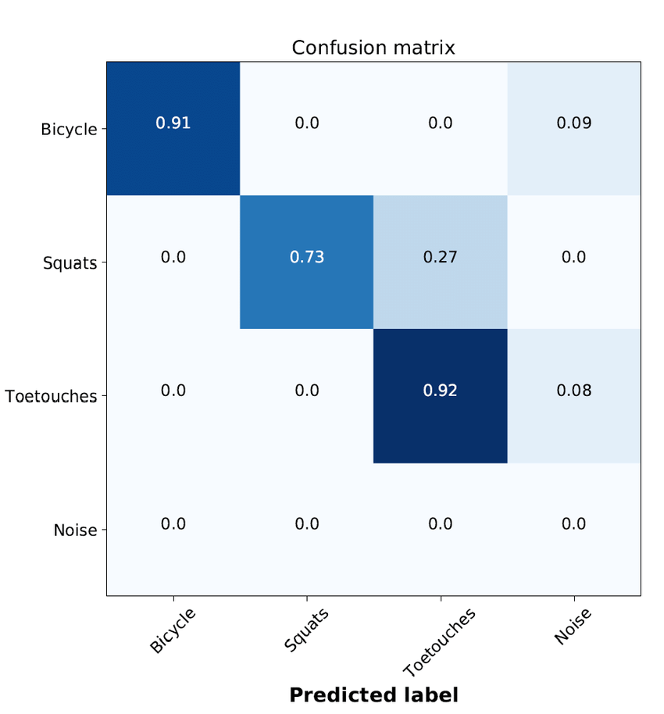
Multi-Classification
For class x:
TruePositive: diagonal position, cm(x, x).
FalsePositive: sum of column x (without main diagonal), sum(cm(:, x))-cm(x, x).
FalseNegative: sum of row x (without main diagonal), sum(cm(x, :))-cm(x, x).
TrueNegative: sum of all values of confusion matrix (without row and col of x), sum(cm)-sum(cm(x, :))-sum(cm(:, x)).

