Slide 1
PODS – Detector Selection- Part 1 (Si Devices)

Slide 2
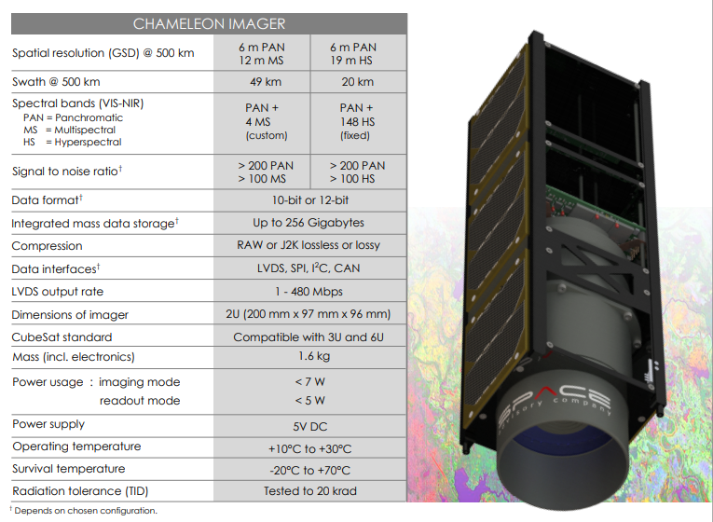
Existing COTS Camera Systems
https://www.cubesatshop.com/

Slide 3
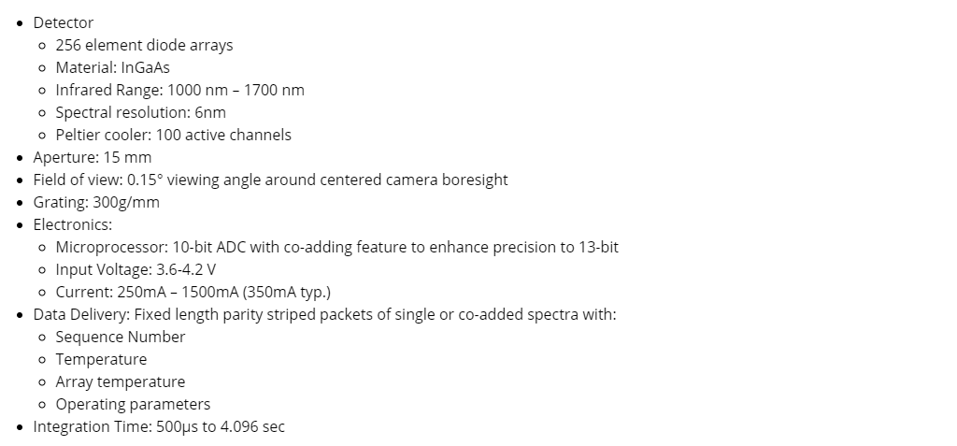
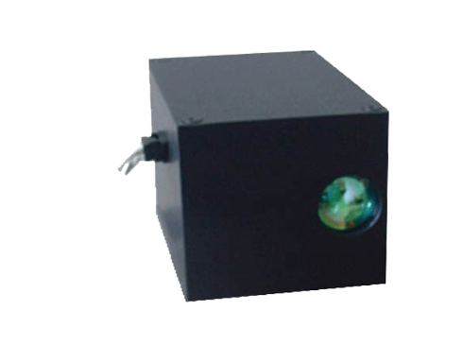
Existing COTS Camera Systems
Argus 1000 Infrared Spectrometer
NOTE: This uses and InGaAs diode array
https://www.cubesatshop.com/

Slide 4
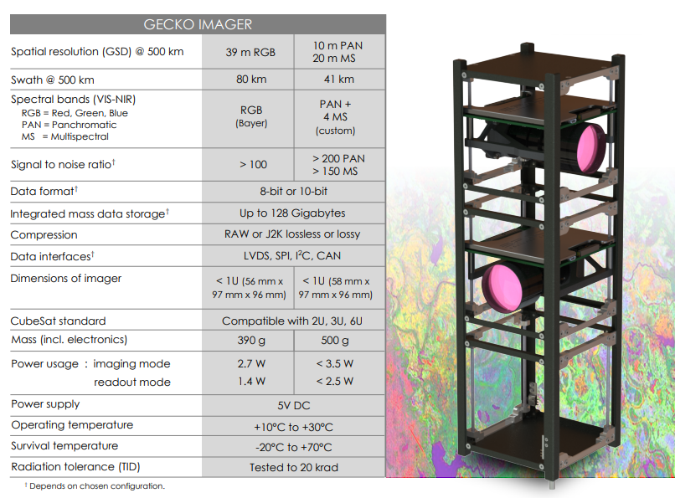
Existing COTS Camera Systems
https://www.cubesatshop.com/

Slide 5
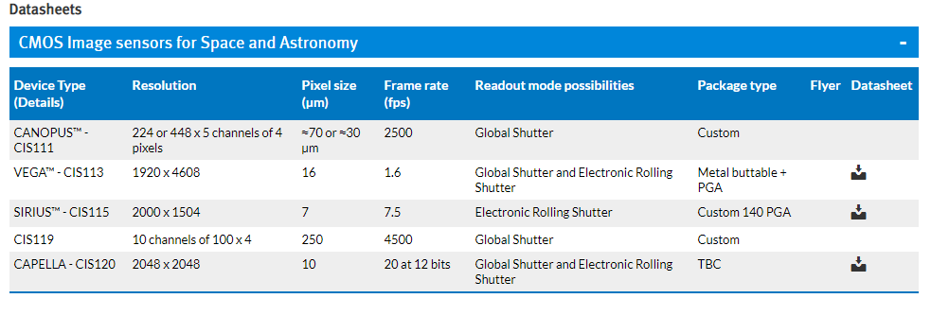
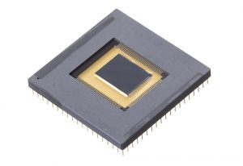
CMOS Sensors
Rolling Electronic Shutter and Global shutter
Fast Readout
Quick RoI
Read out electronics!

Slide 6
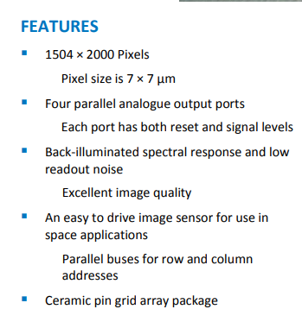
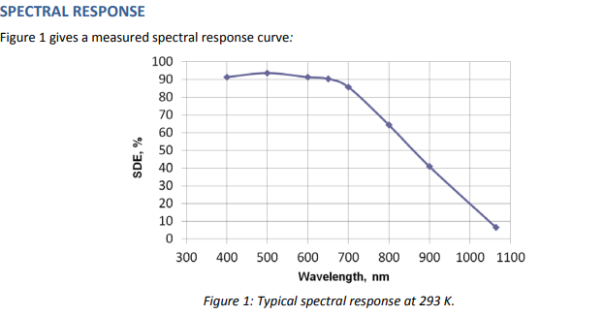
CMOS Sensors
SIRIUS – CIS115 Back Illuminated CMOS Image Sensor
Rolling Electronic Shutter and Global shutter
Fast Readout
Quick RoI
Read out electronics!

Slide 7
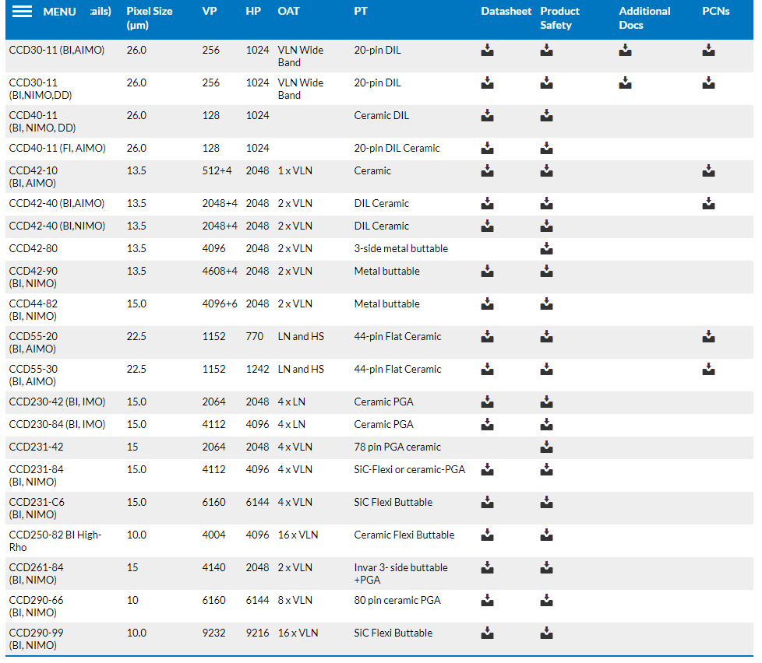
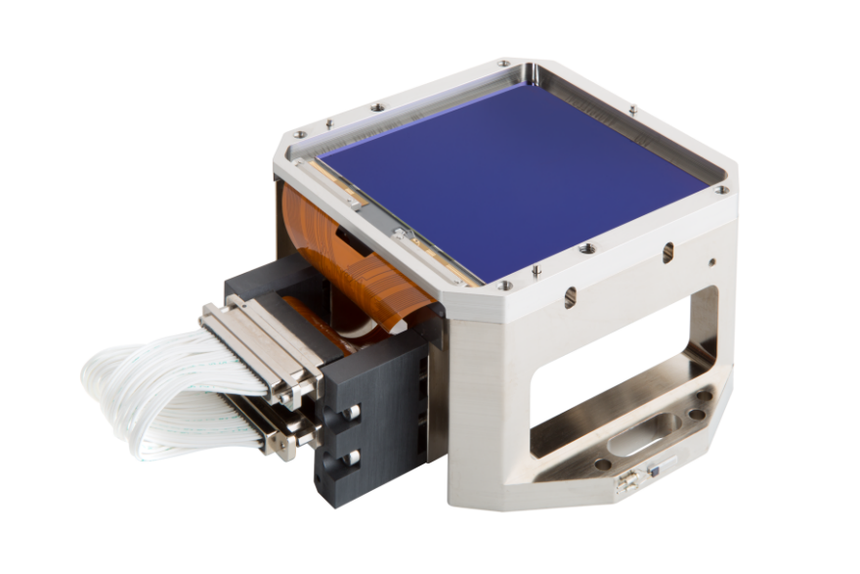
CCD Sensors
Full Frame CCD Sensors

Slide 8
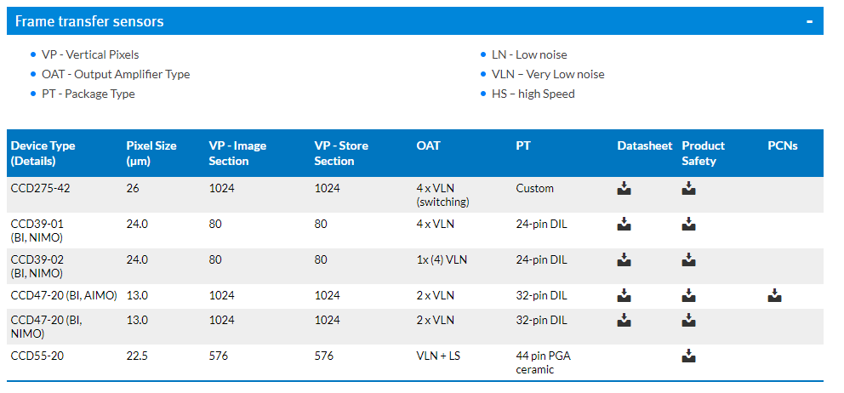
CCD Sensors
Frame Transfer

Slide 9
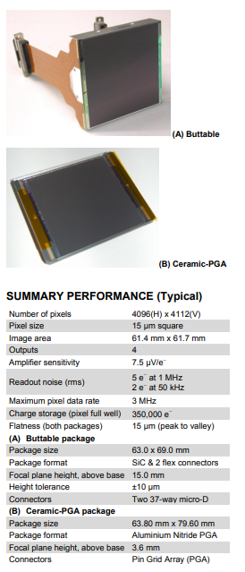
CCD Sensors
A quick glimpse at specifications

