Slide 1
Scraping Fresh News Headlines With Rust And Go
Goal: Get Fresh Headlines From News Sites
Sub-Goal: Implement the program in both Rust and Go
Bonus-Goal: Compare Performance of Finished Programs

Slide 2
Rust
Created within Mozilla in 2010, as of 2021 completely its own thing
1.0 release in 2015, latest release in September 2021 (1.55)
Stack Overflow’s most-loved language (by a significant margin) for 6 years in a row, though only 7% of respondents by 2021 had ever used it
In a nutshell, memory safe C/C++ with a great community and ecosystem (like Python or Javascript) + a very helpful compiler

Slide 3
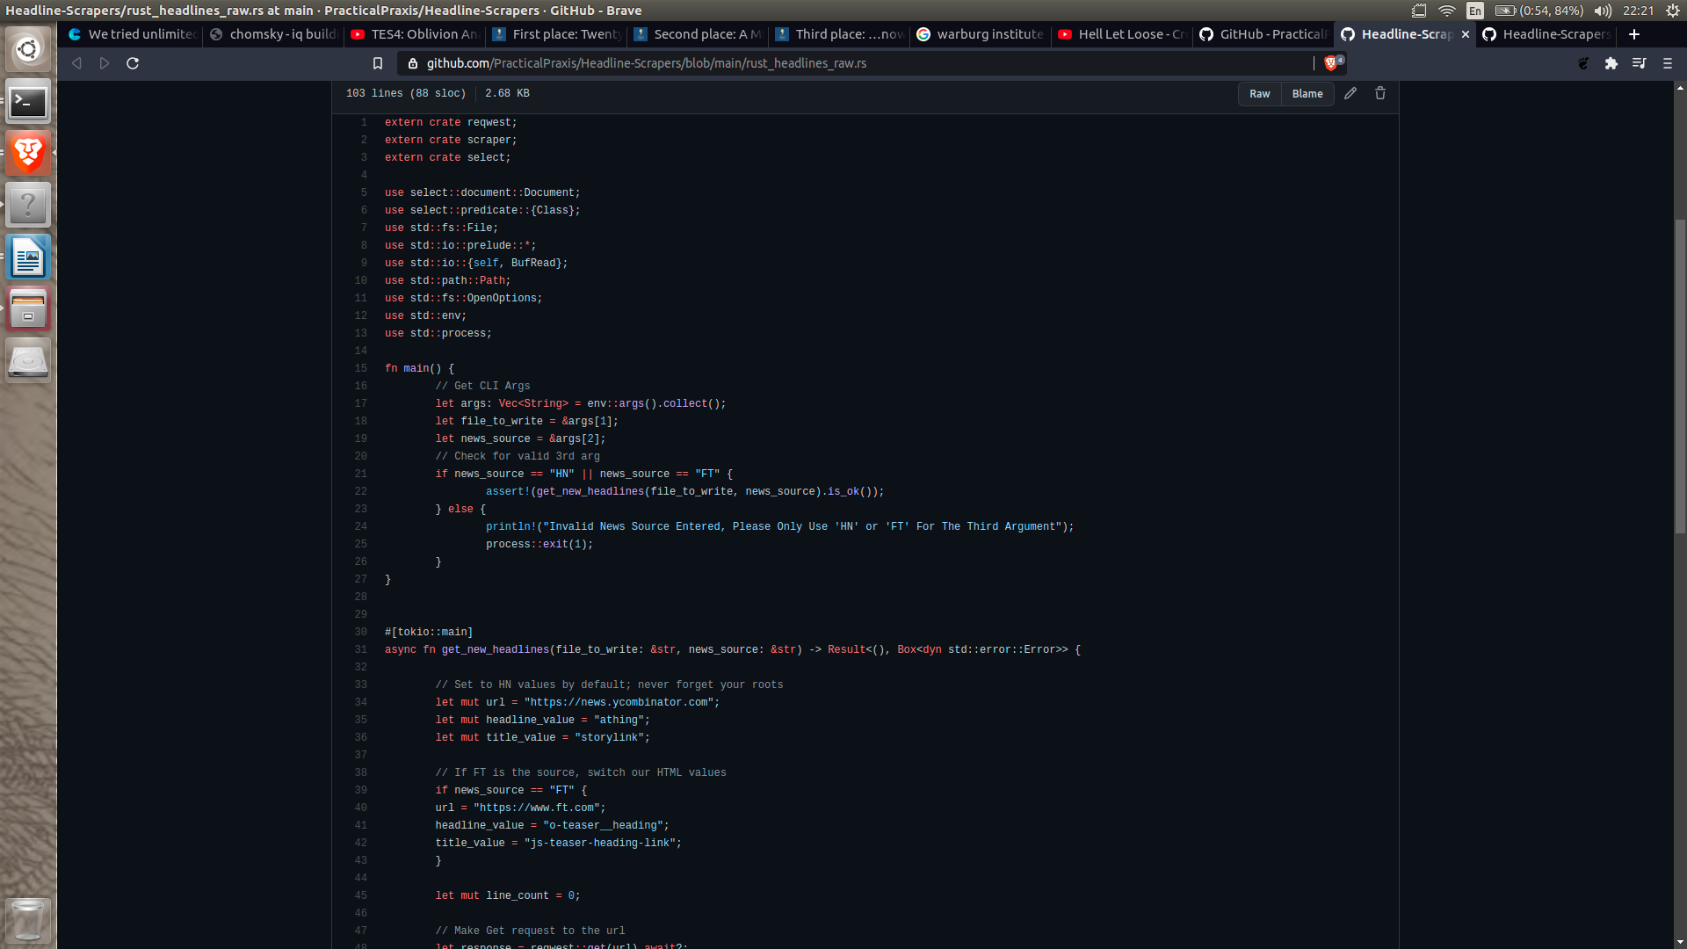
https://github.com/PracticalPraxis/Headline-Scrapers/blob/main/rust_headlines_raw.rs

Slide 4
Go
Created within Google in 2009, open-source*
1.0 release in 2012, latest release in September 2021 (1.17.1)
Used to build Docker, Kubernetes, Mattermost and GitLab
Dev goals: Static typing + readability + high performance (and not being C++)

Slide 5
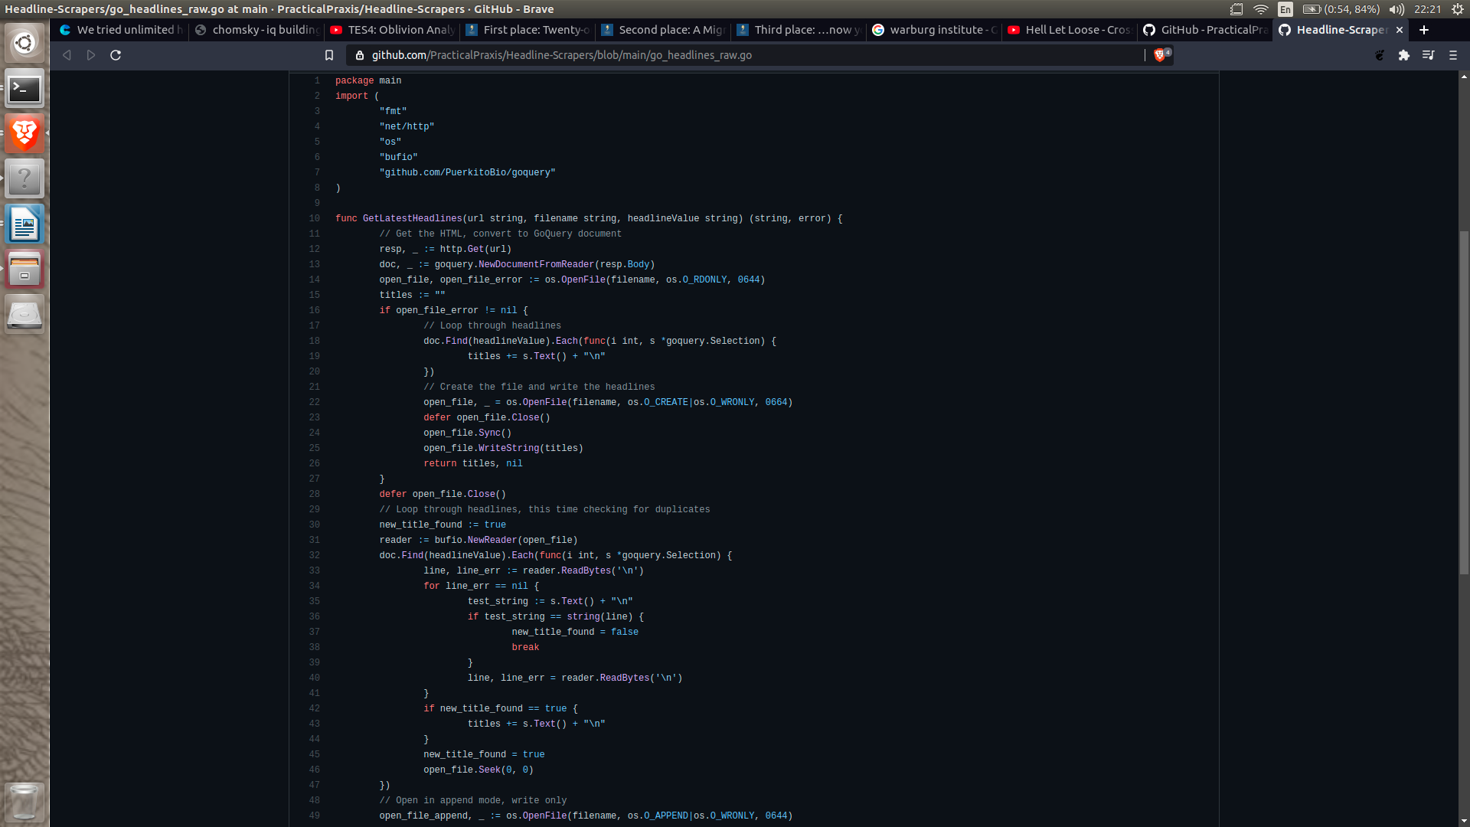
https://github.com/PracticalPraxis/Headline-Scrapers/blob/main/go_headlines_raw.go

Slide 6
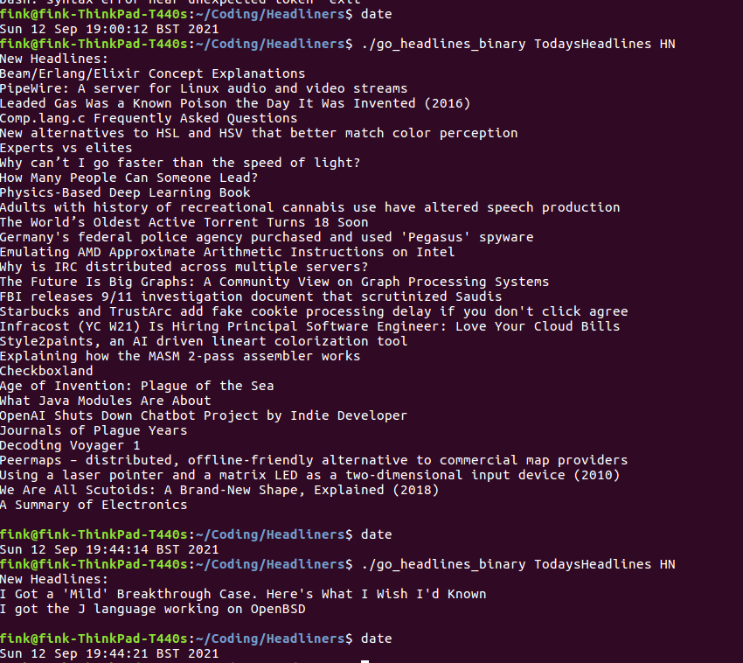
Process

Slide 7
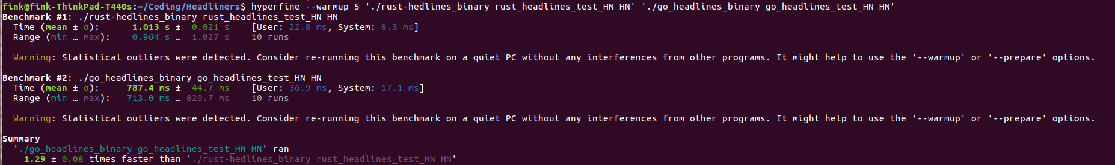
Performance - HN
Hyperfine says….
Average Go Result: 787ms +/- 45ms
Average Rust Result: 1013 ms +/- 21ms
Go had shortest run with: 713ms
Rust had longest run with: 1027ms
On the whole, Go was 1.29 times faster than Rust – but...

Slide 8
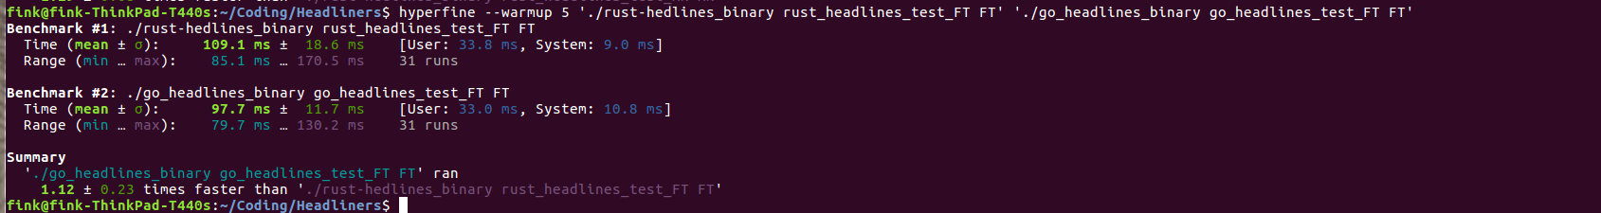
Performance - FT
Hyperfine says….
Average Go Result: 98ms +/- 12ms
Average Rust Result: 109 ms +/- 19ms
Go had shortest run with: 85ms
Rust had longest run with: 171 ms
On the whole, Go was 1.12 times faster than Rust

Slide 9
Conclusions
HN is (relatively) slow for HTTP requests
Go is easier to prototype in than Rust
Go appears slightly faster than Rust (for this specific task)

