Slide 1

Activation Functions

Slide 2
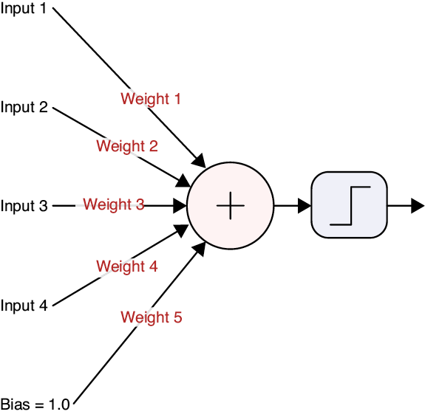
Source: Glassner, A. (2021). Deep learning: A visual approach. San Francisco, CA: No Starch Press. (Chapter 13)
Notes:
We first met this diagram in our neural anatomy presentation. Today, our focus is the activation function. More specifically, some of the popular activation options available to us. I’m spending some extra time on this topic because this choice can have a large impact on how well a network learns.

Slide 3
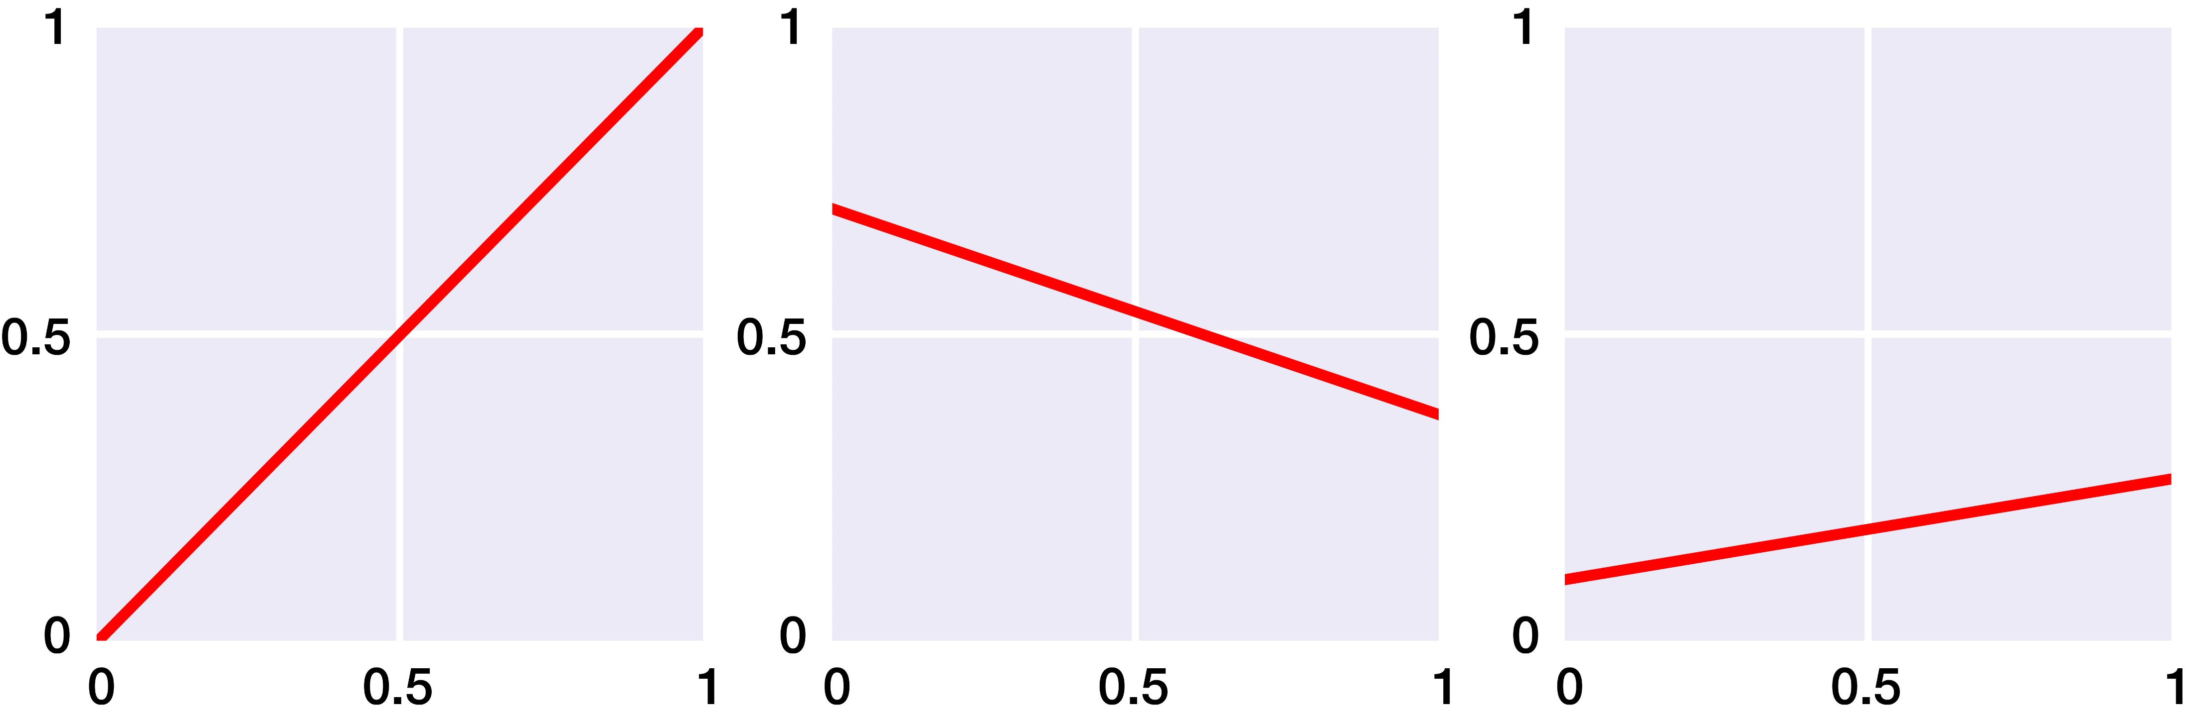
y
x
y = f(x)
Source: Glassner, A. (2021). Deep learning: A visual approach. San Francisco, CA: No Starch Press. (Chapter 13)
Notes:
Let’s first consider activation functions made up of one or more straight lines. Here, the “curves” are just straight lines.
Let’s look at the leftmost example. If we pick any point on the X axis, and go vertically up until we hit the line, the value of that intersection on the Y axis is the same as the value on the X axis. The output, or y value, of this curve is always the same as the input, or x value. We call this the identity function.
The other curves are also straight lines, but they’re tilted to different slopes. We call any curve that’s just a single straight line a linear function.

Slide 4
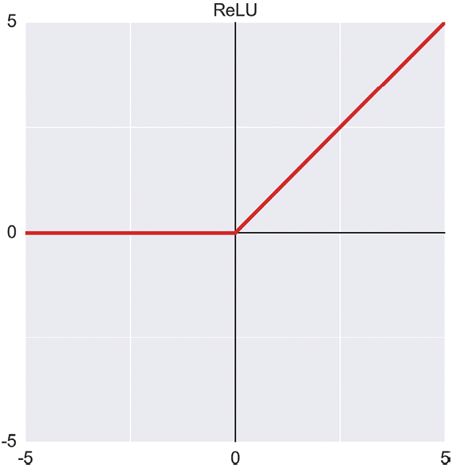
Source: Glassner, A. (2021). Deep learning: A visual approach. San Francisco, CA: No Starch Press. (Chapter 13)
Notes:
The ReLU, or rectified linear unit. It outputs 0 for all negative inputs, otherwise the output is the input.
The ReLU activation function is popular because it’s a simple and fast way to include a nonlinearity at the end of our artificial neurons.

Slide 5
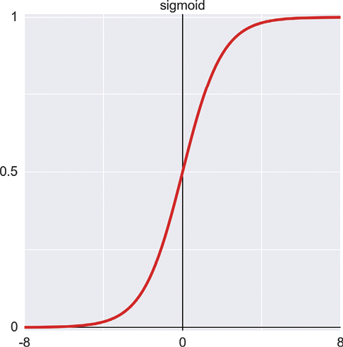
Source: Glassner, A. (2021). Deep learning: A visual approach. San Francisco, CA: No Starch Press. (Chapter 13)
Notes:
The S-shaped sigmoid function is also called the logistic function or logistic curve. It has a value of 0 for very negative inputs, and a value of 1 for very positive inputs. For inputs in the range of about −6 to 6, it smoothly transitions between the two. The name sigmoid comes from the resemblance of the curve to an S shape,

Slide 6
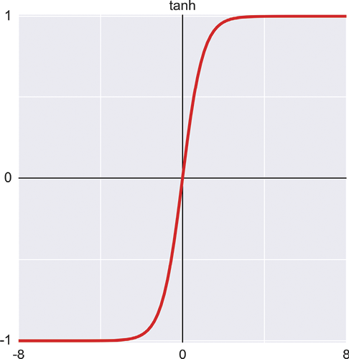
Source: Glassner, A. (2021). Deep learning: A visual approach. San Francisco, CA: No Starch Press. (Chapter 13)
Notes:
The hyperbolic tangent function, written tanh, is S-shaped like the sigmoid. The key differences are that it returns a value of −1 for very negative inputs, and the transition zone is a bit narrower.

Slide 7
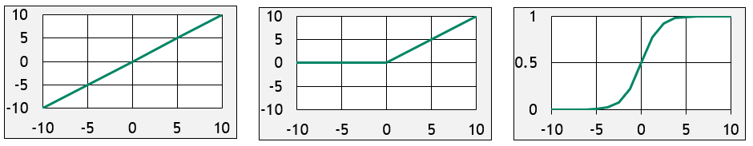
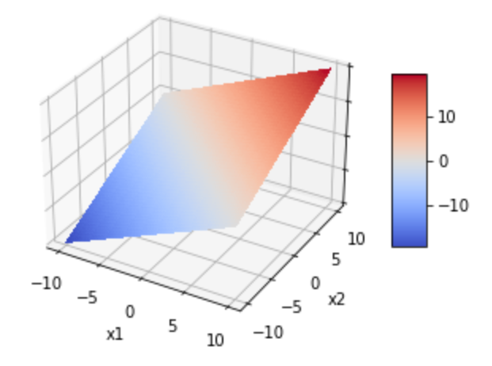
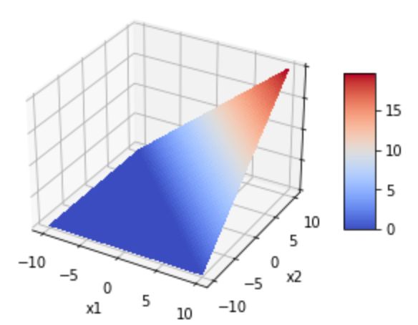
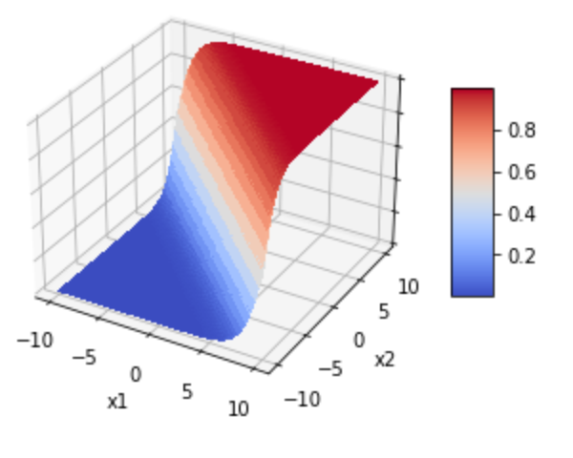
Linear
ReLU
Sigmoid
Notes:
Before moving on, let’s visualize the Linear, ReLu, and Sigmoid activation functions in three-dimensional space. We’ve already seen the graphs for these functions, so the first line is no surprise. On the second, however, we see their three-dimensional equivalents. Linear is just a plane, like a sheet of paper. ReLU is like a wedge. And Sigmoid is like a surf wave.

Slide 8
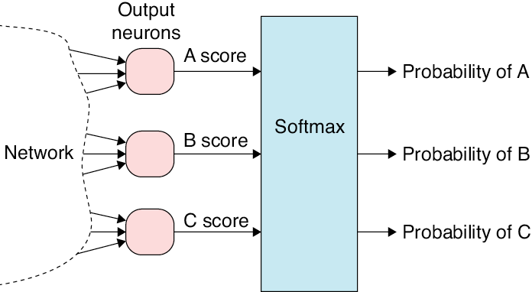
Source: Glassner, A. (2021). Deep learning: A visual approach. San Francisco, CA: No Starch Press. (Chapter 13)
Notes:
There’s an operation that we typically apply only to the output neurons of a classifier neural network, and even then, only if there are two or more output neurons. It’s not an activation function in the sense that we’ve been using the term because it takes as input the outputs of all the output neurons simultaneously. It processes them together and then produces a new output value for each neuron. Though it’s not quite an activation function, it’s close enough in spirit to activation functions to merit including it in this discussion.
The technique is called softmax. The purpose of softmax is to turn the numbers that come out of a classification network into class probabilities. All of the probabilities add up to 1.

Slide 9
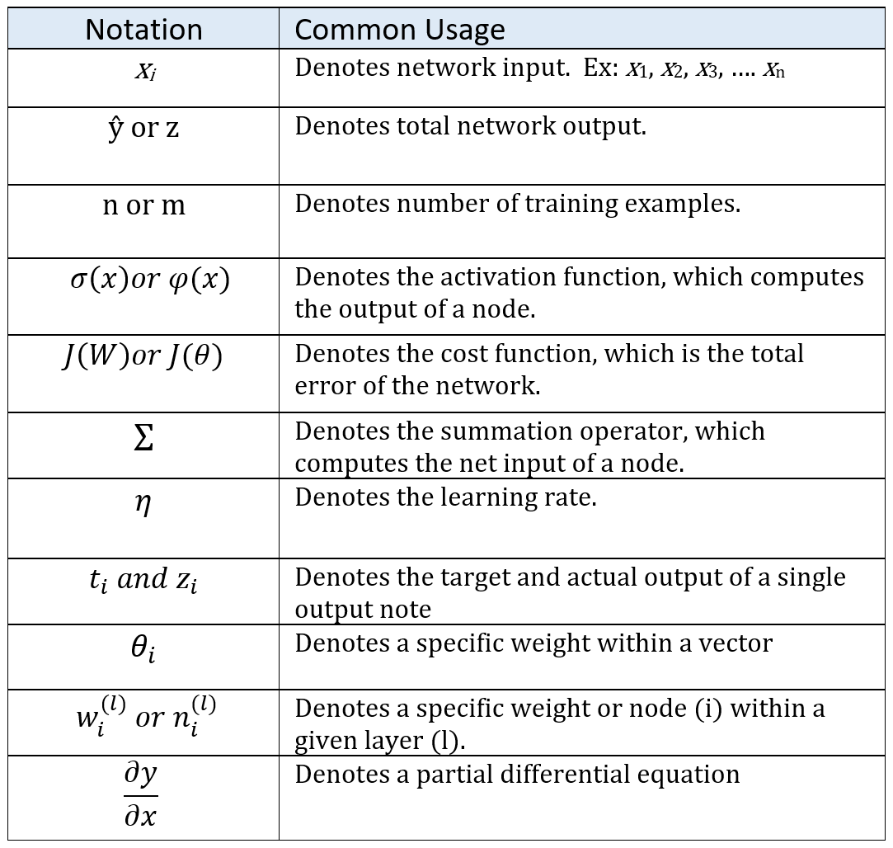
Notes:
And finally – as you continue your deep learning journey – you will encounter a variety of mathematical equations and symbols. But do not fear! With a little effort, you will quickly master them. To get you started, here’s a list of the most frequently used mathematical symbols in deep learning, along with their definitions.

Slide 10

2.02 (Perceptron as Binary Classifier)
2.03 (Multi-class Classification Using a Perceptron)

