Slide 1

Anatomy of a Neural Network

Slide 2
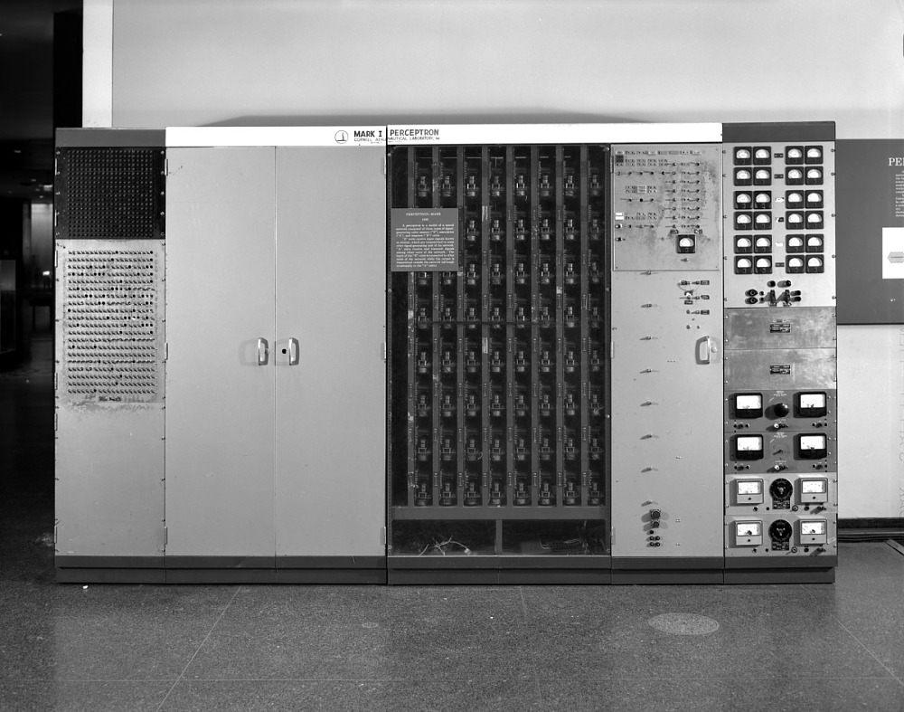
Image Credit: https://americanhistory.si.edu/collections/search/object/nmah_334414
Notes:
The history of artificial neurons began in 1943, with the publication of a paper that presented a massively simplified abstraction of a neuron’s basic functions in mathematical form and described how multiple instances of this object could be connected into a network, or net. The paper, written by McCulloch and Pitts in 1943, launched the field of neural networks.
Building on this insight, in 1957 Frank Rosenblatt proposed the perceptron as a simplified mathematical model of a neuron (Rosenblatt 1962). After the principles of the perceptron had been validated, a perceptron-based computer was built at Cornell University in 1958. It was the size of a refrigerator, called the Mark I Perceptron (Wikipedia 2020c). The device was built to process images, using a grid of 400 photocells that could digitize an image at a resolution of 20 by 20 pixels (the word pixel hadn’t yet been coined). The weight applied to each input of the perceptron was set by turning a knob that controlled an electrical component called a potentiometer. To automate the learning process, electric motors were attached to the potentiometers so the device could literally turn its own knobs to adjust its weights and thereby change its calculations and output. Although the Mark I Perceptron achieved some success, it proved hard to generalize the technique to more complicated kinds of data.
After a few years of stalled progress, a book proved that the original perceptron technique was fundamentally limited (Minsky and Papert 1969). It showed that the lack of progress wasn’t due to a lack of imagination, but the result of theoretical limits built into the structure of a perceptron. A popular consensus formed the perceptron was a dead end. Enthusiasm, interest, and funding all dried up, and most people directed their research to other problems.
However, all that changed about 10 years ago. Big data combined with powerful hardware made it possible to create complex neural networks, capable of doing interesting things.
Source: Glassner, A. (2021). Deep learning: A visual approach. San Francisco, CA: No Starch Press

Slide 3
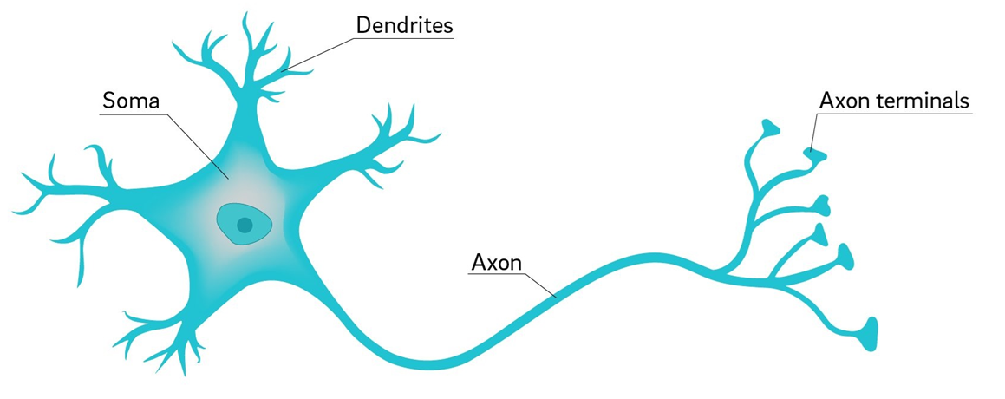
Image Credit: https://ucsdnews.ucsd.edu/pressrelease/why_are_neuron_axons_long_and_spindly
Notes:
With a little history out of the way, let’s begin our exploration of neural networks by first considering the anatomy of a biological neuron – the inspiration behind today’s artificial neural networks.
As pictured here, a neuron is comprised of Dendrites, a cell body (labeled as Soma), and an extended Axon with multiple branches, tipped with Axon terminals. The Axon terminals, in turn, connect to Dendrites from other neurons. Thus, the flow of electrical impulses is from the Dendrites to Soma to Axon. And depending on the strength of the combined electrical impulse, the Soma, in turn, fires, sending an electrical impulse through its axon to all connected downstream neurons. Neural networks solve problems in a similar way to the human brain.
https://ucsdnews.ucsd.edu/pressrelease/why_are_neuron_axons_long_and_spindly

Slide 4
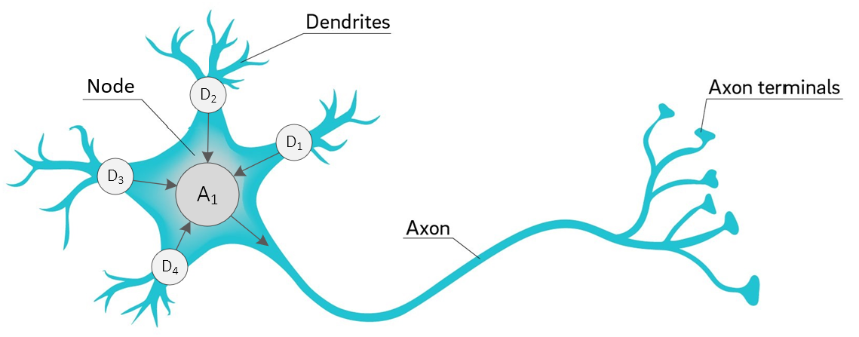
Image Credit: https://ucsdnews.ucsd.edu/pressrelease/why_are_neuron_axons_long_and_spindly
Notes:
Let’s start our learning journey by diagramming basic operations. First, we’ll use the term node – instead of Soma or cell body – to denote a centralized location which collects incoming signals and then outputs a value. And second, let’s label each of our inputs D1, D2, D3, and D4. In this case, the arrows indicate signal direction, with four coming into node A1 and one leaving as output.
With that done, let’s take another step towards a computational model. We’re going to break free from the underlying biology and zoom in on what is happening inside node A1…

Slide 5
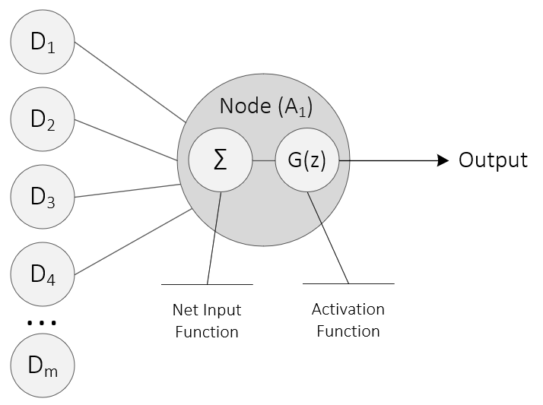
Notes:
The biological underpinnings have now disappeared, and we see that our single node is comprised of two functions. A net input function and an activation function. Furthermore, the inputs to node A1 are lined up on the left. D1, D2, D3, D4. Naturally, we are not limited to just four inputs. We can have as many as we like. The ellipses indicate any number of inputs, with D subscript M being the last in the series. Now earlier, I said that neurons ‘fire.’ Stated computationally, we say that a given node is activated in a two-step process. First, the net input function sums up the incoming input, consisting of numbers in this case. In mathematics, the upper-case Greek letter Sigma denotes a summing operation. And second, the net input function is tightly coupled to its corresponding activation function (labelled G) which, in turn, produces the node’s output. Keep in mind that an activation function can output a positive or negative number, or even zero.
Let’s zoom in on the activation function and take a visual look at three different options.

Slide 6
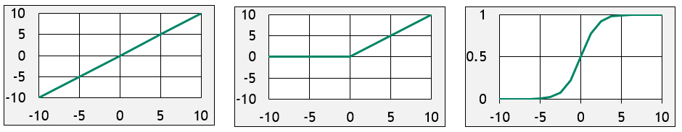
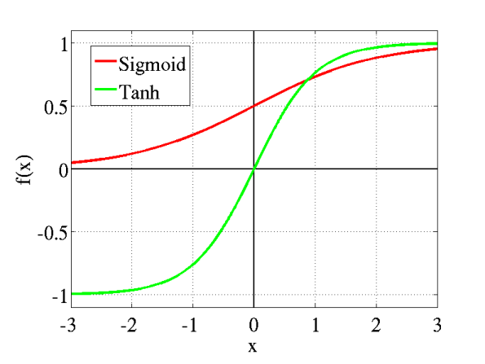
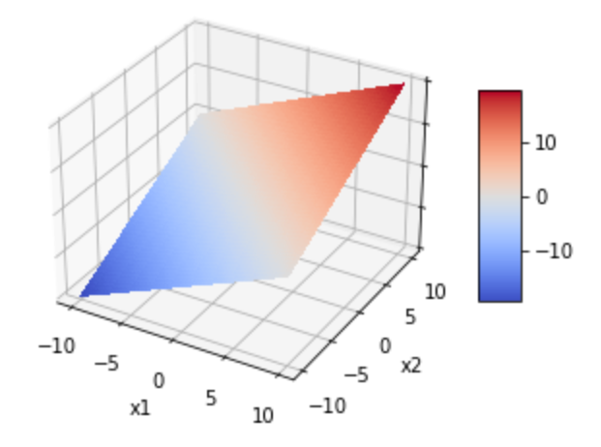
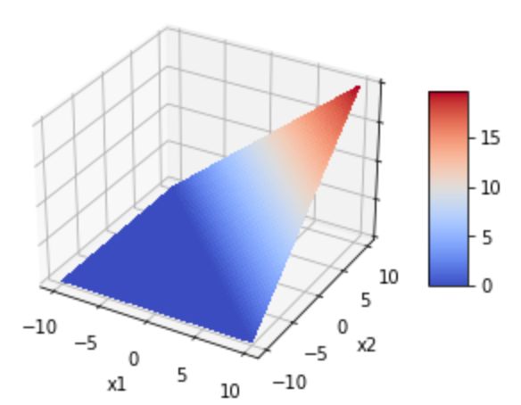
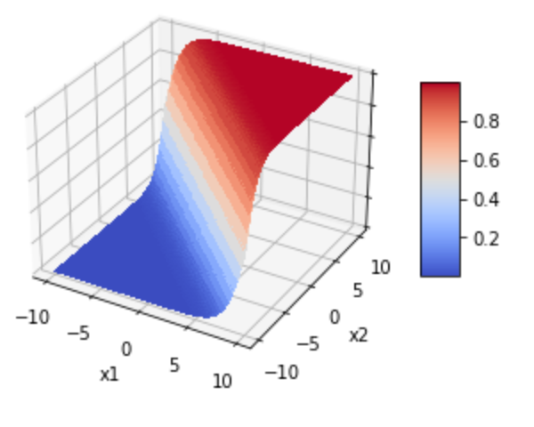
Linear
ReLU
Sigmoid
Notes:
As noted in the last slide, the activation function calculates the output of a given node. Pictured here are the corresponding graphs for three types of activation function – linear, ReLU, and Sigmoid. Each function uniquely converts its input (x-axis) to a corresponding output (y-axis). Consider the ReLU function. Any input at or below zero results in an output of zero. ReLU, by the way, stands for Rectified Linear Unit.
On the second line, the three functions are pictured in three-dimensional space. Keep in mind that these are just three of multiple options. For example, the TanH function is not shown. Linear is just a plane, like a sheet of paper. ReLU is like a wedge. And Sigmoid is like a surf wave.
Okay – let’s zoom back out and see the bigger picture, a complete neural network…

Slide 7
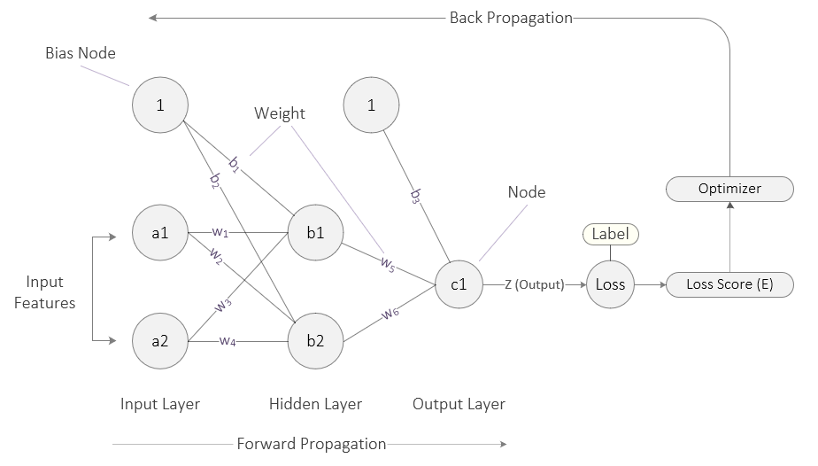
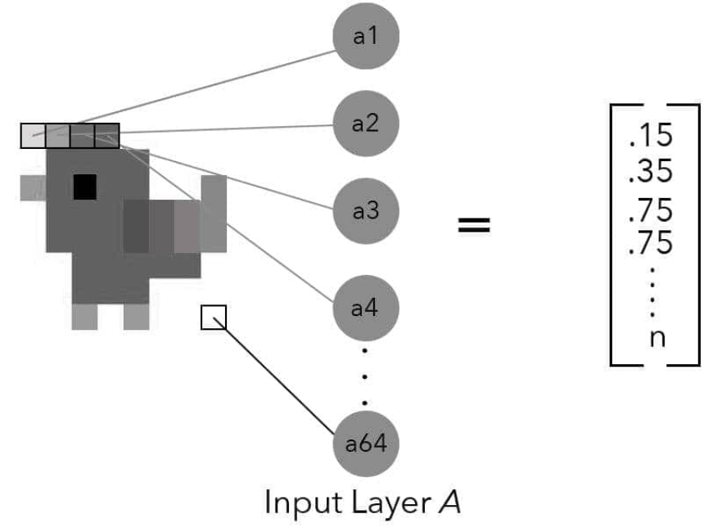
Source: Taylor, M. (2017). Neural networks: A visual introduction for beginners. Vancouver, Canada: Blue Windmill Media.
Notes:
Pictured here is a complete, albeit small, neural network. As such, it consists of an input layer, a single hidden layer, and an output layer. Each layer is comprised of nodes, and a typical neural network can have hundreds of hidden layers, stacked one on top of another. Picture a giant layered cake.
Each example of input data is fed through the input layer. And depending on the size of the input example, the number of input nodes will vary. The input data can be structured data (such as a CSV file) or unstructured data, such as an image. In this example, a greyscale image of a chicken 8 pixels by 8 pixels has been converted into a vector of 64 numbers, as pictured on the left. These are the features which are then fed to the input layer, one feature per node. Only the first two nodes of this network are shown as I wanted to provide a simplified picture of the process.
As just noted, inputs are called features. In this picture, the input layer consists of two nodes (A1 and A2) as well as a bias node. These are fully connected to the hidden layer which also consists of two nodes. Now when I say fully connected, I mean that each node in one layer is linked to every node in the subsequent layer. a1, for example, is linked to b1 and b2 and so on. Some neural networks are not fully connected but we will not talk about those right now. Also, note that the bias node is connected to both b1 and b2. The bias nodes are an unexpected addition. Why are they here? What’s their purpose? I will answer that question in the next slide…
As you can see, each connecting line is labelled. These are the network’s weights. Now a weight is a real number; it can be positive or negative. b1 is the bias weight between bias node 1 and node b1 in the hidden layer. w1 sits between input node a1 and hidden layer node b1. The output from each node’s activation function is subsequently multiplied by the weights which lie between it and the downstream node. For example, the output from a2 is multiplied by w3 and then received as input to node b1. As well, the output from a2 is multiplied by w4 and that, in turn, becomes the input to b2. And now for an important point – weights are adjusted during the back propagation phase. And this is how a neural network ‘learns.’ Let’s keep moving from left to right, in the direction of the forward propagation phase.
In this example, the output layer consists of a single node (C1). Like the nodes before, it sums up its inputs, passes that value to its activation function which then generates a final output (labelled Z in this image). Of course, a neural network can have multiple outputs. But in this case, let’s keep it simple, with the network generating a probability that our image is a chicken. This final output is then fed to a loss function, often called a cost function in the literature. During training, the loss function compares the network’s output to the label attached to the example. So, if the label attached to this image is 1 (it’s 100% certain that this is a chicken) but our network outputs .10, we have a large discrepancy. With that discrepancy, the loss function calculates the network’s total error. This is the penalty the network must pay for arriving at an answer far from the truth.
The networks’ total error is then passed to the optimizer which oversees the backpropagation process. It is during backprop that the weights are adjusted. Hence, the goal of the system is to minimize its error, in a process called gradient descent. We will take an in-depth look at gradient descent in next week’s presentation.

Slide 8
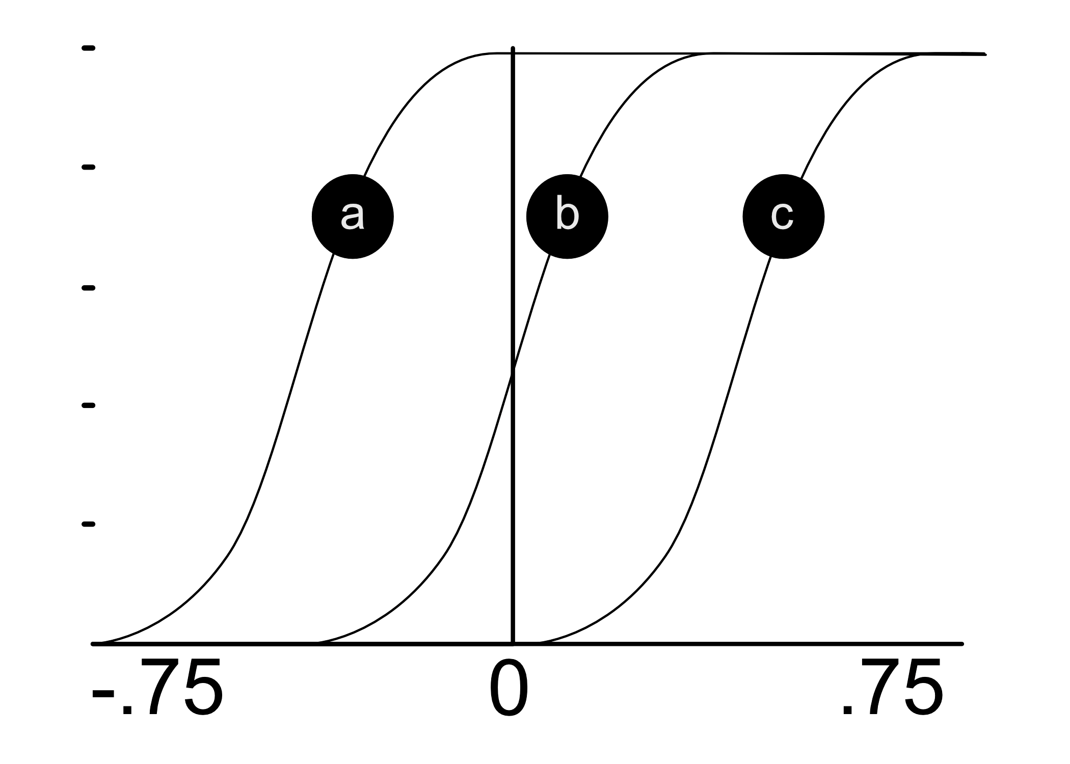
Source: Taylor, M. (2017). Neural networks: A visual introduction for beginners. Vancouver, Canada: Blue Windmill Media.
Notes:
Let’s now justify and explain the existence of the bias nodes. Technically, bias provides every node in a neural network with a trainable constant value (1 or -1). But why do we need them? Well – on a practical level – input from the bias node enables an activation function to be shifted to the left or right. In this case, what looks like a sigmoid function can be shifted to the left (position A) or to the right (position C). In addition to the adjustment of weights which occurs during backpropagation, this ‘shifting’ can be important and critical for successful learning.

Slide 9
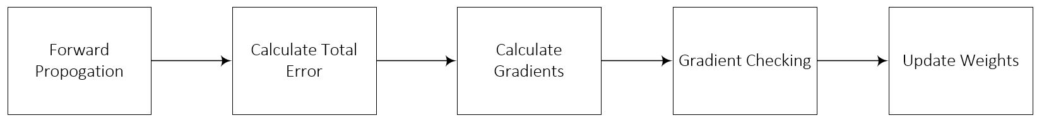
Five Step Process
Summation Operator Activation Function
Cost Function
Partial Derivative
Chain Rule
Gradient Check
Weight Update
Source: Taylor, M. (2017). Neural networks: A visual introduction for beginners. Vancouver, Canada: Blue Windmill Media.
Notes:
Now that I have introduced the basic parts of a neural network, let’s step back and briefly review the key steps of the training process. The five steps which comprise both forward and back propagation are pictured here, along with each step’s corresponding mathematical functions or operations. Gradient checking step is important for quality control, though we do not discuss it in the Practicum AI workshop series. Backpropagation includes the last three steps.

Slide 10
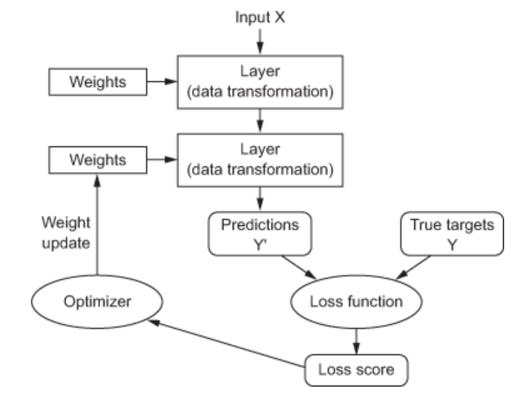
Source: Chollet, F. (2017). Deep learning with Python. Shelter Island, NY: Manning Publications. (Chapter 3)
Notes:
Here’s another visualization of the training process. I like this process diagram because it clearly shows the role of the optimizer in the weight update process.

Slide 11
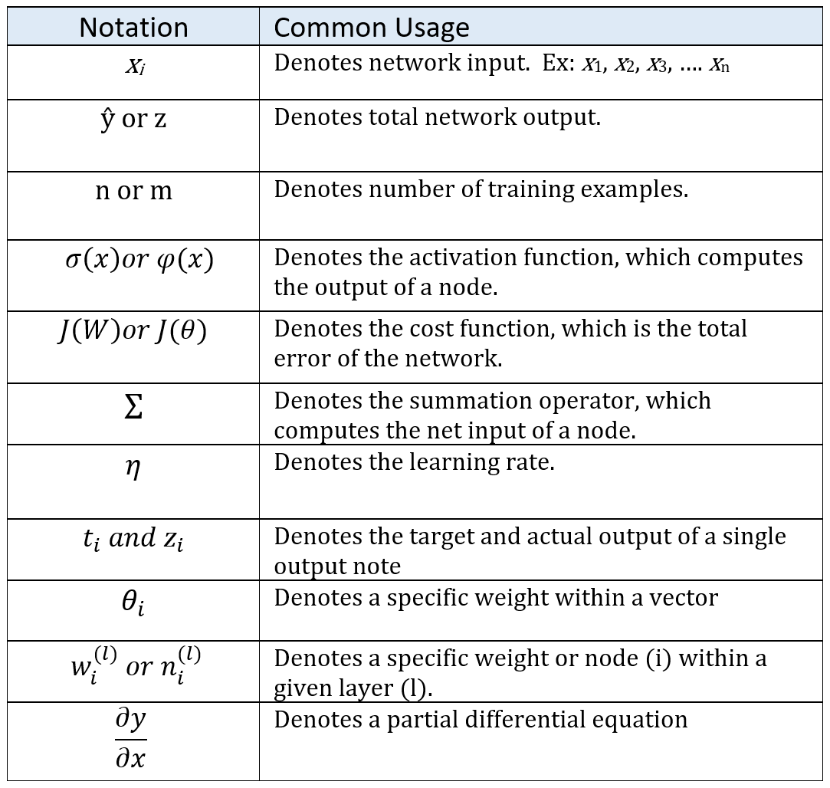
Notes:
And finally – as you continue your deep learning journey – you will encounter a variety of mathematical equations and symbols. But do not fear! With a little effort, you will quickly master them. To get you started, here’s a list of the most frequently used mathematical symbols in deep learning, along with their definitions.

Slide 12
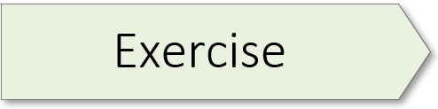
2.01 (Perceptron Implementation)

Slide 13
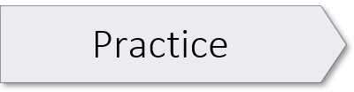
2.02 (Perceptron as Binary Classifier)
2.03 (Multi-class Classification Using a Perceptron)

Slide 15
Key Points
Neural networks are specific
Neural networks are either fixed or adaptive
Neural networks have three basic parts
Input Layer
Hidden Layer(s)
Output Layer
Neural networks use three types of datasets
Training
Validation
Testing
Neural networks are built two ways
Feedforward
Feedback
Notes:
Neural networks are always built to solve a specific type of problem, although this doesn’t mean they can’t be used as “general purpose” tools. Examples of specific uses include: prediction, forecasting, estimation, classification, and pattern recognition.
A neural network has three basic sections, or parts, and each part is composed of “nodes”. There’s the input layer, one or more hidden layers (sometimes dozens of hidden layers), and a final output layer.
Neural networks are built two ways. With a feedforward neural network, signals travel only one way, from input to output. These types of networks are straightforward and used extensively in pattern recognition. A convolutional neural network (CNN) is a specific type of feedforward network often used in image recognition. With feedback – or recurrent neural networks – signals can travel both directions and there can be loops. RNN are more powerful and complex than CNN’s. Despite this, RNN’s have been less influential than feedforward networks.
Neural networks are either fixed or adaptive. The weight values in a fixed network remain static. They do not change. On the other hand, weight values in an adaptive network can change.
Neural networks use three types of datasets. The training dataset is used to adjust the weights of the neural network. The validation dataset is used to minimize a problem known as overfitting, which we cover late. The testing dataset is used as a final test to gauge how accurately the network has been trained. All three datasets are usually taken from the project’s primary dataset, sliced into three parts. Typically, the data is split as follows: Training data: 60% -- Validation data: 20% -- Testing data: 20%.

