Slide 1

Neural Networks: Getting Started

Slide 2
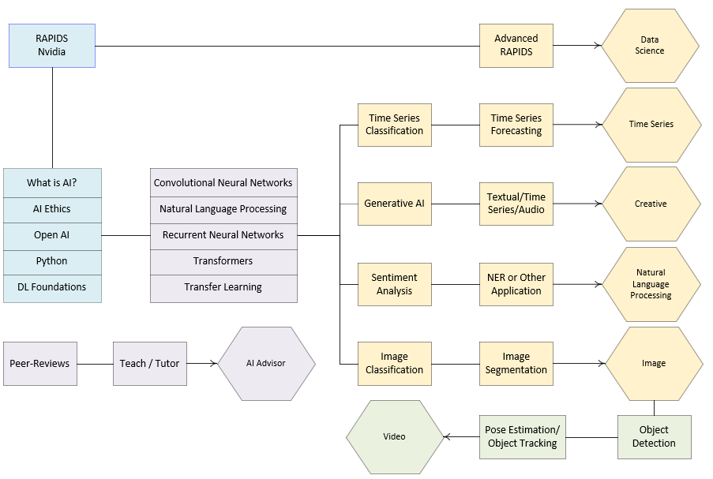
Notes:
This is the entire Practicum AI program, with the DL Foundations series enclosed in a blue box. Last week, we covered AI Ethics. Now – in this workshop series – we begin to get our hands dirty writing code.

Slide 3
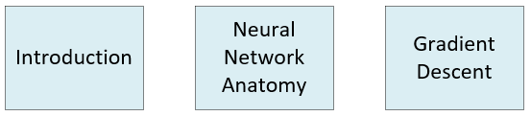
Deep Learning Foundations
Notes:
Our Deep Learning Foundations series comprise 3 workshops. In this session and the next two which follow, we cover the basics.

Slide 4
Essential Questions
How does it work?
Where can I use it?
Notes:
This workshop series is guided by two essential questions: How does it – a particular AI algorithm or technique work – work? And where can I use it?
Now – with respect to the first question – let me assure you that you can understand how a specific algorithm works without having to know all the mathematical details behind its operation. Just as you can drive a car without understanding the laws of thermodynamics, so too can you drive the various AI algorithms without having to master the calculus, statistics, and algebra which power them. However, you do need to know how they work and what the various dials and gauges mean as well as the various ways in which you can control an algorithm’s behavior. The way you do that is by adjusting a model’s hyperparameters.
The second question is also important. In fact, it is the primary focus of today’s learning experience. It is not a question that we can fully answer for you as it requires a certain level of knowledge and imagination on your part, though we can prime your thinking by demonstrating a specific application. That’s what you will be doing today. You are going to write some code to build and then test a neural network capable of classifying images. There are faculty in Dentistry who are already doing some interesting things with AI. One of those persons is Divakar Karanth, a clinical associate professor in orthodontics. I also have an article for you to consider: Artificial intelligence in dentistry: current applications and future perspectives.
But before we do that, let’s first take a quick look at the field of AI and its two sub-disciplines.

Slide 5
Learning Strategies
1. Focus
2. Avoid “Copy and Paste”
3. Study Code Block-by-Block / Line-by-Line
4. Use the Internet to Find Answers
5. Ask for Help
6. Take Your Time
Source: Valle, D.. (2016). How to learn a scripting language.
Notes:
Focus
So often, students think they can learn AI programming while multi-tasking on Facebook or texting friends on their cell phone. After programming for 30 years, I've learned one thing. You'll learn AI much faster if you can devote focused, uninterrupted time to practice.
Avoid the “copy and paste” approach to writing code
Although copying and pasting may help you to avoid typing errors, it can also interfere with your learning process for two reasons:
Typing errors can help you gain experience in writing code it provides informative feedback when you make mistakes. Making and correcting typing errors is an important skill to develop, particularly when you are typing a lot of code for your own data analysis.
Copying and pasting code may give you the impression that you know what you are doing when – in reality – you probably do not fully understand what the individual blocks of code are actually doing. Furthermore, this problem will just get worse as you deal with increasingly longer and more complicated scripts.
Study code block-by-block, line-by-line
This means running one block of code at a time and making sure that you understand why the output is what it is. If things are not clear, it is important to spend more time with that piece of the code. Here are some tricks that are often helpful to understand a particular piece of code:
Break a line of code into its components and try to understand the individual pieces. Sometimes functions are nested within functions.
Document what each block is doing. Clear documentation is critical as you may not remember what you did when you come back to a piece of code at some point in the future. As a wise programmer once said, “Write code for the future you.” Documentation is also useful when you want to adapt or reuse code in some other way. In situations like this, you will immediately know what a specific chunk of code does because it has been clearly documented. Donald Knuth – Literate Programming
Perform mini experiments: create a simpler example in which you can tinker with the code and see what happens to the output.
Use the internet to find answers
Everybody (from novice to more experienced users) relies on the internet when they don’t understand something. It is likely that other people have already asked (and received useful answers) for the problem that you are facing. However, finding the exact piece of information that you need might be hard, especially if you don’t use the correct terms/key words. Learning how to search for the information that you need is a skill that also takes practice. “Stackoverflow” and existing cheatsheets can be very helpful.
Ask for Help
We’re all learning. And some days, I feel like I’m the one who has the most to learn. Alcoa story.
Take your time
It is important to realize that it takes time to learn AI. What this implies is that you should not rush to get things done if you want to master this skill. In particular, everybody goes through some level of struggle and frustration when learning AI. However, once you have mastered it, you will be amazed by what this skill can do for you.

Slide 6
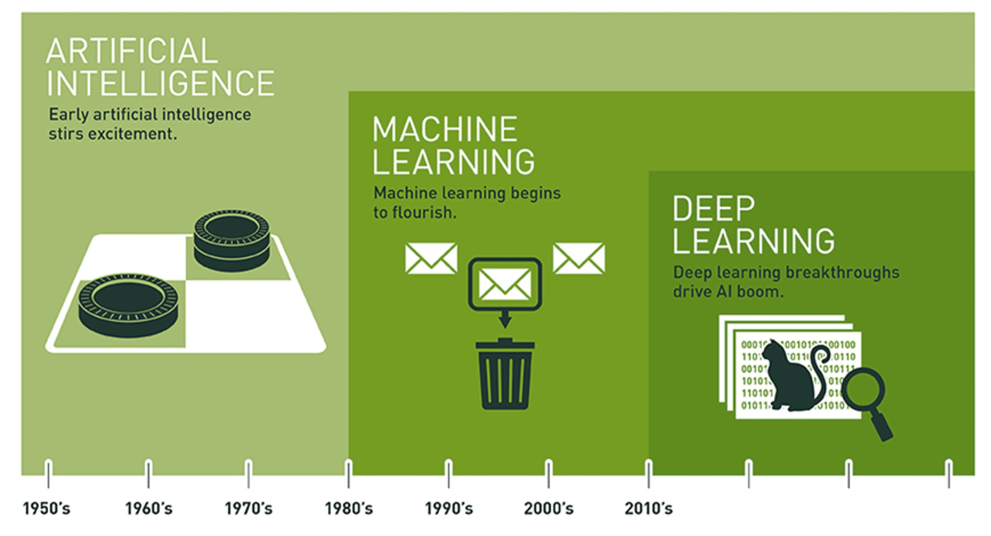
Notes:
Artificial intelligence is the branch of computer science aimed at developing machines that can simulate human intelligence. And human intelligence is dependent on our five senses – sight, hearing, touch, smell, and taste. AI is an established field and has been in existence since the 1950s.
Machine learning is the subset of AI that performs specific tasks by identifying patterns within data and extracting inferences. The inferences derived from data are then used to predict outcomes on unseen data. In machine learning, unlike traditional computer programming, the rules and heuristics are not explicitly written. Rather, they are learned from the dataset.
Deep learning is a subset of machine learning and an extension of a certain kind of algorithm called Artificial Neural Networks (ANNs). Neural networks are not a new phenomenon. Neural networks were created in the first half of the 1940s. Two factors have led to the exponential rise of deep learning in the past ten years. The first is Big Data. The second is enhanced hardware – graphical processing units or GPUs made by companies like Nvidia. And the third is open-source deep learning software like TensorFlow from Google.

Slide 7


Slide 8
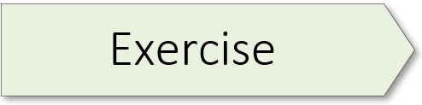
1.01 (Image & Speech Recognition Demo)

Slide 9
Neural Network Types

Slide 10
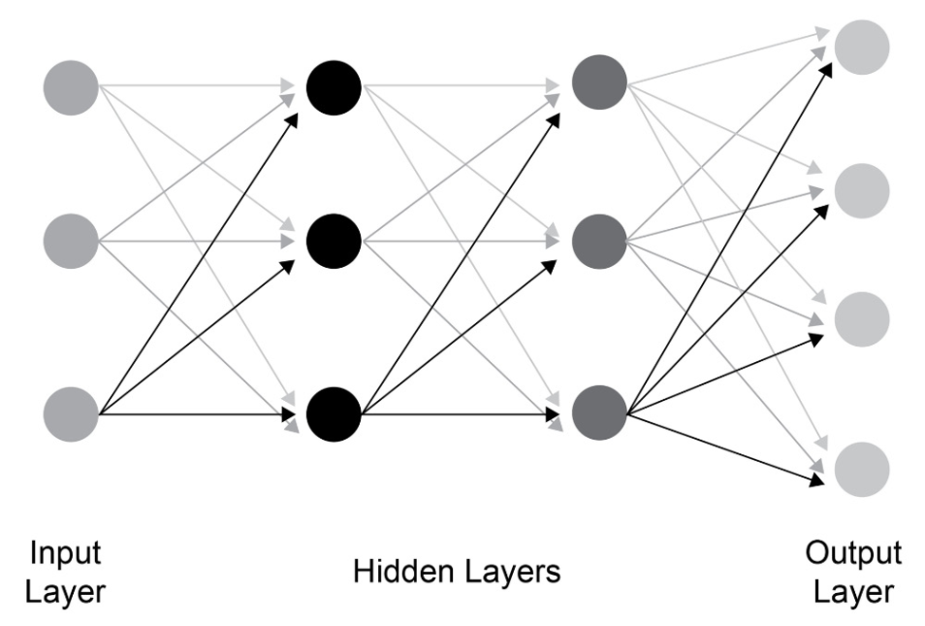
Notes:
The multi-layer perceptron (MLP) is a basic type of neural network. An MLP is also known as a feed-forward network. Applications of the multi-layer perceptron include:
Complex Classification
Machine Translation

Slide 11
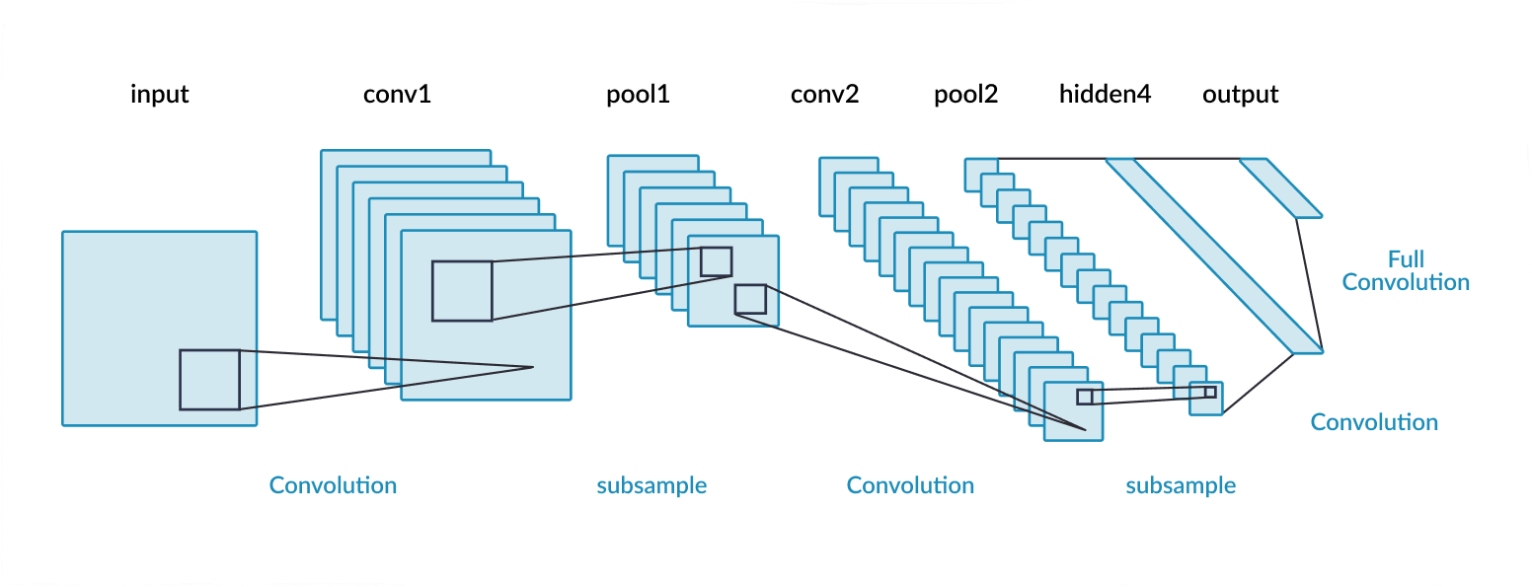
Notes:
A convolutional neural network (CNN) is a class of deep learning model that is predominantly used for image recognition. With a multi-layer perceptron, each neuron in a layer is connected to every other neuron in the next layer. That is, it is a fully connected network. CNNs, however, adopt a different approach and do not employ a fully connected architecture. Instead, CNNs extract local features from images, which are then fed to the subsequent layers. Some application of CNNs include:
Image processing
Computer Vision
Speech Recognition

Slide 12
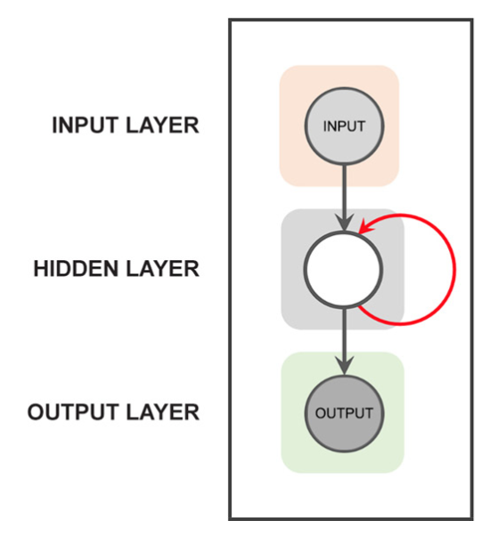
Notes:
Recurrent neural networks (RNNs) propagate data forward, but also backwards, from later processing stages to earlier stages. As pictured here, the red arrow indicates that the hidden layer connects back to itself, thereby allowing the network to remember what it has already done. Transformers are quickly becoming a popular and preferred alternative to RNN’s.
Some application of RNNs include:
Text processing like auto suggest, grammar checks, etc.
Text to speech processing
Sentiment Analysis
Time sequence projections
Translation

Slide 13
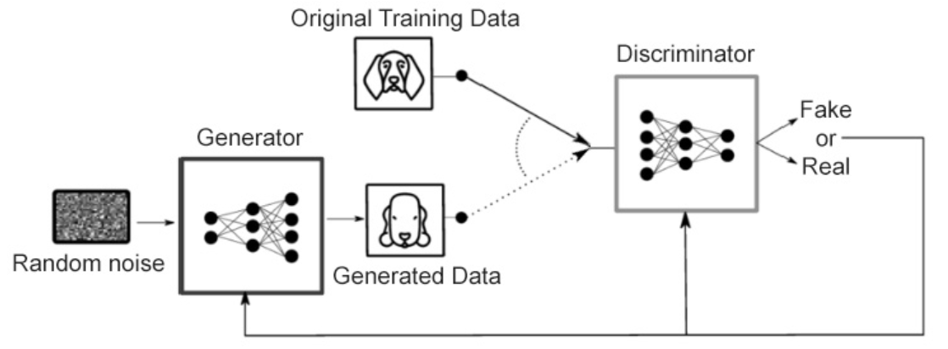
Notes:
Generative adversarial networks (GANs) are networks capable of generating data distributions comparable to any real data distributions.
For example, suppose we want to generate images of dogs from random noise data. For this, we train a GAN network with real images of dogs and the noisy data until we generate data that looks like the real images of dogs.

Slide 14
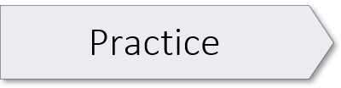
Watch the Matrix Multiplication video embedded in exercise-1.03-student.ipynb. Complete the following exercises:
Exercise 1.02
Exercise 1.03
Exercise 1.04
Exercise 1.05
Exercise 1.06

Slide 16
Summary
Defined Terms (AI, ML, DL)
Created and tested a pre-trained network (resnet50)
Discussed 4 types of neural network
Notes:
Provide an accurate definition of AI and its two primary sub-domains
Create a Jupyter notebook using the JupyterLab IDE with Python and Markdown blocks
Write the Python code to create and then execute the resnet50 pre-trained model
Name the three basic types of neural network and common applications for each

Slide 17
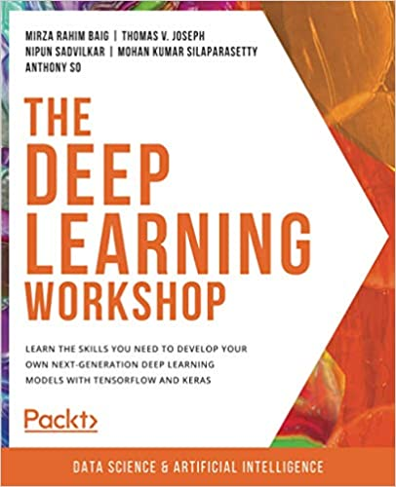
Notes:
Our textbook for this seminar is The Deep Learning Workshop from Packt Publishing. We will provide you with an electronic copy of this book which contains the exercises you will be working on in class as well as out-of-class.

Slide 18

Notes:
Take a minute and consider this image. Can you appreciate the ingenuity and resourcefulness of whoever created the contraption pictured here? How does one develop a similar kind of ability in AI? Part of the answer lies in developing a willingness to “color outside the lines.” And to do that, you need to acquire a playful approach to your learning.
The anthropologist Levi Straus had a name for these kinds of people, calling them Bricoleurs. A bricoleur is a playful tinkerer who uses whatever is at hand to solve an immediate problem. A bricoleur enjoys mashing things up, taking ideas from one domain and using them in another. And most importantly, a bricoleur is not boxed in by disciplinary norms. Or, as we used to say on the farm, “I’m a jack of all trades, master of none.”
Let’s consider

