Slide 1
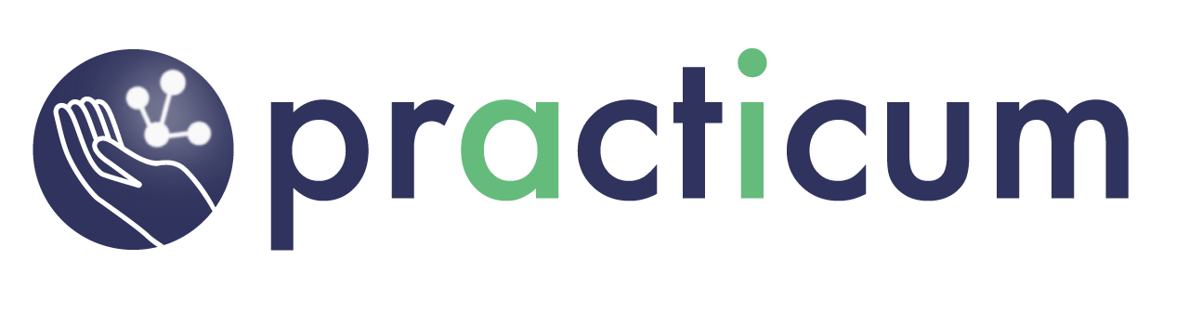
Generative AI

Slide 2
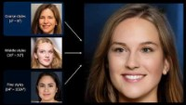
Notes:
The power of creativity has always been the exclusive domain of the human mind. This was one of the facts touted as one of the major differences between the human mind and the artificial intelligence domain. However, deep learning has been making baby steps to being creative. Imagine you were at the Sistine Chapel in the Vatican and were looking up with bewilderment at the frescos immortalized by Michelangelo, wishing your deep learning models were able to recreate something like that. Well, maybe 10 years back, people would have scoffed at your thought. Not anymore, though – deep learning models have made great strides in regenerating immortal works. Applications like these are made possible by a class of networks called Generative Adversarial Networks (GANs).
Nvidia is a leader in the use of AI in creative domains, with their StyleGAN tool. Let’s watch a short video of that tool. In addition to this example, many other use cases are finding traction. Some of the notable ones are as follows:
Synthetic data generation for data augmentation
Generating cartoon characters
Text to image translation
Three-dimensional object generation
The list goes on. As the days go by, applications of GANs increasingly become mainstream.
So, what exactly are GANs? What are the inner dynamics of GANs? How do you generate images or other data distributions from totally unconnected distributions? In this chapter, we'll find out the answers to those questions.

Slide 3
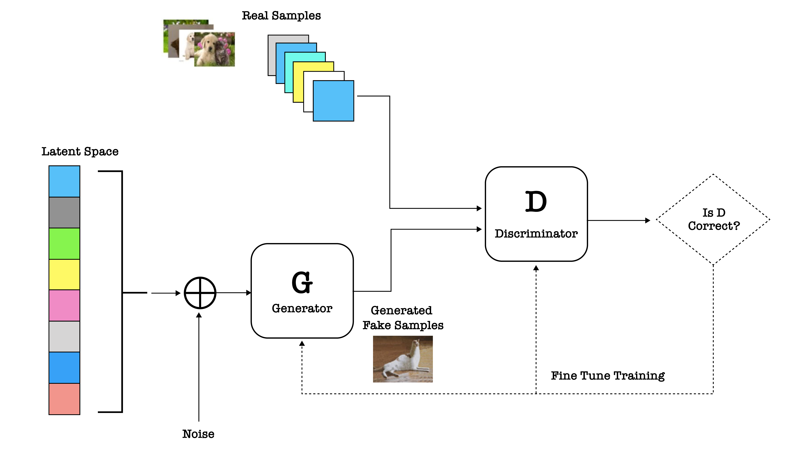
Notes:
GANs are used to create a data distribution from random noise data and make it look similar to a real data distribution. GANs are a family of deep neural networks that comprise two networks that are competing against each other. One of these networks is called the generator network, while the other is called the discriminator network. The functions of these two networks are to compete against each other to generate a probability distribution that closely mimics an existing probability distribution. To state an example of generating a new probability distribution, let's say we have a collection of images of cats and dogs (real images). Using a GAN, we can generate a different set of images (fake images) of cats and dogs from a very random distribution of numbers. The success of a GAN is in generating the best set of cat and dog images to the point that it is difficult for people to differentiate between the fake ones and the real ones.
The figure above provides a concise overview of the components of a GAN and how they come in handy in generating fake images from real ones. Let's understand the process in the context of the preceding diagram:
1. The set of images at the top-left corner of the preceding figure represents a probability distribution of real data (for example, MNIST, images of cats and dogs, pictures of human faces, and more).
2. The generative network shown in the bottom-left part of the diagram generates fake images (probability distributions) from a random noise distribution.
3. The trained discriminative network classifies whether the image that is fed in is fake or real.
4. A feedback loop (the diamond-shaped box) working through the backpropagation algorithm gives feedback to the generator network, thereby refining the parameters of the generator model.
5. The parameters continue to be refined until the discriminator network can’t discriminate between the fake images and the real ones. Now that we have an overview of each of the components, let's dive deeper and understand them better through a problem statement.

Slide 4
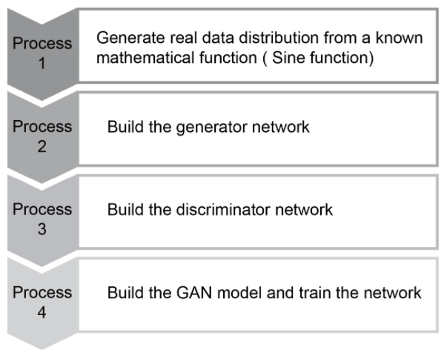
Notes:
The four steps to create a GAN are listed here.

Slide 5
Exercise 7.01:

Slide 6
References
Baig, M. R., et al (2020). The Deep Learning Workshop. Birmingham,
England: Packt Publishing.

Slide 8
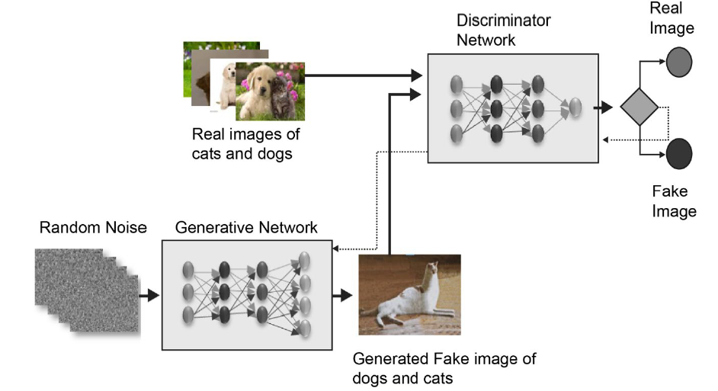

Slide 9
Summary
Notes:
Okay – let’s quickly summarize what we covered in today’s workshop.

