Slide 1

A New Approach to Basic AI Mastery
Notes:
Hello everyone. I’m Dan Maxwell – an AI Trainer / Consultant in Research Computing. In this short presentation, we want to introduce you to our Practicum AI badging program.

Slide 2
Our target student audience is…
Non-technical
Curious about A.I.
Comfortable with DIY Learning
Notes:
Our target student audience is beginners who have little-to-no technical background, are curious about AI who need to quickly acquire foundational AI knowledge and are comfortable with Do-It-Yourself learning.

Slide 3

Notes:
The anthropologist Levi Straus had a name for these kinds of students, calling them Bricoleurs. A bricoleur is a learner who is comfortable mashing things up, taking ideas from one domain and repurposing them in another. They want to answer a question or solve a problem, but they do not wish to be boxed in by disciplinary norms. They are a “jack of all trades, master of none.” In short, they are tinkerers with an immediate research focus.

Slide 4
Unique Instructional Features
Visual Learning
Story Driven
Hands-On
Project Based
Model Perspective
Notes:
Visual rather than mathematical formulas. (Visual – use example of Calculus chain-rule and StatQuest video.) Dual-Coding theory supports visual / narrative learning formats. Story-driven, featuring a Case-Study approach to learning at the Advanced workshop level. Hands-on which develops student confidence in their programming skills. Focus on models, transfer learning, and hyperparameters.
Four levels of hands-on coding. Level 1: student retypes example code. Level 2: student modifies and/or extends example code. Level 3: student writes code from scratch, given an algorithm. Level 4: student solves a problem by defining an algorithm and then writing the code to instantiate it.

Slide 5
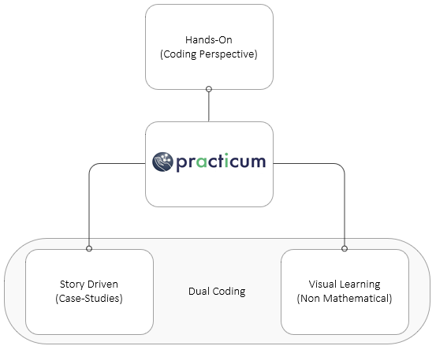
Notes:
… and here’s a visual image of the elements mentioned in the last slide. The notion of project-based learning from a modelling perspective is part of the Hands-On box.

Slide 6
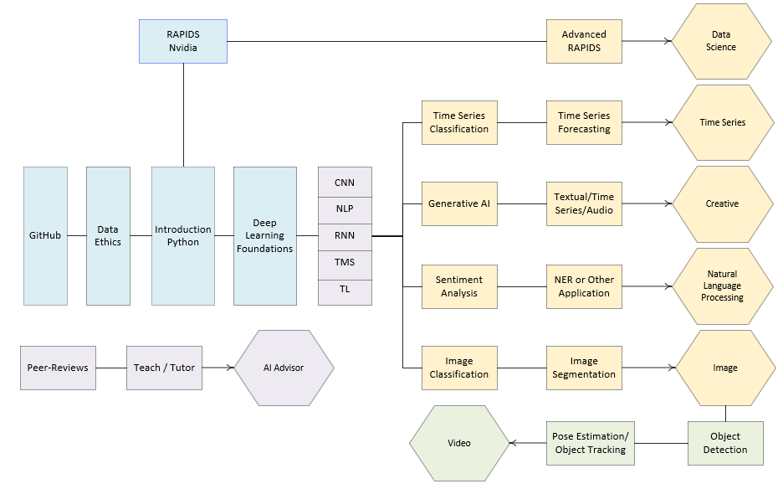
Notes:
… and this is the initial set of badges and workshops to be rolled out over the next year or so. Blue boxes are foundational learning experiences. Yellow are intermediate, and green is advanced. As pictured here, students seeking the Video badge will first have to achieve the Image badge. The Introduction to Python, RAPIDS, Data Ethics, Deep Learning Foundations, and Research Roadmap workshops are available now or close to being finished, with rollouts planned later this year. The badging program, as presently conceived, is flexible and we envision additional badges being added over time. In fact, we have already submitted a funding proposal to create a series of workshops leading to a FAIR Data badge.

Slide 7
Visual + Story
Case-Study + Project

Slide 8
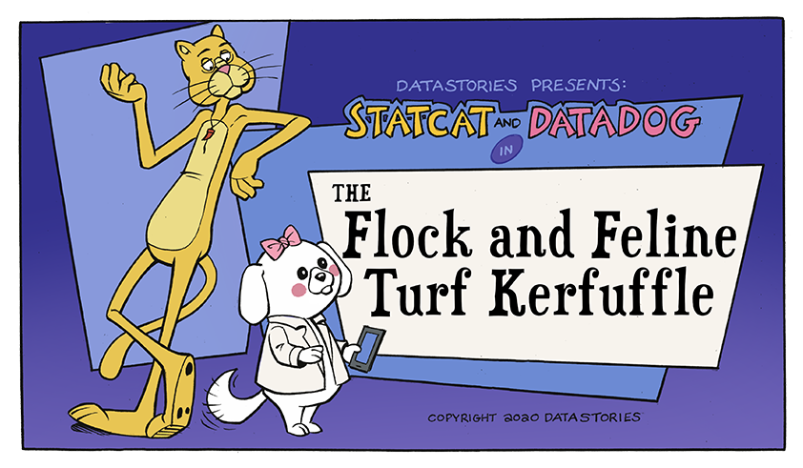
Visual + Story Learning
Notes:
The Practicum AI training program will also take a model first approach. That is, the learning is centered on mastering the basics of model design as well as the various ways in which a given model can be tuned via the controls (hyperparameters) which govern its behavior. And because of this, the Practicum AI training program focuses on applied A.I., with special attention given to transfer learning. Transfer learning is the process one undertakes to repurpose a model developed for a specific application and then use it for another. For example, transfer learning happens when a neural network trained to recognize cars is then used to identify trucks.

Slide 9

Case-Study + Project Learning
Notes:
Each of the Practicum AI badges includes a summative assessment in which students demonstrate their mastery of the topic by creating a publicly accessible portfolio on GitHub. We believe this should prove valuable, especially for students seeking employment as potential employers will be able to see what they can do. Also, our badges can be added to resumes, certifying that the individual has achieved a standardized set of skills.
GitHub and real-world projects from Nvidia business partners…

Slide 10

AI University Consortium
Notes:
Our vision is the creation of a global community of AI educators committed to introducing non-technical students to the joys of AI. Our vision is two-fold. First, we want to continuously offer Practicum AI workshops to students. Second, we want to create a world-class curriculum for teachers committed to the entry-level / intermediate AI audience. AAAI already has a small group of AI educators who host a mini-conference within the larger AAAI conference. This past February about 75 teachers attended, mostly from North America. We believe the Nvidia Tech centers could also be leveraged to reach out to local universities within their respective countries.
An AI University consortium will be a place where AI teachers and instructors from around the globe discuss AI pedagogy, submit innovative AI learning experiences to a shared repository, and gather at an annual conference to advance AI education research and understanding.

Slide 11

Notes:
As noted in the previous slide, the sharing of ideas and curriculum will lie at the heart of the AI University consortium. To that end, the Practicum AI workshop modules are designed with reusability in mind. Modules can be plugged into existing classes. The basic idea is to build once, reuse again and again. Our hope is that these learning experiences will snap easily into AI classes aimed at non-technical audiences.
For many faculty, AI is still a new and somewhat mysterious field. We want to change that by giving them access to well-crafted and easily modified AI learning experiences. And as they develop confidence, our hope is that they will begin to craft new learning experiences to then be shared back to the community.

Slide 12

Notes:
At this point, we’d like to hear from you. Any questions or comments about our Practicum AI program?

Slide 14
Learning Options
In-Person
Synchronous (Online)
Asynchronous (Online)
Adapted to a For-Credit Course
Notes:
Additionally, we plan to offer the Practicum AI program in a variety of ways. The online options will probably be the most popular, allowing students across the world to participate.

Slide 15
Our program is non-credit
Notes:
First off, our Passport to AI Proficiency badging program is non-credit – designed to complement our partner’s various AI certificate offerings and for-credit classes. In other words, this program is not designed to replace what is currently offered in the traditional academic programs.

Slide 16
