Slide 1

Program Overview

Slide 2
A Global Resource for Interactive, Visual, Story-Driven
AI Learning Experiences
Notes:
This is a short statement of where we want to be in three years. Our goal is to be a globally recognized leader in the development and curation of interactive, visual, story-driven AI learning experiences. Just a couple notes. Our focus is AI and Data Science Education. We do not aspire to become a general education publisher. We do, however, view ourselves as a community builder, an organization which supports the worldwide AI Education community.

Slide 3

Visual
Interactive (Coding)
Story-Driven
Notes:
The distinctive nature of our AI Learning experiences can be visualized as a 3-legged stool, with each leg representing a key facet. First, our learning experiences are interactive, featuring abundant hands-on coding exercises to develop student confidence and coding skills. Second, content is delivered visually, not through mathematical formulas. And finally, narrative (story-driven) forms of instruction are used extensively, especially at the advanced levels where case-studies are featured prominently.
Dual-Coding theory supports visual / narrative learning formats
Four levels of hands-on coding. Level 1: student retypes example code. Level 2: student modifies and/or extends example code. Level 3: student writes code from scratch, given an algorithm. Level 4: student solves a problem by defining an algorithm and then writing the code to instantiate it.

Slide 4
Empower AI Educators
Quality & Curation
Design & Production
Research & Assessment
Notes:
The four primary functions we presently envision for the Practicum AI organization are:
Empower AI Educators (This is the heart of our mission and therefore at the center of this image)
Quality & Curation (The QA and curation function ensures that IVS learning experiences created by members of our AI Educator community are of the highest quality)
Research & Assessment (This function enables us to gain a better understanding of what does and does not work)
Design & Production

Slide 5
Beyond STEM
Arts
Social Sciences
Humanities
Languages
Notes:
We seek to serve the “Beyond STEM” market. Most AI training and educational programs are designed for STEM audiences. In the case of AI, this group is typically comprised of computer science, mathematics, physics, statistics, data science, and engineering majors. Our mission is to expand beyond that to include the arts, humanities, health, and social science communities.
We also wish to develop a curriculum targeted specifically to teenage females. Our strategic partner in this endeavor will be Women in High-Performance Computing.

Slide 6
Audience Profile
Minimal Technical Background
Curious about A.I.
Enjoy Tinker & Play Learning
Notes:
Our target student audience is beginners who a minimal technical background -- curious about AI but have little knowledge of the field – and take a tinker and play approach to learning. That final point is important as these workshops feature extensive hands-on coding exercises.
Again – this program is designed for the Beyond STEM crowd, not for computer science, engineering, mathematics, data science, or statistics majors. Students with that kind of background are encouraged to sign up for the advanced AI workshops offered by Nvidia’s Deep Learning Institute.

Slide 7

Notes:
Okay – let’s visualize the message from the last slide visual. Our audience is students who can appreciate the ingenuity and resourcefulness of whoever created the contraption pictured here – and they want to do something similar with AI. Our program is not designed for mathematical prodigies or technical whiz kids. However, it will be of interest to individuals who like to color outside the lines.
The anthropologist Levi Straus had a name for these kinds of people, calling them Bricoleurs. A bricoleur is a playful tinkerer who uses whatever is at hand to solve an immediate problem. A bricoleur enjoys mashing things up, taking ideas from one domain and using them in another. And most importantly, a bricoleur is not boxed in by disciplinary norms. Or, as we used to say on the farm, “I’m a jack of all trades, master of none.”
Is this you? If so, you should enjoy these learning experiences.

Slide 8
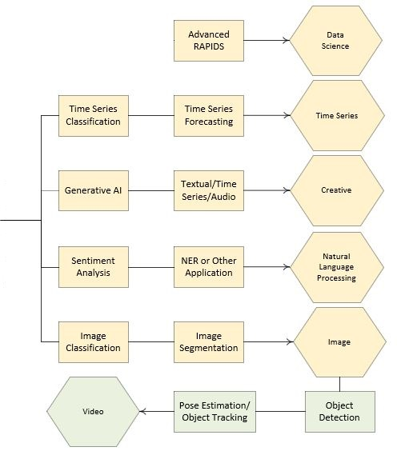
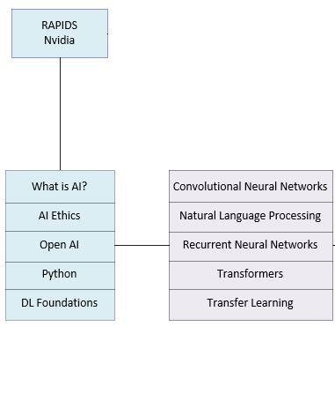
Visual / Hands-On
Case-Study / Project
Notes:
This is the entry-level to intermediate workshops in our Practicum AI program. Blue boxes are foundational learning experiences while purple is intermediate. The Open AI, AI Ethics, Introduction to Python, and Deep Learning Foundations constitute the core sequence of the Practicum AI workshop program. This semester, we are offering most of the entry-level and intermediate workshops, including a some of the intermediate workshops – one for Convolutional Neural Networks, Natural Language Processing, Recurrent Neural Networks, Transformers, and Transfer Learning. The last two workshops – Transformers and Transfer Learning – are still in-development and may or may not be offered. These introductory workshops are visual learning experiences, with abundant hands-on coding exercises.
Our approach shifts, however, in the advanced workshops, pictured in yellow. (Green is a specialty badge) At the advanced levels, our vision is that learning will happen via projects and case-studies. The hexagons are badges students can earn, after completing the requisite workshops in a series.

Slide 9
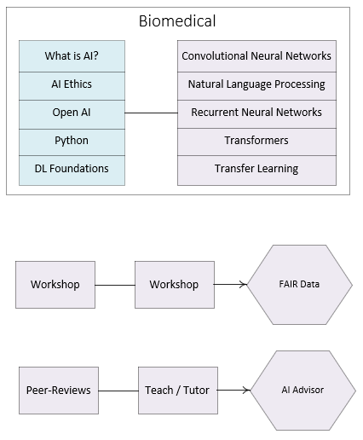
Notes:
The Practicum AI badging program, as presently conceived, is flexible and we envision additional badges being added over time. In fact, we recently received funding to create a series of workshops leading to a FAIR Data badge. And Matt will be collaborating with a faculty member in the Health Sciences to offer a Biomedical version of our entry-level and intermediate workshops. That work should begin next summer.

Slide 10
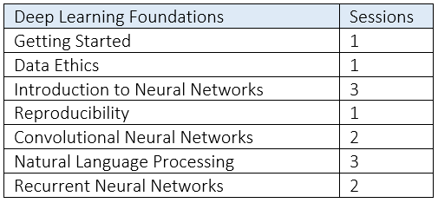
Notes:
The initial set of 13 workshops pictured here will be offered this semester. Because this is a beta release of the program, we limited the cohort to 25 participants who will provide (hopefully) in-depth feedback.

Slide 11
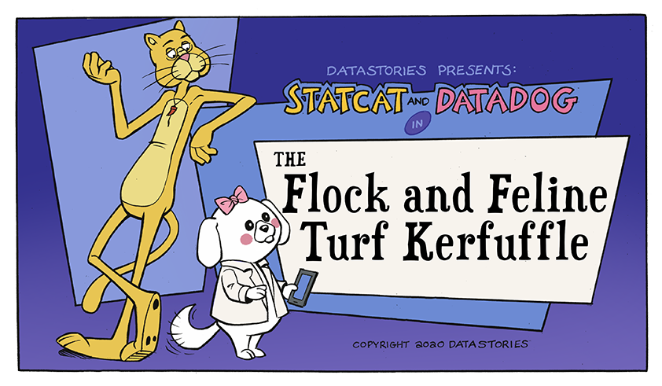
Notes:
One way we deliver visual storytelling is through sequential art. In 2019, I was awarded two UF seed grants to study story-driven approaches to data science education. We’ve developed three prototype DataStories, with a fourth one nearing completion. Each DataStory is unique, though StatCat and DataDog always appear in each.

Slide 12

Image Credit: https://www.everypixel.com/image-3919141663144620822
Notes:
Another way we deliver content is through case-studies. Clyde Herreid at the University of Buffalo is a pioneer in this area.

Slide 13

AI University Consortium
Notes:
We think our program would be a good fit for an Nvidia-led AI University Consortium. Our vision is the creation of a global community of AI educators committed to introducing non-technical students to the joys of AI. That vision is two-fold. First, we want to continuously offer Practicum AI workshops to students. Second, we want to create a world-class curriculum for teachers committed to the entry-level / intermediate AI audience. AAAI already has a small group of AI educators who host a mini-conference within the larger AAAI conference. This past February about 75 teachers attended, mostly from North America. We believe the Nvidia Tech centers could also be leveraged to reach out to local universities within their respective countries.
An AI University consortium will be a place where AI teachers and instructors from around the globe discuss AI pedagogy, submit innovative AI learning experiences to a shared repository, and gather at an annual conference to advance AI education research and understanding.

Slide 14





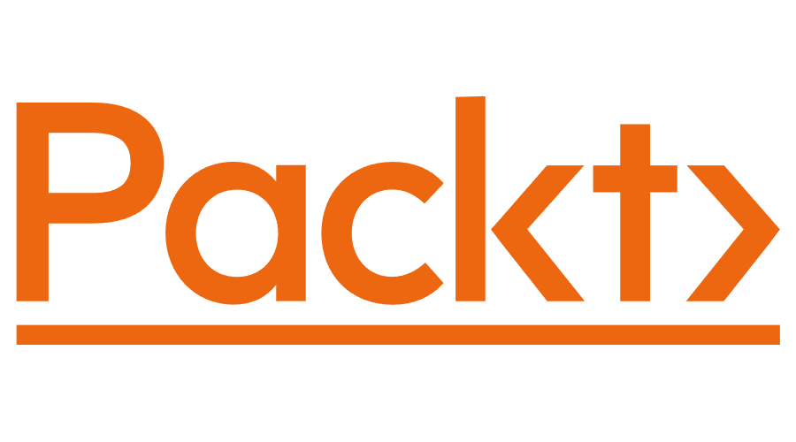

Notes:
Some key partners have already been identified and are pictured here.
Angus Fletcher : Project Narrative
Clyde Herreid : National Center for Case Study Teaching in Science
Josh Starmer : StatQuest
Christina Gardner-McCune : AI4K12
Jay Alammar

Slide 15

Notes:
At this point, we’d like to hear from you. Any questions or comments about our Practicum AI program?

Slide 17
FTE | Function
.5 | Designer / Website / Training Graphics
.5 | Python Auto-Grading & Jupyter Notebook Expert
.5 | Art Director / Artist
.5 | Assessment & Research Coordinator
.5 | Outreach / Marketing / Community Development
Notes:
Our immediate staffing needs are pictured here.

Slide 18
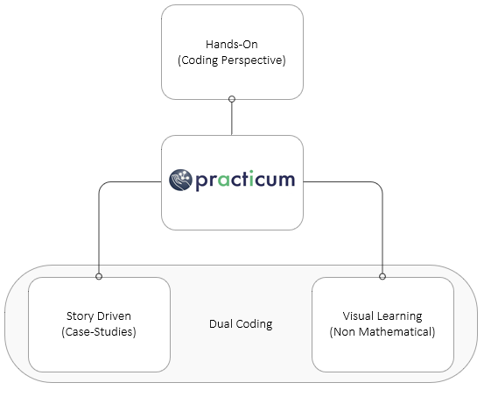
Notes:
Dual-Coding theory provides a solid, theoretical foundation for our approach to AI instruction.

Slide 19

Notes:
As noted in the previous slide, the sharing of ideas and curriculum will lie at the heart of the AI University consortium. To that end, the Practicum AI workshop modules are designed with reusability in mind. Modules can be plugged into existing classes. The basic idea is to build once, reuse again and again. Our hope is that these learning experiences will snap easily into AI classes aimed at non-technical audiences.
For many faculty, AI is still a new and somewhat mysterious field. We want to change that by giving them access to well-crafted and easily modified AI learning experiences. And as they develop confidence, our hope is that they will begin to craft new learning experiences to then be shared back to the community.

Slide 20
Our program is non-credit
Notes:
First off, our Practicum AI program is non-credit – designed to complement our partner’s various AI certificate offerings and for-credit classes. In other words, this program is not designed to replace what is currently offered in the traditional academic programs.

Slide 21
Learning Options
In-Person
Synchronous (Online)
Asynchronous (Online)
Adapted to a For-Credit Course
Notes:
Eventually, we plan to offer the Practicum AI program in a variety of ways.

