Slide 1

Getting Started…
Notes:
Hello and welcome to an overview of the Practicum AI workshop series. I’m Dan Maxwell and I’m an AI trainer in the Research Computing department.
Today’s learning experience will come in two parts. In the first part, I will briefly introduce the field of AI as well as our Practicum AI curriculum, specifically the badges we plan to offer. And then – in part two – we will consider AI from a data point-of-view.

Slide 2
Think about and creatively apply AI to make the world a better place
Notes:
So, let’s start with the big picture. The Practicum AI program is designed to help you think about and creatively apply AI to make the world a better place.
You might be surprised to learn that we view the AI opportunity as a creative challenge of the first order. Of course, you will participate in a considerable number of technical activities in this workshop series. But the more important question is, “What do you want to do? What problems or research questions interest you?” Once you answer that, everything else falls into place. The best learning happens when you have a clear goal in mind.
So, I encourage you to think of AI - not from a technical point-of-view - but as a new way of answering questions, delivering services, and solving problems.

Slide 3
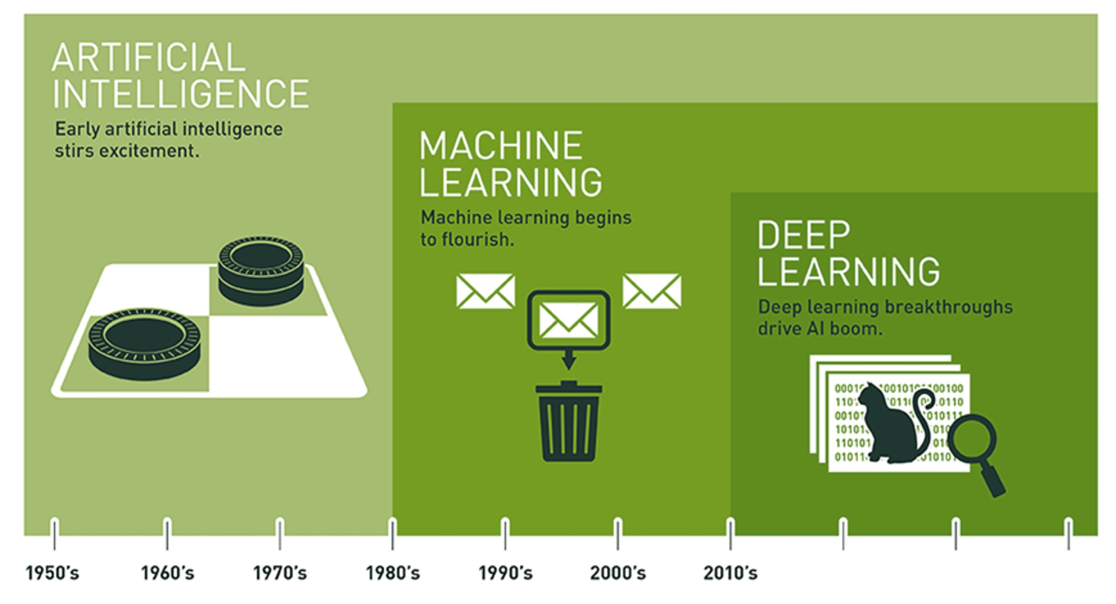
AI is Expansive
Notes:
The field of AI is expansive…
Often, the terms AI, Machine Learning, and Deep Learning are used interchangeably.
But as pictured here, they are distinct domains, with AI encompassing the other two. Indeed, AI has a long and distinguished history. In fact, a lot of interesting AI research happened in the 1950s.
Leading AI textbooks define the field of Artificial Intelligence as the study of "intelligent agents": any system that perceives its environment and takes actions that maximize its chance of achieving its goals. Such systems are capable of performing tasks humans are good at; for example, recognizing objects, making sense of speech, and decision making in a constrained environment.
Machine learning is defined as the subfield of AI that applies statistical methods to enable computer systems to learn from data to achieve an end goal.
And finally, deep learning is a subfield of machine learning which focuses on neural networks. A neural network is a special type of learning algorithm, inspired by billions of interconnected neurons in the human brain.
Let’s consider a couple definitions…

Slide 4
Machine learning is the field of study that gives computers the ability to learn without being explicitly programmed.
-- Arthur Samuel (1959)
Machine learning is the science and art of programming computers so they can learn from data.
Notes:
… and here’s a definition of machine learning coined by Arthur Samuel in 1959. This is concise and one of my personal favorites. However, I also like this second definition: Machine learning is the science (and art) of programming computers so they can learn from data.
Now, the key word in that second definition is data. In fact, deep learning is not possible without data. In the second half of today’s presentation, we will talk about the various types of data and the AI techniques used on them. But first, let’s dive into the details of our Practicum AI workshop program.

Slide 5
Unique Instructional Features
The Practicum AI curriculum is characterized by a visual, story-based approach to learning with abundant hands-on coding experiences
Notes:
Let’s start with a quick statement of the Practicum AI approach to learning.
The three elements highlighted in blue are distinguishing features of Practicum AI. First, AI content is presented in a visual way rather than mathematically. As they say, “A picture is worth a thousand words.” Or in this case, a thousand mathematical symbols. Second, narrative (or story-driven) forms of instruction are used, especially at the advanced levels where case-studies are prominently featured. And finally, abundant hands-on coding exercises develop student programming skills.
Dual-Coding theory supports visual / narrative learning formats
Four levels of hands-on coding. Level 1: student retypes example code. Level 2: student modifies and/or extends example code. Level 3: student writes code from scratch, given an algorithm. Level 4: student solves a problem by defining an algorithm and then writing the code to instantiate it.

Slide 6
Our target audience is…
Non-technical
Curious about A.I.
Committed to Tinker & Play learning
Notes:
Our target student audience is beginners who have little-to-no technical background. That is, our program will benefit those who are curious about AI but have little-to-no knowledge of the field. And lastly, the Practicum AI workshops are designed for those who take a tinker and play approach to learning. This final point is important as these workshops feature extensive hands-on coding exercises.
Again – this program is not designed for a highly technical audience. If you already have a strong technical background or multiple years of programming experience, we encourage you to take the advanced AI workshops offered by Nvidia’s Deep Learning Institute. Please contact us for details.

Slide 7

Notes:
Okay – let’s make the message of the last slide visual. If you are someone who can appreciate the ingenuity and resourcefulness of whoever created the contraption pictured here – and you want to do something similar with AI – then you’re the kind of student we’re looking for. We’re not seeking mathematical prodigies or technical whiz kids. However, we are looking for individuals who color outside the lines.
The anthropologist Levi Straus had a name for these kinds of people, calling them Bricoleurs. A bricoleur is a playful tinkerer who uses whatever is at hand to solve an immediate problem. A bricoleur enjoys mashing things up, taking ideas from one domain and using them in another. And most importantly, a bricoleur is not boxed in by disciplinary norms. Or, as we used to say on the farm, “I’m a jack of all trades, master of none.”
Is this you? If so, you should enjoy these learning experiences.

Slide 8
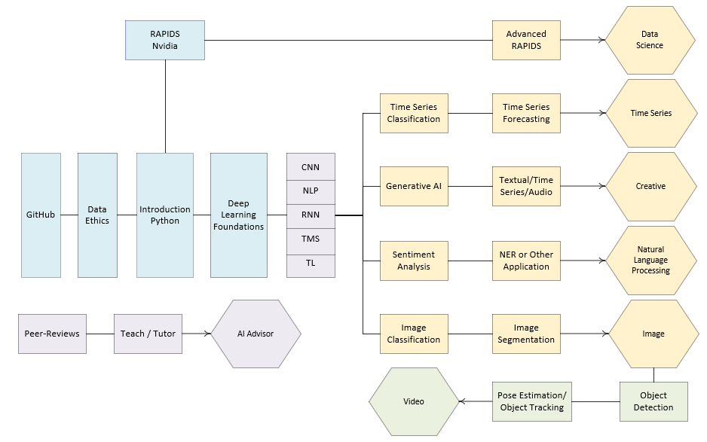
Notes:
… and this is an overview of the Practicum AI badge program. Blue boxes are foundational learning experiences. Purple is intermediate. Yellow is advanced and green is a specialty. The hexagons are badges students can earn, after completing the requisite workshops in the series.
The GitHub, Data Ethics, Introduction to Python, Deep Learning Foundations constitute the core sequence of the Practicum AI workshop program. Our plan this semester is to offer most of the workshops enclosed in the light grey box, including a some of the intermediate workshops – one for Convolutional Neural Networks, Natural Language Processing, Recurrent Neural Networks, Transformers, and Transfer Learning. The last two workshops – Transformers and Transfer Learning – are still in-development and may or may not be offered.
And a final note: the Practicum AI badging program, as presently conceived, is flexible and we envision additional badges being added over time. In fact, we recently received funding to create a series of workshops leading to a FAIR Data badge.

Slide 9
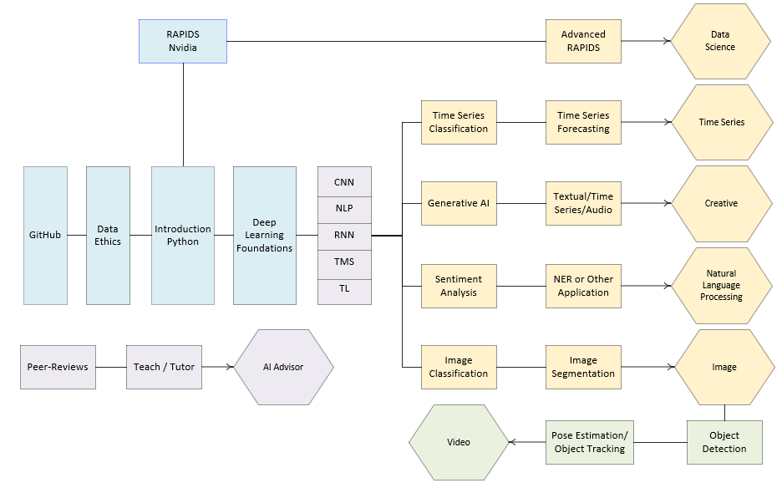
Visual + Story
Case-Study + Project
Notes:
In our introductory and intermediate workshops, learning is hands-on (lots of coding), visual, and story based. As pictured here, that shifts slightly in the advanced workshops which will feature real-world case-studies and project learning. In fact, we’d like to make projects the centerpiece of the badging process, used by students to demonstrate competency in that area.

Slide 10
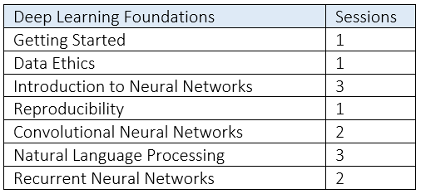
Notes:
… and here’s the list of workshops we plan to offer this semester.

Slide 11
Start with your Interests, not the Technology
Notes:
So, to summarize this section, we believe that your journey to AI mastery ought to start with your interests, not the technology. All too often, however, this gets turned around. We get caught up in technical details, without first having a clear idea of the questions to be answered or the problem at hand.
The Practicum AI badges allow you to create a custom learning path that supports your goals.
And that brings us to our first interactive exercise…

Slide 12

What do you want to do?
What do you currently know about AI?
What would you like to know about AI?
How do you plan to use AI?
Answer research questions
Create an AI-enabled service
Help others learn AI
Notes:
We have now arrived at our first hands-on activity. For the next 5 minutes, stop and ask yourself these questions. Grab a pen and a pad of paper or fire up your word processor and write out your responses.

Slide 13

Data is the New Oil
Notes:
Earlier, I mentioned that the focus of the second half of today’s workshop would be data. Now that we’ve introduced the Practicum AI curriculum, let’s put on a different colored lens and consider AI from the perspective of your data. In fact, the kind of data you have will determine the AI tools you’ll want to consider as you plan your AI learning journey.
For our entry-level and intermediate workshops, you do not need to provide your own data. But as you transition to our advanced workshops, you may want to conduct an AI project – in which case, this half of today’s presentation is important and worth your time.

Slide 14
Data is the New Oil
Notes:
In 2006, a British entrepreneur named Clive Humby coined the phrase “Data is the new oil.” Data powers A.I. systems, and it comes in a variety of formats. Thus, data is a logical starting point for thinking about AI. So, what kinds of data are you presently working with?

Slide 15
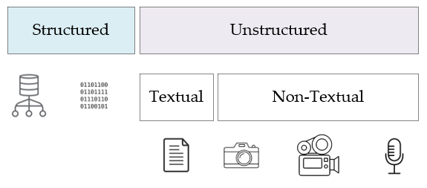
Notes:
In in his book, Data Architecture: A Primer for the Data Scientist, Bill Inman makes a distinction between two foundational types of data – between structured data and its unstructured counterpart. As he points out, most of the world’s data is unstructured. So, what’s the difference between the two?
Structured data is easy to search and organize because it is usually contained in rows and columns and its elements can be mapped into fixed, pre-defined fields. Structured data is of two types. The first type is data which comes from a database management system – Oracle, SQLServer, etc… The Epic healthcare system – used by UF Health – is a structured data source, though it also stores unstructured text data in the form of physician notes. The second is repetitive data, consisting of structured records coming from a variety of non-database sources. Some examples of repetitive data include sensor output, telephone call records, metered data, and so forth.
Unstructured data is data that cannot be contained in a row-column database and does not have an associated data model. Each record is unique in terms of its structure and content. Now there are two types of unstructured data – textual and non-textual. Examples of textual data include emails, transcribed conversations, literary texts, and so on. Non-textual data includes images, video, and audio recordings.

Slide 16
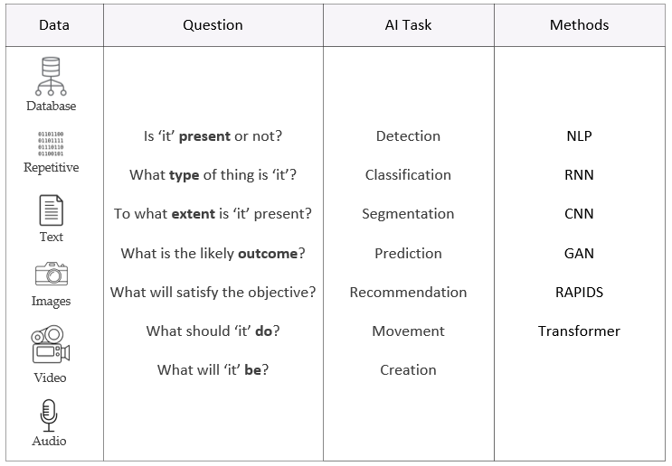
Notes:
With our primary data sources identified, let’s organize everything in a table. On the leftmost column, our data sources are listed, followed by a column of generic questions we might like to ask of our data, another column which lists the related AI task for each question, and finally a column of AI methods and technologies. This table, then, becomes a roadmap to guide your AI learning. The question and AI task columns are self-explanatory, but I’d like to take a few seconds to unpack the abbreviations in the Methods column. Don’t worry about the vocabulary at this point as these terms will be defined in our workshops. But let’s quickly run through the acronyms in the Methods column. NLP – Natural Language Processing; RNN – Recurrent Neural Network; CNN – Convolutional Neural Network; GAN – Generative Adversarial Network; RAPIDS – Nvidia’s data science framework; Transformer – A new kind of neural network.
We will now consider each data source, the types of questions one can ask of each, and the associated AI methods.

Slide 17
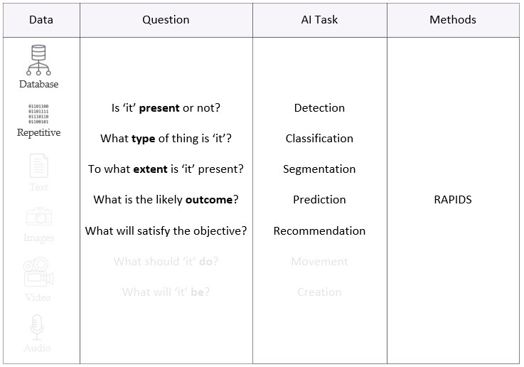
Notes:
In the case of structured data – data derived from databases or repetitive data from sensors – the Nvidia RAPIDS development environment is your best starting point. RAPIDS provides a set of useful libraries, with machine learning functions for almost any research task. The RAPIDS cuDF library, for example, is equivalent to the popular Pandas library which supports dataframes as well as basic data management and cleaning.

Slide 18
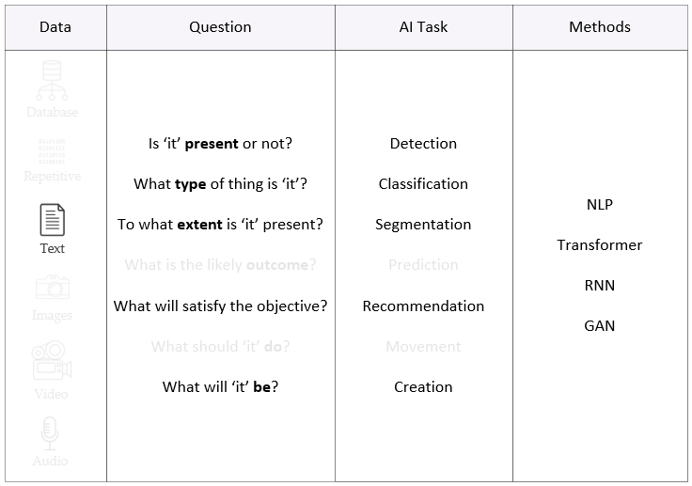
Google BERT
GPT
Notes:
With text data, transformers and recurrent neural networks are established deep learning technologies, appropriate for detection, classification, segmentation, recommendation, and creation tasks. These will solve most text problems, or at least get you started in the right direction. Generative Adversarial Networks or GANs are another choice. However, keep in mind that text generating GANs are a unique animal, different and distinct from GANs used to generate images.
Some specific model you might wish to consider are listed in blue.

Slide 19
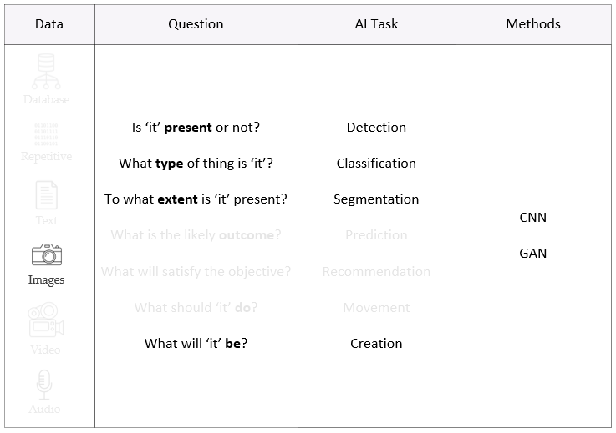
SSDs
YOLO
Faster-RCNN
EfficientDET
ResNet
Mask-RCNN
Unet
Notes:
Convolutional neural networks (CNNs) have been the bread and butter of the image world for some time now. In short, CNNs do it all. For image creation, GANs continue to be the tool of choice, typically constructed with CNN components. Another recent development has been the merging of transformers and GANs, with TransGAN being a prominent example.
Again, specific models you might wish to consider are listed in blue. I will not cover those right now. But my slides will be available as a .pdf.
For detection, consider single shot detection models (SSDs) or YOLO (real-time object detection). Faster-RCNN or EfficientDet are also options, depending on the computational resources available. Classification is a typical CNN task, with ResNet and its variants being popular. And finally – for segmentation tasks – Mask-RCNN or Unet ought to be considered.

Slide 20
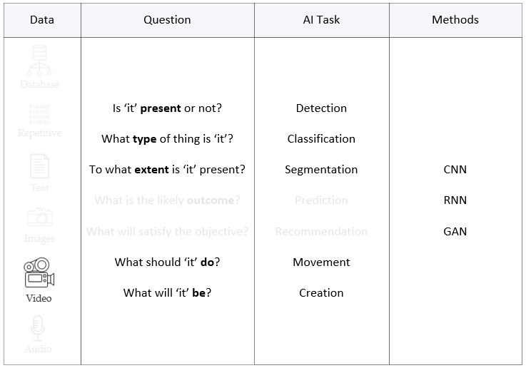
Notes:
Video data is unique, being a time series of images. As with image data, convolutional neural networks have captured most of this market, though CNNs are frequently paired with RNNs as there is both temporal and spatial characteristics in each image frame. With video, single and multi-object tracking is also possible. Interestingly, there are now video GANs, which basically build frame by frame what it thinks the video should look like. This is cutting-edge technology.

Slide 21
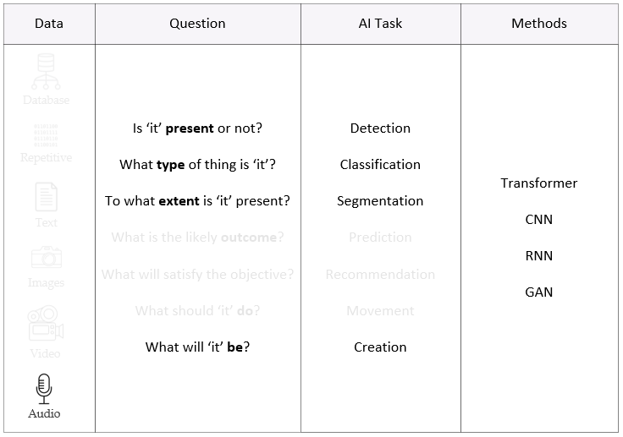
Notes:
Audio is another interesting format. Many audio methods are derived from a MEL spectrum representation, a 2D spectrogram of the recording. Like video, audio is also a time series. Transformers, CNNs, RNNs, and GANs can all be used with audio data. Now that we have covered the various types of data and their associated methods, it’s time to do something practical.

Slide 22

What does your data look like?
Structured Databases
Repetitive Sensors, Scientific Instruments
Textual Documents, Email, Web Content
Non-Textual Images, Video, Audio
Notes:
We have now arrived at our 2nd hands-on activity. For the next 5 minutes, I would like for you to describe the data you’re currently working with and possible AI methods to use on that data. Grab a pen and a pad of paper or fire up your word processor and write out a response.

Slide 23

Application Instructions
Notes:
If you would like to participate in the Practicum AI Workshop series, please fill out the Qualtrix form if you have not done so. Applicants who commit to the full sequence and are interested in becoming Practicum AI Advisors will be given preference.
Unfortunately, we have a limited number of seats – only 25 applicants in this initial cohort. As the Practicum AI program is still in beta, we’re looking for participants willing to provide candid feedback on the presentations and exercises.
Your evaluation is most important to us as we want to create a program which meets student needs.

Slide 24
Summary
Start with your interests, not the technology
Definitions of AI, Machine Learning, and Deep Learning
Practicum AI overview
Data is the new oil
Application
Notes:
Okay – let’s quickly summarize what we covered in today’s workshop.

Slide 25

Questions
Notes:
And finally, do we have any questions? For next week, you have a couple readings. And I hope you will take time to make an entry in your AI journal and join the conversation on the Discussion Board.

Slide 26
References
Inmon, W. H. (2019). Data architecture: A primer for the data scientist. Cambridge, MA: Academic Press
Wooldridge, M. (2021). A brief history of artificial intelligence: What it is, where we are, and where we are going. New York, NY: Flatiron Books.

