Slide 1

Getting Started…
Notes:
Hello and welcome to an overview of the Practicum AI workshop series. Discuss the program’s name..
Let’s get started with the overarching goal of this program…

Slide 2
Creatively reimagine your future in the light of AI
Notes:
In a nutshell, my hope is that you will… … once you complete this workshop series.
I view the AI opportunity as a creative challenge of the first order. Note: I did not say it was a technical challenge. Yes, you will participate in a considerable number of technical activities in this workshop series. But more importantly, the question is, “What do you want to do? What problems or research questions interest you?” Once you answer that, everything else falls into place. The best learning happens when you have a clear goal in mind.
So, I encourage you to think of AI - not from a technical point-of-view - but as a new way of answering questions, delivering services, and solving problems.

Slide 3
Start with your Interests, Not the Technology
Notes:
Unlike most technical learning experiences, our starting point is your interests, not the technology.
All too often, this gets turned around. We start with the technology, without first having a clear idea of the research questions to be answered. I first noticed this phenomenon when I worked at Rockwell in the 1990s. At Rockwell, the technology came first, everything else was secondary. We all believed that object-oriented programming would revolutionize the world, that the emerging internet and related technologies would usher in an age of never-ending profits. For Rockwell, that never happened. We should have started with our customers instead.
But research alone is not enough, we also need something a bit more concrete. Let’s start with some basic definitions…

Slide 4
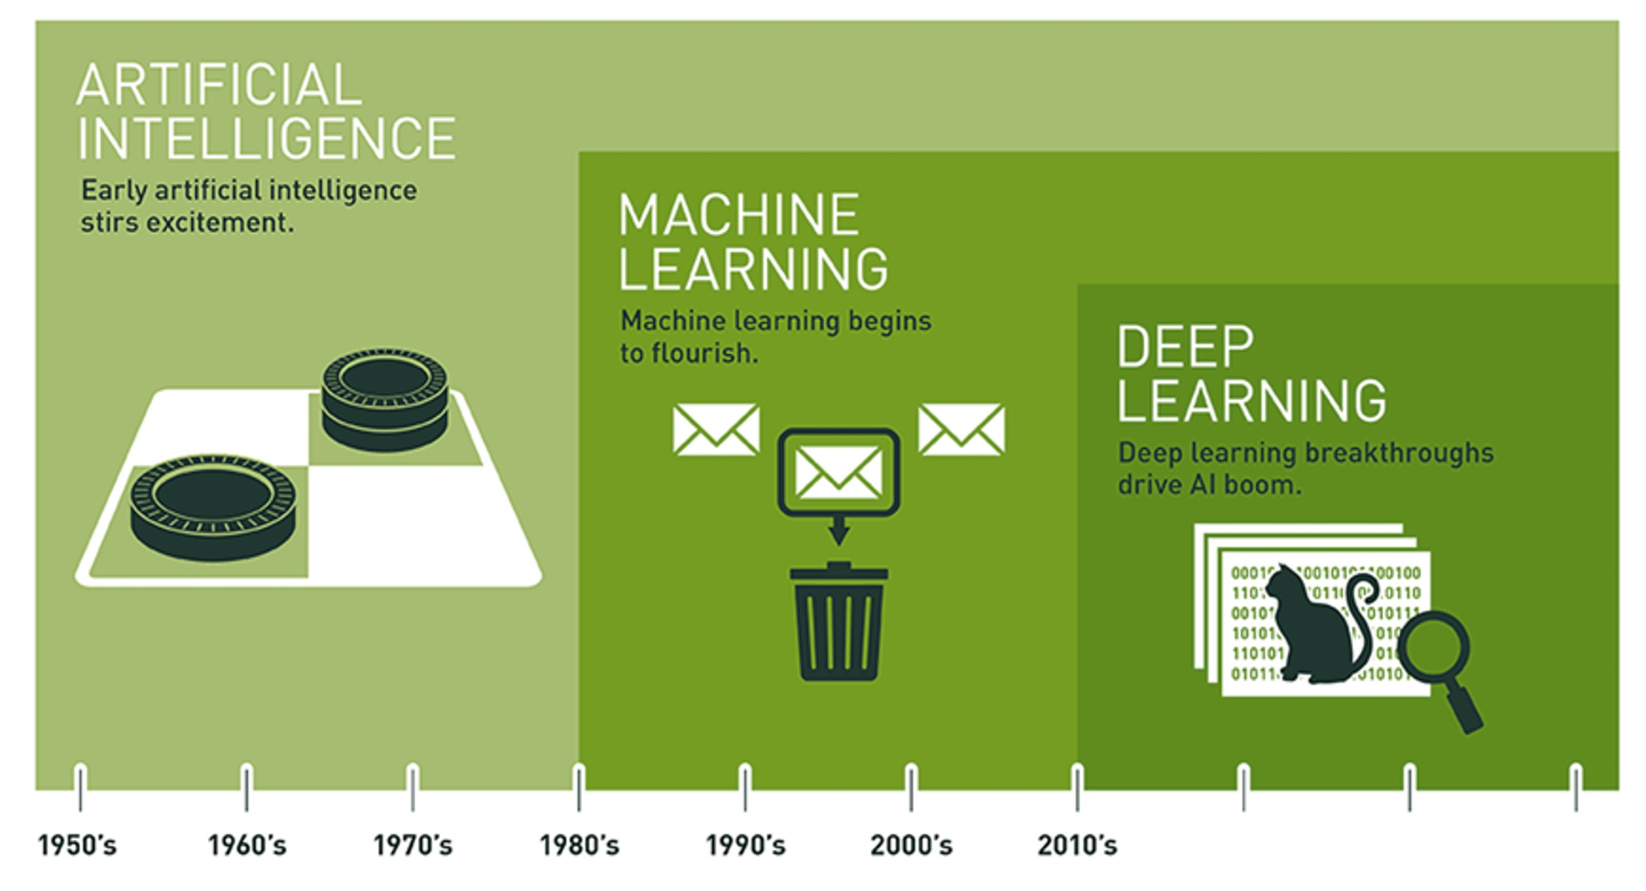
AI is Expansive
Notes:
Often, I hear individuals use the terms AI, Machine Learning, and Deep Learning interchangeably.
But as pictured here, they are distinct domains, with AI encompassing the other two. Interestingly, AI has a long and distinguished history. In fact, a lot of interesting AI research happened in the 1950s. You can learn about that early work in chapter 2 of our textbook.
Artificial intelligence (AI) is the overarching discipline that concerns itself with the development of computer systems capable of performing tasks that humans are good at; for example, recognizing objects, making sense of speech, and decision making in a constrained environment.
Machine learning is defined as the field of AI that applies statistical methods to enable computer systems to learn from data to achieve an end goal.
Deep learning is a field of machine learning which focuses on neural networks. A neural network is a special type of learning algorithm, inspired by billions of interconnected neurons in the human brain.
In the past, AI has experienced multiple “winters.” The early 1990’s was one such period where funding dried up and interest waned. Whether the individual who created this graphic intended it or not, the period under the garbage can is one of those slumps. The problem is one of over-promising and under-delivering.

Slide 5
Machine learning is the field of study that gives computers the ability to learn without being explicitly programmed.
-- Arthur Samuel (1959)
Machine learning is the science and art of programming computers so they can learn from data.
Notes:
… and here’s a definition of machine learning coined by Arthur Samuel in 1959. This is concise and one of my personal favorites. However, I also like this second definition: Machine learning is the science (and art) of programming computers so they can learn from data.
Now, the key word in that second definition is data. In fact, deep learning is not possible without data. The age of big data is upon us…

Slide 6
Practicum AI Overview
Content is Entry-Level to Intermediate
Visual (Not Formulas)
Step-Wise Learning
Applied Artificial Intelligence
Notes:
Visual – use example of Calculus chain-rule and StatQuest video.
Four levels of step-wise learning. Level 1: student retypes example code. Level 2: student modifies and/or extends example code. Level 3: student writes code from scratch, given an algorithm. Level 4: student solves a problem by defining an algorithm and then writing the code to instantiate it.

Slide 7
Practicum AI Participants are…
Non-technical
Curious about A.I.
Comfortable with Hands-On Learning
Problem Solvers
Notes:
So, what kind of student will excel in the Practicum AI program? Is this you?

Slide 8
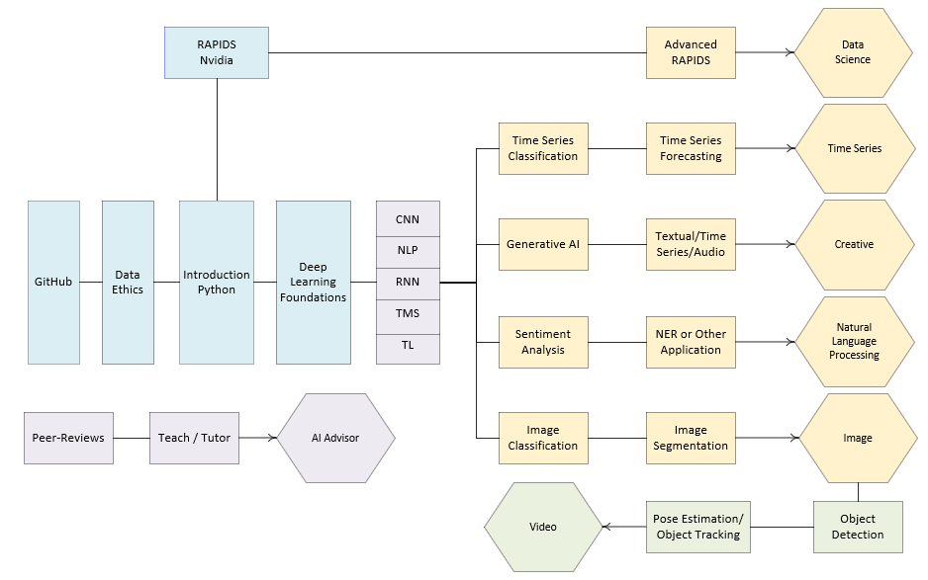
Notes:
… and this is an overview of the Practicum AI badge program. Blue boxes are foundational learning experiences. Yellow are intermediate, and green is advanced. As pictured here, students seeking the Video badge will first have to achieve the Image badge. The Introduction to Python, RAPIDS, Data Ethics, Deep Learning Foundations, and Research Roadmap workshops are available now or close to being finished, with rollouts planned later this year. The badging program, as presently conceived, is flexible and we envision additional badges being added over time. In fact, we have already submitted a funding proposal to create a series of workshops leading to a FAIR Data badge.

Slide 9
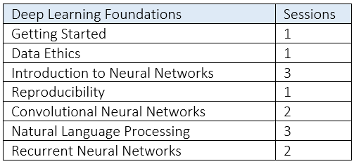

Slide 10

What do you want to do?
What do you currently know about AI?
What would you like to know about AI?
How do you plan to use AI?
Answer research questions
Create an AI-enabled service
Help others learn AI
Notes:
We have now arrived at our first hands-on activity. For the next 10 minutes, I would like for you to stop and ask yourself these questions. Grab a pen and a pad of paper or fire up your word processor and write out a response.

Slide 11
Data is the New Oil
Notes:
In 2006, a British entrepreneur named Clive Humby coined the phrase “Data is the new oil.” Data powers A.I. systems, and it comes in a variety of formats. Thus, data is a logical starting point for thinking about integrating AI into your research program. What kinds of data are you presently working with? Let’s take a look at some different types of data.

Slide 12
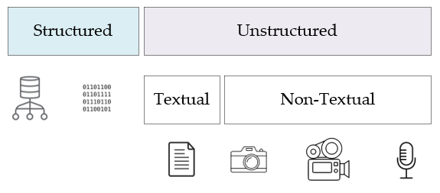
Notes:
In in his book, Data Architecture: A Primer for the Data Scientist, Bill Inman makes a distinction between two foundational types of data – between structured data and its unstructured counterpart. As he points out, most of the world’s data is unstructured. So, what’s the difference between the two?
Structured data is easy to search and organize because it is usually contained in rows and columns and its elements can be mapped into fixed, pre-defined fields. Structured data is of two types. The first type is data which comes from a database management system of some sort – Oracle, SQLServer, etc… The Epic healthcare system – used by UF Health – is a structured data source, though it also stores unstructured text data in the form of physician notes. The second is repetitive data, consisting of structured records coming from a variety of non-database sources. Some examples of repetitive data include sensor output, telephone call records, metered data, and so forth.
Unstructured data is data that cannot be contained in a row-column database and does not have an associated data model. Each record is unique in terms of its structure and content. Now there are two types of unstructured data – textual and non-textual. Examples of textual data include emails, transcribed conversations, literary texts, and so on. Non-textual data includes images, video, and audio recordings.

Slide 13
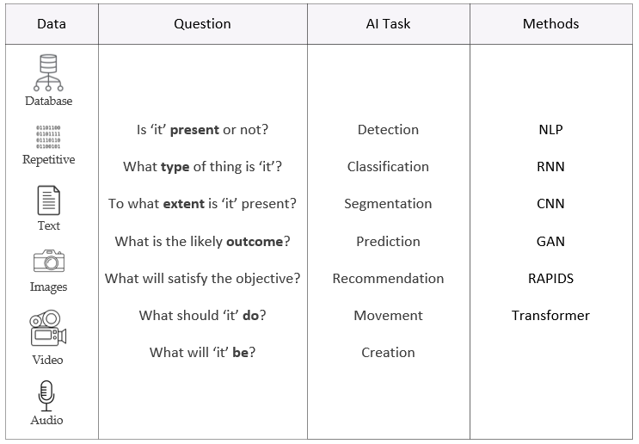
Notes:
With our primary data sources identified, let’s organize everything in a table. On the leftmost column, our data sources are listed, followed by a column of generic questions we might like to ask of our data, another column which lists the related AI task for each question, and finally a column of AI research methods and technologies. This table, then, becomes a roadmap to guide your investigation of AI technologies appropriate for your research program. The question and AI task columns are self-explanatory, but I’d like to take a few minutes to unpack the abbreviations in the Methods column. Don’t worry about the vocabulary at this point as we will define these terms later.
Let’s now consider each data source, the types of questions one can ask of each, and the associated AI methods.

Slide 14
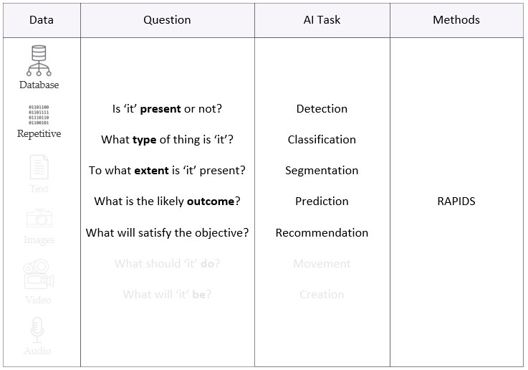
Notes:
In the case of structured data – data derived from databases or repetitive data from sensors – the Nvidia RAPIDS development environment is your best starting point. RAPIDS provides a set of useful libraries, with machine learning functions for almost any research task. The RAPIDS cuDF library, for example, is equivalent to the popular Pandas library which provides support for dataframes and basic data management and cleaning.

Slide 15
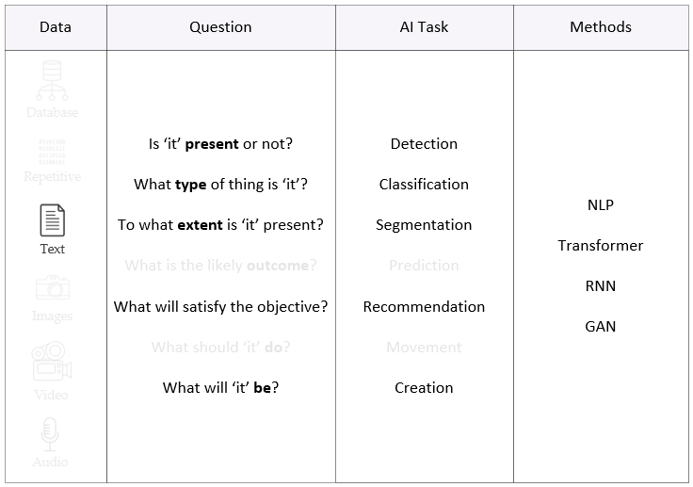
Google BERT
GPT
Notes:
With text data, transformers and recurrent neural networks are established deep learning technologies, appropriate for detection, classification, segmentation, recommendation, and creation tasks. These will solve 99% of text problems, or at least get you started in the right direction.
Some specific models you might want to consider are listed in green. Google’s BERT is a solid choice for these kinds of tasks – a transformer that acts in the encoder phase. For creation tasks, a good choice is GPT, a transformer that focuses on the decoder phase. And of course, Generative Adversarial Networks or GANs are another choice. Keep in mind, however, that text generating GANs are a unique animal, different and distinct from GANs used to generate images.

Slide 16
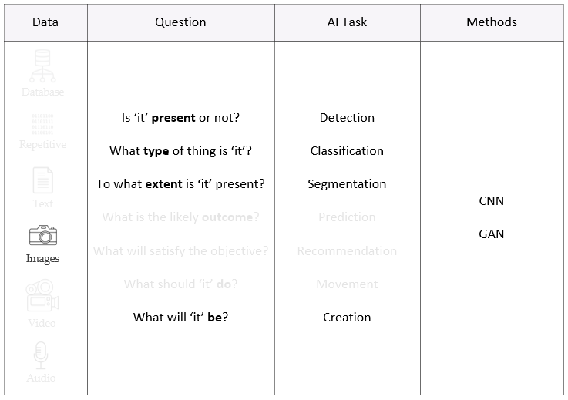
SSDs
YOLO
Faster-RCNN
EfficientDET
ResNet
Mask-RCNN
Unet
Notes:
Convolutional neural networks (CNNs) have been the bread and butter of the image world for some time now. In short, CNNs do it all. Specific models you might wish to consider are listed in green. For detection, consider single shot detection models (SSDs) or YOLO (real-time object detection). Faster-RCNN or EfficientDet are also options, depending on the computational resources available.
Classification is a typical CNN task, with ResNet and its variants being popular. And finally – for segmentation tasks – Mask-RCNN or Unet ought to be considered. More recently, the image research community has begun to embrace transformers, now that their performance is as good as or better than CNNs.
For image creation, GANs continue to be the research tool of choice, typically constructed with CNN components. Another recent development has been the merging of transformers and GANs, with TransGAN being a prominent example.

Slide 17
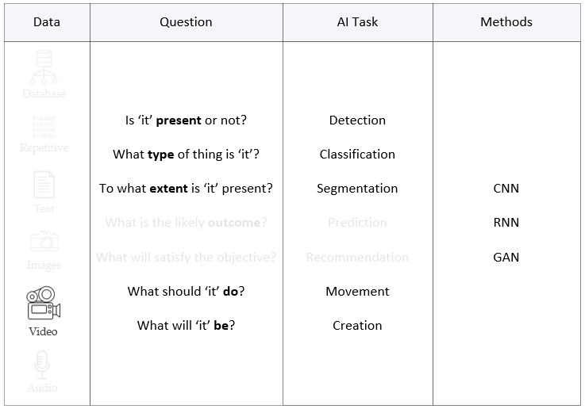
Notes:
Video data is unique, being a time series of images. As with image data, convolutional neural networks have captured most of this market, though CNNs are frequently paired with RNNs as there is both temporal and spatial characteristics in each image frame. With video, single and multi-object tracking is also possible. Interestingly, there are now video GANs, which basically build frame by frame what it thinks the video should look like. This is cutting-edge technology.

Slide 18
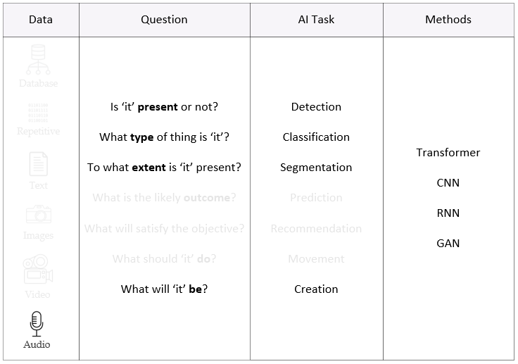
Notes:
Audio is another interesting format. Many audio methods are derived from a MEL spectrum representation, a 2D spectrogram of the recording. Like video, audio is also a time series. Transformers, CNNs, RNNs, and GANs can all be used with audio data. Now that we have covered the various types of data and their associated methods, it’s time to do something practical.

Slide 19
What does your data look like?
Structured Databases
Repetitive Sensors, Scientific Instruments
Textual Documents, Email, Web Content
Non-Textual Images, Video, Audio
Notes:
We have now arrived at our 2nd hands-on activity. For the next 5 minutes, I would like for you to describe the data you’re currently working with and possible AI methods to use on that data. Grab a pen and a pad of paper or fire up your word processor and write out a response.

Slide 20

Application Instructions
Notes:
If you would like to participate in the Practicum AI Workshop series, please send your completed learning plan to us. Applicants who commit to the full sequence and are interested in becoming Practicum AI Advisors will be given preference. We have a limited number of seats – only 25 applicants in this initial cohort. As the Practicum AI program is still in beta, we will be asking you for your candid feedback on the presentations and exercises. Your evaluation is most important to us as we want to create a program which meets student needs.

Slide 21
Summary
Start with your interests, not the technology
Definitions of AI, Machine Learning, and Deep Learning
Practicum AI overview
Data is the new oil
Learning Plan
Notes:
Okay – let’s quickly summarize what we covered in today’s workshop.

Slide 22

Questions
Notes:
And finally, do we have any questions? For next week, you have a couple readings. And I hope you will take time to make an entry in your AI journal and join the conversation on the Discussion Board.

Slide 23
References
Inmon, W. H. (2019). Data architecture: A primer for the data scientist. Cambridge, MA: Academic Press
Wooldridge, M. (2021). A brief history of artificial intelligence: What it is, where we are, and where we are going. New York, NY: Flatiron Books.

