Slide 1
What is AI?
AI Systems
Notes:
Hello and welcome to: “Frontiers of AI: AI Systems”

Slide 2
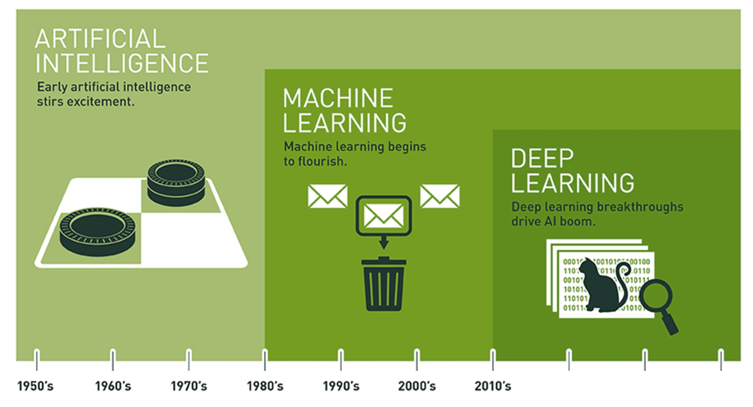
Notes:
As noted in an earlier presentation, AI, Machine Learning, and Deep Learning are distinct domains, with AI encompassing the other two. Interestingly, AI has a long and distinguished history. In fact, a lot of interesting AI research happened in the 1950s.
Artificial intelligence (AI) is the overarching discipline that concerns itself with the development of computer systems capable of performing tasks that humans are good at; for example, recognizing objects, making sense of speech, and decision making in a constrained environment.
Machine learning is defined as the field of AI that applies statistical methods to enable computer systems to learn from data to achieve an end goal.
Deep learning is a field of machine learning which focuses on neural networks. A neural network is a special type of learning algorithm, inspired by billions of interconnected neurons in the human brain.

Slide 3
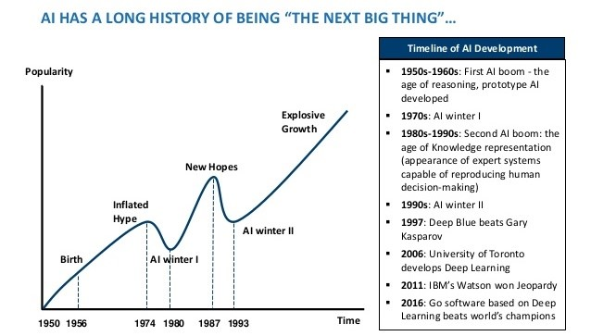
Notes:
In the past, AI has experienced multiple “winters.” The early 1980s and 1990s were two such periods where funding dried up and interest waned. Whether the individual who created this graphic intended it or not, the period under the garbage can is one of those slumps. The problem is one of over-promising and under-delivering. But here are some key points to keep in mind
AI researchers have been making steady progress since the 1950s.
AI is seductive.
AI winters were mostly about over-hyped commercial and government interest and expectations.
AI winters weren't really about failures of AI. AI technologies, including many “failures” are relevant and widely useful today.

Slide 4
Machine learning is the field of study that gives computers the ability to learn without being explicitly programmed.
-- Arthur Samuel (1959)
Machine learning is the science and art of programming computers so they can learn from data.
Notes:
Before we get to the heart of today’s presentation, let’s review a couple definitions of machine learning. I especially like the first definition, coined by Arthur Samuel in 1959. This one is concise and one of my personal favorites. However, I also like this second definition: Machine learning is the science (and art) of programming computers so they can learn from data.
Now, the key word in that second definition is data. In fact, deep learning is not possible without data. The age of big data is upon us…

Slide 5
Notes:
Here are the steps one usually takes in a typical machine learning project. Note that the entire process is completely dependent on “Lots” of data. This truth can be stated simply as, “No data. No machine learning.”

Slide 6
https://teachablemachine.withgoogle.com/
Notes:
15 minutes: students develop a model with teachable machine.

Slide 7

Semi-Supervised
Unsupervised
Reinforcement
Supervised
Notes:
Now that you’ve trained a model using Google’s Teachable Machine, I want to introduce you to the different kinds of A.I. learning systems. There are four principal types of machine learning (supervised, semi-supervised, unsupervised, and reinforcement). Imagine these as four paint cans, with each taking a distinctive approach (color) to machine learning.

Slide 8



Supervised Learning is Task Driven (Predict next value)
Unsupervised Learning is Data Driven (Identify Clusters)
Reinforcement Learning is Experience Driven (Learn from Mistakes)
Notes:
To get us started, consider these high-level definitions. Semi-supervised learning, of course, lies in-between supervised and unsupervised learning.
Let’s dive into the details…

Slide 9
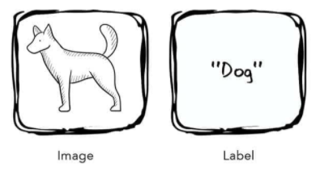
Supervised Learning
Notes:
The first kind of learning is supervised learning. Supervised learning are algorithms which work with data that is labelled (annotated). In this example, we present the algorithm with the image of a dog and its label. The label is the correct answer. And through the process of training, the system uses these labels to assess its predictions, correcting and then adjusting itself as it does so. Eventually, the algorithm is fully trained and should make accurate predictions.
Here’s a concrete example…

Slide 10
Supervised Learning
Figure 1-1. A labeled training set for spam classification.
Notes:
… consider a spam filter. Classification is a typical supervised learning task, and a spam filter is a good example of this. It is first trained with many example emails along with their class (spam or ham), and it must learn how to classify new emails.

Slide 11
Supervised Learning
Figure 1-2. A regression problem: predict a value, given an input feature.
Notes:
Another typical supervised learning task is to predict a target numeric value, such as the price of a car, given a set of features (mileage, age, brand, etc.) called predictors. This sort of task is called regression. To train the system, you need to give it many examples of cars, including both their predictors and their labels (i.e., their prices).
In Machine Learning an attribute is a data type (e.g., “mileage”), while a feature has several meanings, depending on the context, but generally means an attribute plus its value (e.g., “mileage = 15,000”). Many people use the words attribute and feature interchangeably. Feature is used predominantly in the AI literature.
Some other examples of supervised learning algorithms include:
• Linear Regression
• Logistic Regression
• Support Vector Machines (SVMs)
• Decision Trees and Random Forests
• Neural networks

Slide 12
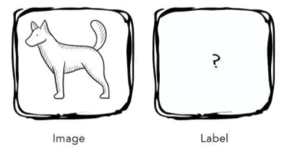
Unsupervised Learning
Notes:
The second kind of learning is unsupervised learning. Unsupervised learning is an algorithm which discovers hidden patterns in a dataset that is not labelled (annotated). In other words, the algorithm is presented with a set of inputs but no correct answers or desired outputs – it must discover the structure and patterns in the data on its own. Consider, for example, the following dataset.

Slide 13
Unsupervised Learning
Notes:
Here we see an unlabeled training dataset of visitors to a popular blog. In this case, we might want to run a clustering algorithm to try and detect groups of similar visitors. Through visual inspection, we can quickly identify at least four groups. But will the AI algorithm be able to mimic this capability?

Slide 14
Unsupervised Learning
Notes:
… it appears that a clustering algorithm has in fact detected those four groups, separated by the dashed lines. At no point did we tell the algorithm which group a visitor belongs to: it finds those connections without our help. For example, it might find that 40% of the blog’s visitors are males who love comic books and generally read the blog in the evening, while 20% are young sci-fi lovers who visit during the weekend. Let’s consider another example…

Slide 15
Unsupervised Learning
Figure 1-6. Data visualization.
Notes:
Visualization algorithms are also good examples of unsupervised learning algorithms: you feed them a lot of complex and unlabeled data, and they output a 2D or 3D representation of your data that can easily be plotted. These algorithms try to preserve as much structure as they can so you can understand how the data is organized.
Some other examples of unsupervised learning algorithms include:
• Clustering
• Anomaly detection and novelty detection
• Visualization and dimensionality reduction
• Association rule learning

Slide 16
Semi-Supervised Learning
Notes:
Semi-supervised learning is a mixture of the previous two learning types, which means it is fed a combination of labeled and unlabeled inputs. In this image, we see two classes with labeled examples indicated by the green triangles and light-yellow boxes. The proximity of the unlabeled examples to their labeled counterparts allows the algorithm to divide the data set into two groups, thereby inferring group membership of any new data points.
Often, you will not have the resources to label every item in a dataset. And so semi-supervised learning provides a middle way forward, between supervised and unsupervised learning. Here you only need to label a sub-set of instances while still gaining all of the advantages of a trained model.

Slide 17
Reinforcement Learning
Notes:
Reinforcement Learning is a very different beast. The learning system, called an agent in this context, observes the environment, selects and performs actions, and is then rewarded or penalized for each action. On its own, the agent must discover the best strategy, called a policy, to get the most reward over time. A policy defines what action the agent should choose when it is in a particular situation.
For example, many robots implement Reinforcement Learning algorithms to learn how to walk. DeepMind’s AlphaGo program is also a good example of Reinforcement Learning: it made the headlines in May 2017 when it beat the world champion at the game of Go. It learned its winning policy by analyzing millions of games, and then playing many games against itself.

Slide 18
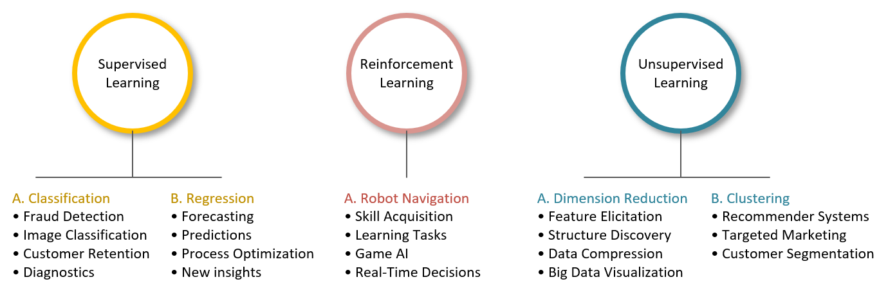
Applications – Practicum Intro
Notes:
… and finally, this image summarizes some of the primary ways in which AI is being used today. I present these applications because background knowledge is key to helping you imagine AI possibilities in your domain. And it’s the reason why I asked Jim Cusick to provide additional bibliographic support. Of course, the challenge is to take an application in another area and then modify it, so it works in yours. I believe this is where a lot of innovation is going to happen in the near future.

Slide 19
Summary
Notes:
Okay – let’s quickly summarize what we covered in today’s workshop.

Slide 20
References
Geron, A. (2019). Hands-on machine learning with Scikit-Learn, Keras
& Tensorflow (2nd ed.). Sebastopol, CA: O’Reilly Media, Inc.

