Slide 1

AI Systems

Slide 2
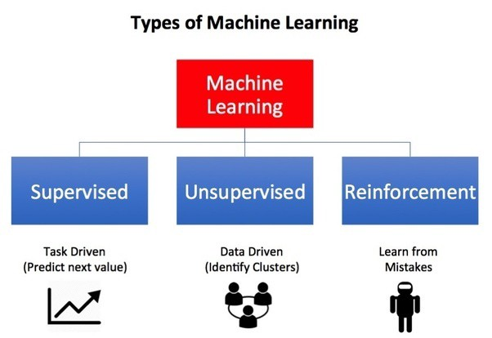
Semi-Supervised
Image Credit: https://towardsdatascience.com/what-are-the-types-of-machine-learning-e2b9e5d1756f
Notes:
Now that you’ve trained a model using Google’s Teachable Machine, I want to introduce you to the different kinds of A.I. learning systems. There are three principal types of machine learning systems (supervised, unsupervised, and reinforcement). Additionally, semi-supervised learning systems are hybrids, being partially supervised.
Additionally, some authors add semi-supervised learning systems to this list, and we will briefly introduce those kinds of systems later in this presentation.
Supervised Learning is Task Driven (Predict next value)
Unsupervised Learning is Data Driven (Identify Clusters)
Reinforcement Learning is Experience Driven (Learn from Mistakes)
Semi-Supervised Learning
Let’s dive into the details…

Slide 3
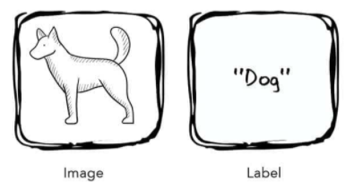
Supervised Learning
Source: Taylor, M. (2017). Neural Networks: A Visual Introduction for Beginners. Sebastopol, CA: Blue Windmill Media.
Notes:
The first kind of learning is supervised learning. Supervised learning are algorithms which work with data that is labelled (annotated). In this example, we present the algorithm with the image of a dog and its label. The label is the correct answer. And through the process of training, the system uses these labels to assess its predictions, correcting and then adjusting itself as it does so. Eventually, the algorithm is fully trained and should make accurate predictions.
Here’s a concrete example…

Slide 4
Supervised Learning
Figure 1-1. A labeled training set for spam classification.
Source: Geron, A. (2019). Hands-On Machine Learning w/Scikit-Learn, Keras & Tensorflow . Sebastopol, CA: O'Reilly Media, Inc. (Chapter 1)
Notes:
… consider a spam filter. Classification is a typical supervised learning task, and a spam filter is a good example of this. It is first trained with many example emails along with their class (spam or ham), and it must learn how to classify new emails.

Slide 5
Supervised Learning
Figure 1-2. A regression problem: predict a value, given an input feature.
Source: Geron, A. (2019). Hands-On Machine Learning w/Scikit-Learn, Keras & Tensorflow . Sebastopol, CA: O'Reilly Media, Inc. (Chapter 1)
Notes:
Another typical supervised learning task is to predict a target numeric value, such as the price of a car, given a set of features (mileage, age, brand, etc.) called predictors. This sort of task is called regression. To train the system, you need to give it many examples of cars, including both their predictors and their labels (i.e., their prices).
In Machine Learning an attribute is a data type (e.g., “mileage”), while a feature has several meanings, depending on the context, but generally means an attribute plus its value (e.g., “mileage = 15,000”). Many people use the words attribute and feature interchangeably. Feature is used predominantly in the AI literature.
Some other examples of supervised learning algorithms include:
• Linear Regression
• Logistic Regression
• Support Vector Machines (SVMs)
• Decision Trees and Random Forests
• Neural networks

Slide 6
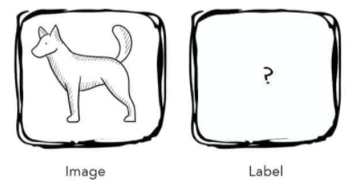
Unsupervised Learning
Source: Taylor, M. (2017). Neural Networks: A Visual Introduction for Beginners. Sebastopol, CA: Blue Windmill Media.
Notes:
The second kind of learning is unsupervised learning. Unsupervised learning is an algorithm which discovers hidden patterns in a dataset that is not labelled (annotated). In other words, the algorithm is presented with a set of inputs but no correct answers or desired outputs – it must discover the structure and patterns in the data on its own. Consider, for example, the following dataset.

Slide 7
Unsupervised Learning
Source: Geron, A. (2019). Hands-On Machine Learning w/Scikit-Learn, Keras & Tensorflow . Sebastopol, CA: O'Reilly Media, Inc. (Chapter 1)
Notes:
Here we see an unlabeled training dataset of visitors to a popular blog. In this case, we might want to run a clustering algorithm to try and detect groups of similar visitors. Through visual inspection, we can quickly identify at least four groups. But will the AI algorithm be able to mimic this capability?

Slide 8
Unsupervised Learning
Source: Geron, A. (2019). Hands-On Machine Learning w/Scikit-Learn, Keras & Tensorflow . Sebastopol, CA: O'Reilly Media, Inc. (Chapter 1)
Notes:
… it appears that a clustering algorithm has in fact detected those four groups, separated by the dashed lines. At no point did we tell the algorithm which group a visitor belongs to: it finds those connections without our help. For example, it might find that 40% of the blog’s visitors are males who love comic books and generally read the blog in the evening, while 20% are young sci-fi lovers who visit during the weekend. Let’s consider another example…

Slide 9
Unsupervised Learning
Figure 1-6. Data visualization.
Source: Geron, A. (2019). Hands-On Machine Learning w/Scikit-Learn, Keras & Tensorflow . Sebastopol, CA: O'Reilly Media, Inc. (Chapter 1)
Notes:
Visualization algorithms are also good examples of unsupervised learning algorithms: you feed them a lot of complex and unlabeled data, and they output a 2D or 3D representation of your data that can easily be plotted. These algorithms try to preserve as much structure as they can so you can understand how the data is organized.
Some other examples of unsupervised learning algorithms include:
• Clustering
• Anomaly detection and novelty detection
• Visualization and dimensionality reduction
• Association rule learning

Slide 10
Semi-Supervised Learning
Source: Geron, A. (2019). Hands-On Machine Learning w/Scikit-Learn, Keras & Tensorflow . Sebastopol, CA: O'Reilly Media, Inc. (Chapter 1)
Notes:
Semi-supervised learning is a mixture of the previous two learning types, which means it is fed a combination of labeled and unlabeled inputs. In this image, we see two classes with labeled examples indicated by the green triangles and light-yellow boxes. The proximity of the unlabeled examples to their labeled counterparts allows the algorithm to divide the data set into two groups, thereby inferring group membership of any new data points.
Often, you will not have the resources to label every item in a dataset. And so semi-supervised learning provides a middle way forward, between supervised and unsupervised learning. Here you only need to label a sub-set of instances while still gaining all of the advantages of a trained model.

Slide 11
Reinforcement Learning
Source: Geron, A. (2019). Hands-On Machine Learning w/Scikit-Learn, Keras & Tensorflow . Sebastopol, CA: O'Reilly Media, Inc. (Chapter 1)
Notes:
Reinforcement Learning is a very different beast. The learning system, called an agent in this context, observes the environment, selects and performs actions, and is then rewarded or penalized for each action. On its own, the agent must discover the best strategy, called a policy, to get the most reward over time. A policy defines what action the agent should choose when it is in a particular situation.
For example, many robots implement Reinforcement Learning algorithms to learn how to walk. DeepMind’s AlphaGo program is also a good example of Reinforcement Learning: it made the headlines in May 2017 when it beat the world champion at the game of Go. It learned its winning policy by analyzing millions of games, and then playing many games against itself.

Slide 12
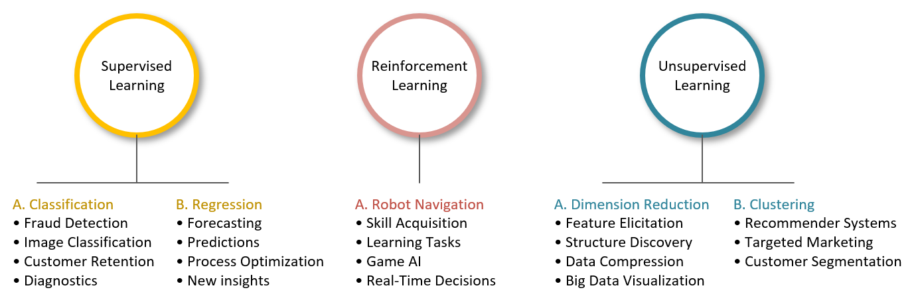
Applications
Notes:
… and finally, this image summarizes some of the primary ways in which AI is being used today. I present these applications because background knowledge is key to helping you imagine AI possibilities in your domain. And it’s the reason why I asked Jim Cusick to provide additional bibliographic support. Of course, the challenge is to take an application in another area and then modify it, so it works in yours. I believe this is where a lot of innovation is going to happen in the near future.

Slide 14
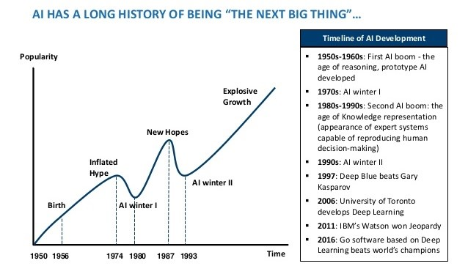
Image Credit: https://www.mdpi.com/2079-9292/10/4/514/htm
Notes:
In the past, AI has experienced multiple “winters.” The early 1980s and 1990s were two such periods where funding dried up and interest waned. Whether the individual who created this graphic intended it or not, the period under the garbage can is one of those slumps. The problem is one of over-promising and under-delivering. But here are some key points to keep in mind
AI researchers have been making steady progress since the 1950s.
AI is seductive.
AI winters were mostly about over-hyped commercial and government interest and expectations.
AI winters weren't really about failures of AI. AI technologies, including many “failures” are relevant and widely useful today.
https://www.mdpi.com/2079-9292/10/4/514/htm

Slide 15
Notes:
Here are the steps one usually takes in a typical machine learning project. Note that the entire process is completely dependent on “Lots” of data. This truth can be stated simply as, “No data. No machine learning.”

