Slide 1

What is AI – Part I
Notes:
Hello and welcome to our class (Frontiers of AI). So, let’s start with Course goals…

Slide 2
Course Goals
What is artificial intelligence? (What is it not?)
What are the main approaches to AI and how do they work?
How is AI applied to real-world problems?
How are AI systems evaluated?
How can we ensure that AI systems are fair and equitable?
Equip you to think about how AI might be applied in your own areas of interest!

Slide 3
What is Artificial Intelligence?
Notes:
Here’s the question we will focus on in our first set of presentations. What are we talking about?

Slide 4
What is a short phrase that describes artificial intelligence?
Please go to PollEv.com/mattg252 and record your response

Slide 5
What is AI – Part II
Notes:
Hello and welcome to our 2nd learning experience in this course…

Slide 6

Notes:
Surprise! Perusall uses an AI algorithm to grade the quality of your written posts. How does it feel to have an algorithm and not a human grading your work? It’s largely a black box, though the software does allow the instructors to adjust multiple settings.

Slide 7
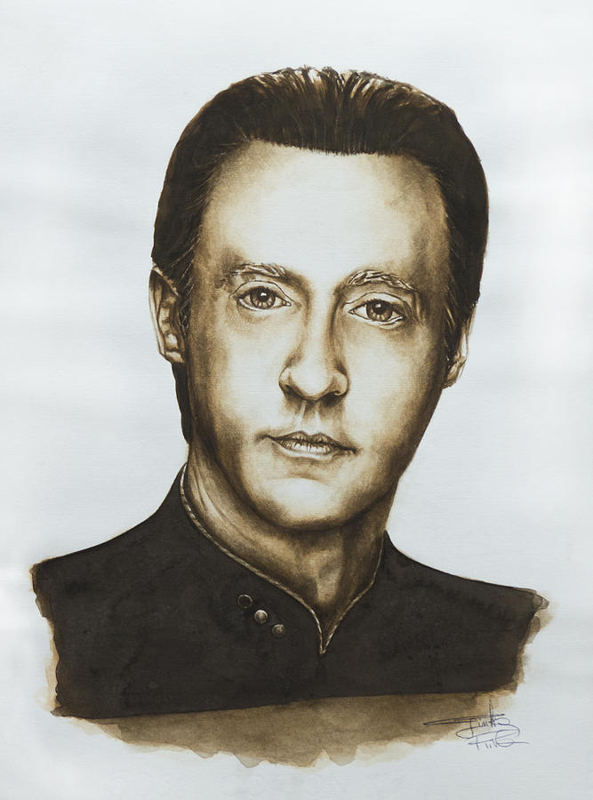
Notes:
In last week’s class, we asked the question, “What is intelligence? And what criteria would you use to assess whether an entity is intelligent? Back in the day, I was a fan of Star Trek: The Next Generation. And this is a painting of Lieutenant Commander Data, the resident Android. Among the first two seasons of TNG, few episodes are as impressive as "The Measure of a Man," in which Data finds himself on trial for his life — not for a crime but simply for being. Starfleet scientist Bruce Maddox (Brian Brophy) wants to perform experiments on Data, but Data is worried he won't survive them. When Maddox forces the issue, Data tries to resign his commission. Maddox argues Data is a machine, Starfleet's property and doesn't have the right to resign his commission, so Picard is forced to face-off against Riker in a legal proceeding to determine whether or not Data has sentience. He famously tells the judge, "Your Honor, Starfleet was founded to seek out new life." Then, pointing to Data, he says, "Well, there it sits.“ As you can see, one’s definition of intelligence is important, and it lies at the heart of this emerging field. For without a clear definition of intelligence, how will we know when we have succeeded?
Now that we’ve got you thinking… I’d like to take a few minutes to talk about the history of AI.

Slide 8
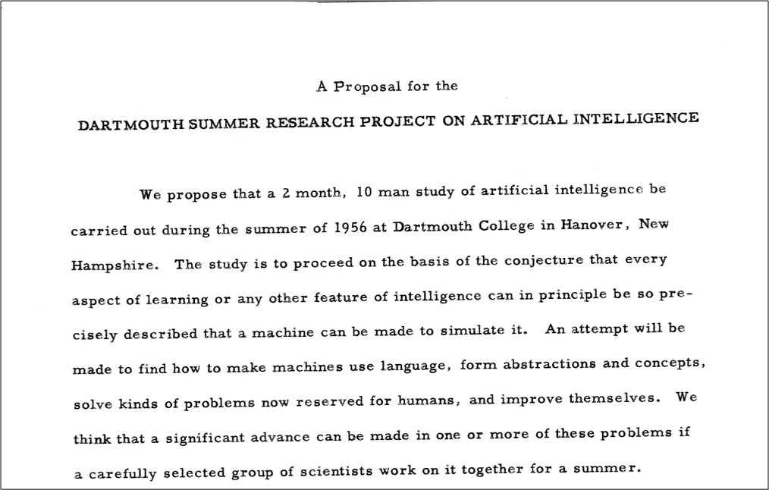
Origin of “AI”!
Notes:
In the mid-1950’s, John McCarthy, then a young Assistant Professor of Mathematics at Dartmouth College, decided to organize a group to clarify and develop ideas about thinking machines. He picked the name 'Artificial Intelligence' for the new field. He chose the name partly for its neutrality; avoiding a focus on narrow automata theory while avoiding cybernetics which was heavily focused on analog feedback, as well as him potentially having to accept the assertive Norbert Wiener as guru or having to argue with him.
In early 1955, McCarthy approached the Rockefeller Foundation to request funding for a summer seminar at Dartmouth for about 10 participants. In June, he and Claude Shannon, a founder of information theory then at Bell Labs, met with Robert Morison, Director of Biological and Medical Research to discuss the idea and possible funding, though Morison was unsure whether money would be made available for such a visionary project.
On September 2, 1955, the project was formally proposed by McCarthy, Marvin Minsky, Nathaniel Rochester and Claude Shannon. The proposal is credited with introducing the term 'artificial intelligence’. The Rockefeller Foundation funded the proposal and the rest, as they say, “is history…”

Slide 9
Dartmouth Proposal (McCarthy et al. 1955): “The study is to proceed on the basis of the conjecture that every aspect of learning or any other feature of intelligence can in principle be so precisely described that a machine can be made to simulate it.”
John McCarthy (2007): “It is the science and engineering of making intelligent machines, especially intelligent computer programs.” “The ultimate effort is to make computer programs that can solve problems and achieve goals in the world as well as humans.”
Wallace Marshall (1987): “Artificial stupidity (AS) may be defined as the attempt by computer scientists to create computer programs capable of causing problems of a type normally associated with human thought.”
Notes:
With that history in place, let’s consider some definitions – starting with the one advanced in the Dartmouth Proposal…

Slide 10
McCarthy (2007): “Intelligence is the computational part of the ability to achieve goals in the world. Varying kinds and degrees of intelligence occur in people, many animals and some machines.”
Allen Newell (1990): An intelligent system “operates in real-time; exploits vast amounts of knowledge; tolerates erroneous, unexpected, and possibly unknown inputs; uses symbols and abstractions; communicates using some form of natural language; learns from the environment; and exhibits adaptive goal-oriented behavior.”
Kurzweil (1990): “In summary, there appears to be no simple definition of intelligence that is satisfactory to most observers, and most would-be definers of intelligence end up with long checklists of its attributes.”
Notes:
… and some more definitions to consider.

Slide 11

What do you think? What is the defining feature of “intelligence”?
Notes:
Okay – given these definitions and the assigned reading for this week – has your initial definition of A.I. changed?
Let’s discuss these questions in the breakout rooms.

Slide 12
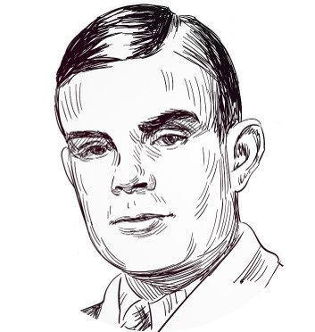
Notes:
This week’s reading introduced you to Alan Turing and the foundational work he did in the field of artificial intelligence. The Turing test of intelligence was first proposed in 1950, in an article entitled, Computing Machinery and Intelligence. This is a foundational document… Let’s review the Turing test.
Turing, AM (1950) Computing Machinery and Intelligence. Mind: 54

Slide 13
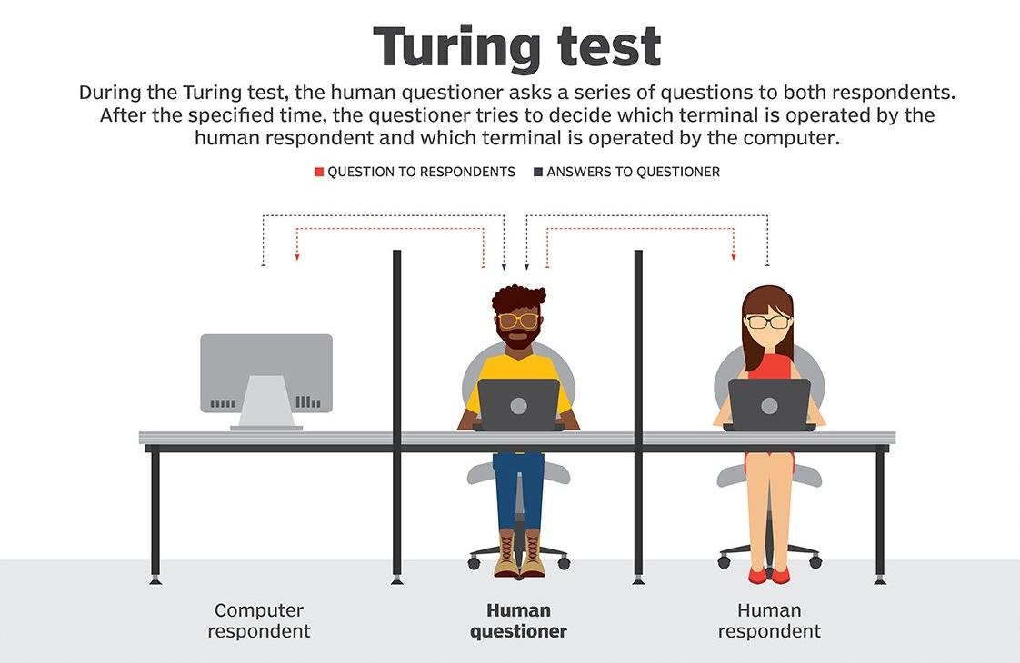
Notes:
At the heart of our reading this week is the Turing test. In fact, the entire chapter is named after Turing. This test has been hugely influential since 1950 since he first described it.
Victorian parlor game – someone tries to tell if another person is a man or a woman simply on the basis of answers they gave to questions posed to them.
Human interacts with a computer – does not know if it is another human or an intelligent system. The interaction is purely in the form of textual questions and answers: the interrogator types a question, and a response is displayed. The task of the interrogator is to determine whether the thing being interrogated is a person or a computer program.
Now, suppose that the thing being interrogated is indeed a computer program, but after some reasonable amount of time, the interrogators cannot reliably tell whether they are interacting with a program or a person. Then surely, Turing argued, you should accept that the program has some sort of human level intelligence because the system is doing something that makes it indistinguishable from the real thing. The key word here is indistinguishable…

Slide 14
ELIZA
Notes:
Woolridge discusses ELIZA, a computer program written in the 1960’s by the German MIT computer scientist Joseph Weizenbaum. Eliza takes the role of a psychiatrist talking to a patient to get the interviewee to contemplate themselves.
ELIZA’s legacy lives on to this day, in the form of the annual Loebner Prize competition. It is unclear whether Turing imagined that anyone would ever actually try out his test for real, but in 1990 that is precisely what American millionaire inventory Hugh Loebner decided to do. Every year, the Loebner Prize invites the submission of computer programs to engage in the Turing test, attempting to convince a panel of judges that they are in fact people.
We’re going to give you time to chat with this year’s winner of the Loebner prize. Her name is Kuki…
Woolridge concludes, “ELIZA is the direct ancestor of a phenomenon that makes AI researchers groan whenever it is mentioned: the internet chatbot.

Slide 15
kuki.ai
Notes:
Breakout conversations – Is Kuki exhibiting intelligent behavior, is this intelligence? (Yes/No)
Team debate

Slide 16
References
Wooldridge, M. (2021). A brief history of artificial intelligence: What it is, where we are, and where we are going. New York, NY: Flatiron Books.

Slide 18
Summary
Notes:
Okay – let’s quickly summarize what we covered in today’s learning experience.

