Slide 1
What is AI?
Welcome
Notes:
Hello and welcome to: “Frontiers of AI
In this class, we will explore the question of AI and its relationship to our world. We created this class specifically for STUDENTS who are curious about AI but wonder how it applies to the program of study they are presently engaged in. The great news is that you do not need to have a strong technical or mathematical background to do interesting AI-enabled research. Our motto is: AI for Everyone!
So, let’s start with some basic definitions…

Slide 2
Course Goals
What is artificial intelligence? (What is it not?)
What are the main approaches to AI and how do they work?
How is AI applied to real-world problems?
How are AI systems evaluated?
How can we ensure that AI systems are fair and equitable?
Equip you to think about how AI might be applied in your own areas of interest!

Slide 3
What is Artificial Intelligence?
Notes:
Here’s the question I’d like for you to focus on in today’s class. A prerequisite of any understanding is a definition of terms. What are we talking about?

Slide 4
What is a short phrase that describes artificial intelligence?
Please go to PollEv.com/mattg252 and record your response

Slide 5
John McCarthy (2007): “It is the science and engineering of making intelligent machines, especially intelligent computer programs.” “The ultimate effort is to make computer programs that can solve problems and achieve goals in the world as well as humans.”
Wallace Marshall (1987): “Artificial stupidity (AS) may be defined as the attempt by computer scientists to create computer programs capable of causing problems of a type normally associated with human thought.”
Dartmouth Proposal (McCarthy et al. 1955): “The study is to proceed on the basis of the conjecture that every aspect of learning or any other feature of intelligence can in principle be so precisely described that a machine can be made to simulate it.”
Notes:
Now that we’ve shared our ideas, let’s consider some other definitions.

Slide 6
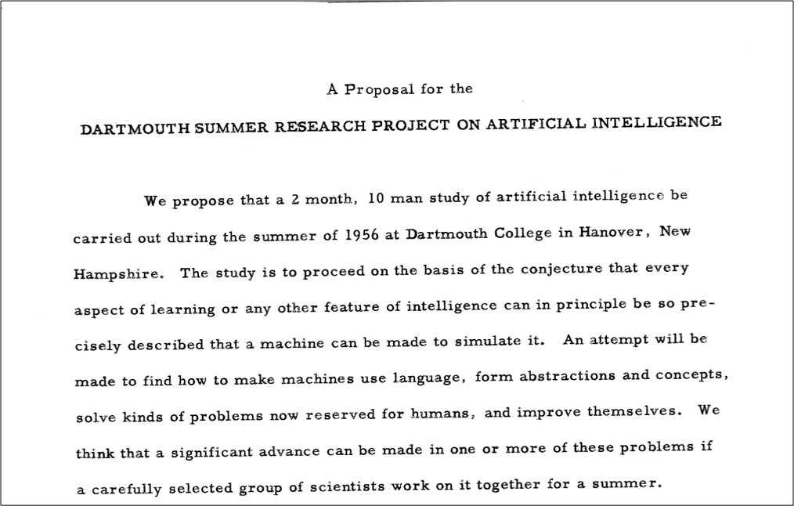
Origin of “AI”!

Slide 7
McCarthy (2007): “Intelligence is the computational part of the ability to achieve goals in the world. Varying kinds and degrees of intelligence occur in people, many animals and some machines.”
Allen Newell (1990): An intelligent system “operates in real-time; exploits vast amounts of knowledge; tolerates erroneous, unexpected, and possibly unknown inputs; uses symbols and abstractions; communicates using some form of natural language; learns from the environment; and exhibits adaptive goal-oriented behavior.”
Kurzweil (1990): “In summary, there appears to be no simple definition of intelligence that is satisfactory to most observers, and most would-be definers of intelligence end up with long checklists of its attributes.”
Alan Turing (1950): The “imitation game” (now called the “Turing test”).

Slide 8

What do you think? What is the defining feature of “intelligence”?
Notes:
Have students go to breakout sessions and recorded notes from the sessions here.

Slide 9
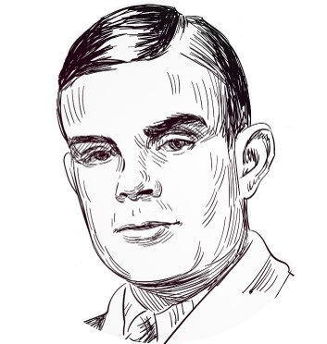
Notes:
Turing, AM (1950) Computing Machinery and Intelligence. Mind: 54

Slide 10
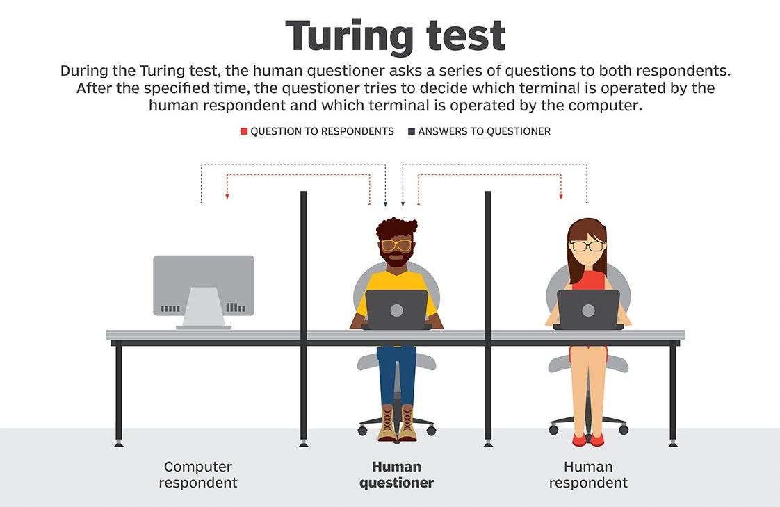
Notes:
At the heart of our reading this week is the Turing test. In fact, the entire chapter is named after Turing. This test has been hugely influential since 1950 since he first described it.
Victorian parlor game – someone tries to tell if another person is a man or a woman simply on the basis of answers they gave to questions posed to them.
Human interacts with a computer – does not know if it is another human or an intelligent system. The interaction is purely in the form of textual questions and answers: the interrogator types a question, and a response is displayed. The task of the interrogator is to determine whether the thing being interrogated is a person or a computer program.
Now, suppose that the thing being interrogated is indeed a computer program, but after some reasonable amount of time, the interrogators cannot reliably tell whether they are interacting with a program or a person. Then surely, Turing argued, you should accept that the program has some sort of human level intelligence because the system is doing something that makes it indistinguishable from the real thing. The key word here is indistinguishable…

Slide 11
ELIZA
Notes:
Woolridge discusses ELIZA, a computer program written in the 1960’s by the German MIT computer scientist Joseph Weizenbaum. Eliza takes the role of a psychiatrist talking to a patient to get the interviewee to contemplate themselves.
ELIZA’s legacy lives on to this day, in the form of the annual Loebner Prize competition. It is unclear whether Turing imagined that anyone would ever actually try out his test for real, but in 1990 that is precisely what American millionaire inventory Hugh Loebner decided to do. Every year, the Loebner Prize invites the submission of computer programs to engage in the Turing test, attempting to convince a panel of judges that they are in fact people.
We’re going to give you time to chat with this year’s winner of the Loebner prize. Her name is Kuki…
Woolridge concludes, “ELIZA is the direct ancestor of a phenomenon that makes AI researchers groan whenever it is mentioned: the internet chatbot.

Slide 12
kuki.ai
Notes:
Students engage in a 10-minute conversation with Kuki.ai
Breakout conversations – Is Kuki exhibiting intelligent behavior, is this intelligence? (Yes/No)
Team debate

Slide 13
Summary
Notes:
Okay – let’s quickly summarize what we covered in today’s workshop.

Slide 14
References
Wooldridge, M. (2021). A brief history of artificial intelligence: What it is, where we are, and where we are going. New York, NY: Flatiron Books.

