Slide 1

Basic Mathematics for AI

Slide 2
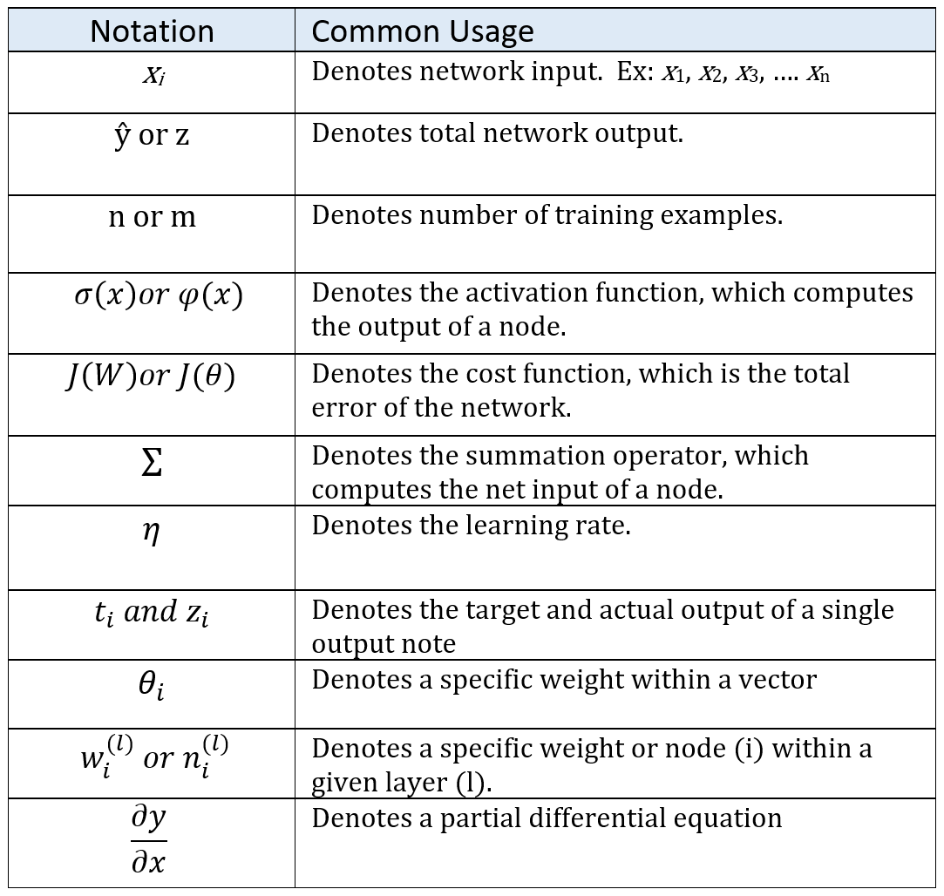
Notes:
And finally – as you continue your deep learning journey – you will encounter a variety of mathematical equations and symbols. But do not fear! With a little effort, you will quickly master them. To get you started, here’s a list of the most frequently used mathematical symbols in deep learning, along with their definitions.

