Slide 1
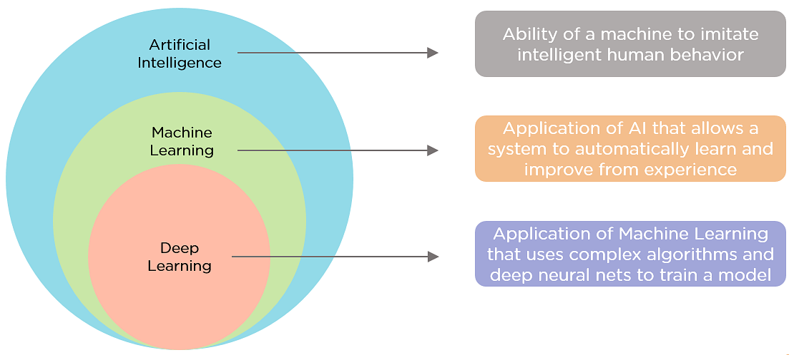
(Source: https://www.simplilearn.com/ice9/free_resources_article_thumb/AIvsML.png)
Notes:
Machine learning, a sub-class of artificial intelligence as shown in Fig, is self-learning based on algorithms that mean the system learns from its experience.
Deep Learning is a subcategory of machine learning. It is a network model with neurons having a lot of parameters and layers in between input and output. DL follows the neural network architectures approach. Thus, called deep neural networks.

Slide 2
Applications
Machine Learning
Predictive programs
Email spam identifiers
Principal Components Analysis
Photo OCR
Anomaly Detection
…
Deep Learning
Computer vision
facial recognition…
Self-driving cars
Art Generation
Natural Language Processing
Neural machine translation…
…
Neha Sharma et al., 2021, Machine Learning and Deep Learning Applications-A Vision.
Notes:
Machine learning and deep learning systems are used for different applications. Where they are used: Basic machine learning applications include predictive programs (such as forecasting prices in the stock market or where and when the next hurricane will hit), email spam identifiers, and programs that design evidence-based treatment plans for medical patients. For deep learning, one highly publicized application is self-driving cars—the programs use many layers of neural networks to determine objects to avoid, recognize traffic lights, and know when to speed up or slow down.

Slide 3
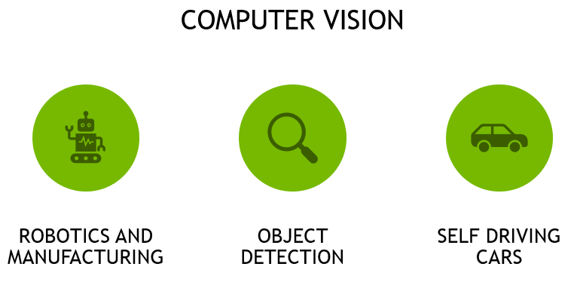
Notes:
The field of Computer Vision has been around long before the field of Deep Learning, but because there are now more and more tagged high quality images available, Deep Learning is having a large influence.
The goal of computer vision is to teach machines to see and perceive images the way that humans do. Thanks to the complexity of our eyes, not to mention the processing our brains do with these images, this is no easy task!
Tesla self-driving car
Andrew Ng – Manufacturing quality control
Robots in manufacturing – Digital Twins (Omniverse)

Slide 4
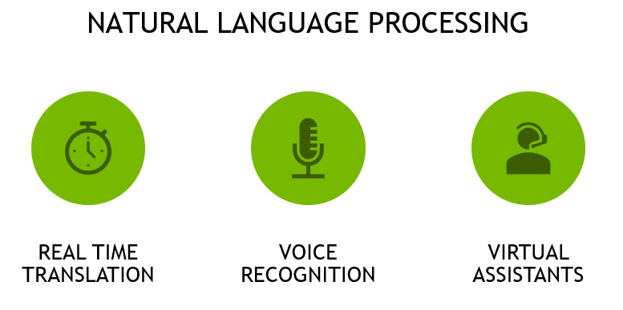
Notes:
Natural language processing, which we’ll also touch on in this course has helped make huge shifts, for example in highly accurate, real time language translation, as well as voice recognition and virtual assistants.
Text to Speech (TTS) Amazon Polly
Speech to Text (STT)
Translation Google Translate
Voice Recognition Apple Siri – Amazon Alexa
Virtual Assistants Alli Gator

Slide 5
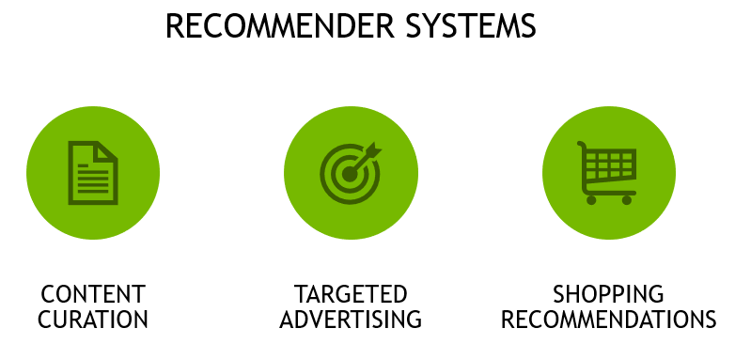
Notes:
Recommender systems based on deep learning fuel the internet with content curated feeds such as facebook, music like spotify, video like youtube and netflix, as well as targeted online advertising and shopping recommendations (Amazon)
Netflix, Amazon, YouTube, Spotify recommendation engines

Slide 6
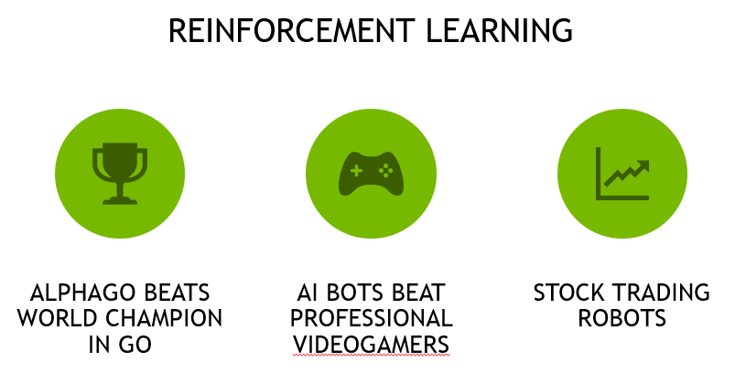



Notes:
Reinforcement learning has achieved incredible results in matching human expert performance, such as the AI alpha-go, which beat the world champion in what is considered one of the most difficult and complex games in the world. AI bots are now also taking on world experts in complex videogames such as Starcraft and DOTA
AlphaGo – Lee Sedol (2016)
Deep Blue – Gary Kasparov (1997)
OpenAI (Gym) and Classic Atari Games
Stock Trading Robots

Slide 7
Notes:
https://www.ai-startups.org/
https://www.ai-startups.org/top/agriculture/

