Slide 1

Overview of the Learning Process

Slide 2
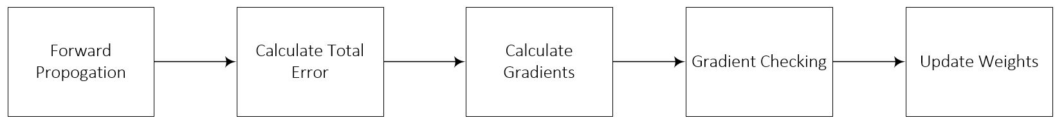
Five Step Process
Summation Operator Activation Function
Cost Function
Partial Derivative
Chain Rule
Gradient Check
Weight Update
Source: Taylor, M. (2017). Neural networks: A visual introduction for beginners. Vancouver, Canada: Blue Windmill Media.
Notes:
Now that I have introduced the basic parts of a neural network, let’s step back and briefly review the key steps of the training process. The five steps which comprise both forward and back propagation are pictured here, along with each step’s corresponding mathematical functions or operations. Gradient checking step is important for quality control, though we do not discuss it in the Practicum AI workshop series. Backpropagation includes the last three steps.

Slide 3
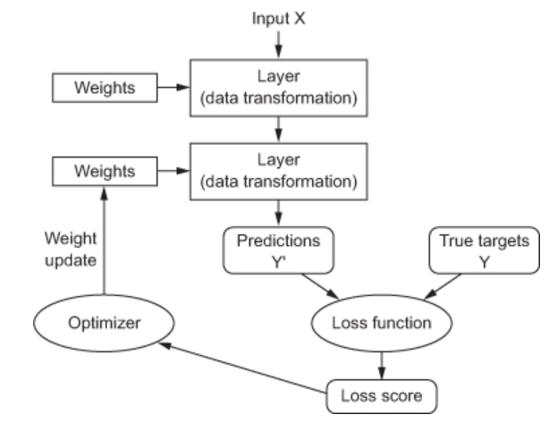
Source: Chollet, F. (2017). Deep learning with Python. Shelter Island, NY: Manning Publications. (Chapter 3)
Notes:
Here’s another visualization of the training process. I like this process diagram because it clearly shows the role of the optimizer in the weight update process.

Slide 4
Key Points
Neural networks are specific
Neural networks are either fixed or adaptive
Neural networks have three basic parts
Input Layer
Hidden Layer(s)
Output Layer
Neural networks use three types of datasets
Training
Validation
Testing
Neural networks are built two ways
Feedforward
Feedback
Notes:
Neural networks are always built to solve a specific type of problem, although this doesn’t mean they can’t be used as “general purpose” tools. Examples of specific uses include: prediction, forecasting, estimation, classification, and pattern recognition.
A neural network has three basic sections, or parts, and each part is composed of “nodes”. There’s the input layer, one or more hidden layers (sometimes dozens of hidden layers), and a final output layer.
Neural networks are built two ways. With a feedforward neural network, signals travel only one way, from input to output. These types of networks are straightforward and used extensively in pattern recognition. A convolutional neural network (CNN) is a specific type of feedforward network often used in image recognition. With feedback – or recurrent neural networks – signals can travel both directions and there can be loops. RNN are more powerful and complex than CNN’s. Despite this, RNN’s have been less influential than feedforward networks.
Neural networks are either fixed or adaptive. The weight values in a fixed network remain static. They do not change. On the other hand, weight values in an adaptive network can change.
Neural networks use three types of datasets. The training dataset is used to adjust the weights of the neural network. The validation dataset is used to minimize a problem known as overfitting, which we cover late. The testing dataset is used as a final test to gauge how accurately the network has been trained. All three datasets are usually taken from the project’s primary dataset, sliced into three parts. Typically, the data is split as follows: Training data: 60% -- Validation data: 20% -- Testing data: 20%.

Slide 5
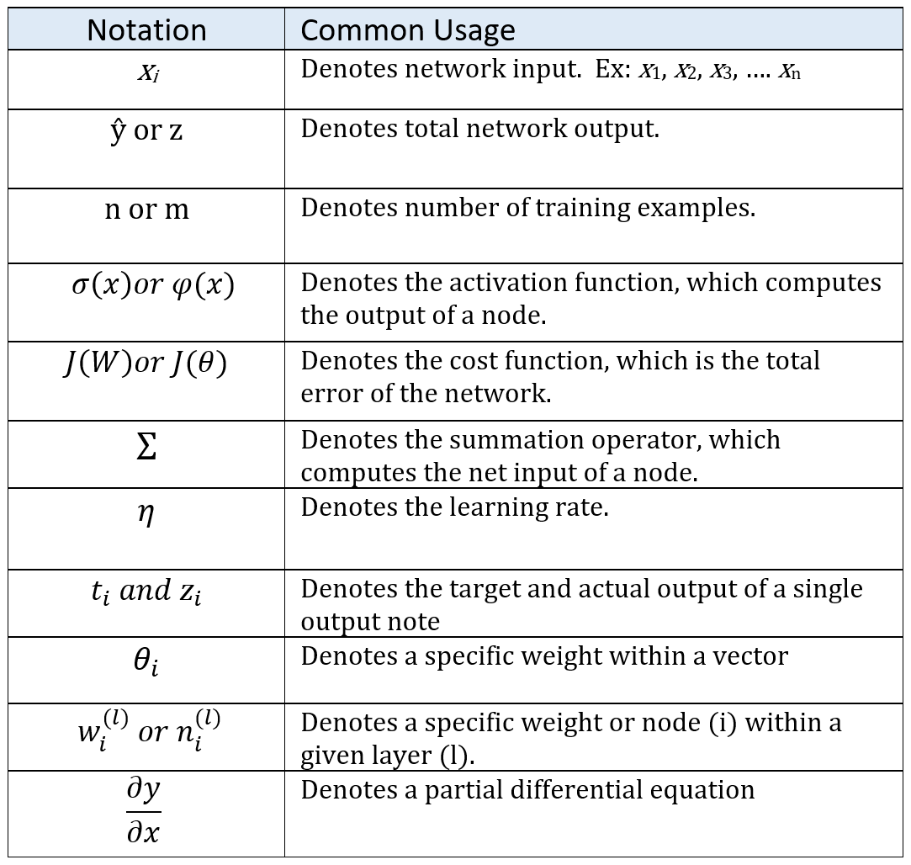
Notes:
And finally – as you continue your deep learning journey – you will encounter a variety of mathematical equations and symbols. But do not fear! With a little effort, you will quickly master them. To get you started, here’s a list of the most frequently used mathematical symbols in deep learning, along with their definitions.

Slide 7
