Slide 1

Anatomy of a Convolutional Neural Network

Slide 2
Lesson Overview
Quick Review
Images and Filters
Convolution
Stride, Padding, Pooling

Slide 3
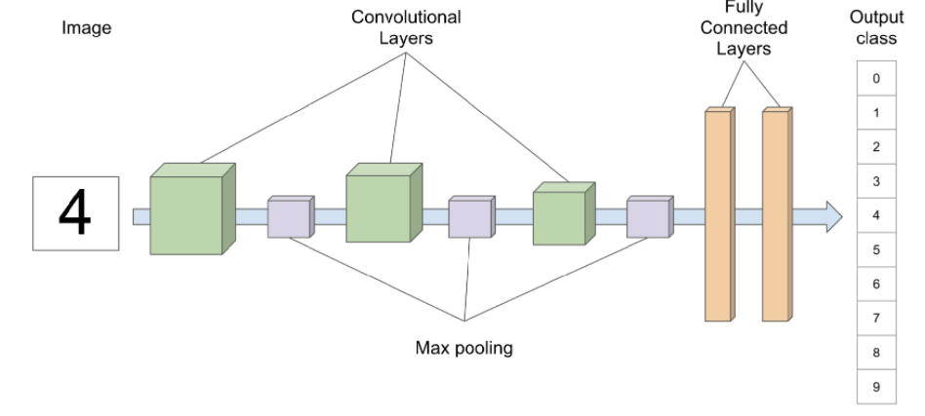
Notes:
Overview of a CNN
Model pictured here classifies handwritten digits – famous MNIST digits dataset – we already introduced you to this model in our last session.
Three convolution layers, followed by max pooling layers
Final two layers are fully connected – discussed in our beginner sequence.
Convolution and pooling layers are new
Variety of layers – just covering a couple now…
=====
Now in our Deep Learning Foundations series, we introduced you to the basic architecture of a multi-layered neural network. To frame this learning experience, we begin with a picture of a convolutional neural network or CNN. Looks familiar, doesn’t it?
The CNN pictured here recognizes and classifies handwritten digits (from 0 to 9). There are three convolution layers in this model, each followed by a max pooling layer. The final layers are fully connected and are responsible for predicting the digit presented to the model. We have already presented the architecture of these last two layers in our Foundations sequence. But the convolution and pooling layers are new, and we will discuss those shortly.
Let’s start by examining the underlying structure of images.

Slide 4
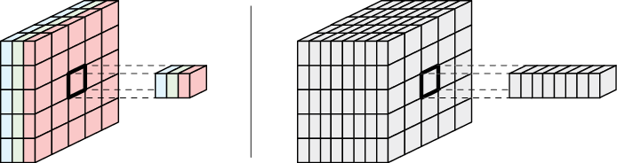
Source: Glassner, A. (2021). Deep learning: A visual approach. San Francisco, CA: No Starch Press. (Chapter 16)
Notes:
How do we present data to a CNN?
Left: When our tensor has one to three channels, we call each point a pixel
Right: For tensors with many channels, we call each slice through the channels an element
=====
As noted in our introductory presentation, images must be first converted to tensors before they can be” “understood” by a CNN. On the left, a small color image has been converted to a tensor with 3 channels. If this had been a grayscale image, it would have had but one channel. When a tensor has more than 3 channels, it’s probably best not to think of it as an image anymore. Thus – for large tensors with many channels or dimensions, we call individual slices of the tensor elements.

Slide 5
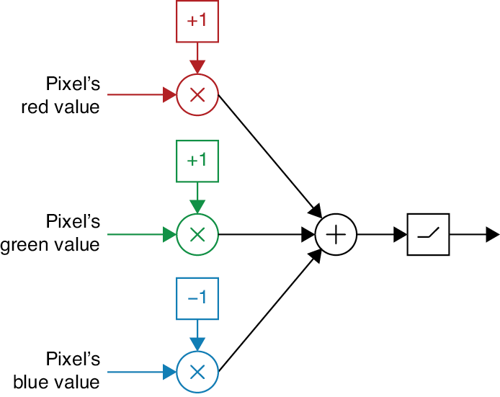
Source: Glassner, A. (2021). Deep learning: A visual approach. San Francisco, CA: No Starch Press. (Chapter 16)
Notes:
Let’s pretend we want to take a color image and create a greyscale image where the amount of white corresponds to yellow in the original.
Process a color image – each pixel in our image contains three numbers: one each for red, green, and blue
For simplicity, let’s assume our RGB values are from -1 to 1.
Pure yellow: red & green = 1, blue = 0
As red and green values decrease, or blue value increases, pixel’s color shifts away from yellow
Combine three values to represent ‘yellowness’ – output
As shown here, the +1, +1, and -1 boxes are weights – these are multiplied by each pixel value and then summed up by the net input (summation) function before being passed off to the activation function
=====
To kick off our discussion of convolution, let’s consider processing a color image. Now each pixel in our image contains three numbers: one each for red, green, and blue. Suppose we want to create a grayscale output that has the same height and width as our color image, but where the amount of white in each pixel corresponds to the amount of yellow in its input pixel.
For simplicity, let’s assume our RGB values are numbers from 0 to 1. Then a pixel that’s pure yellow has red and green values of 1, and a blue value of 0. As the red and green values decrease, or the blue value increases, the pixel’s color shifts away from yellow. We want to combine each input pixel’s RGB values into a single number from 0 to 1 that represents “yellowness,” which is the output pixel’s value.
This sure looks familiar. It has the same structure as an artificial neuron. When we interpret this figure as a neuron, +1, +1, and −1 are the three weights, and the numbers associated with the color values are the three inputs.

Slide 6
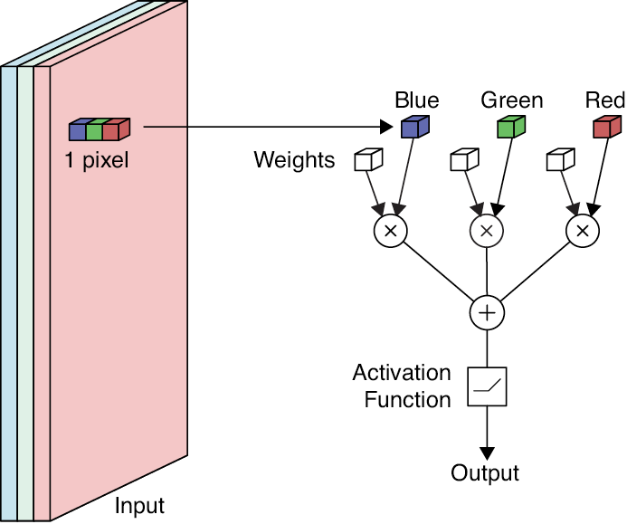
Source: Glassner, A. (2021). Deep learning: A visual approach. San Francisco, CA: No Starch Press. (Chapter 16)
Notes:
Picture of single pixel (3 channels) fed to a single neuron.
Apply operation to every pixel in the image
=====
This figure shows how to apply this neuron to a single pixel in an image. We can apply this operation to every pixel in the input, creating a single output value for every pixel. The result is a new tensor with the same width and height as the input, but only one channel, as shown in the next figure.

Slide 7
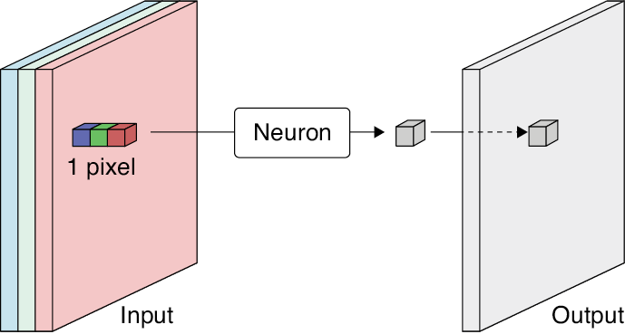
Source: Glassner, A. (2021). Deep learning: A visual approach. San Francisco, CA: No Starch Press. (Chapter 16)
Notes:
Start at upper-left – sweep across and down until entire image scanned.
=====
We often imagine applying the neuron to the upper-left pixel, then moving it one step at a time to the right until we reach the end of the row, then repeating this for the next row, and the next, until we reach the bottom right pixel. We say that we’re sweeping the neuron over the input or scanning the input.

Slide 8
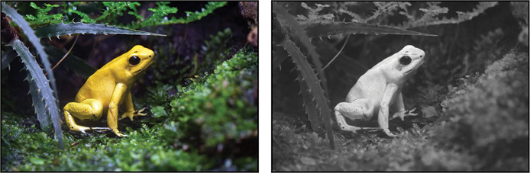
Source: Glassner, A. (2021). Deep learning: A visual approach. San Francisco, CA: No Starch Press. (Chapter 16)
Notes:
Concrete example – image of a yellow frog converted to greyscale…
Greyscale output – more yellow a pixel is, the whiter its corresponding output.
Neuron is identifying or detecting yellow.
We say the neurons filter the input.
In ML, filters are called kernels (mathematical term)
Generalizable – neurons to detect any color
=====
The image here shows the result of this process on a picture of a yellow frog. As we intended, the more yellow that’s present in each input pixel, the more white we see in its corresponding output. We say that the neuron is identifying or detecting yellow in the input.
Of course, there’s nothing special about yellow. We can build a little neuron to detect any color. When we use a neuron in this way, we often say that it is filtering the input. In this context, the weights are sometimes collectively called the filter values or just the filter. Inheriting language from their mathematical roots, the weights are also called the filter kernel or just the kernel.

Slide 9
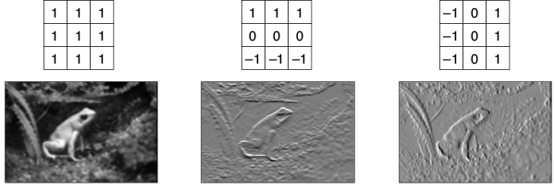
Blurring
Horizontal Edges
Vertical Edges
Source: Glassner, A. (2021). Deep learning: A visual approach. San Francisco, CA: No Starch Press. (Chapter 16)
Notes:
So far, we’ve been sweeping a single neuron over the image, processing one pixel at a time. But in many situations, it’s also useful to look at the pixels near the one we’re processing. Usually, we consider a pixel’s eight immediate neighbors. That is, we use the values in a little three by three box that’s centered on the pixel.
This figure shows three different operations we can apply using a three-by-three filter or kernel:
blurring
detecting horizontal edges
… and detecting vertical edges
To compute each image, we center the block of weights over each pixel in turn and multiply each of the nine values under it by the corresponding weight. We add up the results and use their sum as the output value for that pixel. Let’s visualize this operation.

Slide 10
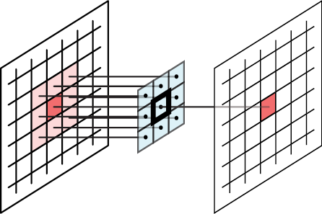
Source: Glassner, A. (2021). Deep learning: A visual approach. San Francisco, CA: No Starch Press. (Chapter 16)
Notes:
Apply a 3 x 3 filter to an image by convolving it with that image, sweeping left to right, top to bottom
Center the 3 x 3 grid of weights over each pixel and apply the neuron to create a single output.
The underlying pixel at the center of the filter is the anchor, reference point, or zero point.
=====
Here we apply a three-by-three filter to an image by convolving it with that image, sweeping from left to right, top to bottom. For each input pixel, we imagine centering the three-by-three grid of weights over that pixel, applying the neuron, and creating a single output value, as shown here. We say that the pixel we’re centering the filter over is the anchor (or the reference point or zero point). But let’s make this concrete with a simulation…

Slide 11
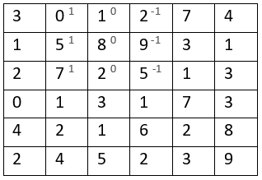
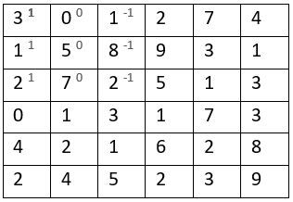
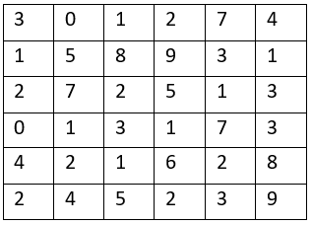
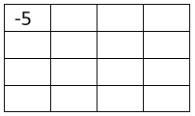
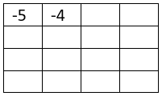
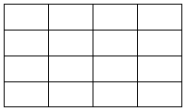

Convolution
Input
Filter or Kernel
Output
*
=
0 x 1 + 5 x 1 + 7 x 1 + 1 x 0 + 8 x 0 + 2 x 0 + 2 x -1 + 9 x -1 + 5 x -1
3 x 1 + 1 x 1 + 2 x 1 + 0 x 0 + 5 x 0 + 7 x 0 + 1 x -1 + 8 x -1 + 2 x -1
Source: https://www.youtube.com/watch?v=XuD4C8vJzEQ
Notes:
Okay -- we start off with an input image, a filter or kernel, and an output tensor waiting to be filled. Note: the asterisk is the mathematical symbol for convolution. Unfortunately – in Python – this is also the multiplication operator.
We start by applying our filter to the upper left corner of our input – now shaded in light blue. As we can see, the filter’s values appear as superscripts. The convolution operation is simple. Multiply each input value by its corresponding filter value. And then, add everything up to arrive at a single output number – in this case -5. The addition and multiplication is shown.
We then slide the filter / kernel over by 1 and repeat the process. The result this time is a -4, as shown in the output tensor. Keep in mind: the convolution operation sweeps the kernel from left to right, top to bottom. And continues until it reaches the bottom right-hand corner. There are variations we will discuss later.
Let’s simulate this process…

Slide 12
Image Credit: https://cognitivetruth.wordpress.com/2019/02/01/convolutional-neural-networks/
Notes:
Here we see 3 kernels – one each for the red, green, and blue channels. As the kernel moves across the underlying input, the two matrices are multiplied. The results of that multiplication are summed, resulting in a single number for each channel. And finally, these three numbers are added together end the result placed in the output matrix.
Around the edges, you see cells with values of zero. We will talk about those shortly.

Slide 13
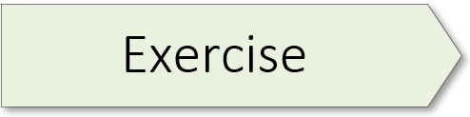
Implementing a Convolution Operation
02.1_convolution.ipynb
Notes:
The exercise for this workshop starts on page 113 of the textbook.

Slide 14
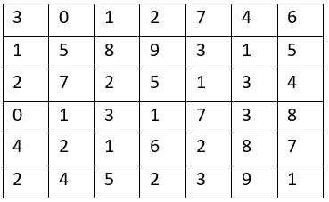
Stride
Stride of 1
Stride of 2
Source: https://www.youtube.com/watch?v=tQYZaDn_kSg
Notes:
As we saw, during convolution we can imagine starting the filter in the upper-left pixel of the input image. The filter produces an output, then takes one step right, produces another output, moves another step right, and so on until it reaches the right edge of that row. Then it moves down one row and back to the left side, and the process repeats.
Simulation: First click sequence – stride of 1, across and down
But we don’t have to move in single steps. Suppose we move, or stride, more than one pixel to the right, or more than one pixel down, as we sweep our filter. Then our output will end up being smaller than the input. We usually use the word stride (and the related striding) only when we use steps greater than one in any dimension.
Simulation: Second click sequence – stride of 2, across and down
In both simulations, the filter moves starting from the upper left. As the filter moves left to right, it produces a sequence of outputs, and those get placed one after the other, also left to right, in the output. When the filter moves down, the new outputs go on a new line of cells in the output.

Slide 15
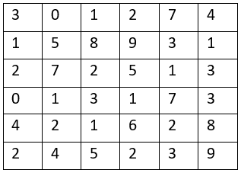
6 x 6
4 x 4
Source: https://www.youtube.com/watch?v=smHa2442Ah4&t=40s
Notes:
There’s a minor issue w/convolution operation. When we convolve an image, the output tensor has smaller dimensions than the input.
Let’s simulate the process.
We first apply a filter to our image.
The pixel at the center of the filter becomes the anchor or reference point, pictured.
The filter values are multiplied by the input values (the convolution is executed) and the summed value is inserted into the output tensor.
However, this leads to an output tensor smaller than the original input. Let’s visualize this by laying the output tensor on top of the input tensor, using the upper-left corner as our anchor point. Here the light grey footprint is smaller by 1 square on all sides.
So, how do we fix this problem?

Slide 16
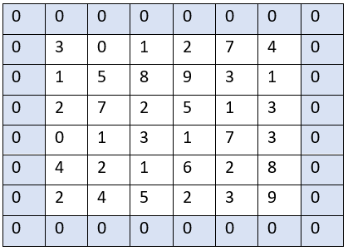
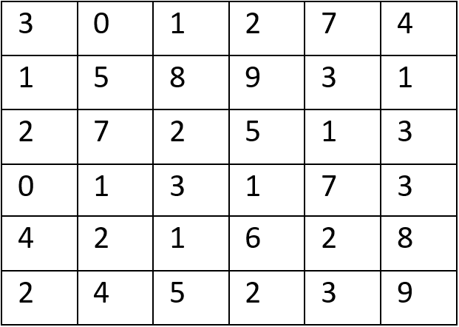
Padding
Source: https://www.youtube.com/watch?v=smHa2442Ah4&t=40s
Notes:
Well, the answer is relatively simple.
We start with an input tensor.
… and simply add a layer of padding around it.
Padding allows us to create an output image of the same width and height as the input. If we place zeros in these cells, it’s called zero-padding. In practice, this is usually done. Or you can mirror the edge pixels in what’s called mirror-padding.
The thickness of the border depends on the size of the filter. We typically use just enough padding so that the filter can be centered on every element of the input. Every filter needs to have its input padded if we don’t want to lose information from the sides.
Most deep learning libraries automatically calculate the necessary amount of padding. We don’t have to worry about it!

Slide 17
Image Credit: https://cognitivetruth.wordpress.com/2019/02/01/convolutional-neural-networks/
Notes:
Padding simulation.

Slide 18
Notes:
As we have already discussed the convolution operation, let’s now take a closer look at pooling, starting with max pooling.

Slide 19
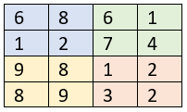

Max Pooling
Input Image
Max pooling with
Stride 2
Result
MAX
MAX
MAX
Source: https://www.youtube.com/watch?v=8oOgPUO-TBY&t=6s
Notes:
Pooling layers are used to reduce the dimensions of the feature maps of convolution layers. But why do we need to perform such down sampling? One of the main reasons is to reduce the number of calculations that are performed in the networks. Adding multiple layers of convolution with different filters can have a significant impact on the training time. Also, reducing the dimensions of feature maps can eliminate some of the noise in the feature map and help us focus only on the detected pattern. It is quite typical to add a pooling layer after each convolutional layer in order to reduce the size of the feature maps.
A pooling operation acts like a filter, but rather than performing a convolution operation, it uses an aggregation function such as average or max (max is the most widely used function in the current CNN architecture). For instance, max pooling will look at a specific area of the feature map and find the maximum values of its pixels. Then, it performs a stride and finds the maximum value among the neighbor pixels. It repeats this process until it processes the entire image.
Let’s simulate this process.
The max filter is applied and the largest (max) number in the input image is added to the output tensor. The colors help us see the connections between the input and the corresponding output.
In this example, our stride is two and the max pooling operation is once again applied, resulting in 7 as its output.

Slide 20
Max Pooling
Image Credit: https://cognitivetruth.wordpress.com/2019/02/01/convolutional-neural-networks/
Notes:
Simulation of max pooling with a stride of 2.

Slide 21

Average Pooling
Input Image
Max pooling with
Stride 2
Result
AVG
AVG
AVG
Source: https://www.youtube.com/watch?v=8oOgPUO-TBY&t=6s
Notes:
Max pooling is not the only option available to us. Here’s a simulation of average pooling.
As in the previous simulation, we apply the filter, take the average of the 4 cells and update the output tensor.
Once again, our stride is two and the average pooling operation is applied, resulting in 4.50 as the output (indicated in green)

Slide 22
Notes:
Focus on last fully connected layer – specifically output in relation to activation function.
For that last layer, activation function will vary, depending on desired final output.
=====
Now – before concluding this presentation – we need to take a closer look at that last fully connected layer, specifically its output in relation to its activation function. Indeed, the activation function you select will vary, depending on what the network is designed to do.

Slide 23
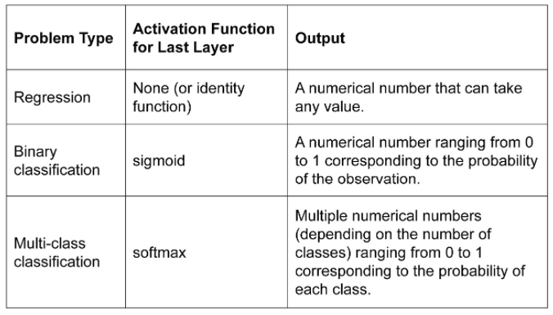
Notes:
CNNs are frequently used for image classification – two types:
Binary – 2 classes – ex. dogs vs. cats
Multi-class – > 2 classes – ex. 20 different kinds of fruits
For predictions, last layer fully connected w/appropriate activation function
Regression: activation function is usually linear
Binary: activation is sigmoid – you’ll see this in our next exercise
Multi-class: activation is softmax – calculates the probability for each class, with all those probabilities summing to one
=====
CNNs are widely used for image classification, where the network predicts the right class for a given input. In fact, there are traditional machine learning algorithms that do the same thing. If the output is only from two different classes, it’s a binary classification, such as recognizing dogs versus cats. If the output can be more than two classes, it’s a multi-class classification task, such as recognizing 20 different sorts of fruits.
In order to make such predictions, the last layer of a CNN model needs to be a fully connected and use the appropriate activation function for a given prediction task. Use the following list of activation functions as a rule of thumb

Slide 24
A Cat & Dog Classifier
02.2_catdog.ipynb
Notes:
The learning experience for this exercise starts on page 130 of the textbook.

Slide 25

Questions
Notes:
Post general questions (entire class) in Chat…
Discuss specific implementation questions at the Help table during exercise…

Slide 27
Image Credit: https://cognitivetruth.wordpress.com/2019/02/01/convolutional-neural-networks/

Slide 28
Source: Glassner, A. (2021). Deep learning: A visual approach. San Francisco, CA: No Starch Press. (Chapter 16)
Notes:
Before we talk about padding, let’s quickly review the convolution operation. For each input pixel, we imagine centering the three-by-three grid of weights over that pixel, applying the neuron, and creating a single output value, as shown here. We say that the pixel we’re centering the filter over is the anchor (or the reference point or zero point). But this operation creates a problem…

Slide 29
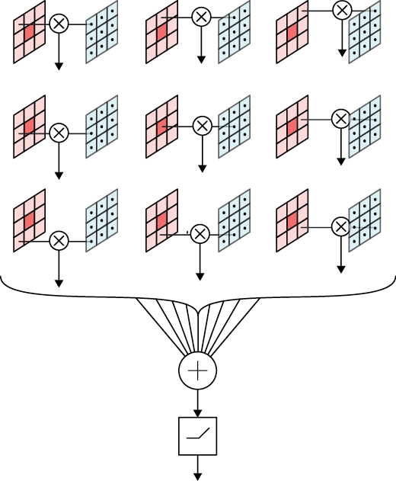
Source: Glassner, A. (2021). Deep learning: A visual approach. San Francisco, CA: No Starch Press. (Chapter 16)
Notes:
This figure provides another view of the convolution process from the perspective of a single neuron, with net input and activation functions. Here we see how a single pixel is processed (shown in dark red). We center the filter over the intended pixel and multiply each of the nine values in the input with its corresponding filter value. We add up all nine results in the net input function and then pass that sum through an activation function.
Note that the neuron pictured here is just like any other neuron. It receives nine numbers as inputs, multiplies each one by its corresponding weight, adds the results together, and passes that number through an activation function. It doesn’t know or care that these nine numbers are coming from a square region of the input, or even that they’re coming from an image.

