Slide 1

Convolutional Neural Networks (Getting Started)
Notes:
Hello and welcome to this first presentation in the Practicum AI Convolutional Neural Networks workshop series. I’m Dan Maxwell, and I will act as your guide and mentor for this learning experience. I currently work as an AI Trainer / Consultant in the Research Computing Department at the University of Florida.
So, let’s get started…

Slide 2
Lesson Overview
JupyterLab / CoLab
Biology of Vision
Image Basics
Vocabulary

Slide 3

Image Credit: https://cktechcheck.com/
Notes:
Students who have not yet validated their HiperGator account should work through the steps in this document:
https://github.com/PracticumAI-Test/HPG_Jupyter_Setup

Slide 4

Notes:
Link: https://github.com/PracticumAI-Test/HPG_Jupyter_Setup

Slide 5
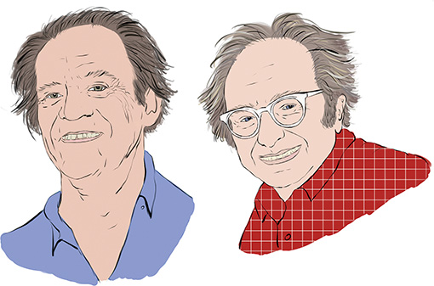
Torsten Wiesel David Hubel
Source: Krohn, J. (2020). Deep Learning Illustrated. New York, NY: Addison-Wesley. (Chapter 1)
Notes:
David H. Hubel & Torsten Wiesel (key names in vision research)
Visual cortex research / experiments on cats 1958 / 1959 – later monkeys.
Nobel Prize in Medicine (1981)
=====
I want to start our CNN workshop series with a brief review of the research on the workings of the human eye. Interestingly, eye research began decades ago. David H. Hubel and Torsten Wiesel performed a series of experiments on cats in 1958 and 1959 (and a few years later with monkeys), giving crucial insights into the structure of the visual cortex. The authors received the Nobel Prize in Physiology or Medicine in 1981 for this work.

Slide 6
Source: Geron, A. (2019). Hands-on machine learning with Sci-Kit learn, Keras, & Tensorflow. Sebastopol, CA: O’Reilly Media. (Chapter 14)
Notes:
Let’s talk briefly about Hubel and Wiesel’s research findings. One of their key discoveries was that many neurons in the visual cortex have a small local receptive field. In other words, some neurons only react to visual stimuli located in a limited region of the visual field. We see that here where the local receptive fields of five neurons are shown as dashed circles. Also, the receptive fields of different neurons may overlap. But taken together, they tile the entire visual field. Hubel and Wiesel also learned that some neurons have larger receptive fields, reacting to more complex patterns or combinations of lower-level patterns.
All this led to the idea that higher level neurons receive input from lower-level neurons. As shown here, the neurons in the second layer are only connected to a few neurons in the first layer. This is called a sparse network. Even so, those connections allow second layer neurons to detect more complex shapes, including triangles, x’s, and so on. The beauty of this architecture lies in its ability to detect all sorts of complex patterns in any part of the visual field.

Slide 7
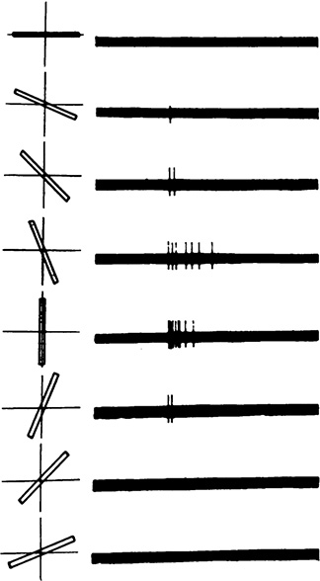
Source: Krohn, J. (2020). Deep Learning Illustrated. New York, NY: Addison-Wesley. (Chapter 1)
Notes:
Hubel and Wiesel also discovered that some neurons only react to images of horizontal lines, while others react to lines with different orientations. Interestingly, two neurons may share the same receptive field, but each reacts to different line orientations. Neurons, in other words, specialize at detecting specific patterns.
Here we see a simple cell in the primary visual cortex of a cat firing at different rates, depending on the orientation of the line shown to it.
=====
Additional information about Hubel and Wiesel’s research is provided in the BiologicalVision.pdf, located in our Practicum Teams workspace. Path: Files -> Textbooks

Slide 8
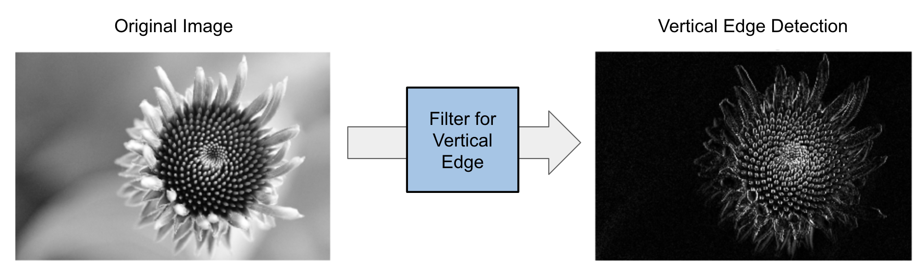
Source: Mirza, R.B. et al. (2021). The deep learning workshop. Birmingham, UK: Packt Publishing. (Chapter 3)
Notes:
So how do we mimic the eye’s ability to detect patterns in its visual field?
Images are unstructured data + features
Features include (lines, circles, rectangles, and so on), colors (red, blue, orange, yellow, and so on), and specific characteristics related to different types of objects (hair, wheel, leaves, and so on)
Our eyes automatically detect features – we mimic this ability with images filters, also called kernels.
Image filters (kernels) are small matrices (tensors) specialized in detecting a defined pattern.
Vertical lines
Horizontal lines
Computer vision systems run such filters on every part of the image, generating a new image with the detected patterns highlighted. These kinds of generated images are called feature maps.
Adobe Photoshop – Gaussian and Sharpen filters
=====
Now once an image has been transformed into a tensor and fed into a CNN, how can we mimic the eye’s ability to detect patterns in its visual field?
Unlike structured data, images don't follow any specific pattern. It is impossible to say, for instance, that the third line will always contain the eye of an animal or that the bottom left corner will always represent a red, round-shaped object. Images can be of anything and don't follow any structure. That’s why images are classified as unstructured data.
However, images do contain features. They contain different shapes (lines, circles, rectangles, and so on), colors (red, blue, orange, yellow, and so on), and specific characteristics related to different types of objects (hair, wheel, leaves, and so on). Our eyes and brain can easily analyze and interpret all these features and identify objects in images. Therefore, we need to simulate the same analytical process for computers. This is where image filters (also called kernels) come into play.
Image filters are small matrices (tensors) specialized in detecting a defined pattern. For instance, we can have a filter for detecting vertical lines only and another one only for horizontal lines. Computer vision systems run such filters in every part of the image and generate a new image with the detected patterns highlighted. These kinds of generated images are called feature maps. An example of a feature map where an edge-detection filter is used is shown here.
Such filters are widely used in image processing. If you've used Adobe Photoshop before (or any other image processing tool), you will have most likely used filters such as Gaussian and Sharpen.

Slide 9
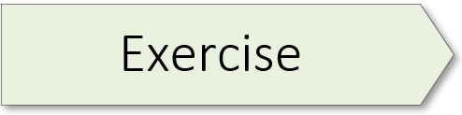
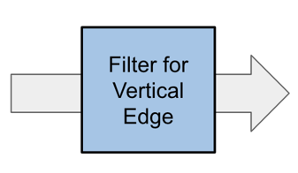
Computer Vision
01.1_vision.ipynb
Notes:
Now that we’ve seen a high-level picture of a vertical edge detection filter, let’s dive into the details of what’s happening inside that blue box. In this learning experience, you will see how a filter is implemented in Python.
=====
Our first hands-on coding exercise comes from Andrew Glassner’s wonderful book Deep Learning: A Visual Approach.

Slide 10
Why do we need Convolutional Neural Networks?
Source: Geron, A. (2019). Hands-on machine learning with Sci-Kit learn, Keras, & Tensorflow. Sebastopol, CA: O’Reilly Media. (Chapter 14)
Notes:
Why CNN’s – why not use fully connected neural networks?
Fully connected works well with small images (28 x 28 pixels – size of MNIST images), not so well with larger images.
A 100 × 100–pixel image has 10,000 pixels, and if the initial layer has just 1,000 neurons, this adds up to a total of 10 million connections. And that’s just the first layer. CNNs solve this problem through partially connected layers and the use of new kinds of layers.
=====
So, why do we need a new kind of neural network? Why not use a deep neural network with fully connected layers for image recognition tasks?
Well, fully connected networks work fine for small images (e.g., MNIST), but they break down for larger images because of the huge number of parameters required. For example, a 100 × 100–pixel image has 10,000 pixels, and if the first layer has just 1,000 neurons (which already severely restricts the amount of information transmitted to the next layer), this means a total of 10 million connections. And that’s just the first layer. CNNs solve this problem through partially connected layers and the use of new kinds of layers.
Source: Geron, A. (2019). Hands-on machine learning with Sci-Kit learn, Keras, & Tensorflow. Sebastopol, CA: O’Reilly Media. (Chapter 14).

Slide 11
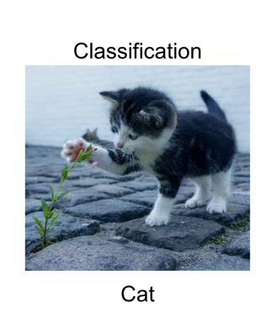
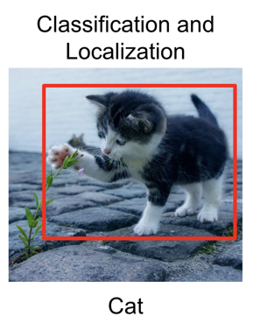
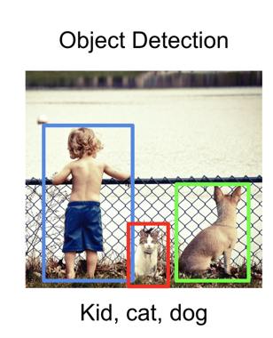
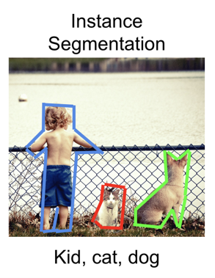
CNN Domains
Source: Mirza, R.B. et al. (2021). The deep learning workshop. Birmingham, UK: Packt Publishing. (Chapter 3)
Notes:
CNN performance has increased dramatically – some CNN models process and interpret images faster and more accurately than humans – Radiology example.
The four different domains:
Image classification, where we need to recognize the main object in an image.
Image classification and localization, where we need to recognize and localize the main object in an image with a bounding box.
Object detection, where we need to recognize multiple objects in an image with bounding boxes.
Image segmentation, where we need to identify the boundaries of objects in an image.
=====
With the advent of convolutional neural networks, the field of computer vision saw some incredible improvements and results. Today, the field of computer vision has advanced to such an extent that, in some cases, computer vision AI systems can process and interpret certain kinds of images faster and more accurately than humans.
Computer vision can be split into four different domains:
Image classification, where we need to recognize the main object in an image.
Image classification and localization, where we need to recognize and localize the main object in an image with a bounding box.
Object detection, where we need to recognize multiple objects in an image with bounding boxes.
Image segmentation, where we need to identify the boundaries of objects in an image

Slide 12
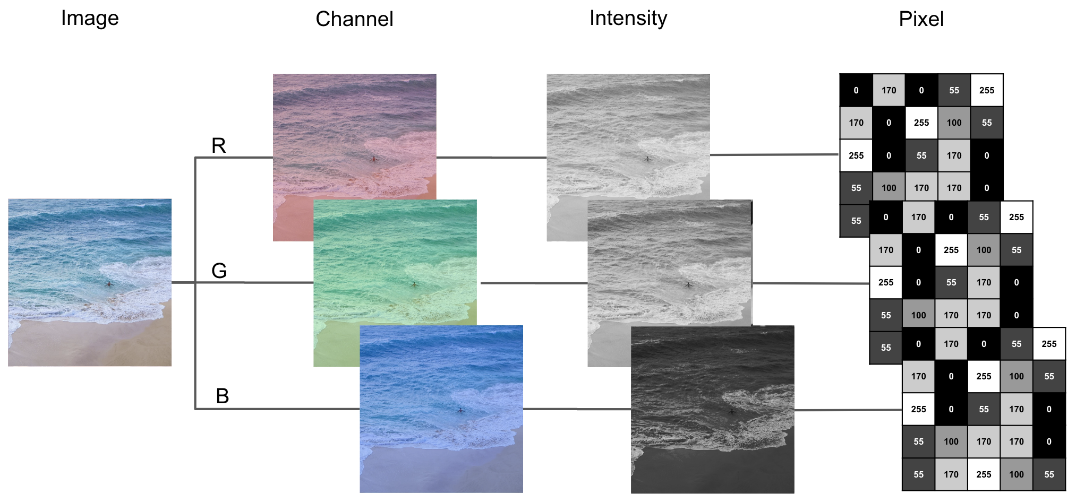
Source: Mirza, R.B. et al. (2021). The deep learning workshop. Birmingham, UK: Packt Publishing. (Chapter 3)
Notes:
Eyes transform light into electrical signals that are then processed by the brain. But computers do not have physical eyes to capture light. They can only process information in digital forms composed of bits (0 or 1). So, to be able to “see", computers require a digitized version of an image.
A digital image is formed by a two-dimensional matrix of pixels. For a grayscale image, each of these pixels can take a value between 0 and 255 that represents its intensity or level of gray. A digital image can be composed of one channel for a black and white image or three channels (red, blue, and green) for a color image:

Slide 13

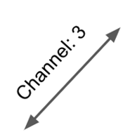

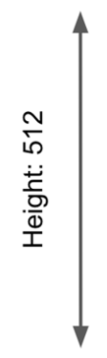
Source: Mirza, R.B. et al. (2021). The deep learning workshop. Birmingham, UK: Packt Publishing. (Chapter 3)
Notes:
A digital image is characterized by its dimensions (height, width, and channel):
Height: The number of pixels on the vertical axis.
Width: The number of pixels on the horizontal axis.
Channel: The number of channels. If there is only one channel, an image is grayscale. If there are three channels, the image is in color.

Slide 14
The MNIST classifier
01.2_mnist.ipynb
Notes:
The MNIST (Modified National Institute of Standards & Technology) dataset is famous in AI. It was curated by Yann LeCun, Corinna Cortes, and Chris Burges in 1998. It consists of 60,000 handwritten digits for model training and 10,000 more for validating the model’s performance on unseen data. Each MNIST digit is a 28 x 28-pixel image. Each pixel is 8-bit, meaning that the pixel darkness can vary from 0 (white) to 255 (black), with the intervening range of integers representing gradually darker shades of gray.
In 1998, Yann LeCun and co-authors introduced the famous LeNet-5 architecture. This model was widely used by banks to recognize handwritten check numbers. In today’s MNIST exercise, you will create a shallow Keras network that does the same thing.
The exercise for this workshop starts on page 123 of The Deep Learning Workshop.

Slide 15
Numbers Vocabulary
atomic
(scalars)
32
vectors
[3,5]
5
3
Notes:
As mentioned earlier, computers only understand numbers. In AI, we use special words to describe the different ways numbers are combined. These combinations assume shapes and those shapes have names. Thus, we need to introduce some numeric vocabulary. AI vocabulary is important and worth learning.
A single number is atomic.
A series of numbers in a single row is a vector.

Slide 16
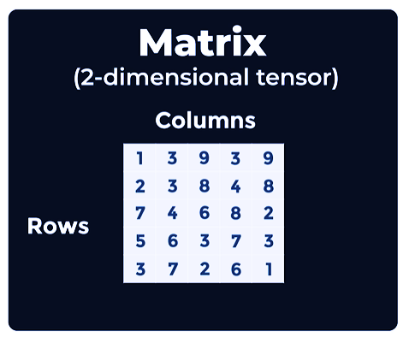
Notes:
A matrix is a 2-dimensional block of numbers comprised of…
Rows
Columns

Slide 17
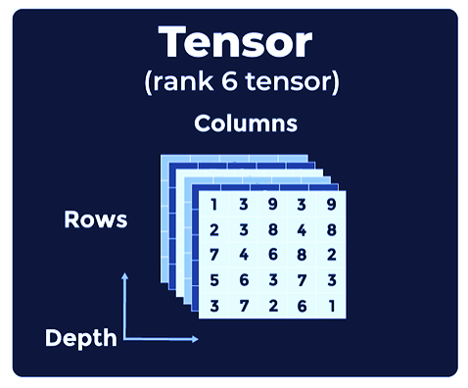
Notes:
We can “stack” matrices and the # in the stack (the dimensions) is the tensor’s rank.

Slide 18
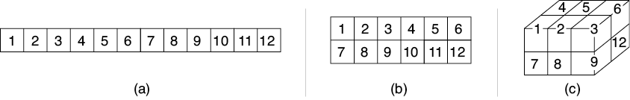
Tensors
Source: Glassner, A. (2021). Deep learning: A visual approach. San Francisco, CA: No Starch Press. (Chapter 13)
Notes:
Let’s summarize what we just learned in the last three slides…
A tensor is a data structure. It’s a block of numbers with a given number of dimensions and a size in each dimension. A tensor has no holes and no bits sticking out. A tensor’s shape is determined by the number of dimensions and the size of each dimension.
A tensor’s shape is a determinant feature.
A single number is atomic.
A row of numbers is a vector. (Rank 1 Tensor)
A set of numbers arranged in rows and columns is a matrix. (Rank 2 Tensor)
A 3-dimensional object filled with numbers is a block / volume. (Rank 3 Tensor)
And finally, a tensor is a generic word we use for any collection of numbers arranged in a box shape with any number of dimensions. Each dimension is called a rank.
=====
So, how does a CNN like the Teachable Machine process images? Keep in mind that computers only understand numbers. Our starting point is a data structure called a tensor.
In our Deep Learning Foundations workshop sequence, we learned that a neural network is built from a sequence of layers. And though the output of any neuron is a single number, we often want to talk about the output of an entire layer at once. The key idea that characterizes this collection of output numbers is its shape. If the layer contains a single neuron, the layer’s output is just a single number.
If we have multiple neurons in a layer, then we can describe their collective output as a list, otherwise known as a one-dimensional (1D) array. Image (A) above shows such an array containing 12 elements. We frequently organize our data into other box-like shapes. For instance, if the input to our system is a black and white image, it can be represented as a 2D array, as pictured in (B). And if it’s a color image, then it can be represented as a 3D array, as shown in (C).
We frequently call a 1D shape an array, list, or vector. To describe a 2D shape we often use the terms grid or matrix, and we can describe a 3D shape as a volume or block. We often use arrays with even more dimensions. But rather than create a mountain of new terms, we use a single term for any collection of numbers arranged in a box shape with any number of dimensions: a tensor (pronounced ten′-sir).
A tensor is merely a block of numbers with a given number of dimensions and a size in each dimension. It has no holes and no bits sticking out. The term tensor has a more complex meaning in some fields of math and physics, but in machine learning, we use this word to mean a collection of numbers organized into a multidimensional block. Taken together, the number of dimensions and the size in each dimension provide the shape of the tensor.

Slide 19

Google AI Glossary
Notes:
https://developers.google.com/machine-learning/glossary

Slide 20

Notes:
Source: Google Teachable Machine: https://teachablemachine.withgoogle.com
Two Locations for the Hanfu/Hanbok dataset
https://drive.google.com/file/d/1q3RIgIoeePNW-fEgNyCgh45gBvMAdeOU/view
https://drive.google.com/file/d/1WbZPzunh6u9f0leymbzmVrJjSxq6JW5w/view?usp=sharing

Slide 21

Notes:
https://playground.tensorflow.org/#activation=tanh&batchSize=10&dataset=circle&regDataset=reg-plane&learningRate=0.03&regularizationRate=0&noise=0&networkShape=4,2&seed=0.25293&showTestData=false&discretize=false&percTrainData=50&x=true&y=true&xTimesY=false&xSquared=false&ySquared=false&cosX=false&sinX=false&cosY=false&sinY=false&collectStats=false&problem=classification&initZero=false&hideText=false

