Slide 1

Data Augmentation
Notes:
Hello everyone. I’m Dan Maxwell – an AI Trainer / Consultant in Research Computing.

Slide 2
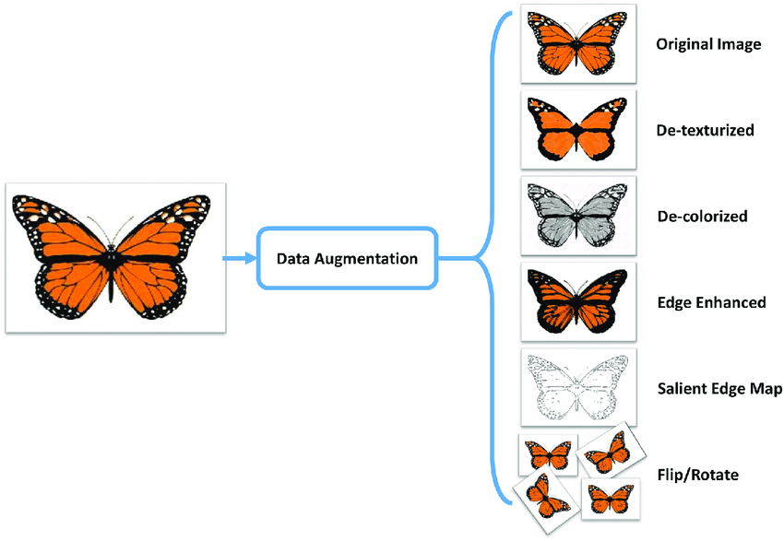
Image Credit: https://medium.com/secure-and-private-ai-writing-challenge/data-augmentation-increases-accuracy-of-your-model-but-how-aa1913468722
Notes:
Data Augmentation – generating multiple variants of an image
But why?
Greater variety of training examples = more robust model
Selfie dataset – all images w/frontal orientation – CNN won’t be able to interpret images taken from other angles, overhead / side-shots, etc…
Generalize better to different types of images
Negative – more images increases training time
Optimize model fit
=====
Okay – so what is data augmentation? Data augmentation is the process of generating new images. By performing data augmentation, we are increasing the number of images in a dataset. Starting with a single image, we can generate, for example, multiple variants of that same image.
But why do we need to perform data augmentation? In our AI ethics workshop, we learned that the composition of a dataset a model trains on is critically important. A greater variety of training examples usually results in a better trained and more robust neural network. Consider the case of an image dataset made up of selfies. Now selfie pictures can be taken from different angles, but if your dataset only contains selfie pictures that are straight in terms of their orientation, your CNN model will not be able to interpret other images with different angles correctly. By performing data augmentation, you help your model generalize better to different types of images. But here’s the drawback: data augmentation also increases the training time as we are now working with a much larger dataset.
In all this, what we’re trying to do is optimize model fit. To describe model fit, let’s begin with a fairly tale…

Slide 3
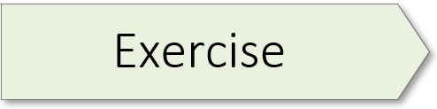
3.04 (Image Classification with Data Augmentation)
Notes:
The learning experience for this workshop starts on page 140 of the textbook. For additional information, please watch the exercise 3.04 orientation video.

Slide 4

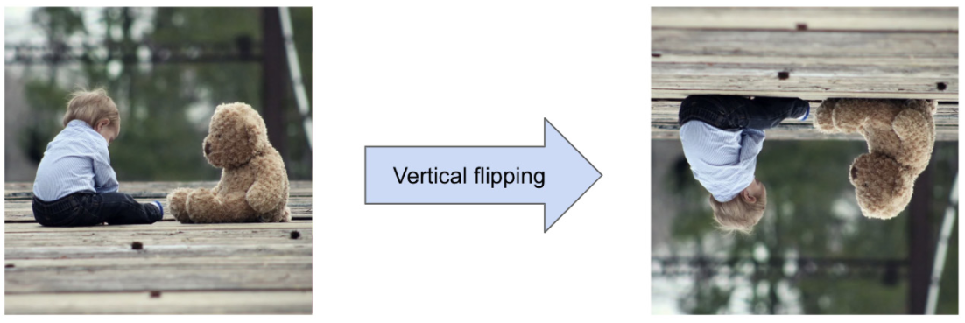
Source: Baig, M.R., et al. (2020). The Deep Learning Workshop. Birmingham, UK: Packt Publishing. (Chapter 3)
Notes:
Now that we have established the need for a diverse training dataset, let’s consider some of the data augmentation techniques presented in the text. As this is available in the text, I will move quickly through the next few slides.
Horizontal flipping returns an image that is flipped horizontally.
Vertical flipping flips an image vertically.

Slide 5

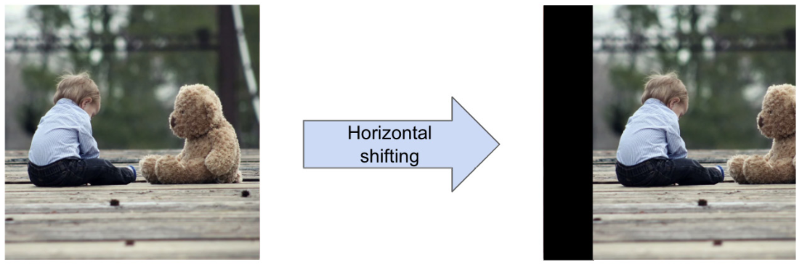
Source: Baig, M.R., et al. (2020). The Deep Learning Workshop. Birmingham, UK: Packt Publishing. (Chapter 3)
Notes:
An image can be zoomed in and provide different sizes of objects in the image.
Horizontal shifting, as its name implies, will shift the image along the horizontal axis but keep it the same size. With this transformation, the image may be cropped, and new pixels generated to fill the void. A common technique is to copy the neighboring pixels or to fill that space with black pixels.

Slide 6
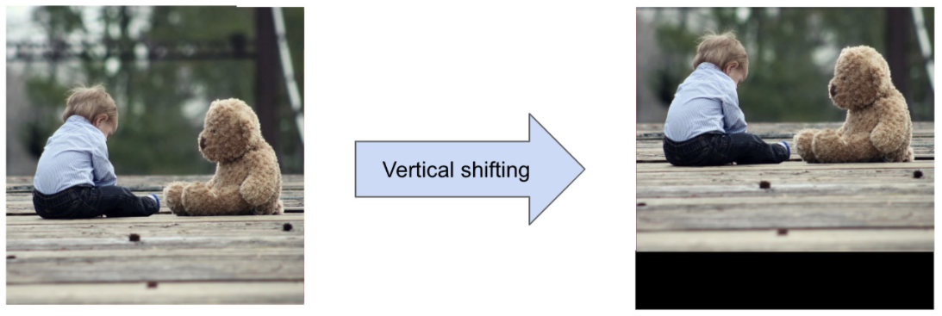
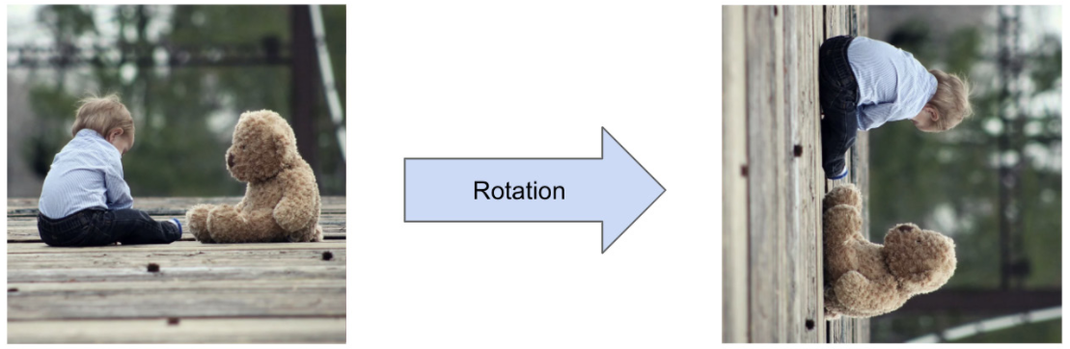
Source: Baig, M.R., et al. (2020). The Deep Learning Workshop. Birmingham, UK: Packt Publishing. (Chapter 3)
Notes:
Vertical shifting is similar to horizontal shifting, but along the vertical axis.
A rotation with a particular angle can be performed as pictured in the second set of images.

Slide 7
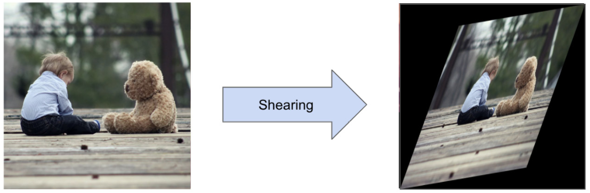
Source: Baig, M.R., et al. (2020). The Deep Learning Workshop. Birmingham, UK: Packt Publishing. (Chapter 3)
Notes:
Shearing transforms the image by moving one of the edges along the axis of the edge. After doing this, the image distorts from a rectangle to a parallelogram.

Slide 8
3.04 (Image Classification with Data Augmentation)
Notes:
The learning experience for this workshop starts on page 140 of the textbook. For additional information, please watch the exercise 3.04 orientation video.

Slide 9
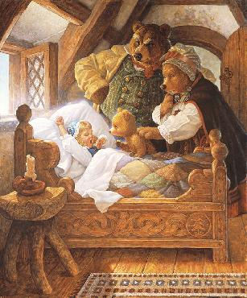
The Goldilocks Problem
Image Credit: https://wenaha.com/product/goldilocks-and-the-three-bears/
Notes:
As a child, you may have read or heard the story of Goldilocks, a little girl who finds an empty cabin in the woods with three empty beds. Goldilocks tries out the first bed and discover that it’s too hard. Then she tries the second bed, and it’s too soft. Finally, she tries the third bed and it’s just right. A peaceful nap ensues until she’s awakened by three bears who ask what she’s doing in their bed. This is often referred to as the Goldilocks problem.
A similar dynamic exists in machine learning. A model can overfit the data, underfit the data, or be just right. And like Goldilocks, it’s often a question of finding that sweet spot, of trying out one model and then another until a proper fit is achieved. Now when we say proper fit, what we’re talking about is a model which makes accurate predictions on the training data but will does so with other data as well. When this happens, the model is said to generalize well. Consider this graph…

Slide 10
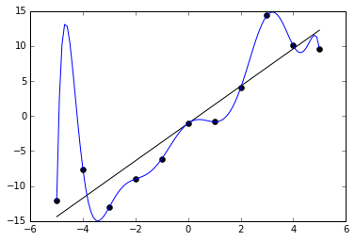
Notes:
Three models, one for each line.
Solid blue line = perfect fit – but how would it do with a new dataset? Model overfits the data.
Dashed green line opposite of blue – 3 datapoints – model underfits the data. Too simple to capture data complexity.
Solid grey line – linear model – appears to be just right.
=====
In this graph, we see three different models, each represented by a different line. The solid blue is a perfect fit to this data. But how do you think this model would extrapolate to a different data set? In this case, the model overfits the data. The situation is just the opposite with the dashed green line. Here the model appears to reference but three data points, ignoring everything else. In this case, the model underfits the data. That is, it’s too simple to accurately capture the complexity of the data. And finally, the solid line is a linear model that appears to be just right. Of the three models, this one will probably generalize best, when faced with a new data set possessing similar characteristics to the one pictured here.
Let’s consider another example…

Slide 11
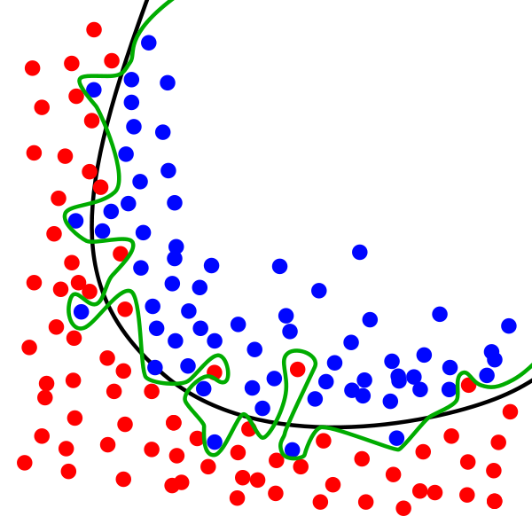

Green
Black
Notes:
Example – two models – squiggly green line / smooth curved black line. Which model will generalize better to other datasets?
Overfitting is "the production of an analysis that corresponds too closely or exactly to a particular set of data and may therefore fail to fit additional data or predict future observations reliably". An overfitted model is a model that contains more parameters than can be justified by the data. The essence of overfitting is to have unknowingly extracted some of the residual variation (i.e. the noise) as if that variation represented underlying model structure.
Underfitting: model is too simple to learn the underlying structure of the data.
=====
Here we see a data set divided into two groups, one red, the other blue. Now take a good look at the two models, the first represented by the squiggly green line, the second represented by the smooth, curved black line. Of these two models, which one overfits the data? And which one will generalize better?
Before moving on, let’s provide some formal definitions. In machine learning, overfitting is "the production of an analysis that corresponds too closely or exactly to a particular set of data and may therefore fail to fit additional data or predict future observations reliably". An overfitted model is a model that contains more parameters than can be justified by the data. The essence of overfitting is to have unknowingly extracted some of the residual variation (i.e. the noise) as if that variation represented underlying model structure.
Underfitting is just the opposite of overfitting. It occurs when your model is too simple to learn the underlying structure of the data.

Slide 12
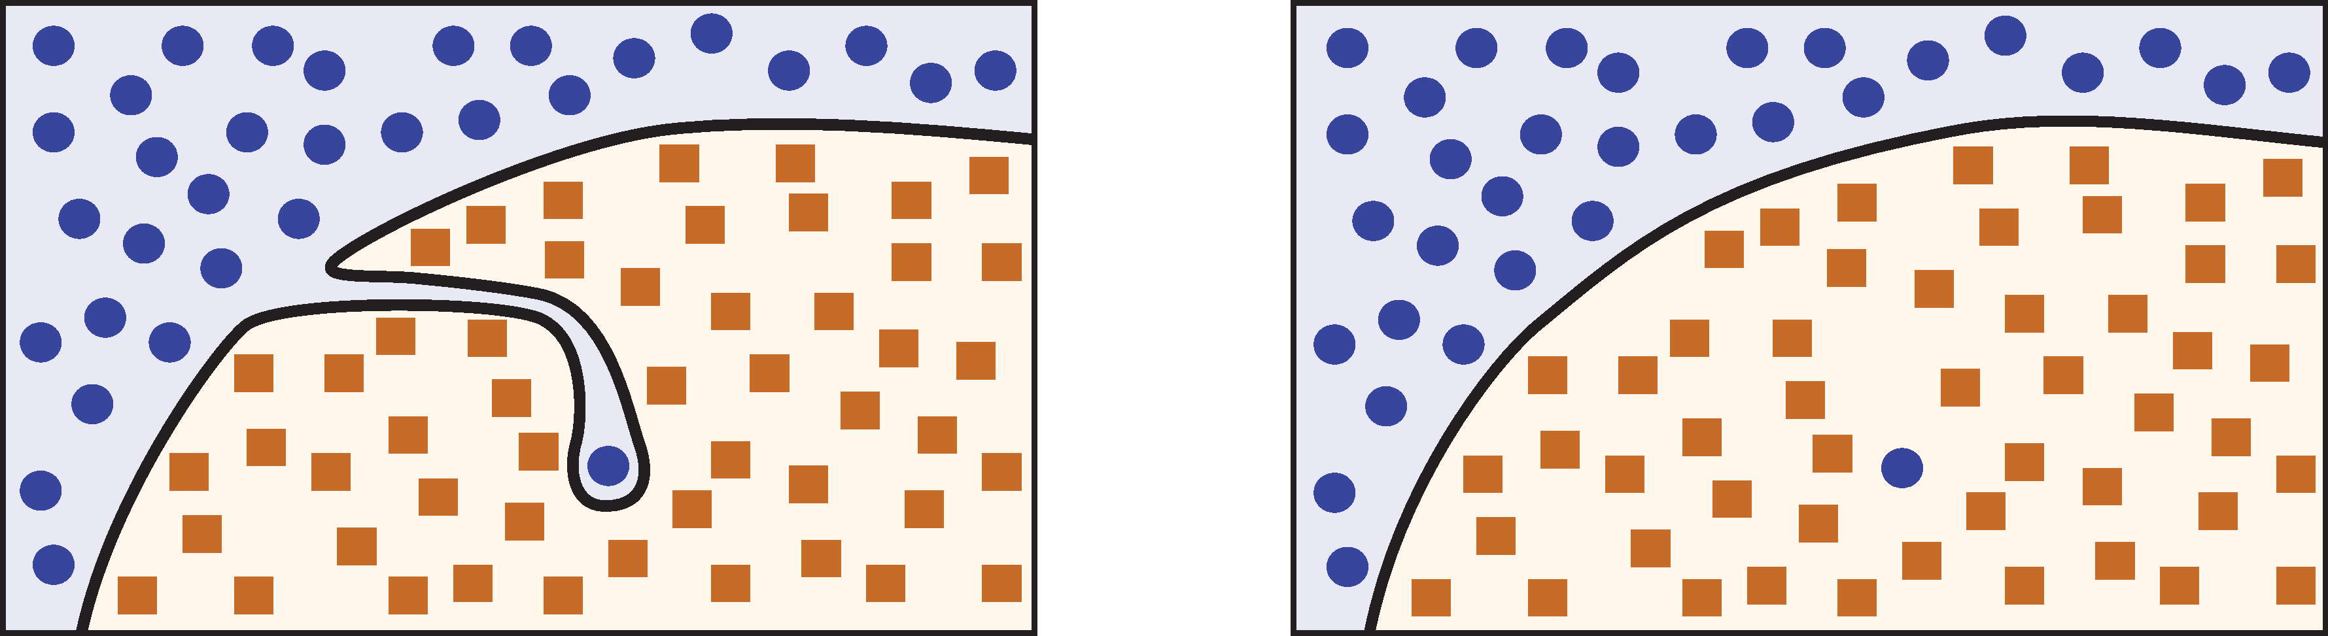
Source: Glassner, A. (2021). Deep learning: A visual approach. San Francisco, CA: No Starch Press. (Chapter 9)
Notes:
Overfitting byproduct of outliers.
Outlier in left image – identify & remove outliers
Simple model on right will generalize better
=====
Often, overfitting is a byproduct of outliers. Consider the image on the left. We have one circular point deep in square territory, resulting in a complicated boundary curve. We call this kind of isolated point an outlier. By drawing the boundary to accommodate this one data point, we risk misclassifying some future data points as blue circles, even though they are solidly inside the brown square region. Here a single outlier has contributed to model overfit, thereby highlighting the importance of identifying and possibly removing outliers from a dataset. The simpler model curve on the right will generalize better and is preferable in this case.

Slide 13
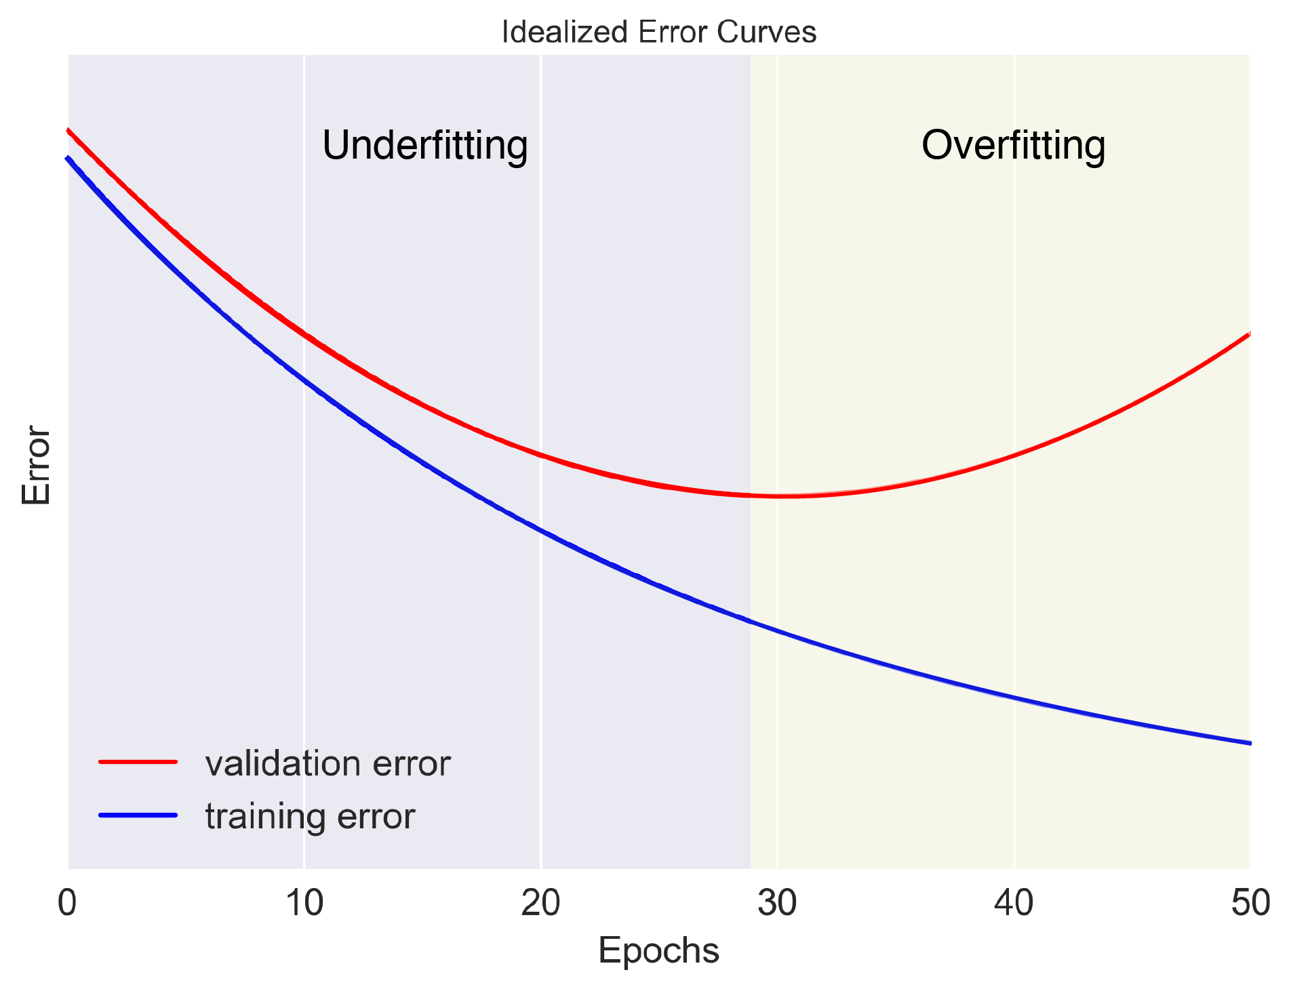
Source: Glassner, A. (2021). Deep learning: A visual approach. San Francisco, CA: No Starch Press. (Chapter 9)
Notes:
So, what does overfit look like when we’re training a neural network? In this image, we see that the training error continues to decrease as we move into the zone of overfitting while the validation error is going up. That’s because we’re still learning from the training data, but now we’re learning information specific to a given dataset, rather than general rules. It’s the performance of the validation set that lets us see that this is happening, because our validation error (an estimate of the generalization error) is getting worse.
Generally speaking, when we start training our model, we are underfitting. That is, the model hasn’t seen enough examples yet to figure out how to handle them properly. As we train more and the model refines its boundaries, the training and validation errors both typically drop, as we see here. At some point, we will discover that although the training error is continuing to drop, the validation error starts to rise. Now we’re overfitting. So, our rule of thumb is this: When we start to overfit, stop training. In this example, that happens at around 28 epochs. The technique of ending training just as validation error begins to rise is called early stopping.

Slide 14
Preventing Overfit
Simplify the model
Collect more training data
Reduce the noise in the training data
Regularization
Notes:
So, your model has overfit the data. What do you do now? Here’s some ways to address that problem…
Simplify the model by selecting one with fewer parameters (for example, a simple linear model as opposed to a high-degree polynomial one), by reducing the number of attributes in the training data, or by constraining the model.
Collect more training data. Sometimes, your data set is just too small and consequently the algorithm overcompensates for what’s not there.
Reduce the noise in the training data. Fix data errors, impute missing values, and possibly remove outliers.
Use regularization methods to prevent overfit. Let’s take a closer look at regularization.

Slide 15
Regularization (λ)
Source: Glassner, A. (2021). Deep learning: A visual approach. San Francisco, CA: No Starch Press. (Chapter 9)
Notes:
Training goal: squeeze as much information as we can out of the training data.
Early stopping when validation error begins to rise. Could we delay this phenomenon – train longer & lower training / validation errors?
Turkey example – high heat leads to burn – prevent this? – wrap in aluminum foil
Techniques to delay onset of overfitting are regularization methods or regularization.
Regularization hyperparameter – lowercase Greek lambda – larger lambda values greater regularization
Other regularization options – dropout, batch norm, layer norm, and weight regularization
Definition: Constraining a model to make it simpler and reduce the risk of overfitting is called regularization
=====
We always want to squeeze as much information as we can out of our training data, stopping just short of overfitting. Early stopping ends learning when the validation error starts rising, but what if there was a way to delay that phenomenon, so we can train longer and continue to push down both training a validation errors?
By analogy, consider cooking a turkey in the oven. If we just put the turkey in a pan and cook it on high heat, the outside eventually starts to burn. But what if we want to cook the turkey longer without burning it? One way to do that is to wrap it in aluminum foil. The foil delays the onset of burning, letting us cook the turkey longer.
The techniques that delay the onset of overfitting are collectively known as regularization methods, or simply regularization. We typically specify the amount of regularization to apply with a hyperparameter that’s traditionally written as a lowercase Greek lambda. Other letters are sometimes used. Most commonly, larger values for lambda mean more regularization. Neural networks have additional regularization options – including dropout, batch norm, layer norm, and weight regularization.
Here’s a definition I like: Constraining a model to make it simpler and reduce the risk of overfitting is called regularization.

Slide 16
Preventing Underfit
Select a more powerful model
Feed better features to the learning algorithm
Reduce the constraints on the model
Notes:
And here are some options when your model underfits a data set.
Select a more powerful model, with more parameters. Sometimes, the simplest solution is not the best answer.
Feed better features to the learning algorithm – also known as feature engineering. A feature, by the way, is an individual measurable property or characteristic of a phenomenon being observed – the mpg on a new car, for instance.
Reduce the constraints on the model. This is most often done by reducing the regularization hyperparameter.

Slide 17
3.04 (Image Classification with Data Augmentation)
Notes:
The learning experience for this workshop starts on page 140 of the textbook. For additional information, please watch the exercise 3.04 orientation video.

Slide 19


Multi-Select Multiple Choice
Single Answer Multiple Choice
Word Cloud

