Slide 1

Data Terminology & Data Types

Slide 2
Data is the New Oil
Notes:
Clive Humby, 2006.
Data powers deep learning AI systems
=====
In 2006, a British entrepreneur named Clive Humby coined the phrase “Data is the new oil.” Data powers A.I. systems, and it comes in a variety of formats. Thus, data is a logical starting point for thinking about AI. So, what kinds of data are you presently working with?
Slide taken from: 04_practicum_intro.pptx in the What is AI workshop

Slide 3
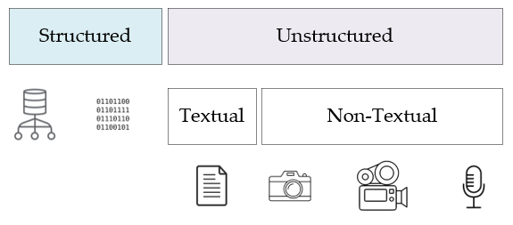
Source: Inmon, W. H. (2019). Data architecture: A primer for the data scientist. Cambridge, MA: Academic Press
Notes:
Bill Inman – Data Architecture: A Primer for the Data Scientist – structured / unstructured data – most data is unstructured
Structured data – contained in rows and columns – two types
Database management systems (Oracle, SQLServer, MySQL, and PostGres)
Repetitive data (sensor output, telephone call records, metered data, etc…)
Unstructured data – not contained in row-column databases – each record is unique – two types
Textual – emails, transcribed conversations, literary texts
Non-Textual – images, video, and audio recordings
=====
In his book, Data Architecture: A Primer for the Data Scientist, Bill Inman makes a distinction between two foundational types of data – between structured data and its unstructured counterpart. As he points out, most of the world’s data is unstructured. So, what’s the difference between the two?
Structured data is easy to search and organize because it is usually contained in rows and columns and its elements can be mapped into fixed, pre-defined fields. Structured data is of two types. The first type is data which comes from a database management system – Oracle, SQLServer, etc… The Epic healthcare system – used by UF Health – is a structured data source, though it also stores unstructured text data in the form of physician notes. The second is repetitive data, consisting of structured records coming from a variety of non-database sources. Some examples of repetitive data include sensor output, telephone call records, metered data, and so forth.
Unstructured data is data that cannot be contained in a row-column database and does not have an associated data model. Each record is unique in terms of its structure and content. Now there are two types of unstructured data – textual and non-textual. Examples of textual data include emails, transcribed conversations, literary texts, and so on. Non-textual data includes images, video, and audio recordings.
Slide taken from: 04_practicum_intro.pptx in the What is AI workshop

Slide 4
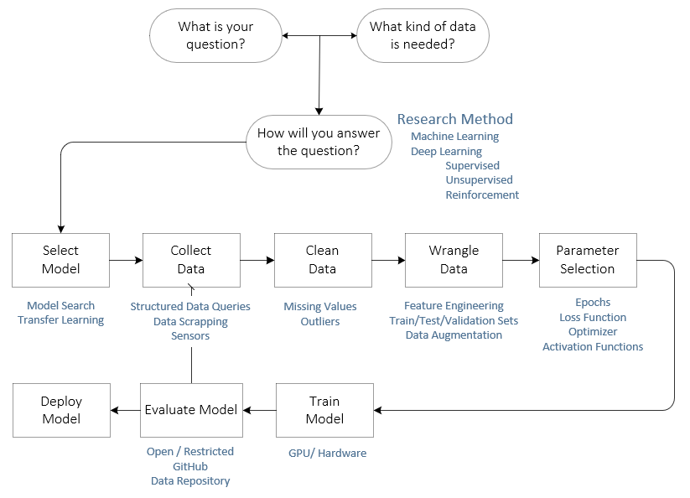
Notes:
Here’s the complete workflow – the next slide shows how the College of Medicine presented a similar workflow.

Slide 5
atomic
(scalars)
32
vectors
[3,5]
5
3
Notes:
A single number is said to be atomic.
In machine learning, a vector is a list of numbers. The more precise mathematical definition states that a vector

Slide 6
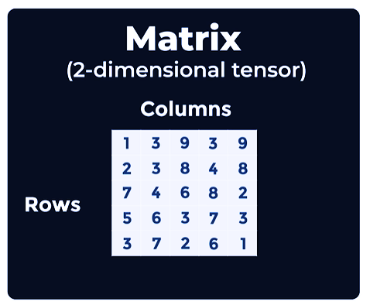
Notes:
The # of dimensions is the tensor’s rank

Slide 7
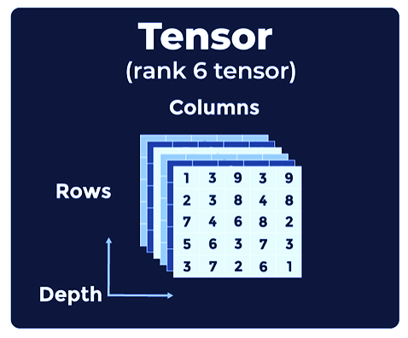

Slide 8
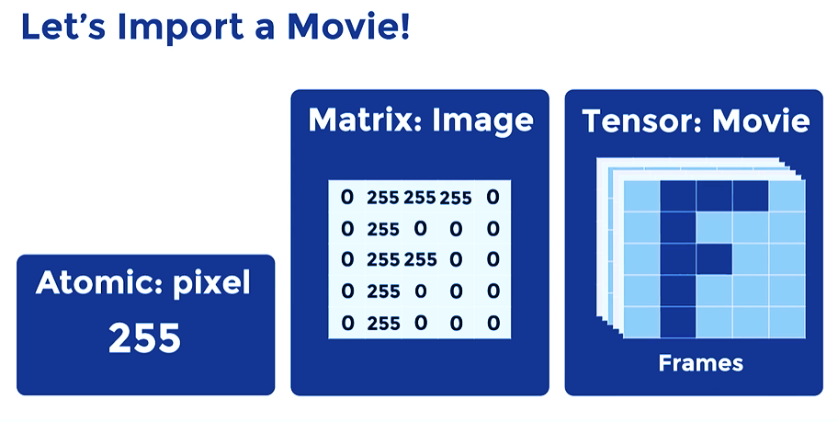

Slide 9
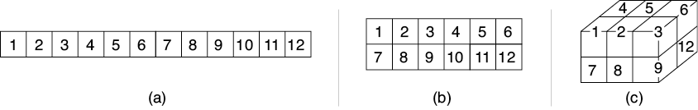
Tensors
Source: Glassner, A. (2021). Deep learning: A visual approach. San Francisco, CA: No Starch Press. (Chapter 13)
Notes:
Importance of technical terms
Computers only understand numbers – How does a CNN process images?
The answer is a data structure called a tensor
Key idea that characterizes a collection of numbers is its shape.
A neural network layer with 1 neuron outputs a single number
But if we have multiple neurons in a layer, then we can describe their collective output as a list, otherwise known as a one-dimensional (1D) array
If the input to our CNN is a black and white image, it can be represented as a 2D array
And if it’s a color image, then it can be represented as a 3D array
A tensor is a block of numbers with a given number of dimensions and a size in each dimension. It has no holes and no bits sticking out. The term tensor has a more complex meaning in some fields of math and physics, but in machine learning, we use this word to mean a collection of numbers organized into a multidimensional block. Taken together, the number of dimensions and the size in each dimension provide the shape of the tensor.
=====
So, how does a CNN like the Teachable Machine process images? Keep in mind that computers only understand numbers. Our starting point is a data structure called a tensor.
In our Deep Learning Foundations workshop sequence, we learned that a neural network is built from a sequence of layers. And though the output of any neuron is a single number, we often want to talk about the output of an entire layer at once. The key idea that characterizes this collection of output numbers is its shape. If the layer contains a single neuron, the layer’s output is just a single number.
If we have multiple neurons in a layer, then we can describe their collective output as a list, otherwise known as a one-dimensional (1D) array. Image (A) above shows such an array containing 12 elements. We frequently organize our data into other box-like shapes. For instance, if the input to our system is a black and white image, it can be represented as a 2D array, as pictured in (B). And if it’s a color image, then it can be represented as a 3D array, as shown in (C).
We frequently call a 1D shape an array, list, or vector. To describe a 2D shape we often use the terms grid or matrix, and we can describe a 3D shape as a volume or block. We often use arrays with even more dimensions. But rather than create a mountain of new terms, we use a single term for any collection of numbers arranged in a box shape with any number of dimensions: a tensor (pronounced ten′-sir).
A tensor is merely a block of numbers with a given number of dimensions and a size in each dimension. It has no holes and no bits sticking out. The term tensor has a more complex meaning in some fields of math and physics, but in machine learning, we use this word to mean a collection of numbers organized into a multidimensional block. Taken together, the number of dimensions and the size in each dimension provide the shape of the tensor.
Slide taken from: 01_cnn_intro.pptx in the CNN workshop

Slide 11
What is your question?
How will
you answer the question?
Select
Model
Clean
Data
Collect
Data
What kind
of data is needed?
Research Method
Machine Learning
Deep Learning
Supervised
Unsupervised Reinforcement
Model Search
Transfer Learning
Structured Data Queries
Data Scrapping
Sensors
Missing Values
Outliers
Wrangle
Data
Parameter
Selection
Train
Model
Feature Engineering
Train/Test/Validation Sets
Data Augmentation
Epochs
Loss Function
Optimizer
Activation Functions
GPU/Hardware
Evaluate
Model
Deploy
Model
Open/Restricted
Github
Data Repository

Slide 12
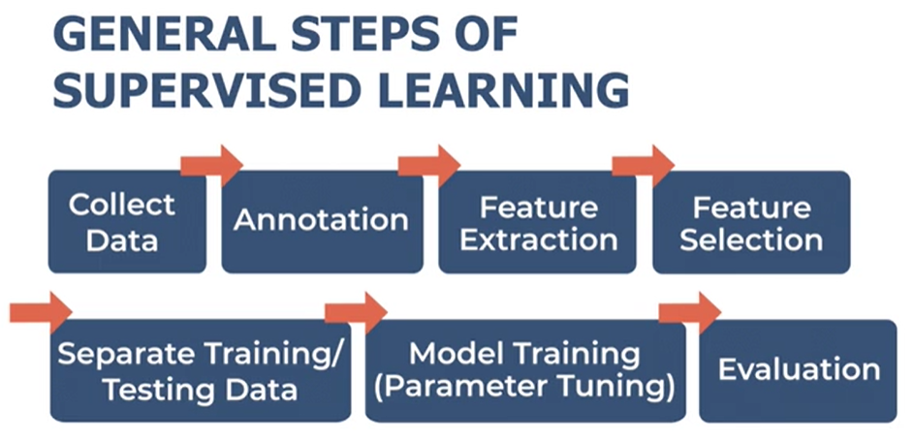

Slide 13
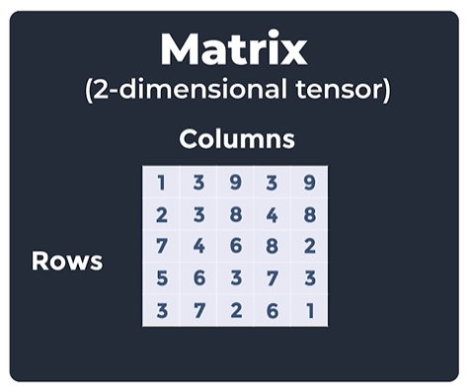
Notes:
The # of dimensions is the tensor’s rank

Slide 14
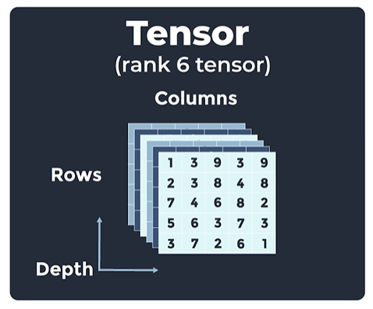

Slide 15
