Slide 1

Data Vocabulary

Slide 2
atomic
(scalars)
32
vectors
[3,5]
5
3
Notes:
A single number is said to be atomic.
In machine learning, a vector is a list of numbers. The more precise mathematical definition states that a vector

Slide 3
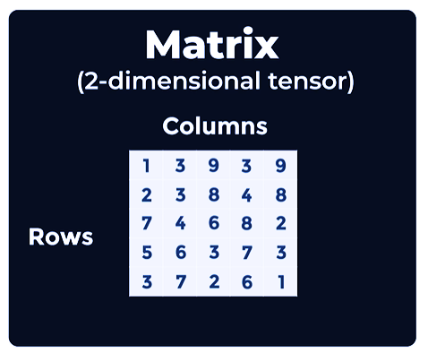
Notes:
The # of dimensions is the tensor’s rank

Slide 4
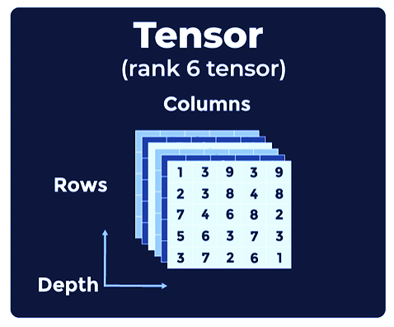

Slide 5
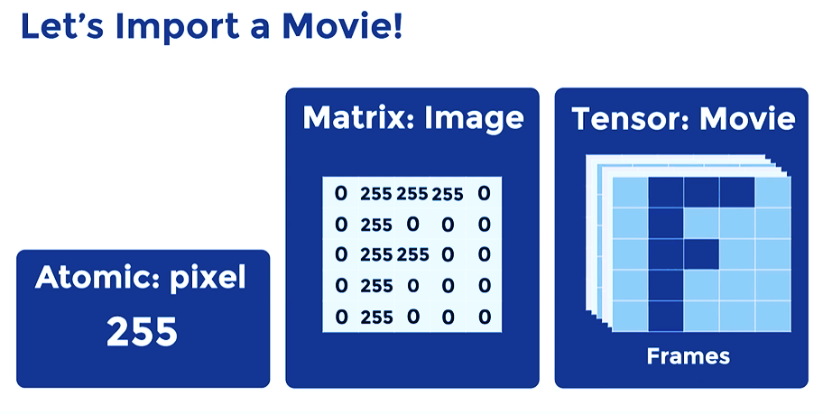

Slide 6
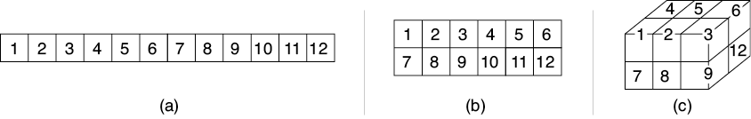
Tensors
Source: Glassner, A. (2021). Deep learning: A visual approach. San Francisco, CA: No Starch Press. (Chapter 13)
Notes:
Importance of technical terms
Computers only understand numbers – How does a CNN process images?
The answer is a data structure called a tensor
Key idea that characterizes a collection of numbers is its shape.
A neural network layer with 1 neuron outputs a single number
But if we have multiple neurons in a layer, then we can describe their collective output as a list, otherwise known as a one-dimensional (1D) array
If the input to our CNN is a black and white image, it can be represented as a 2D array
And if it’s a color image, then it can be represented as a 3D array
A tensor is a block of numbers with a given number of dimensions and a size in each dimension. It has no holes and no bits sticking out. The term tensor has a more complex meaning in some fields of math and physics, but in machine learning, we use this word to mean a collection of numbers organized into a multidimensional block. Taken together, the number of dimensions and the size in each dimension provide the shape of the tensor.
=====
So, how does a CNN like the Teachable Machine process images? Keep in mind that computers only understand numbers. Our starting point is a data structure called a tensor.
In our Deep Learning Foundations workshop sequence, we learned that a neural network is built from a sequence of layers. And though the output of any neuron is a single number, we often want to talk about the output of an entire layer at once. The key idea that characterizes this collection of output numbers is its shape. If the layer contains a single neuron, the layer’s output is just a single number.
If we have multiple neurons in a layer, then we can describe their collective output as a list, otherwise known as a one-dimensional (1D) array. Image (A) above shows such an array containing 12 elements. We frequently organize our data into other box-like shapes. For instance, if the input to our system is a black and white image, it can be represented as a 2D array, as pictured in (B). And if it’s a color image, then it can be represented as a 3D array, as shown in (C).
We frequently call a 1D shape an array, list, or vector. To describe a 2D shape we often use the terms grid or matrix, and we can describe a 3D shape as a volume or block. We often use arrays with even more dimensions. But rather than create a mountain of new terms, we use a single term for any collection of numbers arranged in a box shape with any number of dimensions: a tensor (pronounced ten′-sir).
A tensor is merely a block of numbers with a given number of dimensions and a size in each dimension. It has no holes and no bits sticking out. The term tensor has a more complex meaning in some fields of math and physics, but in machine learning, we use this word to mean a collection of numbers organized into a multidimensional block. Taken together, the number of dimensions and the size in each dimension provide the shape of the tensor.
Slide taken from: 01_cnn_intro.pptx in the CNN workshop

Slide 7
Questions, Data, Methods

Slide 8
Getting Started
Notes:
So, how does one get an AI project off the ground? Typically, a project begins with a research question or idea for a product. But sometimes a unique dataset sets a project in motion. When that’s the case, the data informs and delimits the “askable” questions. The data and questions, in turn, drive the selection of suitable AI methods and techniques. Question, data, and method all mutually influence each other – as pictured here with the bi-directional arrows. In other words, you cannot think of one in isolation from the other two.

Slide 9
Data is the New Oil
Notes:
Clive Humby, 2006.
Data powers deep learning AI systems
=====
In 2006, a British entrepreneur named Clive Humby coined the phrase “Data is the new oil.” Data powers A.I. systems, and it comes in a variety of formats. Thus, data is a logical starting point for thinking about AI. So, what kinds of data are you presently working with?
Slide taken from: 04_practicum_intro.pptx in the What is AI workshop

Slide 10
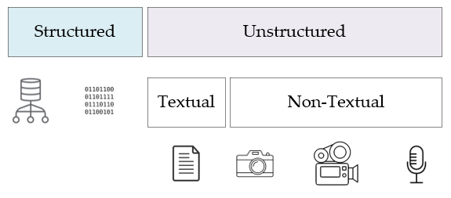
Source: Inmon, W. H. (2019). Data architecture: A primer for the data scientist. Cambridge, MA: Academic Press
Notes:
Bill Inman – Data Architecture: A Primer for the Data Scientist – structured / unstructured data – most data is unstructured
Structured data – contained in rows and columns – two types
Database management systems (Oracle, SQLServer, MySQL, and PostGres)
Repetitive data (sensor output, telephone call records, metered data, etc…)
Unstructured data – not contained in row-column databases – each record is unique – two types
Textual – emails, transcribed conversations, literary texts
Non-Textual – images, video, and audio recordings
=====
In his book, Data Architecture: A Primer for the Data Scientist, Bill Inman makes a distinction between two foundational types of data – between structured data and its unstructured counterpart. As he points out, most of the world’s data is unstructured. So, what’s the difference between the two?
Structured data is easy to search and organize because it is usually contained in rows and columns and its elements can be mapped into fixed, pre-defined fields. Structured data is of two types. The first type is data which comes from a database management system – Oracle, SQLServer, etc… The Epic healthcare system – used by UF Health – is a structured data source, though it also stores unstructured text data in the form of physician notes. The second is repetitive data, consisting of structured records coming from a variety of non-database sources. Some examples of repetitive data include sensor output, telephone call records, metered data, and so forth.
Unstructured data is data that cannot be contained in a row-column database and does not have an associated data model. Each record is unique in terms of its structure and content. Now there are two types of unstructured data – textual and non-textual. Examples of textual data include emails, transcribed conversations, literary texts, and so on. Non-textual data includes images, video, and audio recordings.
Slide taken from: 04_practicum_intro.pptx in the What is AI workshop

Slide 11
Methods
Machine Learning
Regression
Principle Component Analysis
Decision Trees
Support Vector Machines
Others…
Deep Learning
Supervised
Unsupervised
Semi-Supervised
Reinforcement
Notes:
Methods and techniques fall into two primary categories – machine learning and deep learning. ML algorithms rose to prominence in the 1990’s, with advances in computer hardware. Deep learning, on the other hand, came into its own shortly after 2010. This second revolution was powered by Graphic Processing Units (GPUs), plentiful data, and deep learning frameworks – first Tensorflow and then Pytorch.

Slide 12
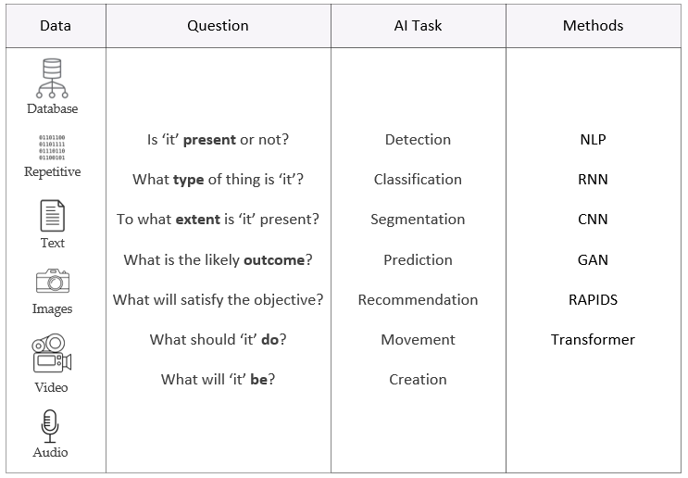
Notes:
Review acronyms in Methods column
=====
With our primary data sources identified, let’s organize everything in a table. On the leftmost column, our data sources are listed, followed by a column of generic questions we might like to ask of our data, another column which lists the related AI task for each question, and finally a column of AI methods and technologies. This table, then, becomes a roadmap to guide your AI learning. The question and AI task columns are self-explanatory, but I’d like to take a few seconds to unpack the abbreviations in the Methods column. Don’t worry about the vocabulary at this point as these terms will be defined in our workshops. But let’s quickly run through the acronyms in the Methods column. NLP – Natural Language Processing; RNN – Recurrent Neural Network; CNN – Convolutional Neural Network; GAN – Generative Adversarial Network; RAPIDS – Nvidia’s data science framework; Transformer – A new kind of neural network.
We will now consider each data source, the types of questions one can ask of each, and the associated AI methods.

Slide 13
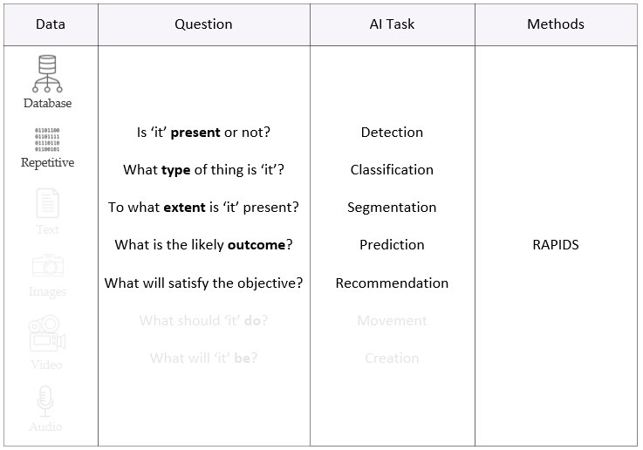
Notes:
Nvidia’s RAPIDS development environment best for structured data
cuDF similar to popular Pandas library
Support for dataframes, data cleaning, and data management
Huge performance boost – 10 to 100 times faster
=====
In the case of structured data – data derived from databases or repetitive data from sensors – the Nvidia RAPIDS development environment is your best starting point. RAPIDS provides a set of useful libraries, with machine learning functions for almost any research task. The RAPIDS cuDF library, for example, is equivalent to the popular Pandas library which supports dataframes as well as basic data management and cleaning.

Slide 14
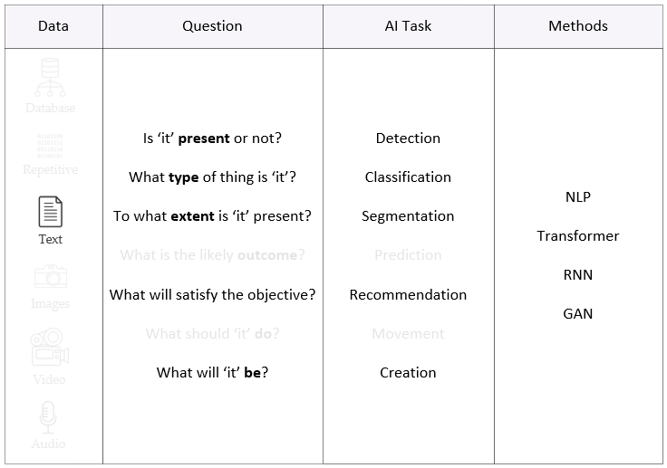
Notes:
Text generating GANs are a unique animal, different from GANs used to generate images
=====
With text data, transformers and recurrent neural networks are established deep learning technologies, appropriate for detection, classification, segmentation, recommendation, and creation tasks. These will solve most text problems, or at least get you started in the right direction. Generative Adversarial Networks or GANs are another choice. However, keep in mind that text generating GANs are a unique animal, different and distinct from GANs used to generate images.

Slide 15
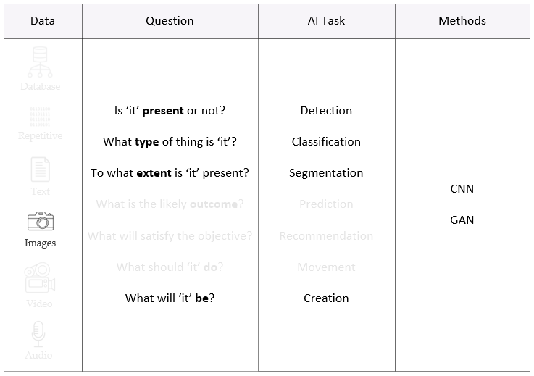
Notes:
Convolutional neural networks – bread and butter of image work.
Special models for single shot detection and real time object detection.
Recent development – transformers + GANs = TransGAN. Also, diffusion models are gaining traction.
=====
Convolutional neural networks (CNNs) have been the bread and butter of the image world for some time now. In short, CNNs do it all. For image creation, GANs continue to be the tool of choice, typically constructed with CNN components. Another recent development has been the merging of transformers and GANs, with TransGAN being a prominent example.
For detection, consider single shot detection models (SSDs) or YOLO (real-time object detection). Faster-RCNN or EfficientDet are also options, depending on the computational resources available. Classification is a typical CNN task, with ResNet and its variants being popular. And finally – for segmentation tasks – Mask-RCNN or Unet ought to be considered.

Slide 16
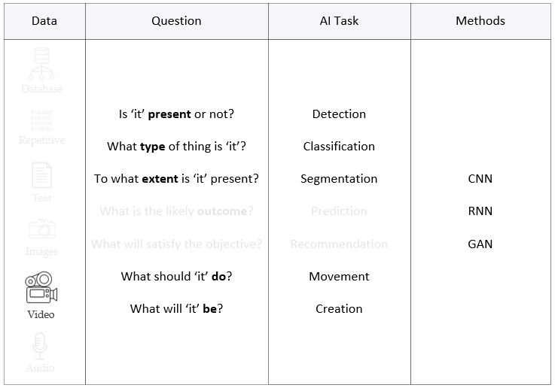
Notes:
Video data is unique in that it is a time series of images
CNNs paired with RNNs as there is both temporal and spatial characteristics
New development is video GANs which generate new frames, one by one – Cutting edge technology
=====
Video data is unique, being a time series of images. As with image data, convolutional neural networks have captured most of this market, though CNNs are frequently paired with RNNs as there is both temporal and spatial characteristics in each image frame. With video, single and multi-object tracking is also possible. Interestingly, there are now video GANs, which basically build frame by frame what it thinks the video should look like. This is cutting-edge technology.

Slide 17
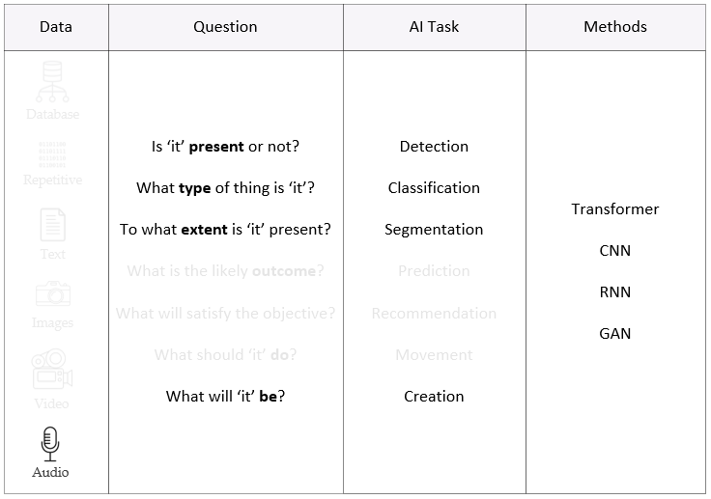
Notes:
Audio interesting format
MEL spectrum representation – 2D spectrogram of a recording
Audio is time series, just like video
=====
Audio is another interesting format. Many audio methods are derived from a MEL spectrum representation, a 2D spectrogram of the recording. Like video, audio is also a time series. Transformers, CNNs, RNNs, and GANs can all be used with audio data. Now that we have covered the various types of data and their associated methods, it’s time to do something practical.

Slide 18
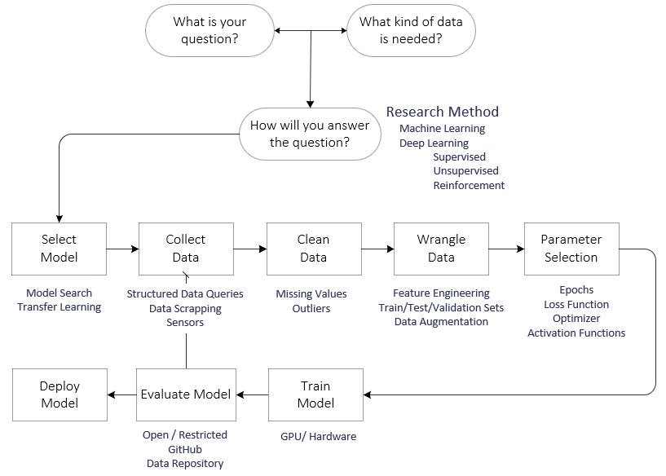
Notes:
The full AI-project lifecycle is shown here. Interestingly, data-related activities usually consume about 80% of project time. Given that fact, Andrew Ng – one of the world’s leading AI experts – recently launched a Data-Centric AI movement. His argument is simple. Data is the most important ingredient in a deep learning project. And I agree.

Slide 19

What do you want to do?
Question
What?
Why?
How?
Method
Machine Learning
Deep Learning
Data
Structured (Databases)
Repetitive (Sensors, Instruments)
Textual (Documents, Email, Web)
Non-Textual (Images, Video, Audio)
Notes:
We have now arrived at our hands-on activity. Take a minute to describe the AI project you’d like to execute. What’s your question? What machine learning or deep learning methods do you think are appropriate? And what kind of data will you need to collect?

Slide 21
What is your question?
How will
you answer the question?
Select
Model
Clean
Data
Collect
Data
What kind
of data is needed?
Research Method
Machine Learning
Deep Learning
Supervised
Unsupervised Reinforcement
Model Search
Transfer Learning
Structured Data Queries
Data Scrapping
Sensors
Missing Values
Outliers
Wrangle
Data
Parameter
Selection
Train
Model
Feature Engineering
Train/Test/Validation Sets
Data Augmentation
Epochs
Loss Function
Optimizer
Activation Functions
GPU/Hardware
Evaluate
Model
Deploy
Model
Open/Restricted
Github
Data Repository

Slide 22
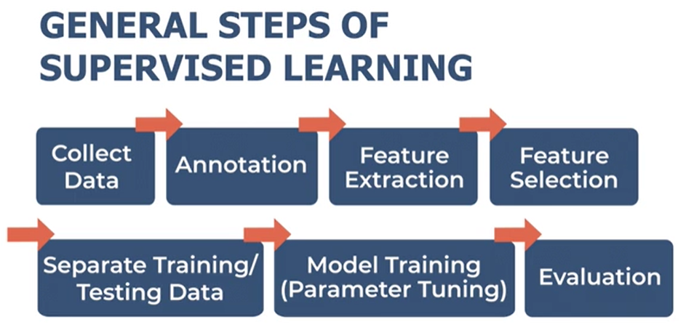

Slide 23
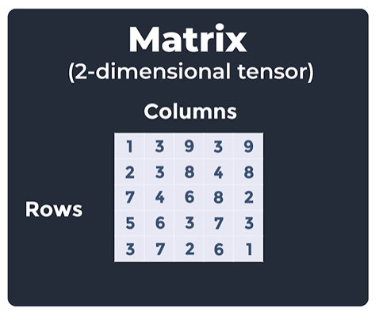
Notes:
The # of dimensions is the tensor’s rank

Slide 24
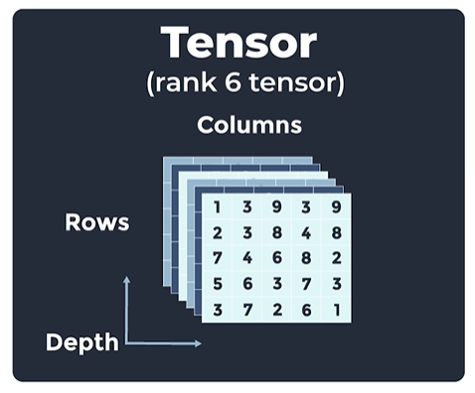

Slide 25
