Slide 1

AI Ethics
Notes:
Hello and welcome to the AI Ethics segment of our Deep Learning Workshop…

Slide 2
Agenda
Why Ethics Matter in AI
Two Philosophical Frameworks
Unbalanced (Biased) Data
Model Ethics
Notes:
Here’s a quick look at today’s agenda.
Once you’ve completed today’s workshop, our hope is that you will ‘understand some of the basic ethical issues related to artificial intelligence.
To motivate today’s learning, let’s take a trip back in time…

Slide 3

Notes:
IBM – computer company of the 1930’s
Tabulating machines
Population statistics
=====
In the late 1930’s, IBM was the computing giant of its day, a position it held into the late 1980’s. The company manufactured tabulating machines, an incredibly important and useful technology for census work. The machinery IBM manufactured allowed governments to create a statistical picture of their population.

Slide 4
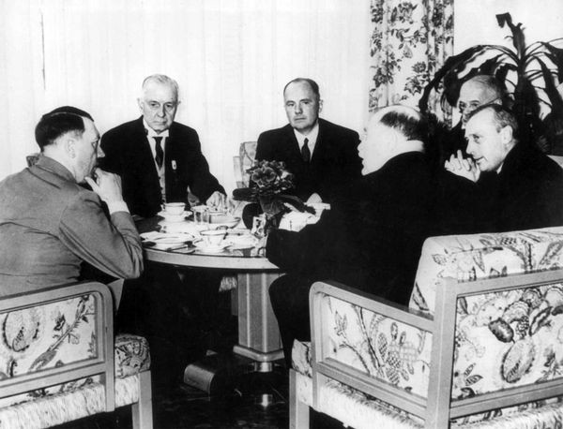
Thomas J. Watson (Sr)
Adolf Hitler
Source: Howard, J. & Gugger S. (2020). Deep learning for coders with fastai & Pytorch: AI applications without a PhD. Sebastopol, CA: O'Reilly Media, Inc.
Notes:
Nazi Germany – big IBM customer
Tabulation machines
Extermination of Jews and undesirables
Thomas J. Watson approved 1939 release of IBM alphabetizing machines – deportation of Polish Jews
Watson awarded service to Reich medal (1937)
=====
IBM enjoyed a booming business and one of its best customers was Nazi Germany. In 2001, a Swiss judge ruled that it was not unreasonable to conclude that “IBM’s technical assistance facilitated the tasks of the Nazis in the commission of their crimes against humanity…”
IBM, you see, supplied the Nazis with the data tabulation products needed to track the extermination of Jews and other undesirables. In fact, the relationship was driven from the top of the company, with marketing aimed at Hitler and his leadership team. Company President Thomas Watson personally approved the 1939 release of special IBM alphabetizing machines to help organize the deportation of Polish Jews. Here we see Adolf Hitler (far left) meeting with IBM CEO Tom Watson Sr. (second from left), shortly before Hitler awarded Watson a special “Service to the Reich” medal in 1937.

Slide 5
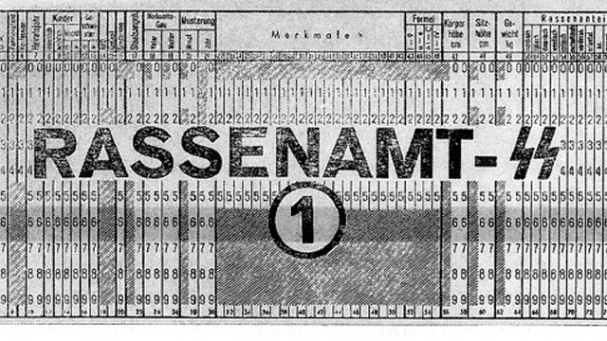
Notes:
IBM training and support @ concentration camps
Jews: code (8) – 6 million killed
Romanis: code (12) – 300,000 killed
General execution (4)
Gas chamber (6)
IBM project managers, engineers, and technicians said nothing (upright, church-attending people)
How would you feel if you discovered that you were working on a system like this?
=====
Meetings like the one just pictured were not isolated incidents – the organization’s involvement was extensive. IBM and its subsidiaries provided training and onsite maintenance at the concentration camps: printing off cards, configuring machines, and repairing them when they broke. IBM set up categorizations on its punch card system to indicate how each person was killed, what group they belonged to, and other logistical information to track them through the vast Holocaust system. IBM’s code for Jews in the concentration camps was 8: some 6,000,000 were killed. Its code for Romanis was 12, some 300,000 were killed in the “Gypsy camp”. General executions were coded as 4, death in the gas chambers as 6.
Of course, IBM’s project managers and engineers and technicians were just ordinary citizens, living ordinary lives. Caring for their families, going to church on Sunday, doing their jobs the best they could. They followed orders. The marketing department was just doing what they could to achieve IBM’s business development goals. As Edwin Black writes, “To the blind technocrat, the means were more important than the ends. The destruction of the Jewish people became even less important because the invigorating nature of IBM’s technical achievement was only heightened by the fantastic profits to be made at a time when bread lines stretched across the world.”
Step back for a moment and consider: How would you feel if you discovered that you had been part of a system that ended up hurting society? Would you be open to finding out? How can you help make sure this doesn’t happen? Clearly, this story is an outlier… You might say, “Well, I am not working on a genocide system and never plan to do so!” But ethics is difficult precisely because we live in a world of subtle shades. Where do you draw the line?

Slide 6
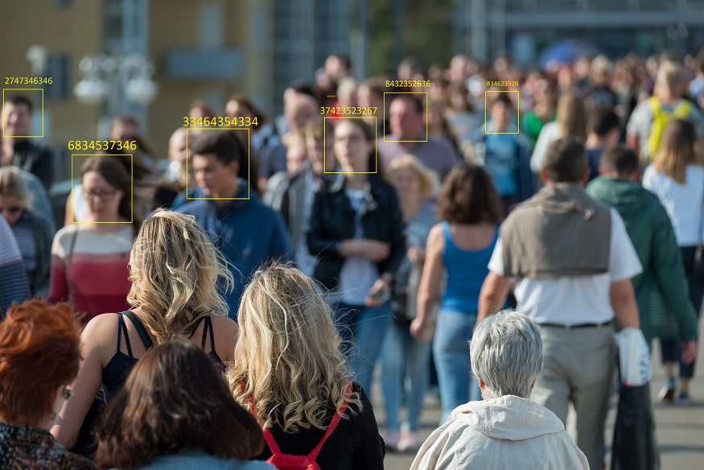
Image Credit: https://semify.com/?Facial-Recognition-Tech-Keeps-Its-Digital-Eye-On-The-Masses,-And-So-Do-The-Organizations-Using-It-&AID=1779
Notes:
How about facial recognition systems? In recent years, law enforcement organizations around the world have begun to use this technology to maintain social order Would you work for a company that built and sold AI-enabled recognition systems? Would you conduct research to enhance the capabilities of these systems?

Slide 7


Yes
No
Maybe
Notes:
How would you decide if a given AI project or work assignment is unethical? Would you work at Affectiva, an emotion recognition company.

Slide 8
Two Philosophical Frameworks

Slide 9
Source: Salganik, M. J. (2018). Bit by bit: Social research in the digital age. Princeton, NJ: Princeton University Press.
Notes:
Principles – Belmont Report (1979) and Menlo Report (2011)
4 principles
Balancing principles
Principles derived from two ethical frameworks
Consequentialism
Deontology
=====
Now that we’ve established the rationale and importance of data ethics, I would like to step back and provide a philosophical context. A good starting point is the principles expressed in two reports—the Belmont Report of 1979 and the Menlo Report of 2011. Together, the Belmont Report and the Menlo Report offer four principles to guide ethical deliberations by researchers: Respect for Persons, Beneficence, Justice, and Respect for Law and Public Interest. Applying these four principles in practice is not always straightforward, and it can require difficult balancing. The principles, however, clarify trade-offs, suggest improvements to data management, and enable researchers to explain their reasoning to each other and the public.
The four ethical principles of Respect for Persons, Beneficence, Justice, and Respect for Law and Public Interest are themselves largely derived from two more abstract ethical frameworks: consequentialism and deontology. Understanding these frameworks is helpful because it will enable you identify and then reason about one of the most fundamental tensions in AI ethics: using potentially unethical means to achieve ethical ends.
And finally, we must translate all of this into practice. That’s where the rubber meets the road!

Slide 10
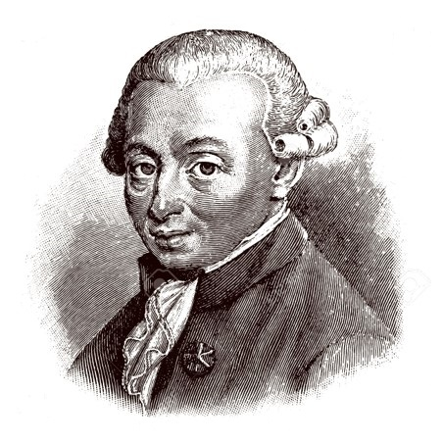
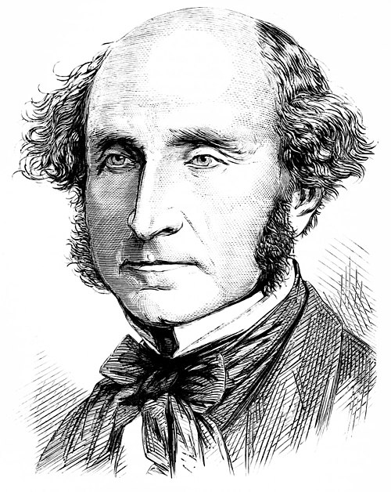
Consequentialism
Deontology
The end justifies the means…
Do unto others as you would have them do unto you…
Notes:
Consequentialism
Jeremy Bentham & John Stuart Mill (Left)
“The end justifies the means” – qualified with “as long as the end state is better than the one that preceded it…”
Principle of Beneficence – Consequentialism
Deontology
Immanuel Kant (Right)
Ethical duties and responsibilities, independent of their consequences
Golden rule – Kant: “Act only according to that maxim whereby you can, at the same time, will that it should become a universal law. The principle of Respect for Persons”
Principle of Respect for Persons – Deontology
Deontology vs Consequentialism
Opposite ends of a spectrum
Two ships passing in the night
Blend of the two approaches
=====
Consequentialism has its roots in the work of Jeremy Bentham and John Stuart Mill. John is pictured here. A concise but somewhat extreme statement of the consequentialist position is that the “the end justified the means.” Of course, a consequentialist would probably qualify that by adding, “as long as the end state is better than the one that preceded it” (Sinnott-Armstrong 2014). The principle of Beneficence – the need to balance risk and benefits – is deeply rooted in consequentialist thinking.
By contrast, Deontology, has its roots in the work of Immanuel Kant. Here the focus is on ethical duties and responsibilities, independent of their consequences (Alexander and Moore 2015). The golden rule is a concise statement of this position, though Kant stated it more philosophically. Act only according to that maxim whereby you can, at the same time, will that it should become a universal law. The principle of Respect for Persons – the autonomy of research participants – is deeply rooted in deontological thinking.
Clearly, these two philosophies fall at opposite ends of a spectrum. Deontologists focus on means while consequentialists focus on ends.
In practice, most AI researchers implicitly embrace a blend of these two ethical frameworks. However, the fundamental differences between them is the reason why many ethical debates do not make much progress. Consequentialists offer arguments about ends whereas Deontologists offer arguments about means. And, neither side finds the arguments of the other as convincing. The two groups are like two ships passing in the night.

Slide 11
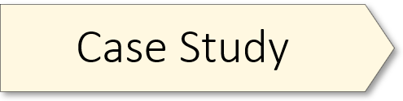
The 50 Centers (Discussion questions)
Part one of the study was based on a leaked archive of private email communications. Is it (ever) ethical to use leaked, private data for research?
What if the data are from communications involving a government entity rather than civilian communications?
Do the goals of the study matter (in this case, understanding the behavior of a repressive government)?
In part two of the study, the Chinese social media users who were the subject of the research did not consent to being studied and were unaware they were being studied. Was this ethical?
Why do you think this was approved by the IRB?
Should it have been approved?
Abstract : https://bit.ly/3HoSl8n
Notes:
Short Link
https://bit.ly/3HoSl8n
Original Link
https://docs.google.com/document/d/1ootsqYoUS1nb9Ta5yRJeNTnZ4Ohftdb64TKKrQWpRKY/edit?usp=sharing

Slide 12
Unbalanced (Biased) Data

Slide 13
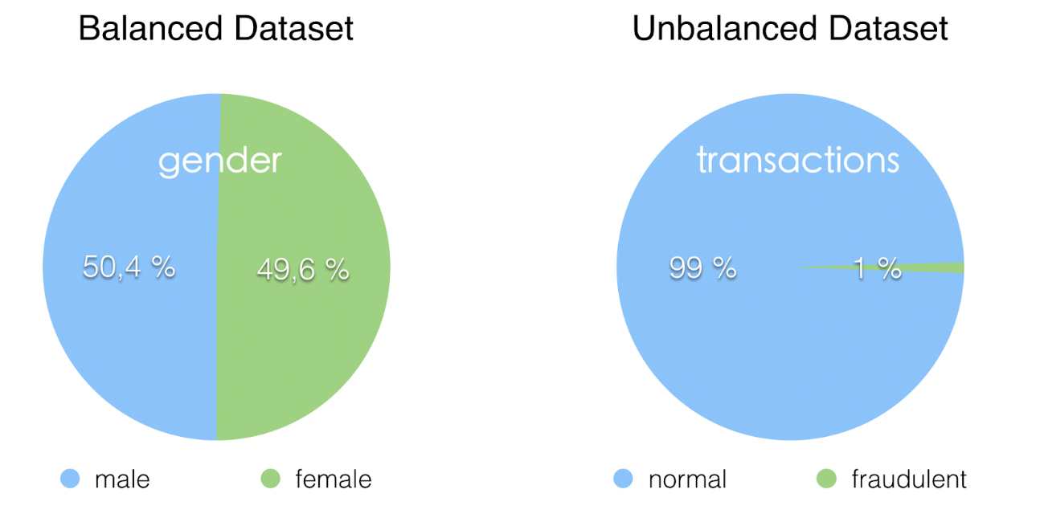
Image Credit: https://medium.com/strands-tech-corner/unbalanced-datasets-what-to-do-144e0552d9cd
Notes:
Big data != good data if unbalanced
Sample – Population
=====
Let’s now consider some of the issues that arise when the data used to train an AI model is unbalanced or biased. Here we see two datasets, one balanced, the other not. What kinds of problems arise when we train our models on data like this? Let’s consider the makeup of two popular image datasets, frequently used to train classifiers.

Slide 14
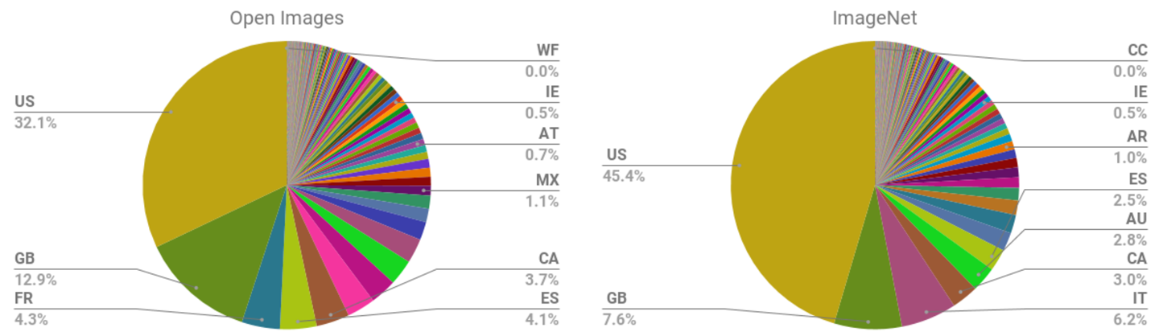
Source: Shankar, S, et. al. (2017). No classification without representation: Assessing geodiversity issues in open data sets for the developing world Retrieved from: https://oreil.ly/VqtOA.
Notes:
Pie charts of country of origin for images in the Open Images and ImageNet datasets – mostly Western
Where’s Asia, where’s China?
Unbalanced data = poor model performance
Authors of this study conclude: “We analyzed two large, publicly available image data sets to assess geo-diversity and found that these data sets appear to exhibit an observable amerocentric and eurocentric representation bias. Further, we analyzed classifiers trained on these data sets to assess the impact of these training distributions and found strong differences in the relative performance on images from different locales.”
=====
The pie charts pictured here indicate that a majority of images in the Open Images and ImageNet datasets come from the US and other Western countries. So why does this matter? Well, image classification models trained on unbalanced or biased data sets like these will perform worse when asked to classify images from non-Western countries and cultures. The authors of this research article – see citation at the bottom – write, “We analyzed two large, publicly available image data sets to assess geo-diversity and found that these data sets appear to exhibit an observable amerocentric and eurocentric representation bias. Further, we analyzed classifiers trained on these data sets to assess the impact of these training distributions and found strong differences in the relative performance on images from different locales.” Or stated more simply, biased data results in poor model performance.

Slide 15
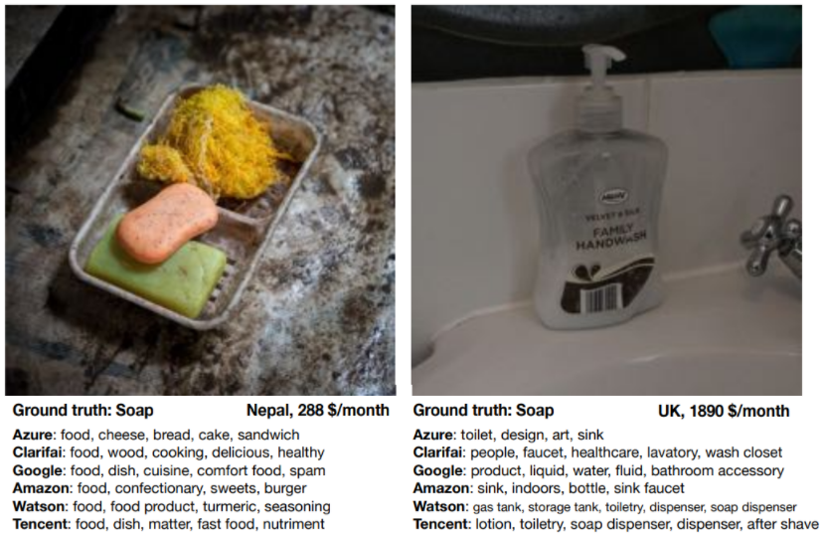
Source: DeVries, T, et. al. (2019). Does object recognition work for everyone? Retrieved from: https://oreil.ly/BkFjL.
Notes:
Image on left – big name models classify this as food.
Study discovered poor model performance for lower-income countries.
AI models can only learn what they ‘see.’
=====
So, what happens when a model is trained with a biased data set? Let’s consider a concrete example. With the image on the left, we see that the models have all classified it as food. What’s even more surprising is that all of these classifiers were developed by major AI players (Google, IBM, Tencent). What’s going on here? Well, what the authors of this article discovered is this: models trained on unbalanced or biased data sets have much greater difficulty identifying household items (such as soap, spices, sofas, or beds) when the image is from a lower-income country. In short, the models misclassified this image because they had not “seen” enough images like it during training.

Slide 16
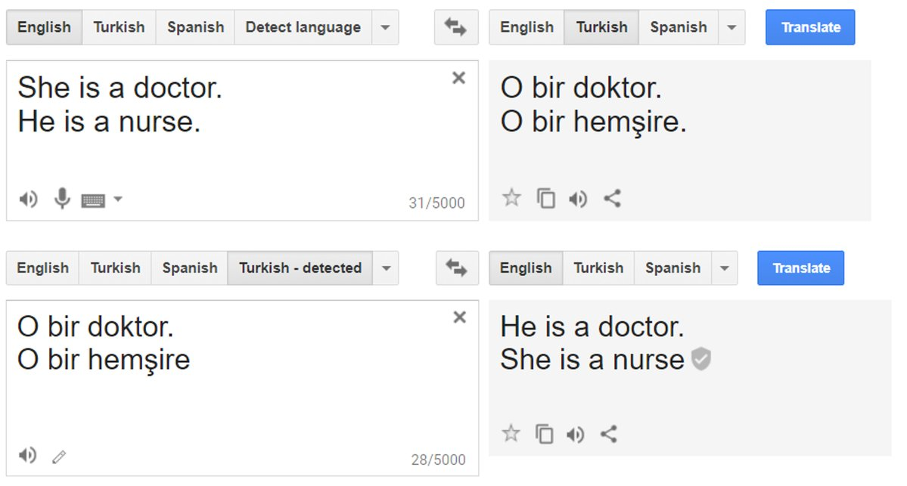
Source: Tousignant, L. (2017). Google Translate’s algorithm has gender bias. Retrieved from: https://oreil.ly/Vt_vT.
Notes:
Data can reflect cultural and historical biases
Google Translate – Turkish gender-neutral pronoun ‘O’
Male jobs = ‘He’ / Female jobs = ‘She’
Google has now fixed this problem
=====
Data can also reflect cultural and historical biases. Consider this example. In 2017, an article in the New York Post reported that Google Translate showed systematic bias in how it translated the Turkish gender-neutral pronoun “o” into English. When applied to jobs often associated with males, it used “he.” But when applied to jobs often associated with females, it used “she”. Once again, the data used to train this NLP system reflects the reality as present in the data; namely, that more men are doctors than women. Thankfully, this is changing as medical schools now admit as many women as men…
BTW: Google has now fixed this problem as Translate now provides both masculine and feminine translations.

Slide 17
Model Ethics
Notes:
Now that we’ve discussed unbalanced (biased) data, let’s move on to our fourth and final section for today – Model Ethics.

Slide 18
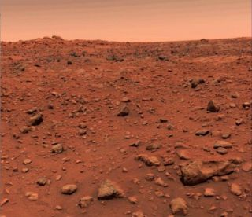
I remember in 2000 hearing James Martin, the leader of the Viking Mission to Mars, saying that his job as a spacecraft engineer was not to land on Mars, but to land on the model of Mars provided by the Geologists
Peter Norvig
Image Credit: https://www.space.com/33482-viking-mars-landing-science-legacy.html
Notes:
In this case, our starting point is the proposition that the “map is not the territory.” I like this Norvig quote as it is both concrete and memorable. Martin’s job was “not to land on Mars, but to land on the model of Mars provided by the Geologists.”
So, what happens when we place too much faith in a model’s representation of reality?
Well, consider what happened on September 26, 1983…

Slide 19
Launch?
Source: Christian, B (2020). The alignment problem: Machine learning and human values. New York, NY: W.W. Norton & Company.
Notes:
… it was just after midnight, and Soviet duty officer Stanislav Petrov was in a bunker outside of Moscow, monitoring the Oko early-warning satellite system. Suddenly the screen lit up and sirens began to wail. The system indicated that an LGM-30 Minuteman intercontinental ballistic missile was inbound from the United States.
“Giant blood-red letters appeared on our main screen,” he says. The letters said, “LAUNCH” The siren went off again. A second missile had been launched. Then a third. Then a fourth. Then a fifth. The early warning system reported that the reliability of its alert was “highest.” The rules were clear. Petrov was to report the inbound strike to his superiors, who would decide whether to order a full retaliation.
Let’s take a poll…

Slide 20
Yes
No
Maybe
Source: Christian, B (2020). The alignment problem: Machine learning and human values. New York, NY: W.W. Norton & Company.
Notes:
Thankfully, Petrov ignored the warning, picked up the phone and told his superiors that the alarm was false.
As it turned out, this was a system (model) error: nothing more than sunlight, reflecting off the clouds over North Dakota.

Slide 21


Jack fruit: 99.6% Confidence Level The Real Deal
(AlexNet)
Image Credits: https://www.wallpaperbetter.com/3d-and-abstract-wallpaper/blur-color-abstract-174759 ; https://depositphotos.com/stock-photos/jackfruit.html
Notes:
High confidence – AlexNet 99.6% confident that rainbow image is a Jack Fruit
No hallucination mechanism
Adversarial examples
Imperceptible alteration of image = dramatically different prediction (Panda image (57.5%) classified as a Gibbon (99.3%))
Brittle AI systems are easily broken
=====
The problem is that many AI models not only make erroneous judgements, but they make them with outrageously high confidence. It is a well-known property of deep-learning systems that they are brittle. Pre-trained models such as AlexNet and ResNet do a great job of correctly categorizing a wide variety of images. But here’s the catch. AlexNet categorizes every image you present to it, including randomly generated rainbow-colored static. AlexNet, for example, is 99.6% confident that the rainbow-colored image pictured here is a Jack fruit. Not only is the system hallucinating, but it appears to have no mechanism to detect, let alone communicate that it is doing so. In their book Rebooting AI, Gary Marcus and Ernest Davis discuss this issue at length. Or, as a highly-cited 2015 paper put it, “Deep Neural Networks are Easily Fooled.”
A closely related problem is adversarial examples. Take, for instance, a system which classifies a Panda image at a 57.5% confidence level. But when that image is altered just slightly – an imperceptible change to its pixels – the model suddenly classifies the altered image as a Gibbon at a 99.3% confidence level.
The Alignment Problem – chapter 9 (Uncertainty)

Slide 22
Insect Classification (Discussion question)
What assumption(s) underpin the automated classification system Thomas Dietterich created?
Abstract : https://bit.ly/3kFZWFJ
Notes:
Short Link
https://bit.ly/3kFZWFJ
Original Link
https://docs.google.com/document/d/1eBOct2LumJB8gAnqDOg0NoddjuBtuDdksh3ttESz71s/edit?usp=sharing

Slide 23

Open Category Problem
Notes:
Thomas Dietterich – Open Category Problem
Models assume the world is comprised of a limited number of categories.
Example: ResNet models limited to 1000 categories
The world is more complex than that
=====
A system like AlexNet, ResNet, or the insect classification system discussed in the previous case-study are trained on a set of images tagged as belonging to a limited number of categories. In the case of AlexNet and ResNet, that number is large. Nevertheless, such systems implicitly assume that the world consists of only, say, a thousand different kinds of objects. The classification system Dietterich created was limited to 29 species. He notes, “But in doing all of that sort of classic machine-learning work, we forgot about the fact that when these guys are out in the stream collecting additional things, there are going to be many other species, and even other non-bugs, that will get captured in the process: bits of leaves and twigs and rocks and so on. And, you know, our system assumed that every image it saw belonged to one of these 29 classes.” Dietterich calls this the “open category problem.”

Slide 24
All models are wrong, but some are useful
George E.P. Box
Notes:
George Box quotation.
Common-sense question, “Does this model’s output even make sense?” Or to put it another way, let’s not launch the ballistic missiles immediately.
Know the social context in which your model is operating
Identify the system’s primary goal
Reduce recidivism rates
Minimize loan risk
Enhance profit margins (Amazon recommendations)
=====
All that to say – as George Box put it – All models are wrong, but some are useful. The key point here is that critical evaluation (thinking) must be part of AI model construction from start to finish. Stop and ask yourself, “Does this model’s output even make sense?” Or to put it another way, let’s not launch the ballistic missiles immediately. Rather, let’s step back and do what Stanislov Petrov did in 1983. Let’s think about what we’re doing, the assumptions built into our models, the possibility of data bias, and the impact of a particular model on society at large.
Too often, we create and deploy our AI models without adequate consideration of the social environment or context in which they operate. I’d like to end today’s workshop on a practical note, with a set of guidelines you might wish to consider in your AI projects.

Slide 25

Practical Guidelines
Image Credit: http://clipart-library.com/clipart/338971.htm
Notes:
List of practical guidelines – don’t have time to cover these here.
Please review those guidelines in the handout at the link provided
https://docs.google.com/document/d/1C7Br1q1t50npj3XSkA188OUeyYEUFA23_60uskNnk4g/edit?usp=sharing

Slide 26

Questions
Notes:
And finally, do we have any questions? For next week, you have a couple readings. And I hope you will take time to make an entry in your AI journal and join the conversation on the Discussion Board.

Slide 27
References
Salganik, M. J. (2019). Bit by bit: Social research in the digital age. Princeton, NJ: Princeton University Press
Howard, J. & Gugger, S. (2020). Deep learning for coders with fastai & PyTorch: AI applications without a PhD. Sebastopol, CA: O’Reilly-Media

Slide 29


Multi-Select Multiple Choice
Single Answer Multiple Choice
Word Cloud

Slide 30

Statistical Power & Data Ethics
Notes:
An important idea when making decisions about studies with unknown risk is power analysis, which allows researchers to calculate the sample size they will need to reliably detect an effect of a given size (Cohen 1988). Even though some researchers are obsessed with making studies as big as possible, research ethics suggests that researchers should make the studies as small as possible. Power analysis is not new, of course, but there is an important difference between the way it was used in the analog age and how it should be used today. In the analog age, researchers generally did power analysis to make sure that their study was not too small (i.e. under-powered). Now, however, researchers should do power analysis to make sure that their study is not too big (over-powered).
Bit by Bit, Salganik, p. 319.

Slide 31
Source: Aurelien, G (2019). Hands-on machine learning with Sci-Kit Learn, Keras & Tensorflow. Sebastopol, CA: O'Reilly Media, Inc
Notes:
The typical lifecycle of an AI / machine learning project looks something like this. At each step, consider the entire AI system, including the social context in which it operates. As we have already discussed ethical concerns from both a model (algorithm) and data perspective, let’s step back briefly and end with some practical guidelines applicable to the entire project, from both a deontological and consequentialist perspective.

Slide 32
Google Image Dataset (Discussion questions)
Do the researchers adequately describe how the dataset was created as well as its contents?
How transparent should a private company be about the data used for published research?
Should all data be FAIR (Findable, Accessible, Interoperable, Reusable)? If not, what kinds of data ought to be exempted and why?
Abstract : https://bit.ly/3HoHcVe
Notes:
Short Link
https://bit.ly/3HoHcVe
Original Link
https://docs.google.com/document/d/1fmYbVVM4wqZsk_klB1RW2jXBSTHeBdOBghV9nHyAbwc/edit

Slide 33
Encore Discussion questions
In this case-study, the IRB at Georgia Tech declined review because it did not involve human subjects.
In your opinion, were human subjects involved in this study?
From an ethical point-of-view, was the decision to decline review right or wrong?
What ethical obligations do researchers have in cases where an IRB declines review?
As well, the study did not include informed consent.
Was informed consent needed in this particular case?
Are there cases where the value of the research might override informed consent?
Abstract : https://bit.ly/30x2wXR
Notes:
Short Link
https://bit.ly/30x2wXR
Original Link
https://docs.google.com/document/d/1Lycn08UI5mZsn44prBFe3N8VhW8kwJhP4BJBWlXxjOo/edit

