Slide 1

Generative AI

Slide 2

Image Credit: https://cktechcheck.com/

Slide 3
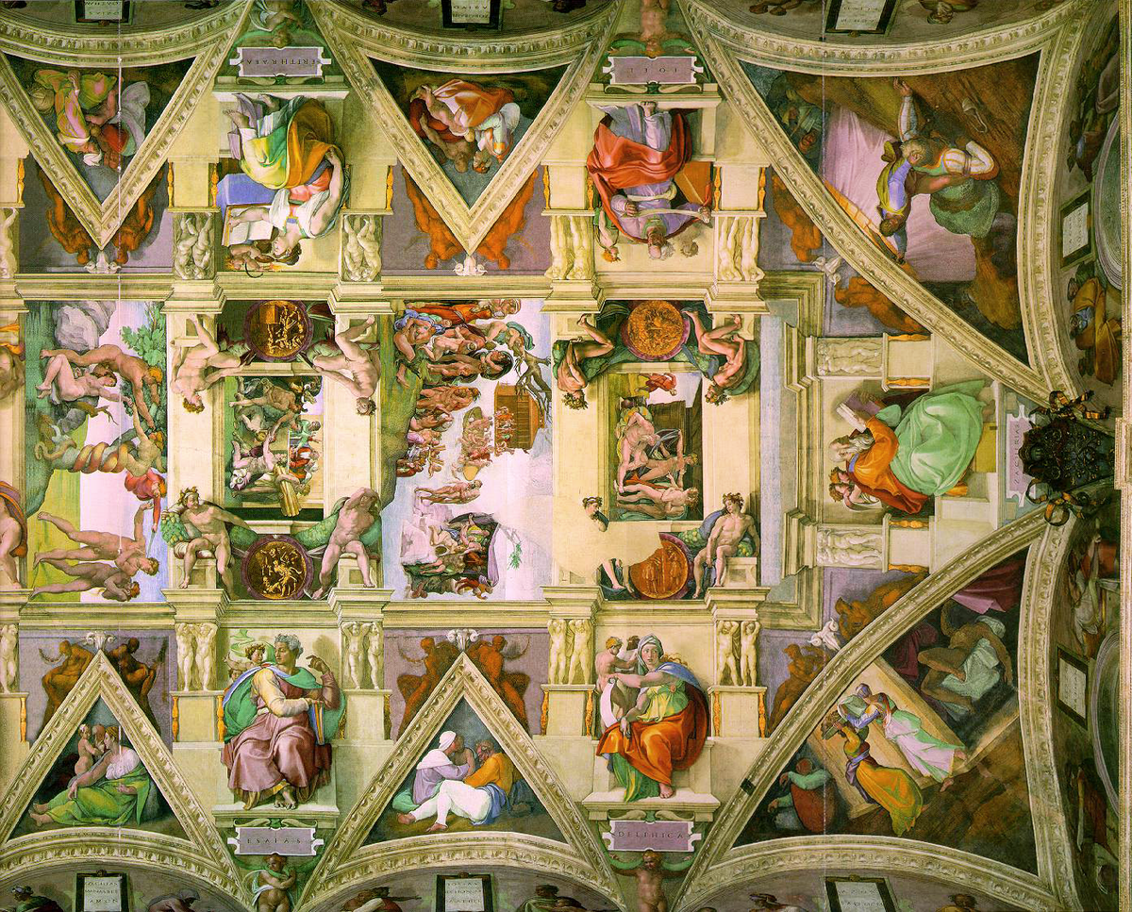
Notes:
Imagine you’re at the Vatican in the Sistine Chapel, and you look up and see this – Michelangelo’s amazing frescos. And suddenly, the thought hits you, “Could a deep learning model create art like this? Now ten years ago, a thought like this would have been considered ridiculous. But not anymore. Generative adversarial networks (GANs), diffusion models, and autoencoders are now creating beautiful works of art.
Until recently, everyone thought that only humans had this ability. Creativity was a sign of intelligence, and AI critics used to say, “How can a machine be intelligent if it can’t paint, write an essay, or compose a musical score?” However, all this has begun to change as AI advances.

Slide 4
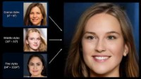
Notes:
In this first mini-lecture, I’m going to talk about GANs. Nvidia is a leader in generative AI, with their StyleGAN model. StyleGAN became famous for its ability to generate human faces. But beyond that, GANs are also used to:
Generate synthetic data – data augmentation
Generating cartoon characters
Text to image translation
Three-dimensional object generation
The list goes on. As the days go by, applications of GANs increasingly become mainstream.
So, what exactly is a GAN? How does a GAN work?
Text Source: Deep Learning Workshop.
=====
https://www.nextrembrandt.com/

Slide 5
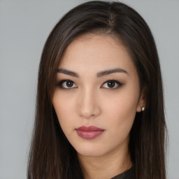

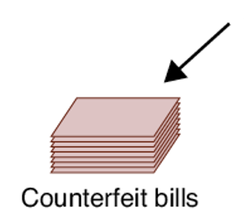
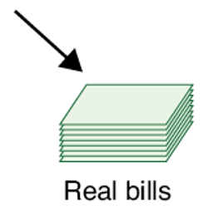
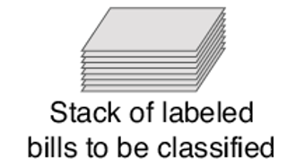
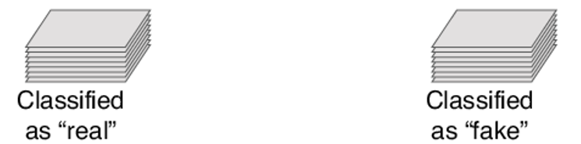
Dawn
Glenn
Source: Glassner, A. (2021). Deep learning: A visual approach. San Francisco, CA: No Starch Press. (Chapter 22)
Notes:
To understand how GANs work, let’s tell a story…
This is the story of a modern Bonnie & Clyde. It’s the story of two conspirators, Glenn and Dawn who’ve setup an operation to counterfeit $100 bills. Glenn’s name starts with G because he plays the role of the generator, the one who forges new money. Dawn’s name begins with D because she plays the role of the discriminator, the critic who decides if a given bill is real or one of Glenn’s fakes.
As the generator, Glenn sits in a back room all day, meticulously creating metal plates and printing false currency. (CLICK) Dawn, on the other hand, is the quality-control half of the operation. It’s her job to take a mixed-up pile of real bills along with Glenn’s forgeries and decide which is which.
Each morning, Glenn creates forgeries using all the information he has up to that point. In the beginning, he doesn’t know anything. So, he just splashes different colors and inks on the paper. Or maybe he draws some faces or numbers. It’s just random stuff. At the same time, Dawn goes to the bank and withdraws a stack of real $100 notes. (CLICK) Very lightly, she writes the word Real on the back of each one in pencil. Then, when Glenn finishes for the day, she collects his forgeries and writes the word Fake on the back of each. And finally, she shuffles the two piles together. (CLICK)
Now Dawn gets to work. One by one, she goes through the bills, and without looking at the backs, she decides if each one is real or fake. (CLICK) Let’s say she asks herself, “Is this bill real?” We call an answer of “yes” a positive response to that bill and an answer of “no” a negative response to that bill.
Glassner, p. 650

Slide 6
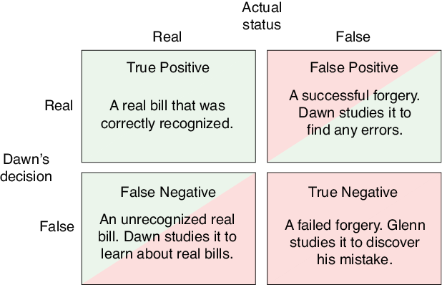
Source: Glassner, A. (2021). Deep learning: A visual approach. San Francisco, CA: No Starch Press.
Notes:
And since each bill can be real or fake, there are four possibilities, as pictured here.
When Dawn looks at a bill, if it’s real and she says it’s real, then her “positive” decision is accurate, and we have a true positive (TP). If the bill is real but her decision is “negative” (she thinks it’s fake), then it’s a false negative (FN). If the bill is fake but she thinks it’s real, that’s a false positive (FP). Finally, if it’s fake and she correctly identifies it as fake, that’s a true negative (TN). In all cases but true positive, either Dawn or Glenn uses that example to improve their work.
The discriminator is a classifier, kind of like an art critic. It places each input into one of two classes: real or fake. When the prediction is wrong, that network’s error function has a large value. We then train the discriminator in the usual way with backprop and optimization, so that the class is more likely to be right the next time.
The generator’s job is quite different. It never sees the training data at all. Instead, we give it a random input (like a list of a few hundred numbers), and from that it produces an output. That’s all it does. If the discriminator thinks that output is real (that is, from the training set), then the generator got away with its forgery and doesn’t need to improve. But if the discriminator flags the output as fake, then the generator gets an error signal. And we use backprop and optimization to teach it to move away from results like the ones caught by the discriminator.
Each time we run the generator, we give it new, random, starting values. The generator has a daunting task: turn this small list of numbers into an output that fools the discriminator. The generator’s output can be anything: a song that sounds like it was written by Bach, a piece of speech that sounds like a person, a photo of a human face, or a bill worth $100.
How can we possibly train such a system? The generator never sees the data it’s trying to emulate, so it can’t learn from it. It only knows when it’s wrong. The approach that works best is trial and error. We start out, as described earlier, with a generator and a discriminator that are both entirely untrained. At the start, both networks are just flailing around, producing meaningless outputs.
Slowly, though, the discriminator starts to learn, because we give it the proper labels for the data it’s classifying. And as the discriminator gets a little better, the generator tries a bunch of different variations on its output until something gets past the discriminator (that is, the discriminator thinks it was real data, and not from the generator). The generator hangs onto that as its best work so far. Then the discriminator gets a little better, and in turn, the generator gets a little better. As time goes on, the tiny improvements in each network accumulate, until the discriminator is very sensitive to the differences between real and generated data, and the generator is very skilled at making those differences as small as possible.

Slide 7
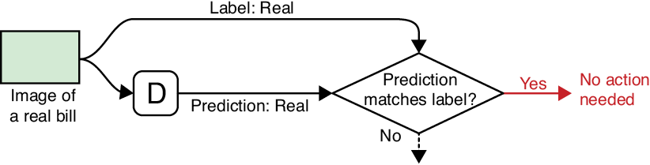
True Positive
Source: Glassner, A. (2021). Deep learning: A visual approach. San Francisco, CA: No Starch Press.
Notes:
In the previous slide, we showed the four possible situations that arise after Dawn decides whether a bill is real or fake. The first is a True Positive. Here the discriminator correctly reports that the image of a real bill is, in fact, real. And because this is what we want the discriminator to do, no learning takes place.

Slide 8
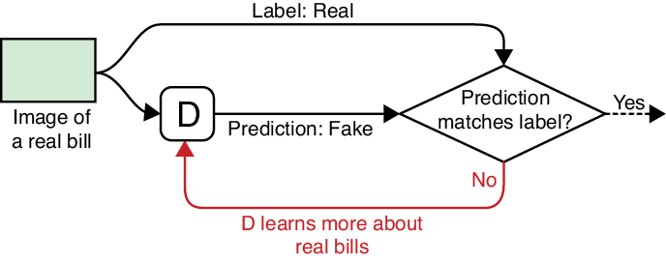
False Negative
Source: Glassner, A. (2021). Deep learning: A visual approach. San Francisco, CA: No Starch Press.
Notes:
Next, we have the false negative. This happens when the discriminator incorrectly declares a real bill to be a fake. As a result, the discriminator needs to learn more about real bills, so it doesn’t repeat this error.

Slide 9
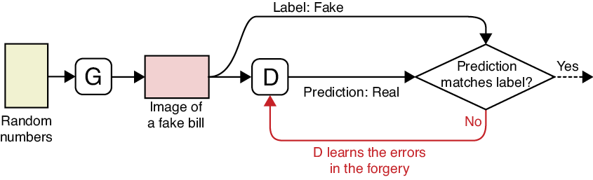
False Positive
Source: Glassner, A. (2021). Deep learning: A visual approach. San Francisco, CA: No Starch Press.
Notes:
The false positive is when the discriminator gets fooled by the generator and declares a forged bill to be real. In this case, the discriminator needs to study the bill more carefully and find any errors or inaccuracies so that it won’t get fooled again.

Slide 10
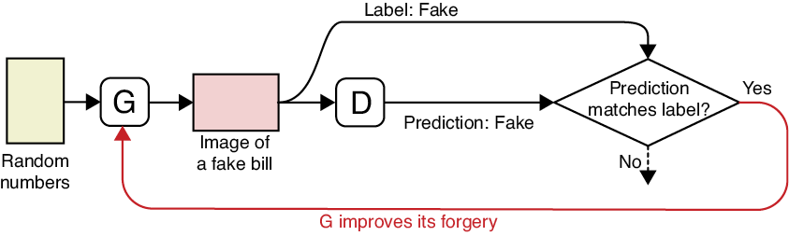
True Negative
Source: Glassner, A. (2021). Deep learning: A visual approach. San Francisco, CA: No Starch Press.
Notes:
And finally, the true negative is when the discriminator correctly identifies a forgery. In this case, the generator needs to learn how to improve its output.
Of these four possibilities, one of them (TP) has no effect on either network, two of them (FN and FP) cause the discriminator to improve its ability to recognize real and fake bills, and only one (TN) causes the generator to learn and avoid repeating mistakes.

Slide 11
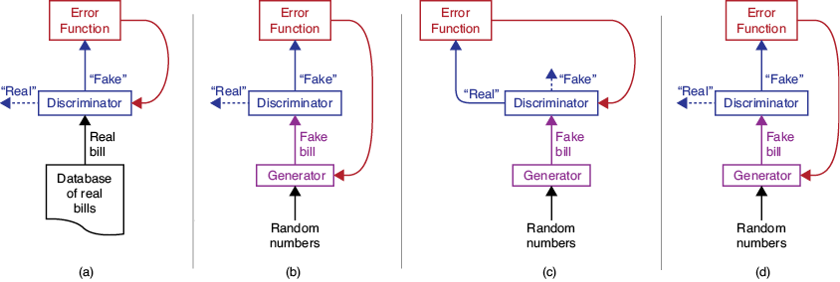
The GAN Training Cycle
False Negative
True Negative
False Positive
True Negative
Source: Glassner, A. (2021). Deep learning: A visual approach. San Francisco, CA: No Starch Press.
Notes:
Let’s now assemble the feedback loops into a single training cycle for both discriminator and generator. Generally, we repeat a set of four steps over and over. In each step, we give the discriminator either a real or fake bill, and then based on its response, follow one of the flowcharts we just saw.
The training cycle goes like this. We first train the discriminator, then the generator, then the discriminator again, and finally the generator. The idea is to test for each of the three situations in which one or the other network needs to learn. The true negative case, where the generator learns, is repeated twice for reasons we’ll get to in a moment. A visual representation of that process is shown here.
(CLICK) First, in part (a), we try to learn from false negatives. We give the discriminator a random bill from the dataset of real bills. If it misclassifies it as a forgery, we tell the discriminator to learn from that mistake.
(CLICK) Second, in part (b), we look for true negatives. We give some random numbers to the generator, produce a fake bill, and hand that to the discriminator. If the discriminator catches the forgery, we tell the generator, which attempts to learn to produce better counterfeits.
(CLICK) Third, in part (c), we look for false positives. We give a new batch of random values to the generator. It produces a new, fake bill, which we hand to the discriminator. If the discriminator is fooled and says the bill is real, the discriminator learns from its mistake.
(CLICK) Finally, in part (d), we repeat the true negative test from the second step. We give new random numbers to the generator, make a new fake bill, and if the discriminator catches the forgery, the generator learns.

Slide 12
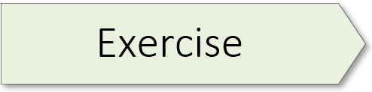
Gaussian GAN 01.1_gaussian_gan.ipynb

Slide 13
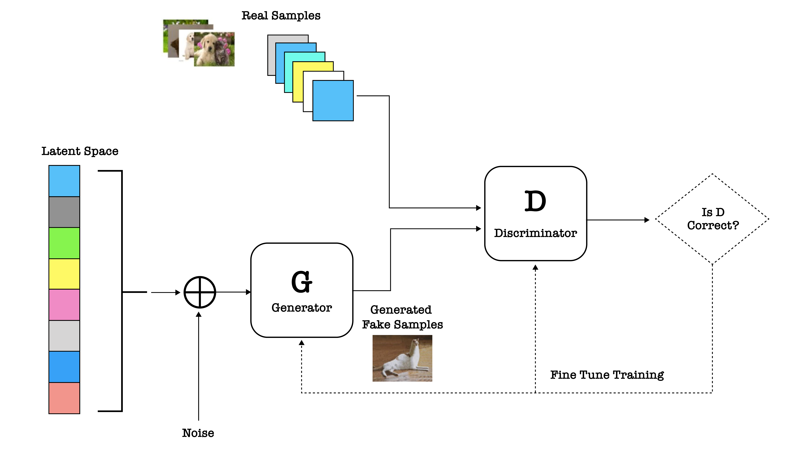
Image Credit: https://www.kdnuggets.com/2017/01/generative-adversarial-networks-hot-topic-machine-learning.html
Notes:
Now that you’ve spent some time refactoring and understanding the code in the Gaussian GAN notebook, let’s review the basic GAN architecture. As noted in the first mini-lecture, the basic idea behind the GAN is simple: create a data distribution from random noise that looks like a real data distribution. As noted earlier, a GAN typically consists of two networks – a generator and a discriminator.
Consider the concrete example pictured here. Here we have a collection of real cat and dog images. Using a GAN, we can generate a different set of images (fake images) of cats and dogs from a random distribution of numbers. We know the GAN has succeeded when the generated images from the “data noise” are so good that the discriminator is unable to tell the difference between the two.
The figure shown here provides a concise overview of the components of a GAN and how they interact. A couple key points:
The set of images at the top of the figure represents a probability distribution of real data, in this case a data set of real cat / dog images. This discriminator is trained on this data set, thereby developing an “eye” for the real.
The generator network creates fake images (probability distributions) from a random noise distribution. In this case, it has generated an image of an elongated cat. Is this good enough to fool the discriminator?
The trained discriminator network classifies whether the image fed to it is fake or real.
A feedback loop (the diamond-shaped box) working through the backpropagation algorithm gives feedback to the generator network, thereby refining the parameters of the generator model.
The parameters continue to be refined until the discriminator network can’t tell what is real and what is fake.
Text Source: Deep Learning Workshop.

Slide 14
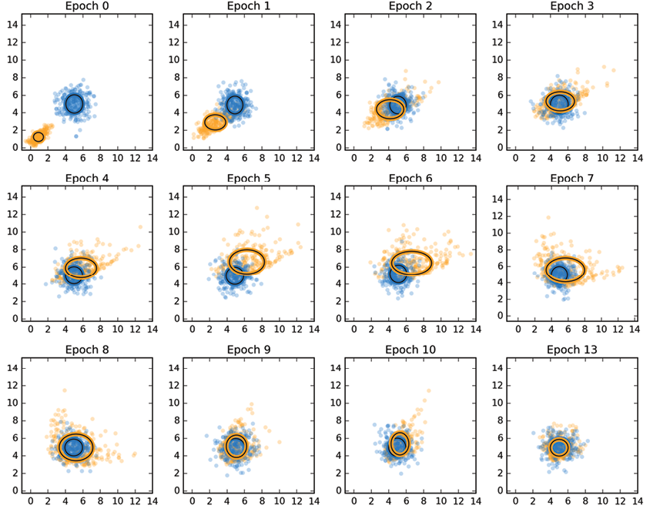
Notes:
Interestingly, our exercise today allowed us to “see” the GAN process in action. You generated a plot like the one shown here where the blue points are from the original dataset and the orange points were produced by the generator. As we can see, the generator gets progressively better at producing data that mimics the original distribution, until the cloud of orange and blue points are mixed.

Slide 15
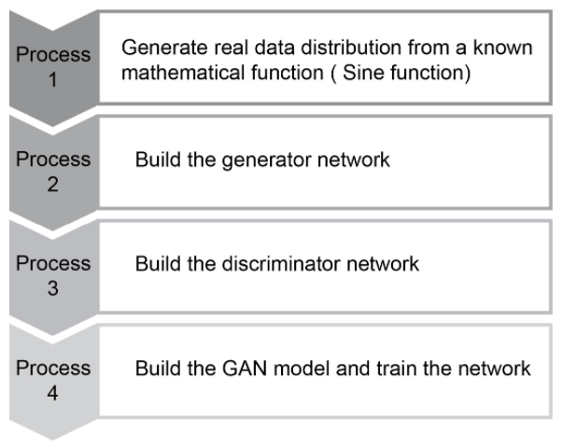
Notes:
The four steps to create a GAN are listed here.

Slide 16

Exercise
Open AI Chat
https://chat.openai.com/chat

Slide 17
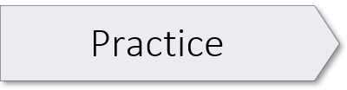
01.2_generate_data.ipynb 01.3_generator.ipynb 01.4_discriminator.ipynb 01.5_gan.ipynb
Notes:
These exercises come from chapter 7 (Generative Adversarial Networks) of The Deep Learning Workshop. Although we do not cover these exercises in this workshop, I encourage you to take the time to work through them, including the content found in chapter 7.

