Slide 1

Generative AI

Slide 2
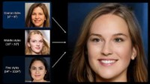
Notes:
Until now, the power of creativity has been the exclusive domain of the human mind. And critics of AI have touted this as a key difference between real (human) intelligence and its artificial equivalent. They say, “How can a machine be intelligent if it lacks any creative abilities?” However, deep learning has been making baby steps to simulate creativity.
Imagine you are at the Sistine Chapel in the Vatican, and you look up at the incredible frescos immortalized by Michelangelo. And suddenly, the thought hits you, “Could a deep learning model recreate something like that?” Ten years ago, such a thought would have been considered ridiculous. Not anymore, as deep learning models have made great strides in regenerating immortal works. Applications like these are made possible by a class of networks called Generative Adversarial Networks (GANs).
Nvidia is a leader in the use of AI in creative domains, with their StyleGAN tool. Let’s watch a short video of that tool. In addition to the generation of faces, many other use cases are finding traction. Some of the notable ones are as follows:
Synthetic data generation for data augmentation
Generating cartoon characters
Text to image translation
Three-dimensional object generation
The list goes on. As the days go by, applications of GANs increasingly become mainstream.
So, what exactly are GANs? How do GANs work?
Text Source: Deep Learning Workshop.

Slide 3
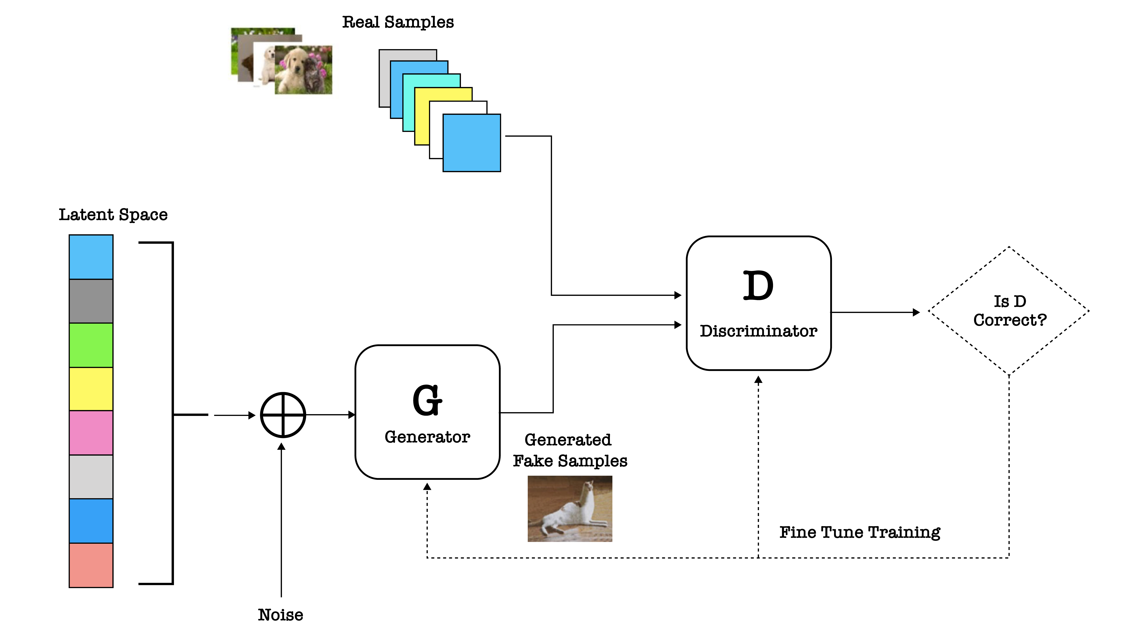
Image Credit: https://www.kdnuggets.com/2017/01/generative-adversarial-networks-hot-topic-machine-learning.html
Notes:
GANs are used to create a data distribution from random noise data and make it look similar to a real data distribution. A GAN network typically consists of two networks. The first is called a generator network while the other is called the discriminator network. The two networks then compete against each other. The generator acts like an art forger, creating images that look real. While the discriminator assumes the role of an art critic, judging whether a particular image is real or fake. Or put another way, the two networks compete against each other to generate a probability distribution that closely mimics an existing probability distribution.
Consider a concrete example. Let's say we have a collection of images of cats and dogs (real images). Using a GAN, we can generate a different set of images (fake images) of cats and dogs from a random distribution of number. We know the GAN has succeeded when the generated images from the “data noise” are so good that individuals are unable to tell the difference between the real images and the fake ones.
The figure shown here provides a concise overview of the components of a GAN and how they interact. Let's understand the process in the context of this diagram:
The set of images at the top of the figure represents a probability distribution of real data, in this case a data set of real cat / dog images. This discriminator is trained on this data set, thereby developing an “eye” for the real.
The generator network creates fake images (probability distributions) from a random noise distribution. In this case, it has generated an image of an elongated cat. Is this good enough to fool the discriminator?
The trained discriminator network classifies whether the image fed to it is fake or real.
A feedback loop (the diamond-shaped box) working through the backpropagation algorithm gives feedback to the generator network, thereby refining the parameters of the generator model.
The parameters continue to be refined until the discriminator network can’t tell what is real and what is fake.
Text Source: Deep Learning Workshop.

Slide 4
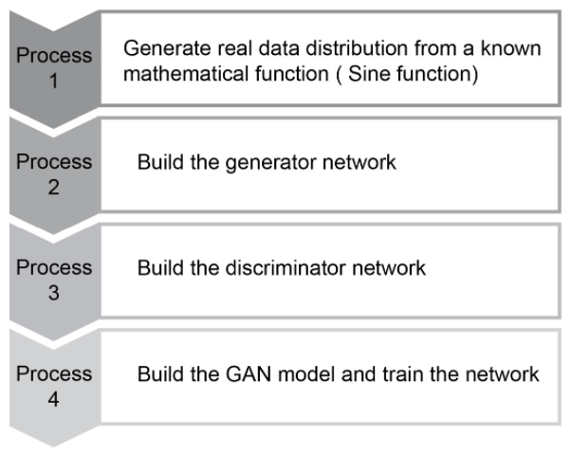
Notes:
The four steps to create a GAN are listed here.

Slide 5
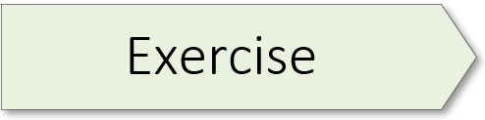
Exercise 7.01:

Slide 6
References
Baig, M. R., et al (2020). The Deep Learning Workshop. Birmingham,
England: Packt Publishing.

Slide 8
https://www.nextrembrandt.com/

Slide 9
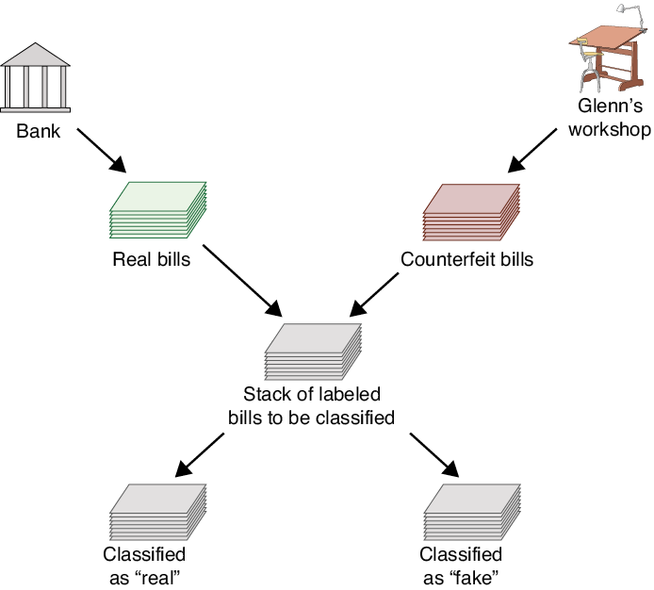
https://www.nextrembrandt.com/
Source: Glassner, A. (2021). Deep learning: A visual approach. San Francisco, CA: No Starch Press.
Notes:
Dawn and Glen

Slide 10
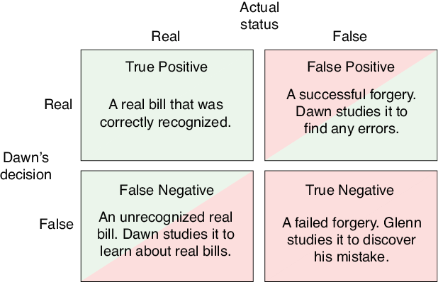
Source: Glassner, A. (2021). Deep learning: A visual approach. San Francisco, CA: No Starch Press.

Slide 11
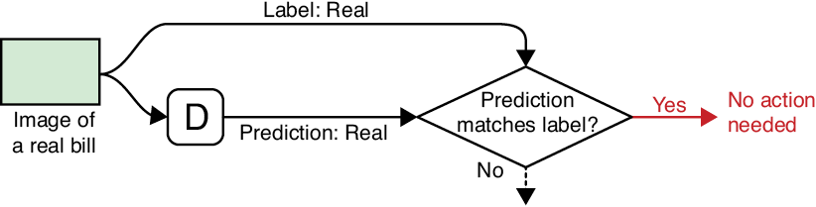
Source: Glassner, A. (2021). Deep learning: A visual approach. San Francisco, CA: No Starch Press.

Slide 12
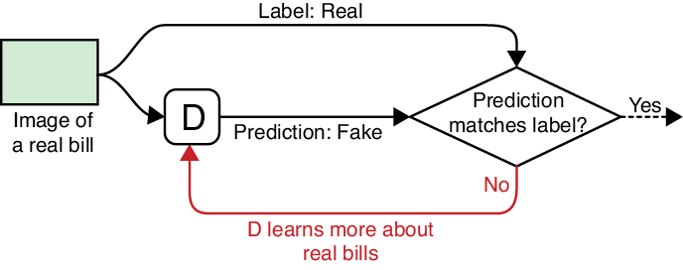
Source: Glassner, A. (2021). Deep learning: A visual approach. San Francisco, CA: No Starch Press.

Slide 13
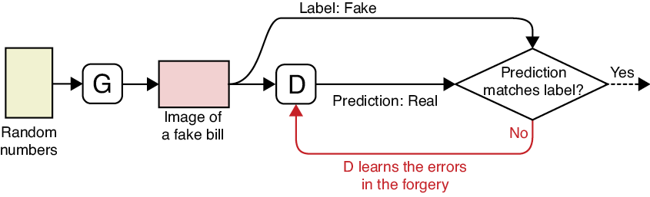
Source: Glassner, A. (2021). Deep learning: A visual approach. San Francisco, CA: No Starch Press.

Slide 14
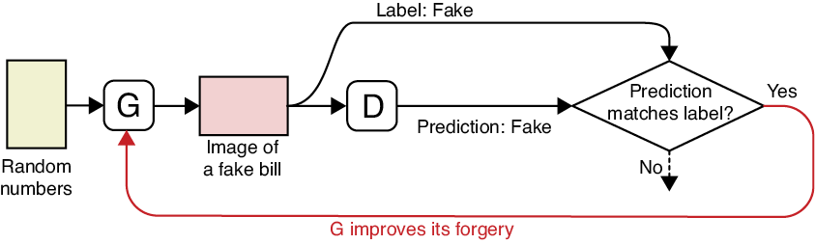
Source: Glassner, A. (2021). Deep learning: A visual approach. San Francisco, CA: No Starch Press.

Slide 15
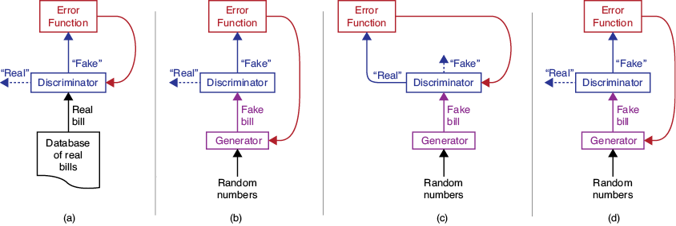
Source: Glassner, A. (2021). Deep learning: A visual approach. San Francisco, CA: No Starch Press.

