Slide 1

What is AI – Part 1
Notes:
Hello and welcome to our class (Frontiers of AI). So, let’s start with Course goals…

Slide 2
Lesson Overview
What is Artificial Intelligence?
How do Machines Learn
Google Teachable Machine

Slide 3
Artificial Intelligence Defined
Notes:
Here’s the question we will focus on in our first set of presentations. What are we talking about?

Slide 4
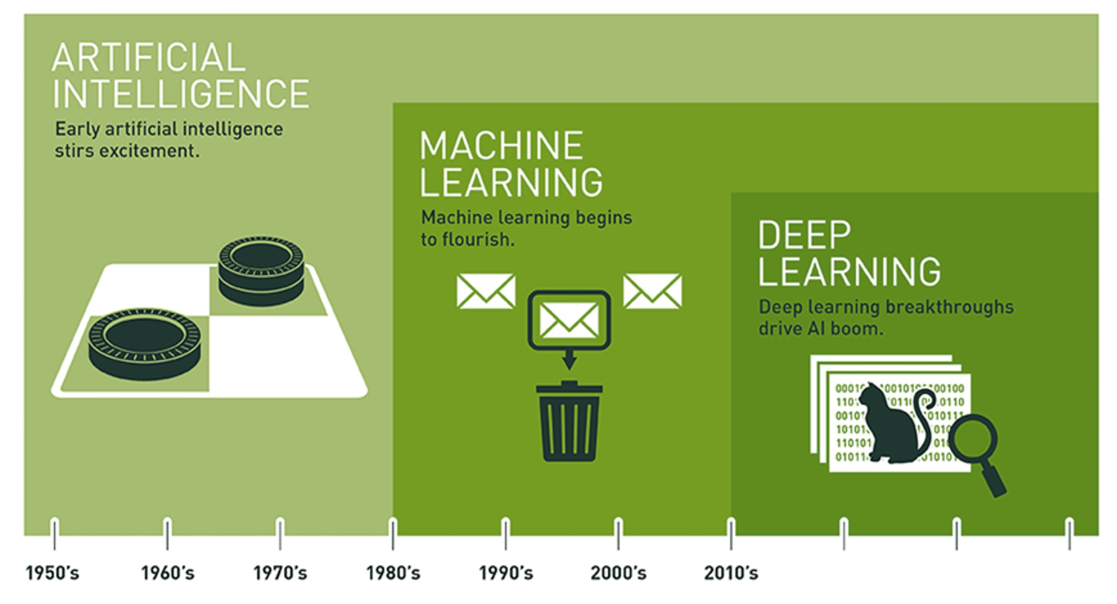
AI is Expansive
Source: Copeland, M. Retrieve from https://blogs.nvidia.com/blog/2016/07/29/whats-difference-artificial-intelligence-machine-learning-deep-learning-ai/
Notes:
Expansive AI
AI encompasses ML and DL
Distinct domains
Uneven progress since the 1950’s, with multiple ‘winters’ where interest and funding dried up
Let’s first examine the relationship between machine learning and deep learning.
=====
The field of AI is expansive…
Often, the terms AI, Machine Learning, and Deep Learning are used interchangeably. But as pictured here, they are distinct domains, with AI encompassing the other two. Indeed, AI has a long and distinguished history. In fact, a lot of interesting AI research happened in the 1950s.
Let’s consider a couple definitions…

Slide 5
ML / DL Comparison
Machine Learning
Deep Learning
1990’s - Present
2010 - Present
Statistics & Math
Artificial Neuron
Sci-Kit Learn / RAPIDS
Tensorflow / Pytorch
Notes:
Although deep learning is a subfield of machine learning, some broad differences exist between the two. Let’s briefly consider a couple.
Deep learning came into its own shortly after 2010. This deep learning revolution was powered by a) Graphic Processing Units (GPUs), b) plentiful data, and c) deep learning frameworks. ML algorithms, on the other hand, rose to prominence in the 1990’s, with advances in computer hardware.
The distinguishing feature of deep learning is the presence of artificial neurons arranged in layers. Deep learning was inspired by the anatomy of the brain, specifically the neuron. The inspiration for machine learning algorithms came from statistical and mathematical formulas.
The development environments are different too. Tensorflow / Keras – Pytorch / FastAI on the deep learning side. Sci-Kit Learn and RAPIDS on the machine learning side. There are many libraries and software packages which provide some level of machine learning support.
As mentioned earlier, AI has experienced multiple winters…
=====
The ImageNet Large Scale Visual Recognition Challenge is the world’s premier ground for assessing the world’s state-of-the-art vision models. AlexNet – a deep learning model – crushed the competition in 2012. It was the only deep-learning competitor that year.

Slide 6
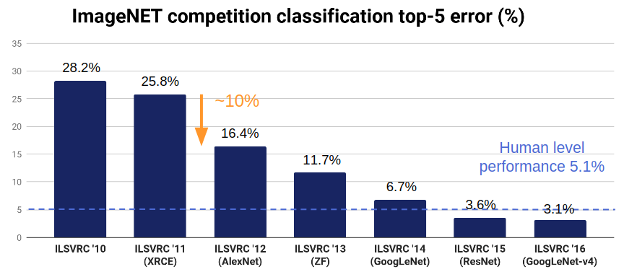
ILSVRC Competition Classification Error Rate (%)
Source: https://becominghuman.ai/a-summary-of-industry-ready-state-of-the-art-computer-vision-techniques-a7f2b893de2f
Notes:
ILSVRC: Large Scale Visual Recognition Challenge - uses the famous ImageNet dataset – 14 million labelled images.
The deep neural network breakthrough happened in 2012 – a roughly 10% decrease in image classification error (from 25.8% in 2011 to 16.4% in 2012).
In 2015, state-of-the-art deep learning algorithms surpassed human level performance for image classification (5.1%) with an accuracy of 3.57%.
Overall, the introduction of deep neural networks resulted in a 10-fold reduction in image classification error (from 25.8% in 2011 to 2.3% in 2017).

Slide 7
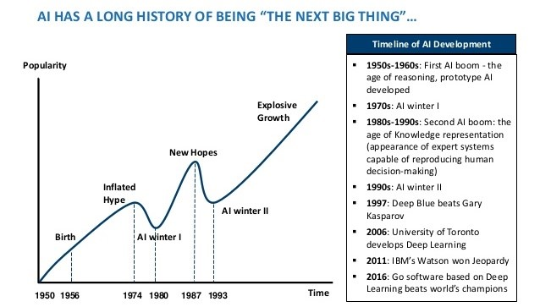
Image Credit: https://www.mdpi.com/2079-9292/10/4/514/htm
Notes:
Although deep learning has been on a tear since 2010, that has not always been the case for the field as a whole.
1st AI winter: mid-1970’s – Marvin Minsky & Seymour Papert argue in their book (Perceptron) that neural networks are a dead-end.
2nd AI winter: early-1990’s – expert systems fail – too difficult to construct and maintain
Hype is the problem. It’s about over-promising and under-delivering. But here are some key points:
AI is seductive
AI researchers have been making steady progress since the 1950s.
AI winters aren’t really about AI failures per se. AI technologies, including many “failures” are still widely used today.
Now for definitions…

Slide 8
Artificial Intelligence is the study of “rational agents”: any system that perceives its environment and takes actions that maximize its chance of achieving its goals.
-- Russell & Norvig (2003)
Notes:
Leading AI textbooks define the field of Artificial Intelligence as the study of “intelligent or rational agents” – any system that perceives its environment and takes actions that maximize its chance of achieving its goals.
Restatement of Russell & Norvig’s definition – Artificial Intelligence: A Modern Approach, 2nd edition – most widely used introductory text.
AI system performance = humans in many cases.
Broad array of applications.
=====
Leading AI textbooks define the field of Artificial Intelligence as the study of “intelligent agents”: any system that perceives its environment and takes actions that maximize its chance of achieving its goals. Such systems are now able to perform tasks humans are good at; for example, recognizing objects, making sense of speech, and decision making in a constrained environment. As our computer programs have become more sophisticated, our ideas of which tasks require human intelligence have evolved. Thus, AI is now used in a wide variety of tasks.

Slide 9
Machine learning is the field of study that gives computers the ability to learn without being explicitly programmed.
-- Arthur Samuel (1959)
Machine learning is the science and art of programming computers so they can learn from data.
Notes:
… and here’s a definition of machine learning coined by Arthur Samuel in 1959. This is concise and one of my personal favorites. However, I also like this second definition: Machine learning is the science (and art) of programming computers so they can learn from data. Now, the key word in that second definition is data. In fact, deep learning is not possible without data.
=====
Machine Learning algorithms parse data, learn from it, and then make a prediction about something in the world. So rather than hand-coding software routines with a specific set of instructions to accomplish a particular task, the machine is “trained” using large amounts of data and algorithms that give it the ability to learn how to perform the task.

Slide 10

Deep Learning
Image Credit: https://www.bettycrocker.com/recipes/rainbow-layer-cake/4969fed8-141e-45f5-9a04-e03addd20fbb
Notes:
Again, deep learning is a subfield of machine learning with a focus on neural networks
A neural network is a special type of learning algorithm, inspired by the billions of interconnected neurons in the human brain.
In a NN, neurons are grouped together in layers – image of a multi-layered cake – if you have many layers, the cake is “deep” when viewed from above.
=====
Since 2010, deep learning became possible because:
Enhanced hardware – GPUs from Nvidia and other suppliers
Open AI software frameworks – Tensorflow, Pytorch, Keras, etc…
Big Data

Slide 11

In a word or two, define artificial intelligence
Notes:
https://app.wooclap.com/PRACTICUMAI?from=event-page

Slide 12
What is AI – Part 2
Notes:
Hello and welcome to our class (Frontiers of AI). So, let’s start with Course goals…

Slide 13

Image Credit: Nicky Johnston
Notes:
Let’s continue our journey of exploring the question, “What is artificial intelligence?
Meet Ai-Da, a creative robot named after Ada, the Countess of Lovelace who worked with Charles Babbage to create one of the world’s first computers (the Difference Engine) in the 19th century. Except for the arms, Ai-Da looks like a person. Here she stands in front of one of her latest creations. A couple questions.
Is Ai-Da exhibiting intelligent / creative behavior?
What criteria would you use to assess whether an entity is intelligent?
Is intelligence an emergent property of consciousness?
The question of what constitutes intelligence is important. It lies at the heart of AI. For without a clear definition, how do we know when we have succeeded? Over time, leading AI researchers have proposed different definitions. Let’s start with the first one.

Slide 14
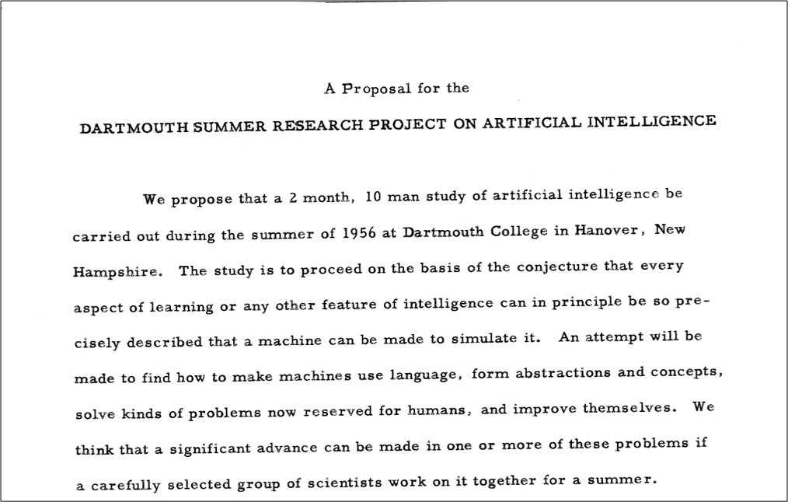
Origin of “AI”!
Notes:
In 1955, the first conference on “artificial intelligence” was held at Dartmouth College. It was attended by the leading computer science researchers of the day – John McCarthy, Marvin Minsky, Nathanial Rochester, and Claude Shannon.
McCarthy coined the phrase “artificial intelligence” when he wrote the funding proposal for the Rockefeller Foundation. This is where modern AI began.
McCarthy also provided a short definition.
=====
In early 1955, John McCarthy accepted a position as an Assistant Professor of Mathematics at Dartmouth College. Soon after, he organized a group to discuss the future of thinking machines. In September, he, Marvin Minsky, Nathanial Rochester, and Claude Shannon submitted a proposal to the Rockefeller Foundation, requesting funds to host the Dartmouth Summer Research Project on Artificial Intelligence. Fortunately, the foundation funded the proposal. And today, this conference is credited with introducing the term 'artificial intelligence’ to the world.

Slide 15
Dartmouth Proposal (McCarthy et al. 1955): “The study is to proceed on the basis of the conjecture that every aspect of learning or any other feature of intelligence can in principle be so precisely described that a machine can be made to simulate it.”
John McCarthy (2007): “It is the science and engineering of making intelligent machines, especially intelligent computer programs.” “The ultimate effort is to make computer programs that can solve problems and achieve goals in the world as well as humans.”
Wallace Marshall (1987): “Artificial stupidity (AS) may be defined as the attempt by computer scientists to create computer programs capable of causing problems of a type normally associated with human thought.”
Notes:
With that history in place, let’s consider some definitions – starting with the one advanced in the Dartmouth Proposal. I like the Wallace Marshall definition…

Slide 16
Allen Newell (1990): An intelligent system “operates in real-time; exploits vast amounts of knowledge; tolerates erroneous, unexpected, and possibly unknown inputs; uses symbols and abstractions; communicates using some form of natural language; learns from the environment; and exhibits adaptive goal-oriented behavior.”
Ray Kurzweil (1990): “In summary, there appears to be no simple definition of intelligence that is satisfactory to most observers, and most would-be definers of intelligence end up with long checklists of its attributes.”
Notes:
… and a couple more definitions.

Slide 17

What do you think? What is the defining feature of “intelligence”?
Image Credit: https://worqiq.com/2018/09/open-to-think-pure-thinking-power/
Notes:
Okay – given these definitions, has your definition of A.I. changed from your response in our first exercise?
Let’s discuss these questions in the breakout rooms.

Slide 18
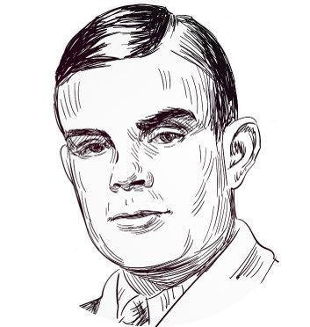
Alan Turing
Image Credit: https://www.dreamstime.com/alan-turing-famous-vector-sketch-portrait-isolated-image189405803
Notes:
Another important name in AI is Alan Turing. The Turing test of intelligence was first proposed by him in 1950, in an article entitled, Computing Machinery and Intelligence. This is a foundational document in this field.
Turing, AM (1950) Computing Machinery and Intelligence. Mind: 54

Slide 19
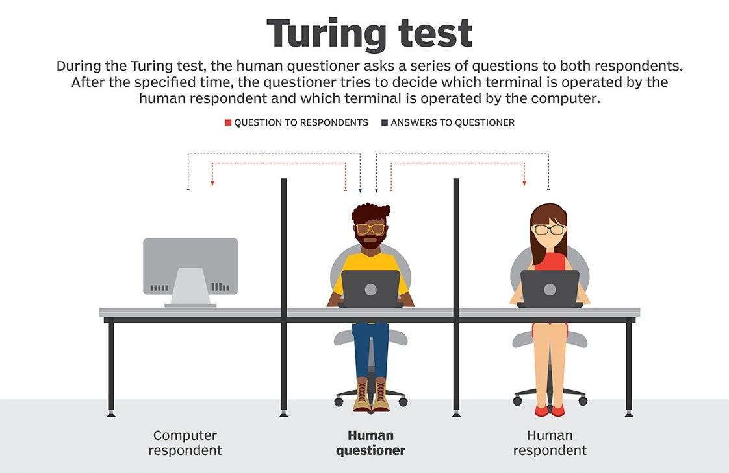
Image Credit: https://searchenterpriseai.techtarget.com/definition/Turing-test
Notes:
The Turing Test has been hugely influential since Turing first described it in 1950.
Turing got the idea from a Victorian parlor game where a man and a woman sat in a separate room. The other players then passed a series of written questions to them and would try to guess the sex of the respondent by the answers they gave.
The Turing Test is a computer version of that game. In the image here, we see a Human questioner in the middle, sending questions to both a computer and another human. The interaction is purely in the form of text and answers: the human questioner types a question, and a response is displayed. Now the task of that person is to determine whether the thing being interrogated is a person or a computer program.
Now, suppose that the thing being interrogated is indeed a computer program, but after some reasonable amount of time, the questioners cannot reliably tell whether they are interacting with a program or a person. Then surely, Turing argued, you should accept that the program has some sort of human level intelligence because the system is doing something that makes it indistinguishable from the real thing. The key word here is indistinguishable…
https://searchenterpriseai.techtarget.com/definition/Turing-test

Slide 20
ELIZA
Notes:
An early attempt at creating a conversational AI program was ELIZA. ELIZA is a famous computer program written in the 1960’s by MIT computer scientist Joseph Weizenbaum. The program mimics the role of a psychiatrist talking to a patient to get the interviewee to contemplate themselves. Strangely, Weizenbaum discovered that many people preferred Eliza over a conversation with a real human-being.
ELIZA’s legacy lives on to this day. In 1990, Hugh Loebner created the Loebner Prize. Each year, the Loebner Prize invites the submission of computer programs to engage in the Turing test, attempting to convince a panel of judges that they are in fact people.
We’re going to give you time to chat with this year’s winner of the Loebner prize. Her name is Kuki…
=====
Woolridge concludes, “ELIZA is the direct ancestor of a phenomenon that makes AI researchers groan whenever it is mentioned: the internet chatbot.

Slide 21
kuki.ai
Notes:
Breakout conversations – Is Kuki exhibiting intelligent behavior, is this intelligence? (Yes/No)

