Slide 1

Word Embeddings and Word Vectors
Notes:
Last week, we talked about text representation, and The Deep Learning Workshop textbook presents three “classical” approaches to do this:
One-hot encoding, where the feature for a term was simply marking its presence in a document.
The count/frequency-based approach attempted to add the importance of the term by using its frequency in a document.
And finally, the TF-IDF approach attempted to use a "normalized" importance value of the term, factoring in how common the term is across the documents.
In today’s workshop, we’re going to look at word embeddings, a popular way to represent text. So, what exactly are word embeddings? Loosely speaking, they are vector representations of a particular word. Word embeddings capture the context of a word in a document, semantic and syntactic similarity, as well as relation to other words, etc..

Slide 2
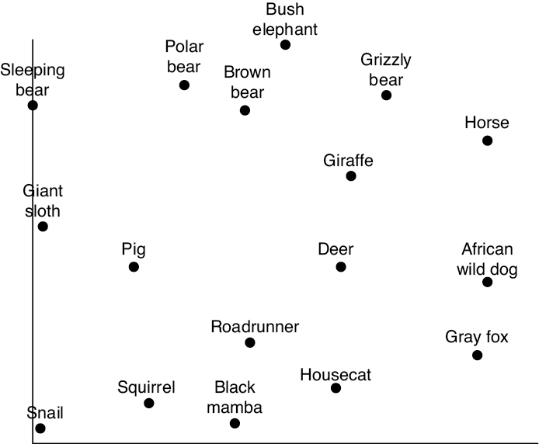
Source: Glassner, A. (2021). Deep learning: A visual approach. San Francisco, CA: No Starch Press. (Chapter 20)
Notes:
Word embedding (or token embedding) is a bit abstract. So, let’s begin with a concrete story.
Now imagine you work as an animal wrangler on a movie with a tempestuous director. Today you’re filming a sequence where the human heroes are chased by some animals. The director asks you for a list of animals you can provide to produce a scary chase. You call your office, and the staff send you a chart of available animals, with the horizontal axis representing each adult animal’s average top speed and the vertical axis representing its average weight.
But due to a printer error, the chart is missing the labels on the axes, so you have an image of the animals laid out in 2D but you don’t know what the axes mean.
The director doesn’t even look at the chart. “Horses,” she says, “I want horses!” So, you bring in the horses, and they rehearse the scene. But the director is unhappy. “No, no, no!” she says. “The horses are too twitchy and quick. They’re like foxes. Give me horses that are less foxlike.”
How on Earth can you satisfy this request? What does it even mean? Happily, you can do what she asks with this chart, just by combining arrows.

Slide 3
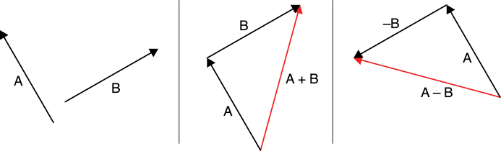
Source: Glassner, A. (2021). Deep learning: A visual approach. San Francisco, CA: No Starch Press. (Chapter 20)
Notes:
You only need to do two things with arrows: add them and subtract them. To add arrow B to arrow A, place the tail of B onto the head of A. The new arrow A + B starts at the tail of A, and ends at the head of B, as shown here in the image in the middle.
To subtract B from A, just flip B around by 180 degrees to make –B, and add together A and –B. The result, A – B, starts at the tail of A and ends at the head of –B, as in the image on the right.

Slide 4
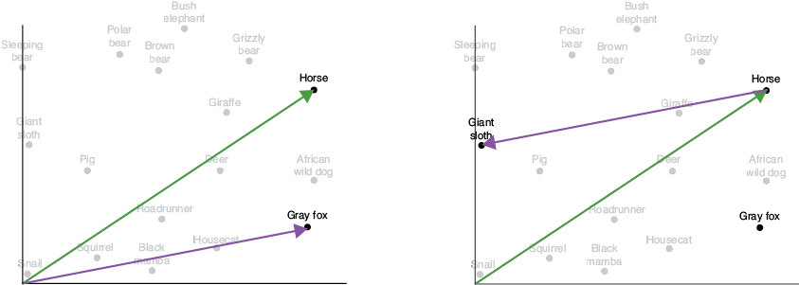
Source: Glassner, A. (2021). Deep learning: A visual approach. San Francisco, CA: No Starch Press. (Chapter 20)
Notes:
Now you can satisfy the director’s desire to remove the fox qualities from the horses. Start by drawing an arrow from the bottom left of the chart to the horse, and another to the fox, as in the image on the left.
Now subtract foxes from horses, as requested, by subtracting the fox arrow from the horse arrow. Following the rules from the previous slide, that means flipping the fox arrow around and placing its tail at the head of the horse arrow, to arrive at the image on the right.
A giant sloth. Well, okay, it’s what the director wanted. We can even write this like a little bit of arithmetic: horse – fox = giant sloth (at least, according to our diagram).

Slide 5
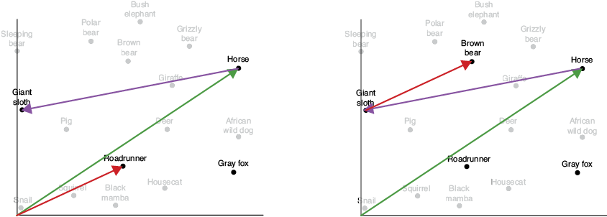
Source: Glassner, A. (2021). Deep learning: A visual approach. San Francisco, CA: No Starch Press. (Chapter 20)
Notes:
The director throws her latte on the ground. “No, no, no! Sure, sloths would look great, but they hardly move! Make them fast! Give me sloths that are like roadrunners!”
Now we know just how to satisfy this ridiculous demand: find the arrow from the bottom left to the roadrunner, as shown in the image on the left, and add that to the head of the arrow pointing to the sloth, giving us a brown bear. That is, horse – fox + roadrunner = brown bear, as in the image on the right.
You offer the director a group of brown bears (called a sleuth of bears). The director rolls her eyes dramatically. “Finally. Something that’s fast like horses, but not twitchy like foxes, and quick like roadrunners. It’s only what I asked for in the first place.” They shoot the chase scene with bears, and the movie later comes out to great acclaim.
There are two key elements to this story. The first is that the animals in our chart were laid out in a useful way, even though we didn’t know what that way was, or what the axes represented.
The second key point is that we didn’t need the axis labels after all. We were able to navigate the chart just by adding and subtracting arrows pointing to elements on the chart itself. That is, we didn’t try to find a “slower horse.” Rather, we worked strictly with the animals themselves, and their various attributes came along implicitly. Removing the speediness of a fox from a big animal like a horse gave us a big, slow animal.
What does this have to do with processing language?

Slide 6
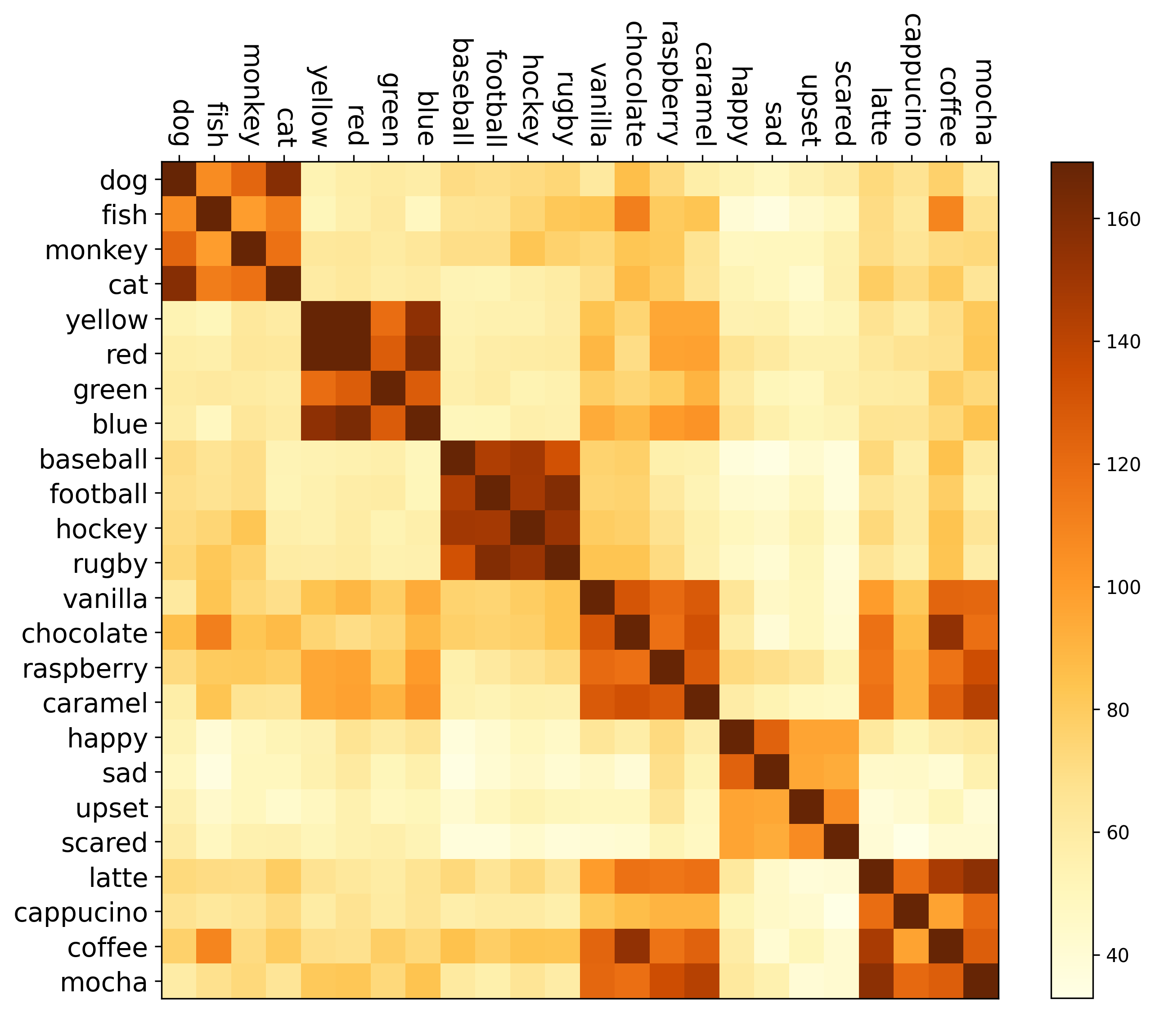
Source: Glassner, A. (2021). Deep learning: A visual approach. San Francisco, CA: No Starch Press. (Chapter 20)
Notes:
To apply what we’ve just seen to text, we replace the animals with words. And instead of using only two axes, we’ll place our words in a space of hundreds of dimensions.
All this is done by an algorithm that works out what each axis in this space means as it places every word at an appropriate point. Instead of assigning each word a single number, the algorithm assigns the word a list of numbers, representing its coordinates in a huge space. This algorithm is called an embedder, and we say that this process is one of embedding words in the embedding space, thereby creating word embeddings. The embedder constructs the space and sets the coordinates of each word so it’s near similar words.
The relationships between words in an embedding space can be visualized. (Click) This image (heat map) shows six sets of four related words. The more the embeddings of any two words are alike, the higher the word pair score. Higher scores, in turn, are darker red. Each word matches itself more strongly than unrelated words. These can be seen as a dark red diagonal of blocks.
=====
Do you see anything odd here? Why does the fish, chocolate, and coffee combinations score above average? And, what’s the story with blue and caramel?

Slide 7
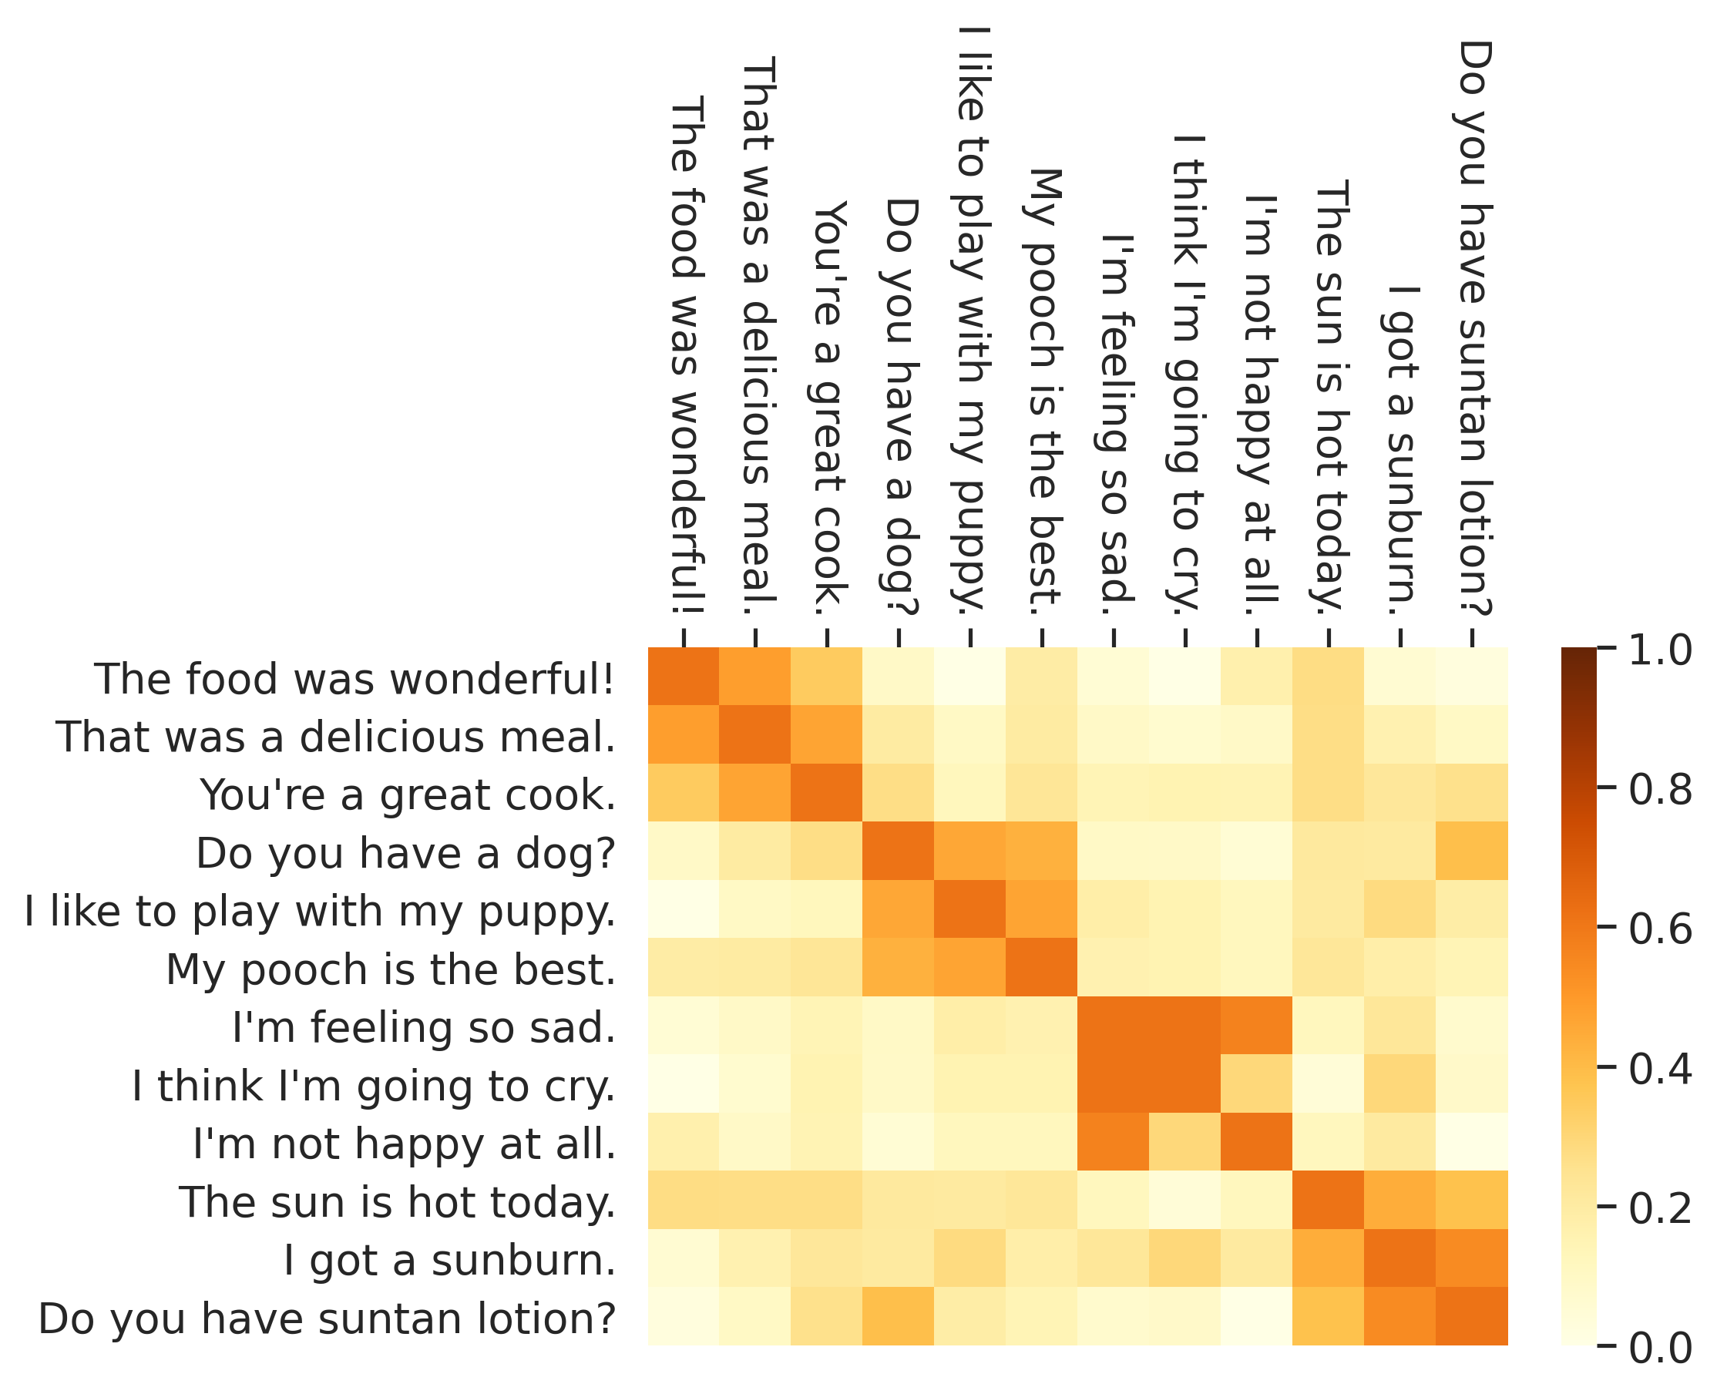
Source: Glassner, A. (2021). Deep learning: A visual approach. San Francisco, CA: No Starch Press. (Chapter 20)
Notes:
We can also embed entire sentences, so that we can compare them as a whole, rather than word by word. This image shows comparisons between embeddings for a dozen sentences.

Slide 8
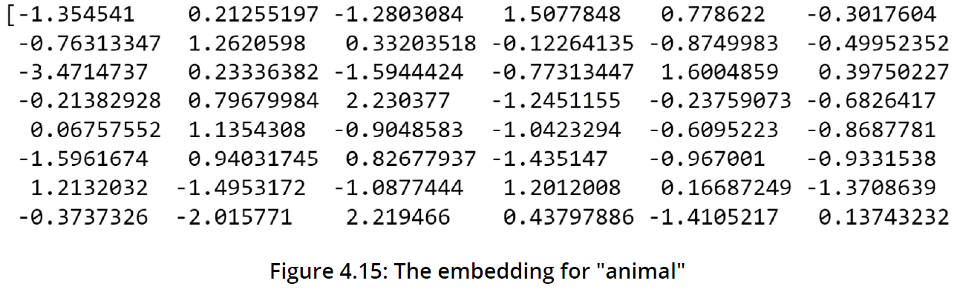
Source: Mirza, R.B. et al. (2021). The deep learning workshop. Birmingham, UK: Packt Publishing. (Chapter 4)
Notes:
And finally, here’s what a word embedding looks like in real life. In today’s last exercise, we print out a multi-dimensional embedding that looks something like the one pictured here.
The beauty of training an embedder in a space with hundreds (or even thousands) of dimensions is that it can use the space much more efficiently than any person could, enabling it to simultaneously represent an enormous number of relationships.
=====
The embedder works out for itself how to construct the space and find the coordinates of each word so that it’s near similar words. For example, if it sees a lot of sentences that begin with, I just drank some _____, then whatever noun comes next is interpreted as a drink of some sort, and it is placed near other kinds of drinks. If it sees I just ate a red _____, then whatever comes next is interpreted as something that’s red and edible, and it is placed near other things that are red and near other things that are edible. The same thing is true of dozens or even hundreds of other relationships, both obvious and subtle. Because the space has so many dimensions and the axes can have arbitrarily complex meanings, words can belong simultaneously to many clusters based on seemingly unrelated characteristics.

Slide 9
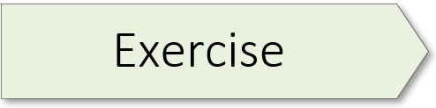
Word Embedding Demo
Notes:
Note: the demo can take 1 – 2 minutes to download: https://www.cs.cmu.edu/~dst/test/Word2VecDemo/

Slide 10
Have a good day
Have a great day
V = {Have, a, good, great, day}
Source: Karani, D. (2018). Retrieved: https://towardsdatascience.com/introduction-to-word-embedding-and-word2vec-652d0c2060fa
Notes:
Let’s consider another concrete example. Take, for example, these two sentences: Have a good day and Have a great day. The meaning of these two sentences is similar, though the second one is a bit more emphatic. We’ll start by constructing an exhaustive vocabulary – called V – consisting of these five words {Have, a, good, great, day}.

Slide 11
Source: Karani, D. (2018). Retrieved: https://towardsdatascience.com/introduction-to-word-embedding-and-word2vec-652d0c2060fa
Notes:
Next, we create a one-hot encoded vector for each of these words. As we see here, the length of each vector is 5, with the position of each word within V indicated by a 1. The word ‘Have’ is the first word in V and thus the initial digit of its vector is 1. Now to visualize this encoding, imagine a 5-dimensional space where each word occupies a single dimension and has nothing to do with the rest. While simple, the problem with this representation is that the words ‘good’ and ‘great’ overlap to a degree. That is, they share similar meanings. But one-hot encoding does not capture that. Word embeddings, on the other hand, can represent relationships and dependencies between words.

Slide 12
Word2Vec
CBOW (Common Bag of Words)
2. Skip-Gram
Notes:
Word2Vec is a popular word embedder developed at Google by Thomas Mikolov in 2013. The model comes in two flavors or architectures.
The first is CBOW, the acronym for Common Bag of Words.
And the second is Skip-Gram.
Let’s first consider the CBOW architecture…

Slide 13
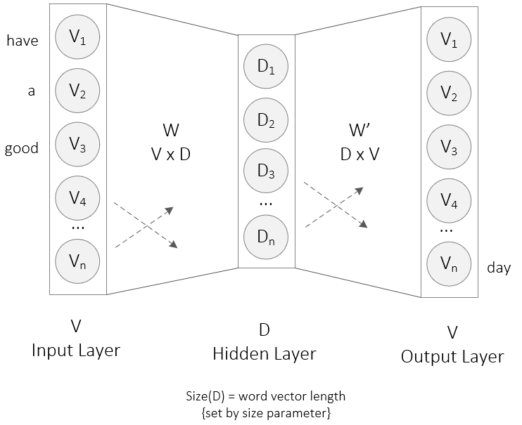
CBOW
Source: Karani, D. (2018). Retrieved: https://towardsdatascience.com/introduction-to-word-embedding-and-word2vec-652d0c2060fa
Notes:
The CBOW architecture takes the context of each word as the input and tries to predict a missing word, given that context. Consider our example: Have a good day. The first three words of that sentence are shown on the left, next to the first three nodes of the input layer. The network’s goal is to predict the target word (day), using these context words. To do that, we one-hot encode the input words and measure the output error compared to the one-hot encoding of the target word - the word day in this example. And in the process of predicting the target word, we learn its vector representation.
Let’s take a closer look at the architecture.
The input to the neural network is a one hot encoded vector – labeled V for Vocabulary – of size N, with one input for each word. The hidden layer (D) contains M neurons or nodes, with the number of nodes or neurons in this layer set by Word2Vec’s size argument. Word vector sizes vary, though dimensions of 768 and 1024 are common. And finally, the output is a vector (labelled V for vocabulary) of size N, with each element being a softmax value.
Let’s review the terms in this image: - This is a simple neural network with 3 layers – input, hidden, and output.
- W is the weight matrix that maps the input V to the hidden layer (a V*D dimensional matrix) - W’ is the weight matrix that maps the hidden layer outputs to the output layer (a D*V dimensional matrix)
- The dashed arrow lines indicate the direction of forward propagation as well as the fact that these are fully connected layers
I won’t get into the mathematics. We’ll just get an idea of what’s going on. Let’s zoom in on that hidden layer.

Slide 14
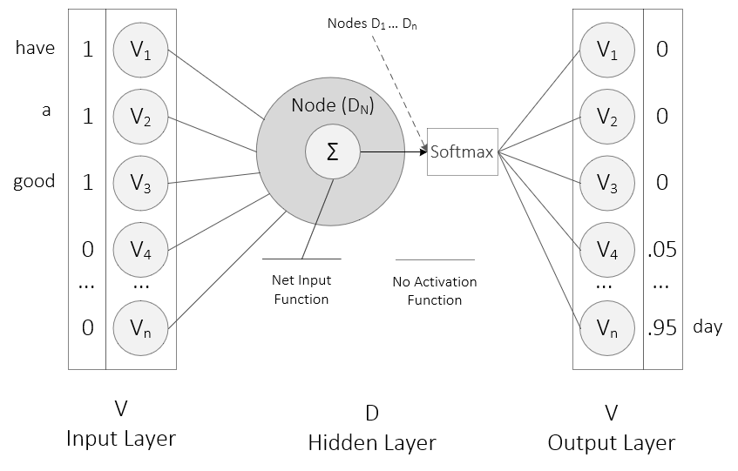
Source: Karani, D. (2018). Retrieved: https://towardsdatascience.com/introduction-to-word-embedding-and-word2vec-652d0c2060fa
Notes:
In this example, the one hot encoded input vector is displayed, with 1’s indicating the presence of a specific word and 0’s indicating absence. Unlike a traditional neural network, there is no activation function like sigmoid, tanh, or ReLU. The only non-linearity is the softmax calculations in the output layer. All that is present in the hidden nodes is a net input function that sums up the incoming values – the values in the input vector multiplied by the weights in the W matrix. In the output on the right, we see that softmax is 95% certain that the next word is ‘day’ with a 5% probability that it is ‘great.’ Keep in mind that softmax output always sums to 1 or 100%, as is the case here.

Slide 15
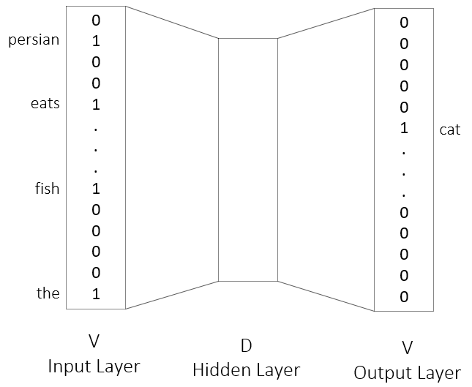
The Persian cat eats fish. CBOW Architecture
Source: Mirza, R.B. et al. (2021). The deep learning workshop. Birmingham, UK: Packt Publishing. (Chapter 4)
Notes:
So far, we have seen how a missing word can be predicted, using context words. The CBOW architecture does just that. Here we see that the context words predict cat as the missing word. CBOW is relatively fast and generates better representations for more frequent words. But we can flip this model…

Slide 16
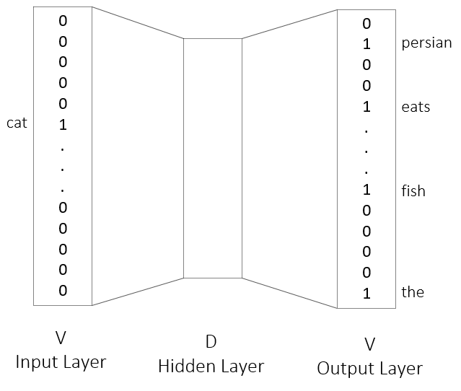
The Persian cat eats fish. Skip-Gram Architecture
Source: Mirza, R.B. et al. (2021). The deep learning workshop. Birmingham, UK: Packt Publishing. (Chapter 4)
Notes:
With the Skip-Gram architecture, a single target word is used to predict all its context words. Skip Gram works well with small amounts of data as well as rare words.

Slide 17
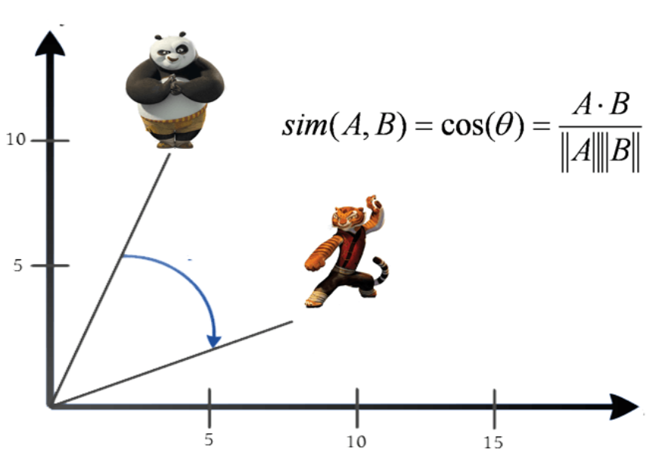
Cosine Similarity
“Good”
“Great”
Source: Karani, D. (2018). Retrieved: https://towardsdatascience.com/introduction-to-word-embedding-and-word2vec-652d0c2060fa
Notes:
As stated earlier, the primary disadvantage with one-hot encoding is that all the words are independent of each other. But word embeddings solve that problem. The basic idea behind word embeddings is that we want words that appear in similar contexts to be spatially close to each other. Mathematically we do that by measuring the cosine of the angle between word vectors. Thus, the cosine of the angle between similar words such as “good” and “great” ought to be near 1. That is, an angle close to 0. In this image:
Po the Panda is the word vector for ‘good’
While Master Tigress is the word vector for ‘great’.
In this image, the two words are spatially proximate to each other because their meaning overlaps to a large degree.

Slide 18
Embeddings
02.1_embeddings.ipynb
Notes:
Our last notebook in this workshop series consists of two exercises. (You will want to run the code blocks at the start of the notebook before starting the exercises.)
4.05 (Vectors for Phrases) – page 201
4.06 (Training Word Vectors on Different Datasets) – page 205

Slide 19
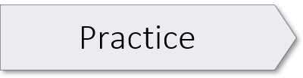
Alice in Wonderland
02.2_alice_wonderland.ipynb

Slide 21
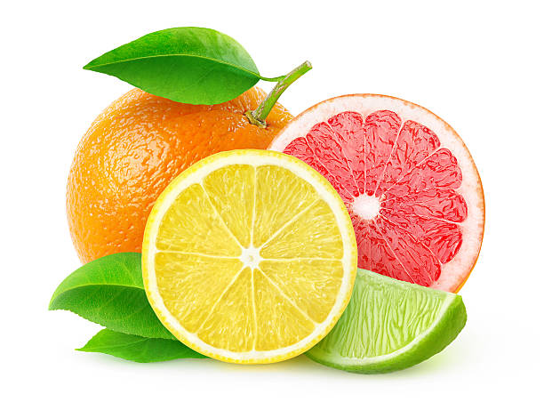
Grapefruit
Citrus
Orange
Image Credit: https://www.istockphoto.com/photos/citrus-fruit
Notes:
Let’s wrap up with a quick review. Word embedding is a process whereby words that appear close together in a text are moved closer together in a vector space. The process is iterative, moving synonyms close together because synonyms have the same words around them.
Consider, for example, these sentences – “Grapefruit is my favorite citrus. Grapefruits grow on a tree. The orange is also a citrus.” Now you can see how processing thousands of sentences like these would create a connection between citrus, orange, and grapefruit. Just as juice, fruit, and tree are similar. All based on word proximity.
The main problem with this approach is it only creates 1 embedding per word… hence, more recent transformer models such as BERT and GPT support contextualized embeddings; that is, multiple embeddings per word, to represent different meanings of a word. Our transformer workshop covers this new architecture in-depth.
(E. Stubbs Email: 05.21.21)

Slide 22
Lesson Overview
Learning Objective 1
Learning Objective 1
Learning Objective 1
Learning Objective 1

Slide 23
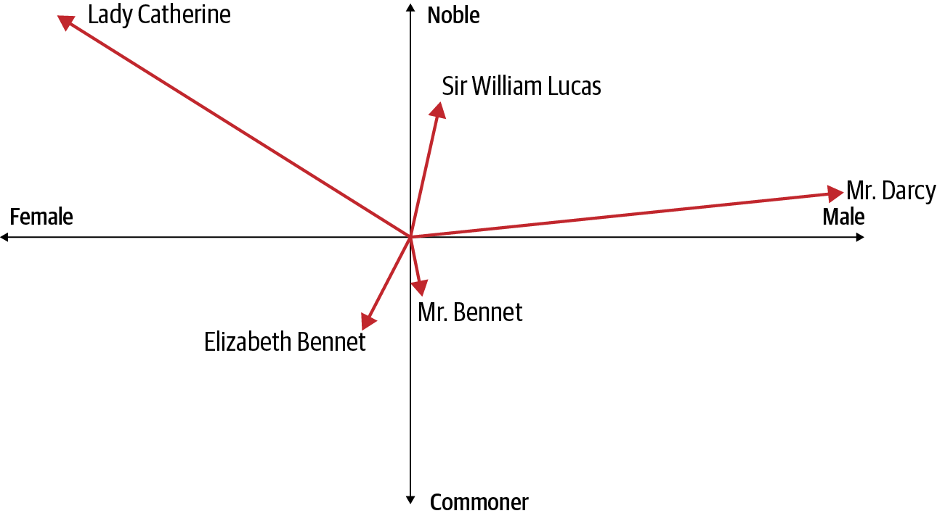
Source: Moroney, L. (2021). AI and machine learning for coders. Sebastapol, CA: O’Reilly Media. (Chapter 6)
Notes:
Suppose we were to look at characters from the Jane Austen novel Pride and Prejudice, considering the dimensions of gender and nobility. We could plot the former on the x-axis and the latter on the y-axis, with the length of the vector denoting each character’s wealth.
From an inspection of the graph, you can derive a fair amount of information about each character. Three of them are male. Mr. Darcy is extremely wealthy, but his nobility isn’t clear (he’s called “Mister,” unlike the less wealthy but apparently more noble Sir William Lucas). The other “Mister,” Mr. Bennet, is clearly not nobility and is struggling financially. Elizabeth Bennet, his daughter, is similar to him, but female. Lady Catherine, the other female character in our example, is nobility and incredibly wealthy. The romance between Mr. Darcy and Elizabeth causes tension—prejudice coming from the noble side of the vectors toward the less-noble.
As this example shows, by considering multiple dimensions we can begin to see real meaning in the words (in this case, character names). Again, we’re not talking about concrete definitions, but more a relative meaning based on the axes and the relation between the vector for one word and the other vectors.
This leads us to the concept of an embedding, which is simply a vector representation of a word that is learned while training a neural network.

