Slide 1

Natural Language Processing: Getting Started

Slide 2
Computer
Science
Linguistics
NLP
Artificial Intelligence
Source: Glassner, A. (2021). Deep learning: A visual approach. San Francisco, CA: No Starch Press. (Chapter 19)
Notes:
Natural language Processing (NLP) lies at the intersection of AI, linguistics, and computer science
An NLP model mimics human language abilities but has no human-level understanding
NLP systems play a statistical game – given a set of words, the next word in the sequence ought to be x because of the probabilities learned from the training data. The game is played by assigning numbers to words and finding useful statistical relationships between those numbers.
Not even a glimmer of understanding – the same holds true for CNNs which have no actual understanding of the image.
=====
The field that studies language from an AI perspective is called natural language processing, or NLP. As shown here, NLP resides at the intersection of linguistics, computer science, and artificial intelligence. Most of today’s NLP algorithms are unconcerned with any kind of actual understanding of the language they process. Instead, they extract statistics from the data and use those statistics as the basis for tasks like answering questions or generating text.
As is the case with any neural network, the model itself has no human-like understanding of the examples it sees. For example, a convolutional neural network can identify objects in photos without having any actual understanding of the photo. The model is simply playing a statistical game with the pixels presented to it. Likewise, NLP systems don’t understand the language they manipulate. Instead, they assign numbers to words and find useful statistical relationships between those numbers.
In a fundamental sense, these systems have no knowledge that there is even a thing such as language, or that the objects they manipulate have semantic meanings. As always, the system is using statistics to generate outputs that we declare to be acceptable in a particular situation, without even a glimmer of comprehension of what it’s doing or what the outputs might mean to a person.

Slide 3
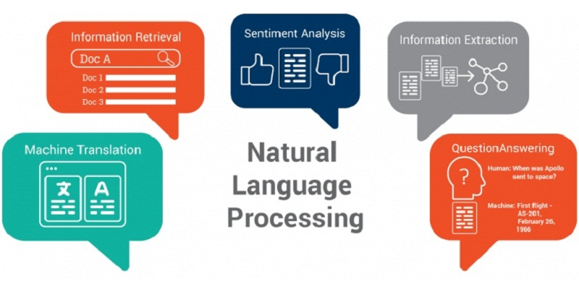
Image Credit: https://www.syntech.co.in/nlp/
Notes:
NLP is a large field – think of all the places language (spoken and written) is used.
NLP enables applications in the five primary categories shown here. Specific applications include the following:
Sentiment Analysis: Given opinionated text like a movie review, determine whether the overall sense is positive or negative.
Machine Translation: Turn text into another language.
Question Answering: Answer questions about the text, like who is the hero, or what actions occurred.
Information Extraction: Summarize and provide a short overview of the text, emphasizing the main points (Named Entity Recognition – person, place, organization, or object)
Generate New Text: Given some starting text, write more text that seems to follow from it.
Logical Flow: If a sentence first asserts a premise and the following sentence asserts a conclusion based on that premise, determine whether the conclusion logically follows from the premise.
… and many more.

Slide 4
Language is Ambiguous
The boy saw a man with a telescope.
Bob convinced Robin to buy a television for himself.
Robin has quit skydiving.
Notes:
But before we go any further, we need to acknowledge that NLP isn't easy because language is ambiguous. Here are three examples:
Consider this sentence: "The boy saw a man with a telescope.“ Who had the telescope? Did the boy use a telescope to see the man through it? Or was the man carrying a telescope with him? There is an ambiguity that we can't resolve with this sentence alone. Maybe some more context will help us figure this out.
And another sentence: “Bob convinced Robin to buy a television for himself." Who was the TV bought for – Bob or Robin? This is another case of ambiguity that we may be able to resolve with more context, but again, it may be very difficult for a machine/program.
And finally: "Robin has quit skydiving." This sentence implies that Robin was once an active skydiver. However, this presupposition is hard for a machine to infer.
Winograd schemas developed by Hector Levesque – Pronoun resolution.
The city councilmen refused the demonstrators a permit because they [feared/advocated] violence. Does the pronoun 'they' refer to the city councilmen or the demonstrators?

Slide 5

“Alexa, play some funky music…”
Notes:
NLP is all around us, but it really took off when deep neural networks became a reality.
Deep learning enables many NLP tasks.
Prior to deep neural networks, sentiment analysis, translation, and chatbots required a lot of manual intervention.
=====
The emergence of deep learning has had a strong positive impact on many fields, and NLP is no exception. Applications that use sentiment prediction, machine translation, and chatbots previously required a lot of manual intervention. With deep learning and NLP, these tasks are completely automated and bring with them impressive performance.

Slide 6


Slide 7
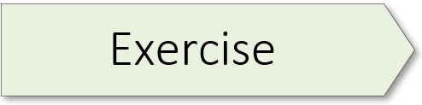
A Tour of NLP Applications
01.1_nlp_tour.ipynb

Slide 8

Data Pre-Processing & Cleaning
Image Credit: https://www.formpl.us/blog/data-cleaning
Notes:
Data pre-processing & cleaning accounts for 80+% of the time on an AI project
Data staging: all activities associated with cleaning and prepping data sets – this is critically important (Andrew Ng initiative)
Since 1950’s, programmers have been saying, “Garbage in, Garbage out.”
Data representation is a key NLP process:
Representation is converting raw text into something the computer understands
Word embeddings – now popular (deep learning text representation) – topic of next NLP workshop
=====
Data pre-processing and cleaning usually accounts for 80+% of the time spent on an AI project. Staging the data, as the process is often called, includes all activities associated with cleaning and preparing a data set for analysis. A properly staged data set is critically important… For as computer folks have been saying for a long time (since the late 1950’s) – garbage in, garbage out. This holds true for Natural Language Processing as well.
One key task in NLP is text data representation – which is, in simple terms, converting raw text into something a model would understand. Word embeddings constitute a deep learning-based approach that has changed the game, providing a powerful representation of text. We'll discuss embeddings in our next workshop. But first, let’s talk about some basic data pre-processing options.

Slide 9
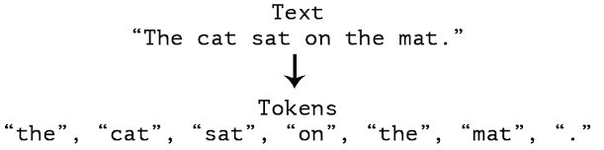
Tokenization
Image Credit: https://www.kdnuggets.com/2020/03/tensorflow-keras-tokenization-text-data-prep.html
Notes:
Tokenization is typically the first step in text pre-processing. It’s the splitting of a raw input text sequence into tokens. In simple terms, it is breaking the raw text into constituent elements that you want to work on. A token can be a paragraph, sentence, word, or even a character.

Slide 10
Stop Word Removal “the”, “of”, “an”, etc.
Cleaning Options
Normalizing Case “CAT”, “Cat”, and “caT”
Punctuation ! , : ; “”
Source: Mirza, R.B. et al. (2021). The deep learning workshop. Birmingham, UK: Packt Publishing. (Chapter 4)
Notes:
Cleaning options – 3 basic options:
Normalize case – we usually don't want "cat", "CAT", "Cat", and "caT" to be treated as separate entities. To do so, we typically convert all text into lowercase (we could also convert it into uppercase if we wanted).
Remove punctuation as separate tokens. Again, bear in mind that there could be tasks where punctuations could be important. As an example, when performing sentiment analysis, that is, predicting if the sentiment in the text is positive or negative, an exclamation can add value.
A lot of terms that don't add a lot of information/value. These are typically referred to as "stop words". We can think of these as belonging to two broad categories:
General/functional: These are filler words in the language that don't provide a lot of information but help stitch together other informative words to form meaningful sentences, such as "the", "an", "of", and so on.
Contextual: These aren't general functional terms, but given the context, don’t add a lot of value. If you're working with reviews of a mobile phone, where all reviews are talking about the phone, the term "phone" itself may not add a lot of information.

Slide 11
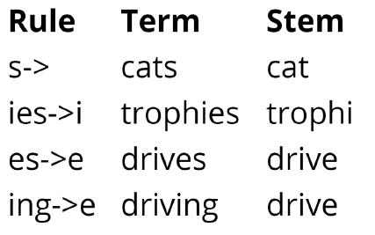
Stemming & Lemmatization
Source: Mirza, R.B. et al. (2021). The deep learning workshop. Birmingham, UK: Packt Publishing. (Chapter 4)
Notes:
Eat", "eats", "eating", "ate" – are all just variations of the same word, referring to the same action. In most text and spoken language, we have multiple forms of the same word. Typically, we don't want these to be considered as separate tokens. Stemming is a rule-based approach to achieve normalization by reducing a word to its "stem". The stem is the root of the word before any affixes (an element added to make a variant) are added. This approach is rather simple – chop off the suffix to get the stem. A popular algorithm is the Porter stemming algorithm, which applies a series of rules.
Lemmatization is a more sophisticated approach that refers to a dictionary and finds a valid root form (the lemma) of the word. Lemmatization works best when the part of speech of the word is also provided – it considers the role the term is playing and returns the appropriate form. The output from a lemmatization step is always a valid English word.

Slide 12
One-Hot Encoding
Source: Mirza, R.B. et al. (2021). The deep learning workshop. Birmingham, UK: Packt Publishing. (Chapter 4)
Notes:
One-hot encoding is one of the most intuitive approaches toward text representation. A one-hot encoded feature is a binary indicator of a term being present in the text. It's a simple approach that is easy to interpret – the presence or absence of a word. Here we see that the term “nlp” appears in the input text in the first and third rows. So for those rows, we say it’s ‘one-hot encoded” with its indicator variable set to one. Otherwise, it’s zero. And the same holds true for the other words.

Slide 13

Term Frequencies
Image Credit: https://www.istockphoto.com/photos/coming-soon-sign
Notes:
Unfortunately, I did not have time to create a set of slides for term frequencies – text representations which tell us how often a word appears in a body of text. The notebook, however, has some introductory content and an exercise on this topic.

Slide 14
Data Cleaning
01.2_data_cleaning.ipynb
Notes:
Today’s second notebook contains three data prep exercises, with a fourth one that is optional:
4.01 (Tokenization, Case Normalization, and Stop Word Removal) – page 166
4.02 (Stemming our Data) – page 172
4.03 (Creating One-Hot Encoding for Our Data) – page 181

Slide 15
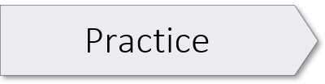
Data Cleaning
01.2_data_cleaning.ipynb
(4.04: Document Term Matrix with TF-IDF)
Notes:
This exercise is optional and is included in the notebook for this session.
4.04 (Document Term Matrix with TF-IDF) - Page 188

Slide 17

Image Credit: https://cktechcheck.com/

