Slide 1

Python for AI

Slide 2
What is Data Wrangling?
Data Wrangling is the process of gathering, collecting, and transforming raw data into another format for better understanding, decision-making, accessing, and analysis in less time.
Discovery
Structuring
Cleaning
Publishing
Validating
Enriching
Steps in data wrangling
Sources: A Handy Guide to Data Wrangling and Importing CSV in Python (turing.com)
Notes:
There are 6 broad steps in data wrangling, which are:
Step 1 Discovery: Understanding the data.
Step 2 Structuring: Structuring different data types into standardized formats.
Step 3 Cleaning: Eliminating redundant and incomplete data.
Step 4 Enriching: Enhancing data by supplementing it with data from internal/external sources.
Step 5 Validating: Checking for accuracy and data quality.
Step 6 Publishing: Releasing data for analytics.
=====
https://www.turing.com/kb/data-wrangling-and-importing-csv-in-python

Slide 3
Importance of Data Wrangling
20%
80%
Data Exploration and Modeling
Data Wrangling
Notes:
Did you know, data professionals spend almost 80% of their time wrangling the data, leaving a mere 20% for exploration and modeling?
Some may question if the amount of work and time devoted to data wrangling is worth the effort.
A simple analogy will help you understand. The foundation of a skyscraper is expensive and time-consuming before the above-ground structure starts. Still, this solid foundation is extremely valuable for the building to stand tall and serve its purpose for decades. Similarly, once the code and infrastructure foundation are gathered for data handling, it will deliver immediate results (sometimes almost instantly) for as long as the process is relevant.
However, skipping necessary data-wrangling steps will lead to significant downfalls, missed opportunities, and erroneous models that damage the reputation of analysis within the organization.
====
https://www.simplilearn.com/data-wrangling-article
https://www.datanami.com/2020/07/06/data-prep-still-dominates-data-scientists-time-survey-finds/

Slide 4





Data
Duplicates
Missing
Outliers
Data
data
formatting
errors
Common Data Wrangling Challenges
Sources: Taming the Data Beast: The Art of Efficient Data Wrangling (capellasolutions.com)
Notes:
Here are some common challenges that data wranglers face:
Data quality issues: Data may be incomplete, inconsistent, or inaccurate, which can lead to errors in analysis.
Data format issues: Data may be in different formats, such as CSV, JSON, or XML, and may require conversion to a unified format for analysis.
Data size issues: As data volumes continue to grow, processing and analyzing large datasets can become a significant challenge.
Data integration issues: Combining data from different sources can be difficult, especially if the data has different structures or uses different identifiers.
====
https://www.capellasolutions.com/blog/taming-the-data-beast-the-art-of-efficient-data-wrangling

Slide 5
Data Wrangling Techniques
Cleaning
Removing or correcting data that is incorrect, incomplete, or irrelevant.
Parsing
Breaking down complex data structures into simpler, more manageable forms.
Aggregating
Joining
Filtering
Selecting a subset of the data based on specific criteria, such as data ranges or numerical values.
Combining data from multiple sources into a single, unified dataset.
Summarizing data into groups or categories, such as calculating averages or counts.
Sources: Taming the Data Beast: The Art of Efficient Data Wrangling (capellasolutions.com)
Notes:
To overcome challenges, data wranglers need to use a combination of tools, techniques, and best practices.
Data-wrangling techniques are diverse, encompassing processes such as Data Cleaning, Data Parsing, Data Filtering, Data joining, and Data Aggregating. It is important to note that this list is not exhaustive, as there are many other data-wrangling techniques available.

Slide 6

Data Wrangling Best Practices
Test your work
Document your work
Keep the original data
Plan ahead
Automate where possible
Sources: Taming the Data Beast: The Art of Efficient Data Wrangling (capellasolutions.com)
Notes:
To ensure a successful and efficient data-wrangling process, here are some practices you can implement.
Plan: Define the objectives of your data-wrangling project and plan out the necessary steps and tools to achieve your goals.
Documentation: Keep track of the data-wrangling process and document any changes made to the data, enabling others to understand your work and reproduce your results.
Test: Test your data-wrangling processes on a small subset of the data before applying them to the full dataset to ensure they're functioning as intended.
Preservation: Always keep a copy of the original data in case you need to revisit and make changes or corrections later.
Automate: Use tools and techniques to automate repetitive or complex data-wrangling tasks, such as writing scripts or macros.

Slide 7

Pandas
Notes:
Hello and welcome to this Practicum AI recording.
I’m Dan Maxwell. And I work as an AI Trainer for Research Computing, here at the university of Florida.
In this short briefing, I’m going to introduce you to basic data statistics and visualization.
[NEXT SLIDE]

Slide 8


pandas
Notes:
So, what is Pandas? I thought the Panda was a cute bear from China. Well – in this case – Pandas is a data wrangling framework. The creators of this tool describe it this way:
Pandas is a fast, powerful, flexible and friendly open-source API (application programming interface), built on top of the Python programming language.
In short, Pandas provides a wonderful set of tools for managing 2-dimensional data. What? Well, that’s nothing more than data in a table.

Slide 9
Anatomy of the Pandas DataFrame
Column 3
Column 4
Column Header
Rows
Series 1
Series 2 …
Notes:
At the very heart of Pandas lies the dataframe. And in my opinion, the Pandas DataFrame is one of the greatest inventions since sliced bread. The DataFrame is a powerful and useful data structure – a natural fit for table data – data usually stored in a plain text file, separated by tabs.
A DataFrame is a named 2-dimensional object…
… Comprised of rows and columns.
The first row in a dataframe contains the column headings.
You can also think of the dataframe as a collection of one-dimensional series.
So, the DataFrame is the way Pandas represents a table, and a Series is the data-structure Pandas uses to represent a column. Note: Pandas is built on top of the Numpy library. Thus, most of the functions used to manage Numpy Arrays also work with Pandas Series and DataFrames.

Slide 10
Creating a DataFrame from a File
Continent | Country | gdpPerCap_2002 | gdpPerCap_2007
Americas | Argentina | 8797 | 12779
Asia | South Korea | 19233 | 23348
Asia | Japan | 28604 | 31656
Notes:
Dataframes can be created in a variety of ways. You can create a dataframe manually or you can do it automagically through a file upload.
Here’s the simple line of code to load a comma separated file (a .csv file) into a dataframe.
Behind the scenes, the method loads the .csv file and then inserts the contents into the dataframe data structure, as we see here.
In addition to the read_csv() method, Pandas also supports data uploads from a variety of other sources such as Excel, pickle files, URLs and more.

Slide 11
Adding a New Column
Continent | Country | gdpPerCap_2002 | gdpPerCap_2007
Americas | Argentina | 8797 | 12779
Asia | South Korea | 19233 | 23348
Asia | Japan | 28604 | 31656
gdpChange
3982
4115
3052
Notes:
Sometimes, you may want to add a column to an existing dataframe. And the code to do that is shown here. Note carefully how the column names are referenced in this sample code, as strings in single quotes, inside brackets.
And here’s what happens when you execute this line of code to calculate the difference between two columns.”

Slide 12
Dropping a Column
Continent | Country | gdpPerCap_2002 | gdpPerCap_2007
Americas | Argentina | 8797 | 12779
Asia | South Korea | 19233 | 23348
Asia | Japan | 28604 | 31656
gdpChange
3982
4115
3052
Notes:
...and here’s the command to drop a column or row. The axis argument specifies whether to delete a row (0) or a column (1). Here we are deleting a column.
Note: if you do not assign the dataframe back to itself – as we do here – or assign it to another variable name, the drop method does not change the original dataframe!! You can also force the change by assigning True to the inplace argument.
And here’s what happens when this line of code is executed.

Slide 13
Basic Data Stats & Visualization
Notes:
Hello and welcome to this Practicum AI recording.
I’m Dan Maxwell. And I work as an AI Trainer for Research Computing, here at the university of Florida.
In this short briefing, I’m going to introduce you to basic data statistics and visualization.
[NEXT SLIDE]

Slide 14
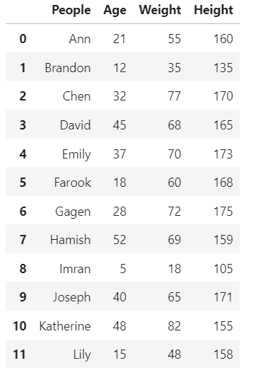
Basic Dataframe Statistics
Notes:
With any data science or AI project, the first order of business is to work up your data. What does the dataset look like? Are you missing any values? Are there outliers? Here’s the simple dataframe you’ll encounter in one of our Python notebook exercises. Let’s use it to take a quick look at some of the statistical methods built into the dataframe object.
The count() method counts the number of instances in a column.
Here we ask for the mean() or average for the Height column. You can apply this to any numeric column.
And finally, the describe() method. This method prints a list of basic statistics for each of the columns – count, mean, standard deviation, min, the 25th, 50th, and 75th percentiles, and the max value. This is a handy method as it allows you to quickly size up your dataset.

Slide 15
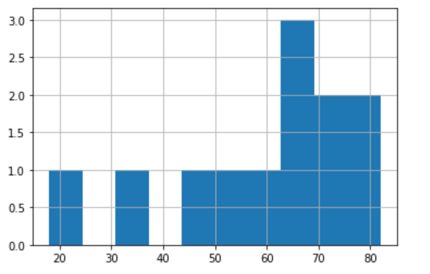
Histogram
Notes:
In addition to basic statistics, I strongly recommend that visualize your data. As they say, a picture is worth a thousand words. In the next couple of slides, I’m going to quickly introduce some basic plots. The first is the histogram.
Here’s a sample line of code to create a histogram.
And here’s what you get when you execute that line of code.
A histogram is a display of statistical information that uses bars to show the frequency of data items in successive numerical buckets of equal size.

Slide 16
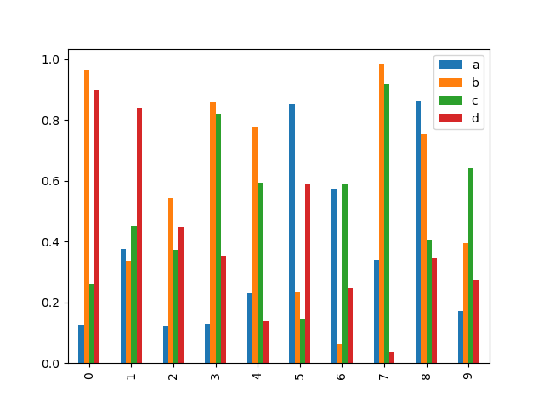
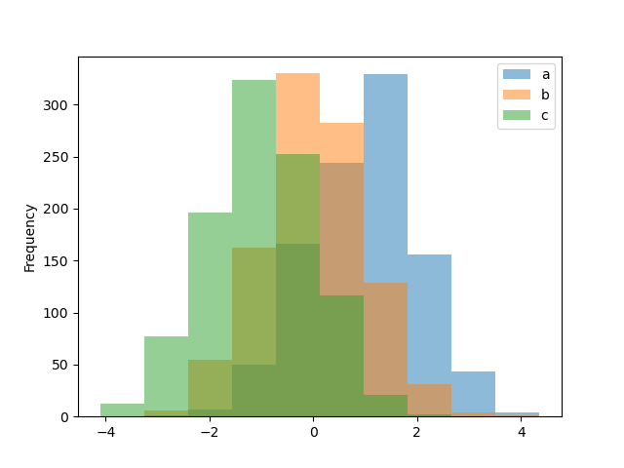
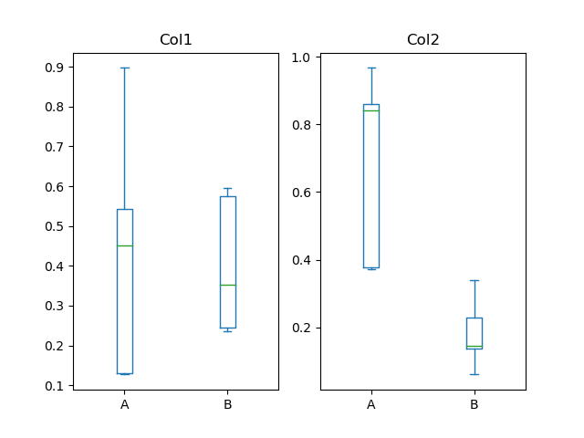
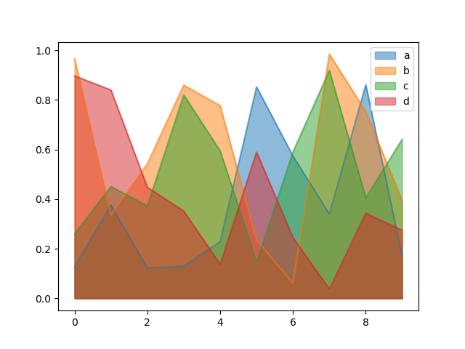
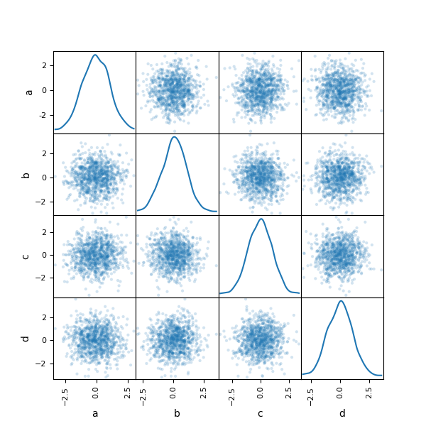
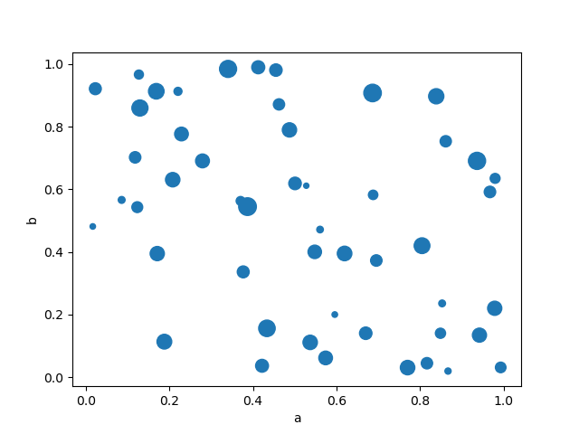
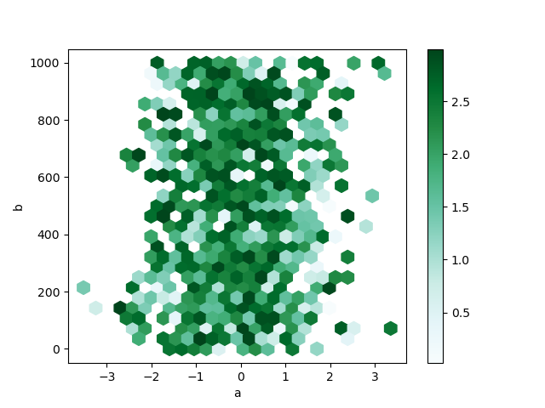
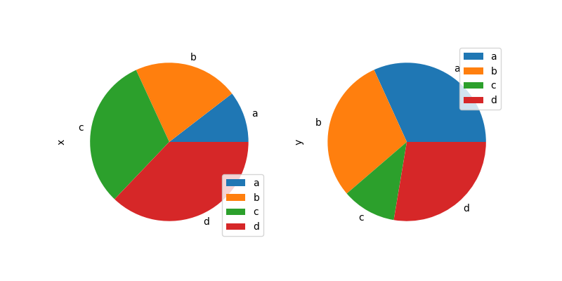
Pandas Chart Types
bar
hist
box
area
scatter
hexbin
pie
scatter_matrix

Slide 17
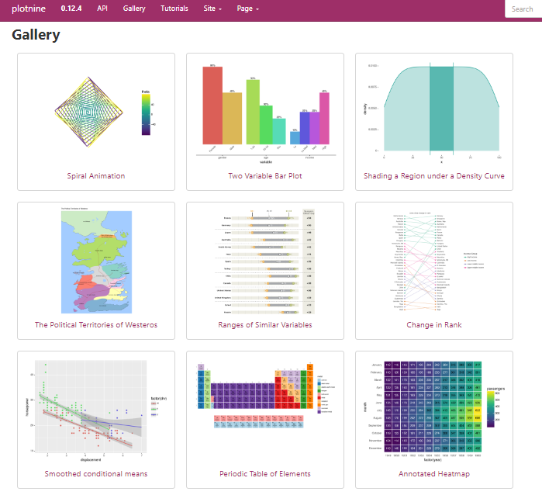

Notes:
One quick note, Plotnine is on version 0.14.1, not 0.12.4!

Slide 18


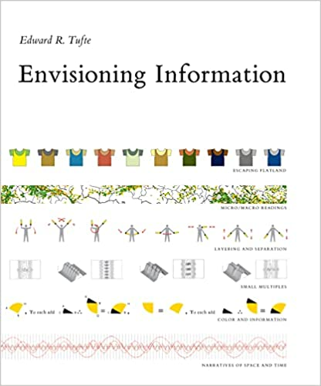
Notes:
And I end this briefing with some reading recommendations. Edward Tufte is one of the world’s leading authorities on data visualization.

