Slide 1

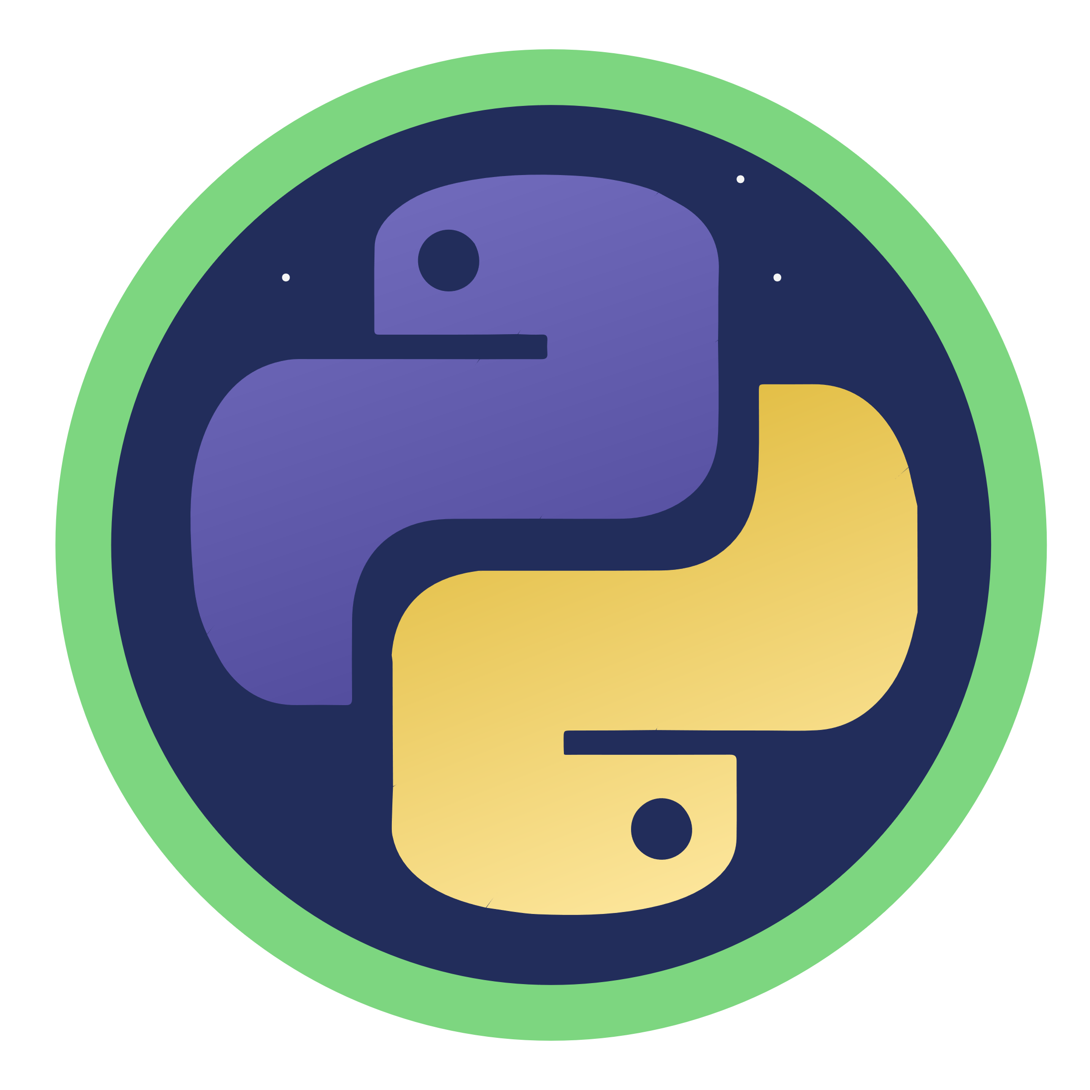
Python for AI
Notes:
Hello and welcome to this Practicum AI recording.
I’m Dan Maxwell. And I work as an AI Trainer for Research Computing, here at the university of Florida.
In this short briefing, I’m going to introduce you to Python functions.
[NEXT SLIDE]

Slide 2

Functions quote
“You can think of a function as a small program inside a program. The basic idea of a function is that we write a sequence of statements and give that sequence a name. The instructions can then be executed at any point in the program by referring to the function name…
When a function is subsequently used in a program, we say that the definition is called or invoked.”
John Zelle
Notes:
So, what exactly is a function? I like this quote by computer science educator John Zelle. Zelle is the author of the bestselling textbook, Python Programming: An Introduction to Computer Science. Zelle writes, “The basic idea of a function is that we write a sequence of statements and give that sequence a name. The instructions can then be executed at any point in another program by referring to the function’s name.”
Zelle, J. (2017). Python Programming: An Introduction to Computer Science (3rd edition). Franklin, Beedle, & Associates. Portland, OR.
[NEXT SLIDE]

Slide 3
Why use Functions?
Main Program
function
load_data()
function data_prep()
function
train()
function
clean_mising()
function normalize()
function
model()
Notes:
So why are functions a good idea? Why do we use them? When designed properly, a function performs a single, specific task. This, in turn, allows us to design modular programs. Imagine a box of Lego bricks that snap together. In computer science, the bricks (or functions) are said to be reusable. And because they are reusable, we can build just about anything with them.
[NEXT SLIDE]

Slide 4
A function is a self-contained block of code…
It may accept inputs (parameters)
It will output (return) one or more results. Sometimes, the returned value is nothing! (None)
Can contain any statements found in a normal program
We've already encountered functions: i.e., int(), float(), range(), and many more – these are "built-in functions". The functions we write ourselves are "user-defined" functions
Source: Randy Switt – University of Florida (Pythonista)
Notes:
Let’s unpack that definition just a bit...
[NEXT SLIDE]

Slide 5
Advantages of Functions
Code Reuse
Simplicity
Flexibility
Ease of Testing
Improved Collaboration
Notes:
Reusable functions offer many advantages:
Code reuse: Reusable functions can be used repeatedly in different parts of a program or in different programs altogether. This leads to less code duplication and ease of maintenance.
Simplicity: Reusable functions designed to perform a specific task are easier to understand and work with. Developers can focus on the individual parts of a program, rather than the entire codebase.
Flexibility: Reusable functions can be modified and adapted to suit different scenarios and requirements. In other words, the same function can be used in different contexts, reducing the need for new code.
Ease of testing: Reusable functions are easier to test since they can be tested independently of the rest of the program. This helps us quickly identify and fix bugs. The result is reliable, stable software.
Improved collaboration: When functions are modular and reusable, multiple developers can work on different parts of a program simultaneously. The result is efficient collaboration and faster development.
[NEXT SLIDE]

Slide 6
Don’t repeat yourself
Thou shalt not repeat thyself
Thou shalt not repeat thyself
Thou shalt not repeat thyself
Thou shalt not repeat thyself
Notes:
One of the cardinal rules of good programming is stated here: Thou shalt not Repeat Thyself. In other words, "Every piece of knowledge or logic must have a single, unambiguous representation within a system." All that to say, if you want to do the same thing multiple times in your code, write a function, and call it wherever it is needed.
[NEXT SLIDE]

Slide 7
Syntax for Creating a Function
def <name>():
<statements>
return <values>
def hello():
print(‘Hello!')
Source: Randy Switt – University of Florida (Pythonista)
Notes:
Alright, let’s look at how you create a Python function…
This is the syntax as you might see it in support documentation.
def – keyword indicating a function
<name> - name of the function. The same rules we learned about for naming variables also apply here.
return – optional statement to return value(s) to the calling program
And here’s a small block of code to create a function called “Hello”
[NEXT SLIDE]

Slide 8
Syntax for Calling a Function
<function_name>()
def hello():
print('Hello!')
hello()
Hello!
Source: Randy Switt – University of Florida (Pythonista)
Notes:
And now, we call our newly created function, and it prints “Hello!” to the output. A couple key points:
A function can only be called after it is defined. Thus, order matters in Python.
A function can be (and usually is!) called many times. That’s the power of reusability!
[NEXT SLIDE]

Slide 9
Function Parameters and Arguments
def <function_name>(param1, param2, . . .)
Source: Randy Switt – University of Florida (Pythonista)
Notes:
At this point, I need to clarify some vocabulary. Parameters and Arguments.
Function parameters are input variables defined ("declared") in the function definition. A function can have 0 to many parameters.
But when you call a function, you must provide arguments for each required parameter.
[NEXT SLIDE]

Slide 10
Parameters vs Arguments
Parameter
def hello(name):
print(f'Hello {name}!')
myName = input('Name? ')
hello(myName)
Argument
Source: Randy Switt – University of Florida (Pythonista)
Notes:
Although I provide a technical definition here, these two terms are often used interchangeably in real life.
Parameter = "Placeholder"
Defined by the function
the "place" where values are assigned when the function is called
Argument = "Actual values"
specified when calling the function
specifies actual values or variables that will be used as inputs
[NEXT SLIDE]

Slide 11
Returning Values
return <value1>,<value2>, . . .
def hello(name):
print(f'Hello {name}!’)
return True
myName = input('Name? ')
status = hello(myName)
print(status)
Name? Randy
Hello Randy!
True
Source: Randy Switt – University of Florida (Pythonista)
Notes:
Now in an earlier slide, I mentioned that functions can – and usually do – return values. To specify return values, we use the reserved word "return" followed by one or more values or variables. Let’s run this block of code and see what we get… First, the program asks for our name and assigns that value to the myName variable. It then passes the myName variable to the hello() function. The hello() function, in turn, prints “Hello <name>” and returns True. And finally, the return value is assigned to the status variable and printed. Note: It is good form to have a function return a status and assign that to a variable, as we do here.
[NEXT SLIDE]

Slide 12
Call by Position or Keyword
def hello(name):
print(f'Hello {name}!')
myName = input('Name? ')
# Call by position
hello(myName)
# Call by keyword
hello(name = myName)
Notes:
When calling a function and passing arguments to it, you can do so in two ways – by position or by keyword. My personal preference is to pass arguments by KEYWORD. When passing by keyword, you explicitly specify the parameters receiving each of your arguments. Here we see that the name parameter will receive the myName argument. The beautiful thing about this approach is that you know exactly what's being passed to what. And your code becomes self-documenting. This is important when you come back to a piece of code after a long time. Write code for the future you!
[NEXT SLIDE]

