Slide 1

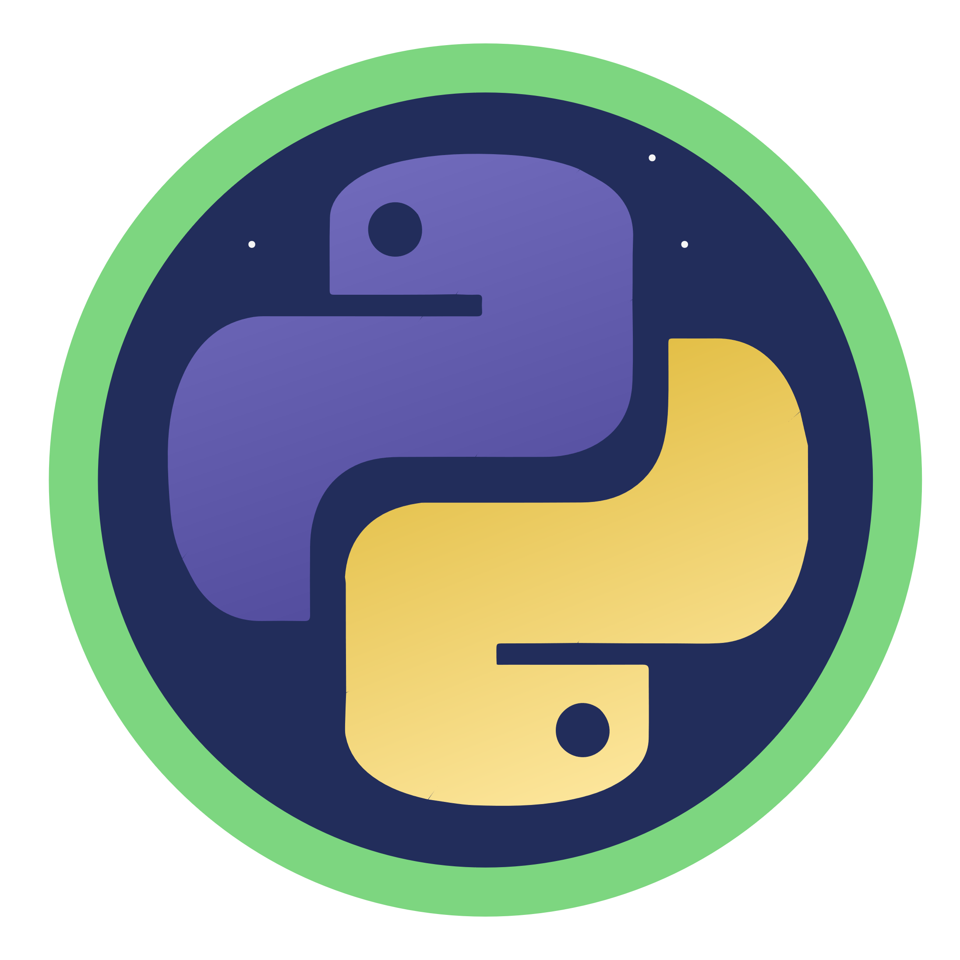
Python for AI
Python for AI
Notes:
Hello and welcome to this Practicum AI recording.
I’m Dan Maxwell. I work as an AI Trainer for Research Computing, here at the University of Florida.
In this briefing, I am going to introduce you to the Python programming language.
[NEXT SLIDE]

Slide 2

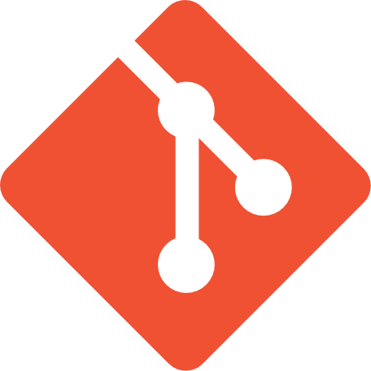

Git, Git Hub, and Jupyter

Slide 3
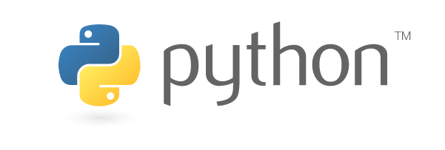

Python

Slide 4

Python and Pandas

