Slide 1
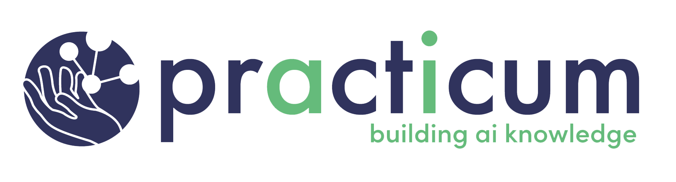
ChatGPT Risks

Slide 2

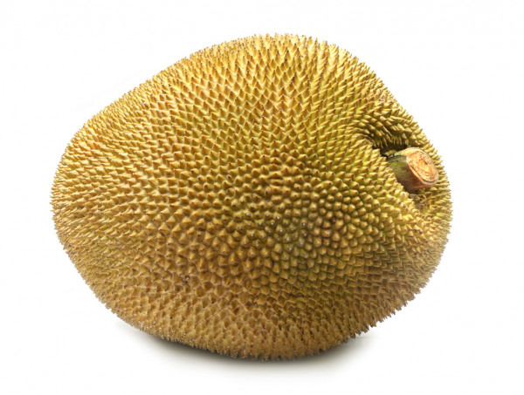

Model Hallucinations
Jack fruit: 99.6% Confidence Level The Real Deal
(AlexNet)
Image Credits: https://www.wallpaperbetter.com/3d-and-abstract-wallpaper/blur-color-abstract-174759 ; https://depositphotos.com/stock-photos/jackfruit.html
Notes:
Let’s talk first about AI model hallucinations. In a nutshell, here’s the problem. Many models not only make erroneous judgements, but they make them with outrageously high confidence. When this happens, we say the model is brittle. Pre-trained models such as AlexNet and ResNet do a great job of correctly categorizing a wide variety of images. But here’s the catch. AlexNet categorizes every image you present to it, even random nonsense. AlexNet, for example, is 99.6% confident that the rainbow image shown here is a Jack fruit. Clearly, the system is hallucinating, but it has no way to detect or communicate this.
Many AI models are easily fooled. Often, malicious hackers will slightly alter an image – making imperceptible changes to just a few pixels. And voila, the system responds with a crazy prediction. A picture of a Panda, after alteration, is now classified as a Gibbon. And better yet, the system is 99.3% confident of its choice. These are known as adversarial examples because they represent attempts by bad actors to confuse a system. Let’s now consider a ChatGPT example.

Slide 3
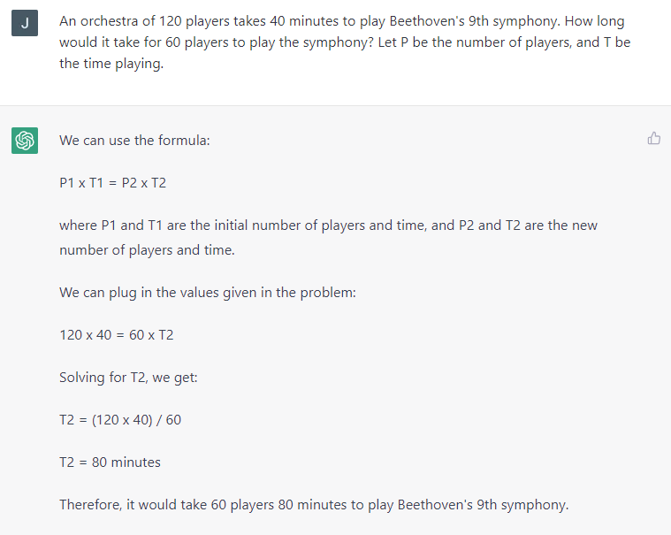
Notes:
Here I provided a common-sense question / prompt to ChatGPT. An orchestra of 120 players takes 40 minutes to play Beethoven’s 9th symphony. How long would it take for 60 players to play the symphony? ChatGPT responds, “It would take 60 players 80 minutes to play Beethoven’s 9th symphony.” Clearly, ChatGPT has framed this question incorrectly, answering it from a mathematical point-of-view rather than a musical one. Although I did not challenge ChatGPT in this case, others have done so, with the result that the model responds that it is, in fact, correct even though it’s hallucinating.
Now imagine a medical – that is, a high-risk situation – where ChatGPT confidently hallucinates but no one validates its response. Does that scare you? It certainly frightens me!

Slide 4
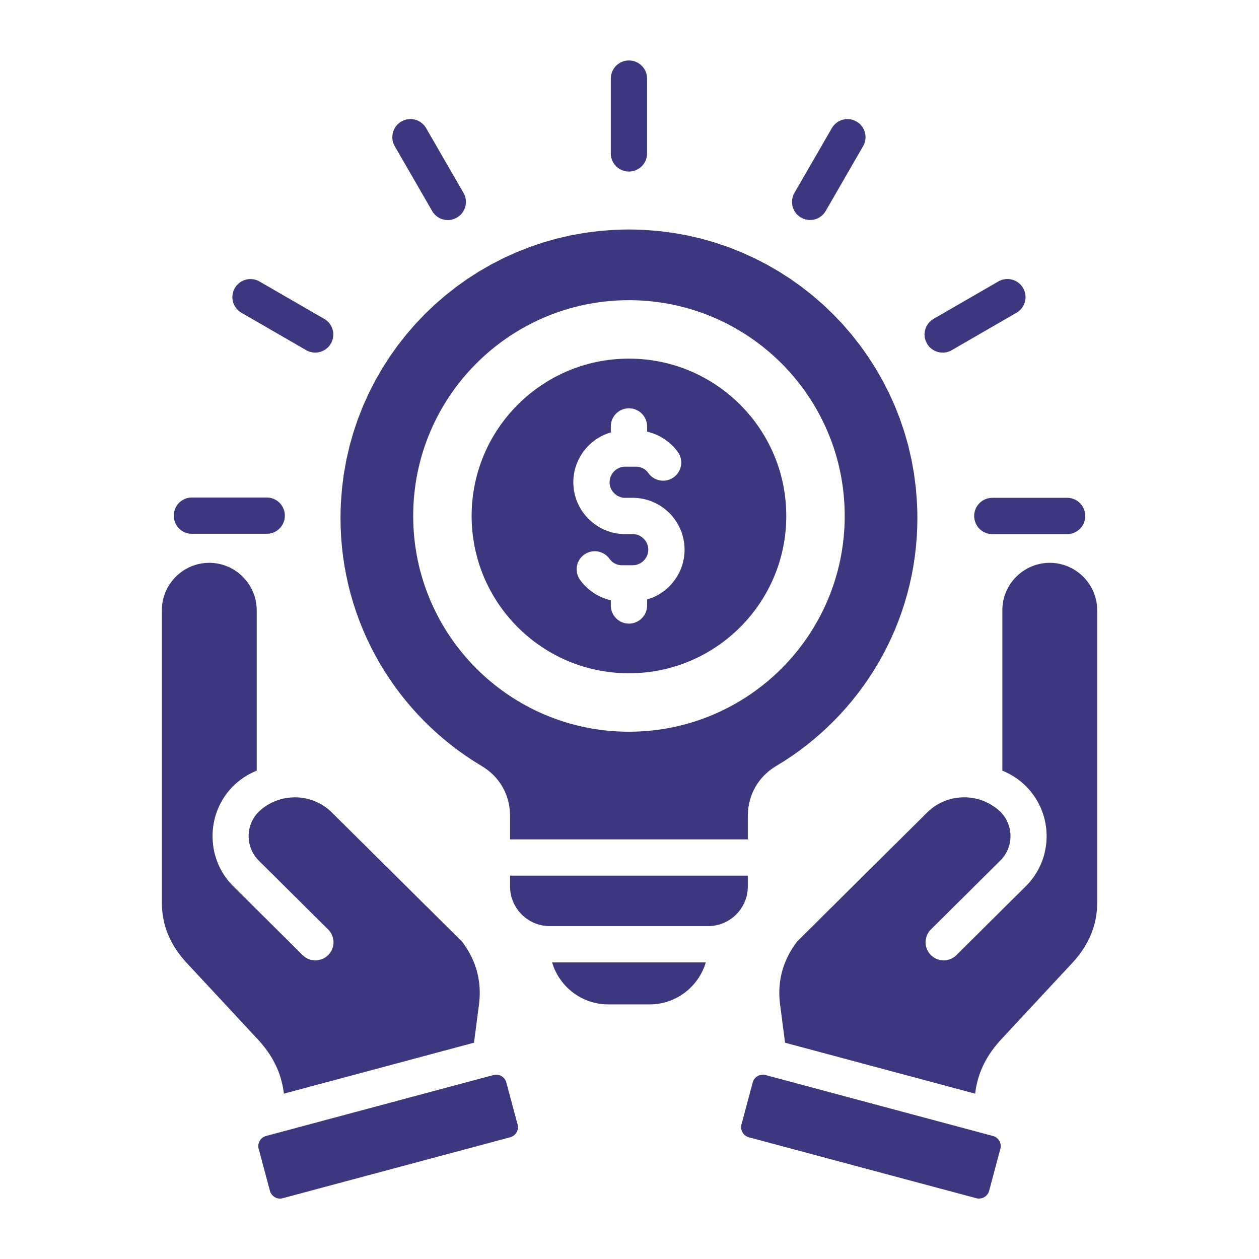
Intellectual Property
Notes:
A second important ethical consideration is intellectual property.
First, never prompt ChatGPT with any (IP) intellectual property or trade secrets as the system retains everything asked of it.
Second, be aware that ChatGPT may respond with copyrighted content and/or IP belonging to other organizations. For example, ChatGPT did not respect licensing restrictions of data pulled from “open” repos in GitHub and other version control systems. That means you may want to do some due diligence when you suspect that that is the case.

Slide 5

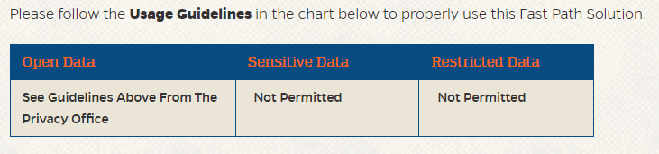
ChatGPT is currently being assessed for regulatory concerns related to privacy and confidentiality of data within the United States and internationally.
Please be advised that data may be retained by ChatGPT and provided as responses to other users. Individuals have limited control over their data and parent company, OpenAI, offers no process to amend or delete data that has been submitted. Therefore, putting data into ChatGPT or similar services is equivalent to disclosing the data to the public.
Any data classified as sensitive or restricted should not be used….
https://irm.ufl.edu/fast-path-solutions/items/chatgpt.html

Slide 6
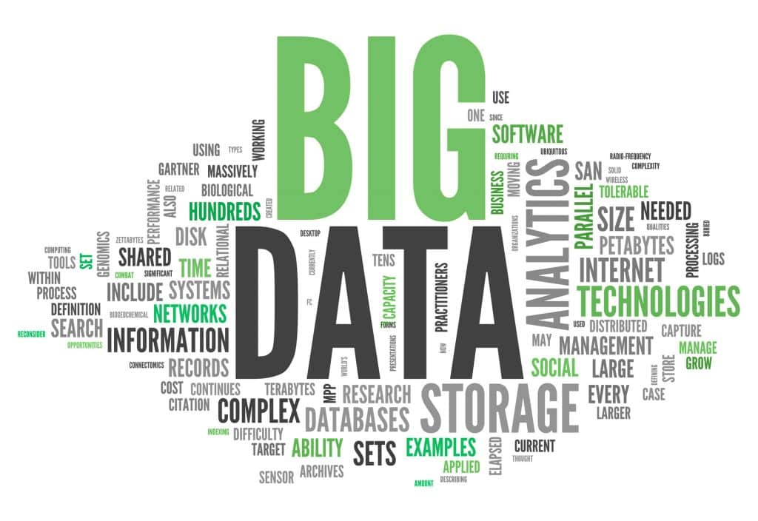
Training Data
Image Credit: https://www.edureka.co/blog/big-data-characteristics/
Notes:
We do not have a clear idea of how much data was used to train ChatGPT. Some believe that it was just about everything available on the open internet. But we do know that the training data for ChatGPT 3.5 does not go beyond September 2021. And how do I know that? I asked ChatGPT. Thus, the system is unable to answer factual questions after that date.
Given that the provenance and composition of the training data is unknown, keep an eye out for what appear to be biased responses.

Slide 7
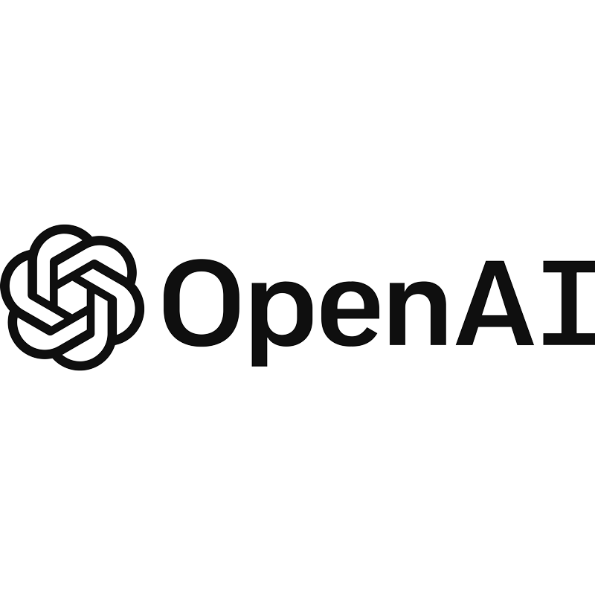
Notes:
And finally, a quick word or two about OpenAI. When Elon Musk, Sam Altman and others founded OpenAI in 2015, the goal was to create a transparent AI company that benefited everyone. In other words, the models, the code, everything was to be open to everyone. That is no longer the case. With a 20-billion-dollar investment from Microsoft, OpenAI is now a black box. I think they ought to rename the company to reflect this new direction. How does ClosedAI sound?
I mention this – not to criticize – but to highlight the fact that businesses exist to make money. The positive side is that we now have an AI service capable of doing some amazing things. On the other hand, the cost of creating ChatGPT, designing the network, collecting data, and then training it was expensive. Only a few companies in the world have the resources to do something like this. And they cannot do so without a return on their investment and protection of trade secrets.

