Slide 1

Python Booleans, Conditionals, and Loops

Slide 2
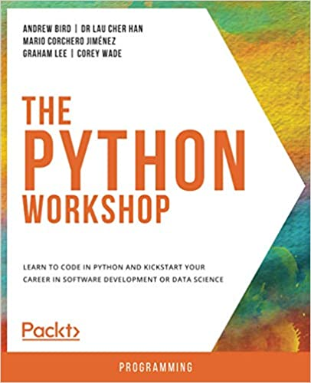

Slide 3
Agenda
Booleans
Conditionals
Loops

Slide 4
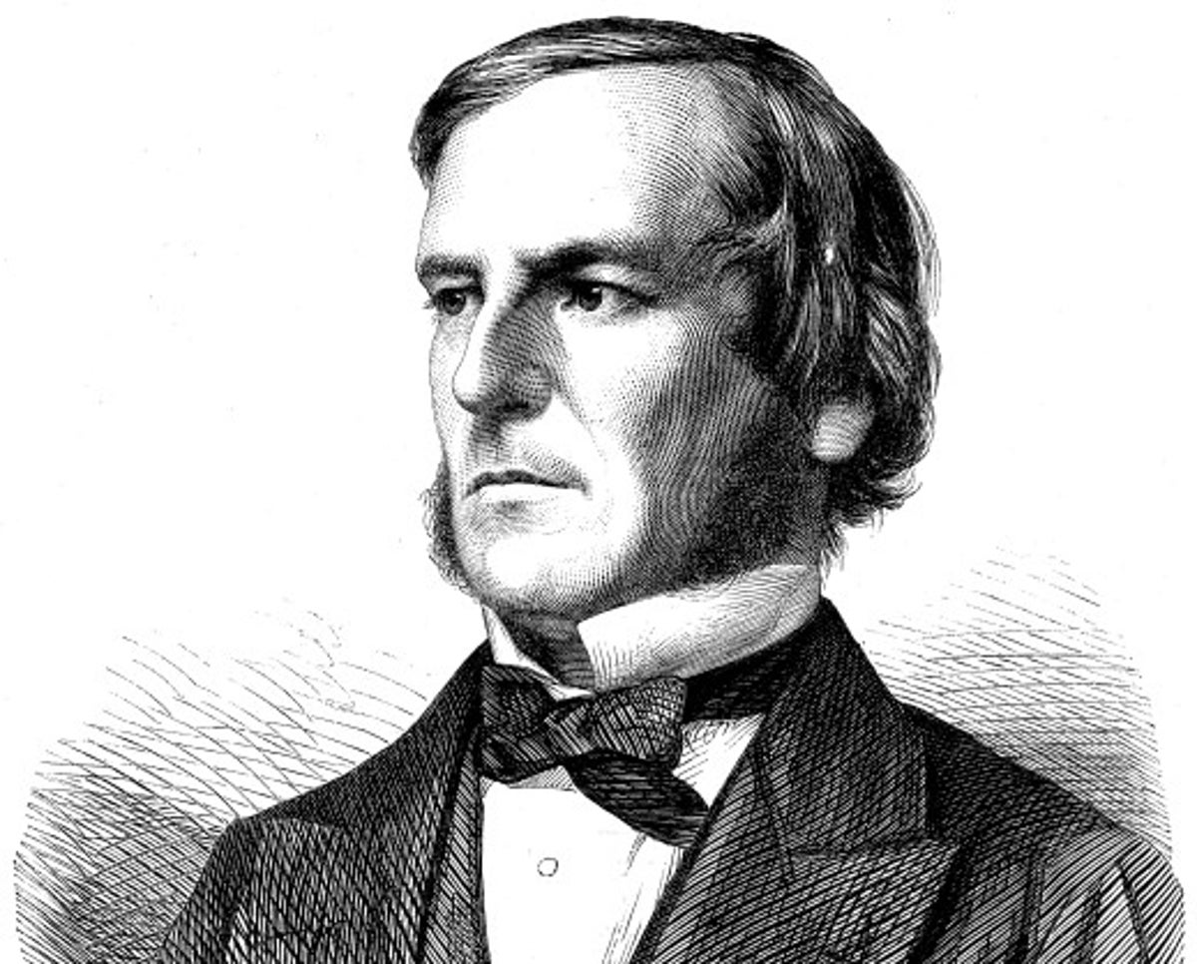
Image Credit: https://www.independent.co.uk/news/science/five-things-you-didn-t-know-about-george-boole-a6717401.html
Notes:
George Boole and Boolean logic

Slide 5
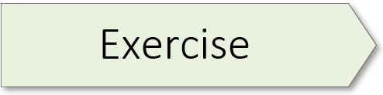
13: Boolean Variables
Notes:
Exercise 13 starts on page 37 of the textbook.

Slide 6
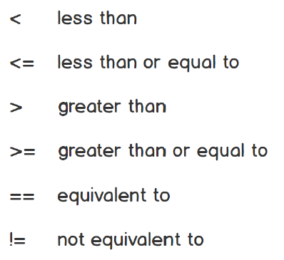

Slide 7
14: Comparison Operators
15: Comparing Strings
Notes:
Exercise 14 starts on page 40 of the textbook.
Exercise 15 starts on page 43 of the textbook.

Slide 8

Image Credit: https://www.castmemberchurch.com/post/three-disciples-jesus-turned-away/

Slide 9
16: If Syntax
17: Using the if-else Syntax
Notes:
Exercise 16 starts on page 44 of the textbook.
Exercise 17 starts on page 45 of the textbook.

Slide 10
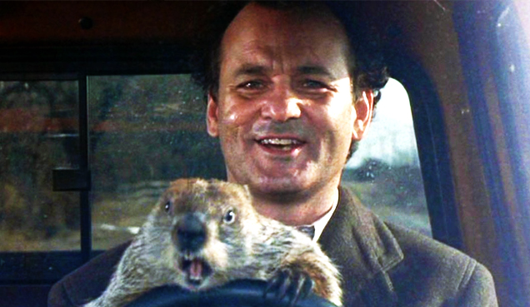
Image Credit: https://cadetcall.org/1258/features/groundhog-day-movie-review/
Notes:
In the comedy Groundhog Day, Bill Murray plays Phil Connors, a disgruntled TV weatherman who’s sent to Punxsutawney, PA to cover the story of Punxsutawney Phil, the town’s famous groundhog who can predict either an early spring or extended winter depending on whether he sees his shadow or not. While there, Phil Connors gets caught in a time warp, reliving the same day over and over again until he learns to value each moment and the people he works with. See the Reference section for links to the movie trailer as well as the film’s Wikipedia entry.
In a programming language, loops allow you to repeat a specific action over and over again. This grants you special powers as a programmer. For example, you could define a groundhog loop that repeats a specified number of times, forcing Phil Connors to relive the same day until the loop reaches a defined limit.

Slide 11
19: Real-Estate Offer
20: Using For Loops
Notes:
Exercise 19 starts on page 54 of the textbook.
Exercise 20 starts on page 55 of the textbook.

