Slide 1

Python Functions

Slide 2
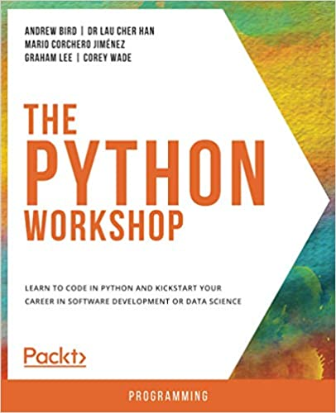

Slide 3
Agenda
Functions
Object-Oriented Concepts

Slide 4
“You can think of a function as a small program inside a program. The basic idea of a function is that we write a sequence of statements and give that sequence a name. The instructions can then be executed at any point in the program by referring to the function name…
When a function is subsequently used in a program, we say that the definition is called or invoked.”
John Zelle
Notes:
Most of the AI code you write in Python is nothing more than calls to various functions. And what is a function? Well, I'm glad you asked. Noted computer science educator John Zelle writes, “The basic idea of a function is that we write a sequence of statements and give that sequence a name. The instructions can then be executed at any point in another program by referring to the function name.
So how do we call or execute a function? Let’s take a look…

Slide 5
myimage = preprocess_input(myimage)
myimage = load_image(’images/pizza.jpg’, target_size = 224)
myresult = mymodel.predict(myimage)
Notes:
Here we see 2 function calls, followed by a method call.

Slide 6
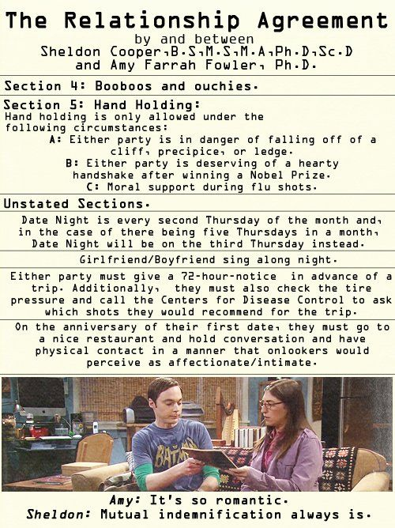
Image Credit: https://www.pinterest.com/pin/558024210062835602/
Notes:
At this point, I want to briefly discuss an important yet often overlooked point.
In the Big Bang Theory TV series, the show's resident genius - Sheldon Cooper - enjoys creating legally-binding agreements that specify the particulars of any relationship he is presently in. His romance with Amy is regulated by a relationship agreement, as is his relationship with his roommate, Leonard Hofstadter.
Python Functions
The fundamental concept behind functions is the notion of a contract. Just as Sheldon's relationship and roommate agreements ensure that the parties involved will act in regular and predictable ways, so too the interface to a function is like a contract. If a call to a function passes the correct arguments in the correct order, a well written function responds in a predictable way, providing the promised output.
Counterintuitively, the first step in creating a function is to define what it will do. I say "counterintuitively" because most programmers simply dive right in and start writing code. This strategy works well for small and rather simple programs. However, you'll quickly run into trouble when the complexity begins to increase. For that reason, seasoned software developers usually begin by writing a specification (spec) - a document that spells out the terms of the contract. A well-written specification typically includes interface documentation as well as pseudocode, a clear statement in plain English of the steps to be taken to accomplish the function's task.
https://www.pinterest.com/pin/558024210062835602/

Slide 7
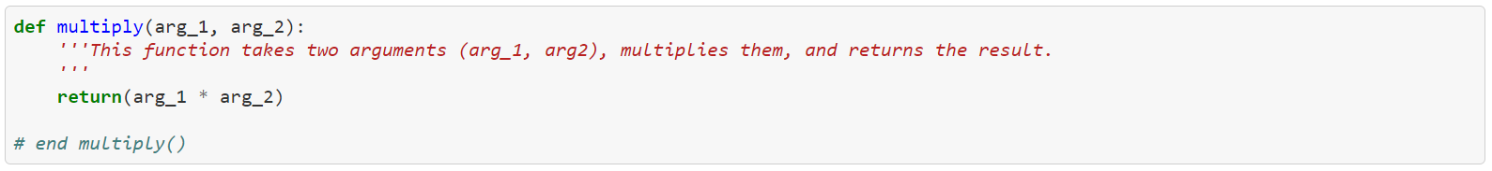
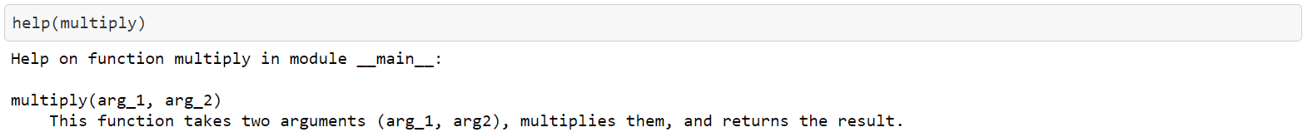
Specification
The multiply() function takes two arguments (arg_1, arg_2), multiplies them, and returns the result.
Notes:
Let's illustrate this process by writing a spec for a rather simple function called multiply. Here's the initial specification. Simple enough!
Because this function is so simple, we won't bother with the pseudocode at this point. For more complex functions, however, pseudocode is strongly recommended as it helps you understand the flow and logic of your program before you start coding. With all that said, here's a first look at the code.
This is a straightforward function, if there ever was one. Even so, a couple points need to be highlighted. Consider, for example, the documentation (doc) string immediately following the function definition. As you can see, this string is enclosed by three single quotes '''. The information in a doc string displays whenever one runs help() on a given function. Here's what you get when you run the command…
In his wonderful book, Python without Fear, Brian Overland makes the following points about doc strings (p. 322). You'll want to keep these in mind as you create doc strings for your functions.
The doc string must be the first statement after the beginning (header) of the function definition.
Normal indentation rules apply. The doc string must be indented under the heading of the definition, just as any statement.
The indentation requirement applies only to the first physical line. However, the cleanest style is to continue the indentation of the first line.
You can use any kind of quotation marks. However, the literal quote marks (''') enable you to write doc strings that span any number of physical lines.
The last thing we need to point out is the comment at the end of the function definition. The pound sign (#) indicates that anything following it is a comment. In this case, we mark the end of the function with a comment. When developing a module containing multiple functions, best practice encourages the placement of comments at the end of each function. This helps you to clearly see where one function ends and another begins.

Slide 8
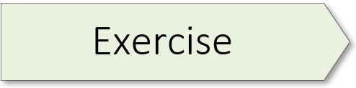
42: Defining & Calling a Function
Notes:
Exercise 42 starts on page 116 of the textbook.

Slide 9

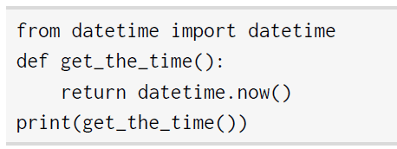
Arguments / Parameters
Notes:
A function can be executed at any point in a program by referring to its name. When a function is subsequently used in a program, we say that the definition is called or invoked. Most Python functions have arguments, sometimes called parameters. In this example, the add_up() function can receive two arguments – x and y.
Keep in mind that the term 'argument' and 'parameter' are used interchangeably in the technical literature. You can also write functions which accept no arguments, as is the case with the get_the_time() function shown here.

Slide 10
Call by Position or Keyword?
Notes:
When calling a function and passing arguments to it, you can do so in two ways – by position or by keyword. We have a couple exercises to introduce you to these two options. Although you can pass arguments to a function in multiple ways, my personal preference is to pass arguments to functions by KEYWORD. When you do that, you know exactly what's being passed to the function. And your code becomes self-documenting. This is important when you come back to a piece of code after a lapse of time. The goal is to write code for the future you.

Slide 11
45: Keyword Function
46: Positional & Keyword Function
Notes:
Exercise 45 starts on page 119 of the textbook.
Exercise 46 starts on page 119 of the textbook.

Slide 12

Iterative Functions
Image Credit: https://www.kindpng.com/free/blue-arrow/

Slide 13
48: For Loop Function
49: Exiting For Loop Function
Notes:
Exercise 48 starts on page 123 of the textbook.
Exercise 49 starts on page 123 of the textbook.

Slide 14
Do not repeat yourself
Do not repeat yourself
Do not repeat yourself
Do not repeat yourself
Notes:
Don't Repeat Yourself
One of the cardinal rules of good programming is stated here: Do not Repeat Yourself (DRY). In other words, "Every piece of knowledge or logic must have a single, unambiguous representation within a system." If you want to do the same thing multiple times in your code, it should be expressed as a function, and called wherever it is needed.
Bird, Andrew, et al. The Python Workshop : Learn to Code in Python and Kickstart Your Career in Software Development or Data Science, Packt Publishing,
Limited, 2019. ProQuest Ebook Central, http://ebookcentral.proquest.com/lib/ufl/detail.action?docID=5974923.

Slide 15
54: Helper Function
Notes:
Exercise 54 starts on page 135 of the textbook.

Slide 16
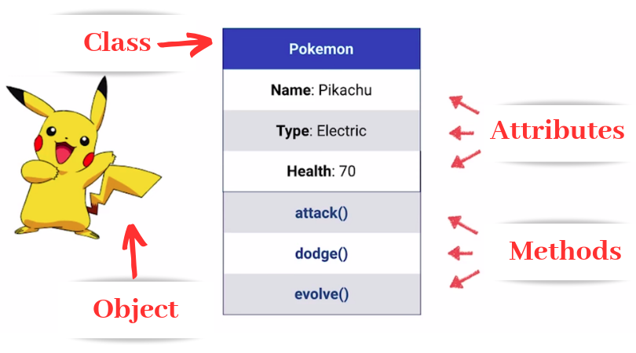
Image Credit: https://medium.com/future-vision/intro-to-oop-with-python-39ba63967e45
Notes:
Think of a class as a blueprint for how an object may operate. The object is a particular instance derived from the class. For example, an object could represent a particular person with attributes including name, age, address, etc., and methods like walking, talking, breathing, and running. Here the object is Pikachu, derived from the class Pokemon. Keep in mind: methods define what a given object can do while attributes define its features.

Slide 17
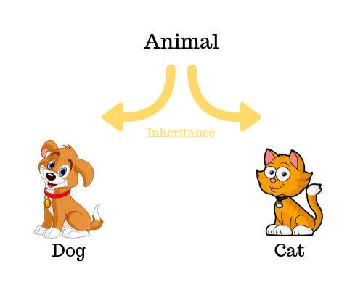
Image Credit: https://tutorials.supunkavinda.blog/php/oop-inheritance
Notes:
In the previous slide, I indicated that an object is a particular instance of a class. In technical terms, we say that objects are instantiated. That is, they are actual things you can manipulate in code. Interestingly, we can create hierarchies of classes. In Object-Oriented Programming, when a class derives from another class, it’s called inheritance.

