Slide 1

Python Data Management

Slide 2
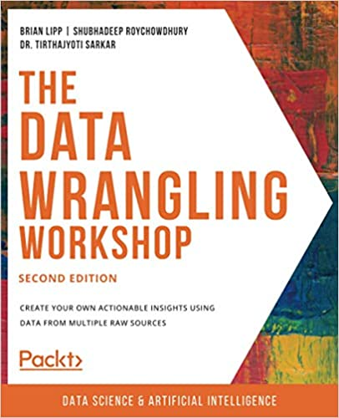

Slide 3
Agenda
Introduction
Reading .csv Files

Slide 4


Slide 5
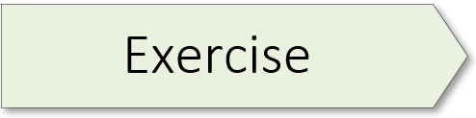
3.12: Creating a Pandas Series
Notes:
Exercise 3.12 starts on page 116 of the textbook.

Slide 6
3.13: Panda Series and Data Handling
Notes:
Exercise 3.13 starts on page 118 of the textbook.

Slide 7
3.14: Creating Pandas DataFrames
Notes:
Exercise 3.14 starts on page 120 of the textbook.

Slide 8
3.15: Viewing a DataFrame Partially
Notes:
Exercise 3.15 starts on page 122 of the textbook.

Slide 9
Indexing and Slicing

Slide 10
3.16: Creating and Deleting a New Column or Row
Notes:
Exercise 3.16 starts on page 129 of the textbook.

Slide 11
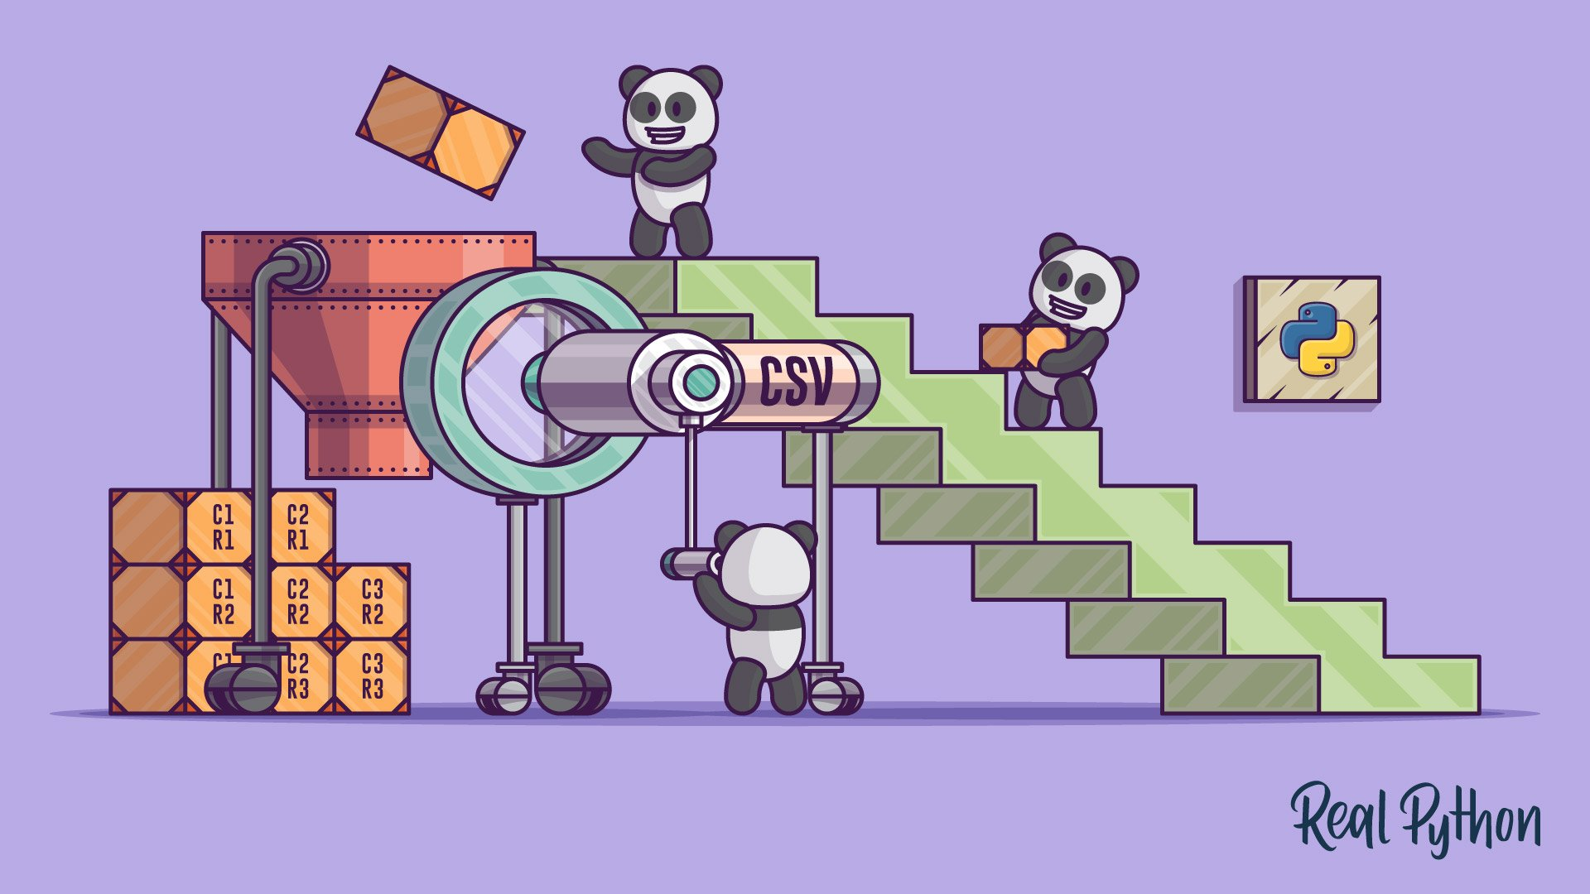
Image Credit: https://realpython.com/courses/reading-and-writing-csv-files/

Slide 12
5.01: Working with headers when reading data from a .csv file
Notes:
Exercise 5.01 starts on page 240 of the textbook.

Slide 13
5.02: Reading from a .csv File where delimiters are not commas
Notes:
Exercise 5.02 starts on page 244 of the textbook.

Slide 14
5.03: Bypassing and renaming the headers of a .csv file
Notes:
Exercise 5.03 starts on page 246 of the textbook.

Slide 15
5.04: Skipping initial rows and footers when reading a .csv file
Notes:
Exercise 5.04 starts on page 248 of the textbook.

