Slide 1

Python Booleans, Conditionals, and Loops

Slide 2
Agenda
Booleans
Conditionals
Loops

Slide 3
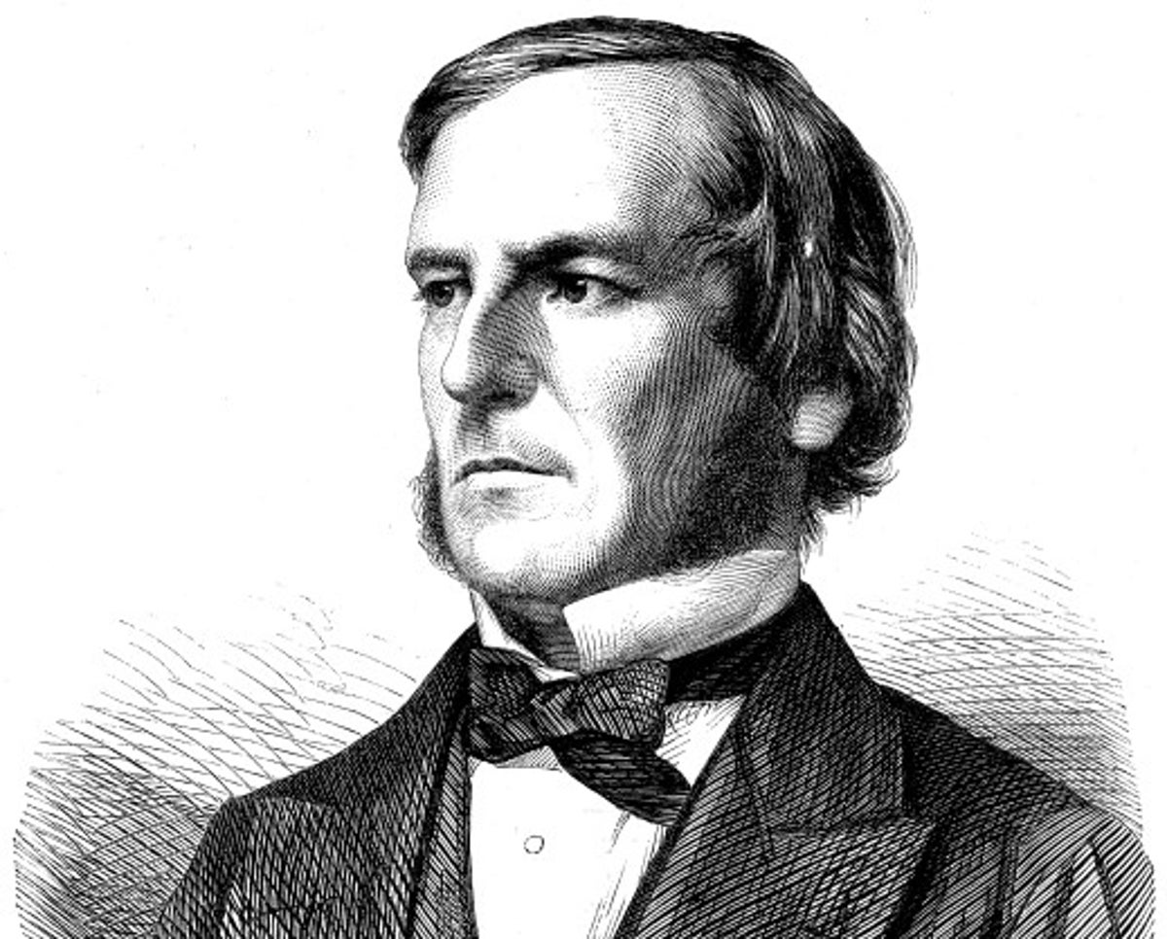
Image Credit: https://www.independent.co.uk/news/science/five-things-you-didn-t-know-about-george-boole-a6717401.html
Notes:
George Boole and Boolean logic

Slide 4
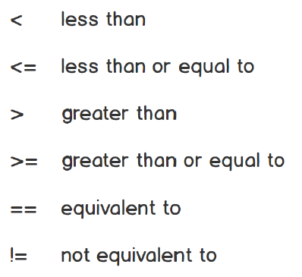

Slide 5
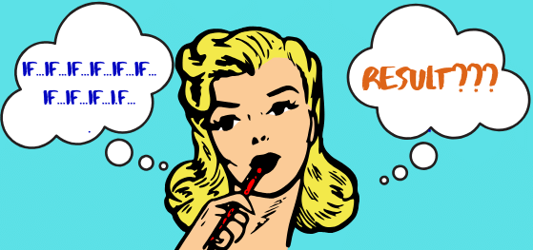
Image Credit: https://www.castmemberchurch.com/post/three-disciples-jesus-turned-away/

Slide 6
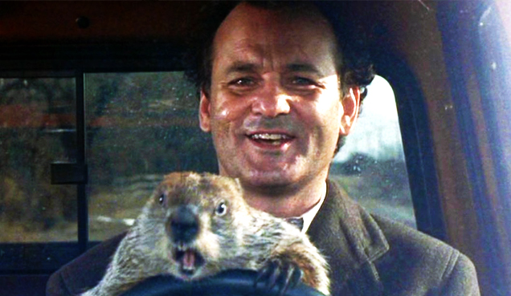
Image Credit: https://cadetcall.org/1258/features/groundhog-day-movie-review/
Notes:
In the comedy Groundhog Day, Bill Murray plays Phil Connors, a disgruntled TV weatherman who’s sent to Punxsutawney, PA to cover the story of Punxsutawney Phil, the town’s famous groundhog who can predict either an early spring or extended winter depending on whether he sees his shadow or not. While there, Phil Connors gets caught in a time warp, reliving the same day over and over again until he learns to value each moment and the people he works with. See the Reference section for links to the movie trailer as well as the film’s Wikipedia entry.
In a programming language, loops allow you to repeat a specific action over and over again. This grants you special powers as a programmer. For example, you could define a groundhog loop that repeats a specified number of times, forcing Phil Connors to relive the same day until the loop reaches a defined limit.

