Slide 1

Variables and Memory

Slide 2

Variables
Notes:
In computer science, a variable is a named location in memory. Consider this clear plastic container with a variety of objects in it. Each object is a specific size and takes up a certain amount of space. Now think of this container as your computer’s memory. Each time you create and assign a specific value to a variable, the software allocates space in memory large enough to contain whatever you assign to it. Or using a container analogy, it creates a box to hold its value. The variable’s datatype determines the amount of memory required to hold it, just as we see in this picture. Behind the name you use for a variable, there’s a hidden address or pointer to its location or compartment in memory.

Slide 3
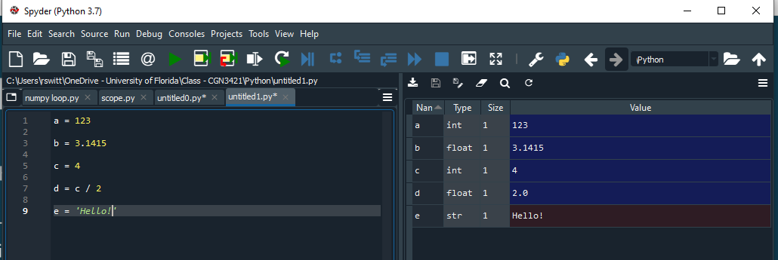
Python Variables
Python variables are dynamically declared
The data type is inferred by the data that is assigned (unless specifically defined)
Pros
Quick
usually correct
Cons
may get unintended results
doesn't flag errors

Slide 4
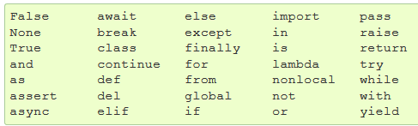
Variable name rules
Variable names (in Python) are case sensitive and MUST
Begin with a letter (or an underscore)
Not contain a space or a period (.)
Not be the same as a reserved keyword
But be careful these can override other functions!
Be unique (can’t be the same as another variable, function, or subroutine name)
Not more than 79 Characters (if this is a problem, you’re doing it wrong!)
Reserved words

Slide 5
Variable Naming Conventions
Naming conventions are suggested, not required
Make your names intuitive, readable, concise, and consistent!
Begin variable names with a letter in lower case (“a” not “A”)
Use “camel casing” – capitalize each new “word” (myVar, sumDollars) OR
Use underscores to separate each “word” (my_var, sum_dollars)
For longer programs, begin variables with prefix indicating variable type (strName, fltDollars)

Slide 6
Operators

Slide 7
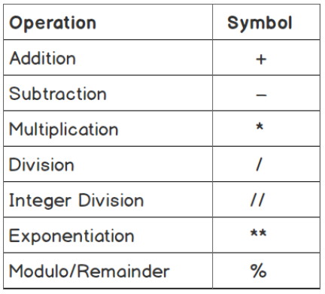

Slide 8
Python Arithmetic Operators
Addition +
Subtraction -
Multiplication *
Division /
Exponent (power) ** (3**2)
Grouping ( )
Integer (floor) Division //
Modulus %
Remainder i.e. 5 % 2 = 1

Slide 9
Python Operators (Comparison)
Comparison Operators compare 2 numbers or strings
They always return a Boolean value (i.e. True or False)
Equal to == (note that this is different than '=')
Less Than <
Greater Than >
Less than or equal to <=
Greater than or equal to >=
Not Equal to !=
(! is often called "bang" and stands for "not")

Slide 10
Other Operators
Logical Operators
and - evaluates to True if left and right sides are BOTH True (5>2) and (90<100)
or - evaluates to True EITHER left or right sides are True (5<2) or (90 <100)
not - reverses True to False and vice versa
Identity Operators
is - returns true if both variables are the same object (more on this next lecture)
is not - returns true if both variables are NOT the same object
Membership Operators
in - returns true if specified sequence is present in the object (x in y)
not in - returns true if specified sequence in NOT in the object (x not in y)

Slide 11
Other Operators
Logical Operators
and - evaluates to True if left and right sides are BOTH True (5>2) and (90<100)
or - evaluates to True EITHER left or right sides are True (5<2) or (90 <100)
not - reverses True to False and vice versa
Identity Operators
is - returns true if both variables are the same object (more on this next lecture)
is not - returns true if both variables are NOT the same object
Membership Operators
in - returns true if specified sequence is present in the object (x in y)
not in - returns true if specified sequence in NOT in the object (x not in y)

Slide 12
Multiple assignment in Python
Python allows you to do multiple assignments in one line
Assign one value to multiple variables
x = y = z = 45
Assign multiple values to multiple variables (very pythonic!)
x, y, z = 1, 2, 'banana'
This is super handy for data structures (coming soon!)

Slide 13
Python Assignment Operators
Python has several augmented operators that allow assignment and operations to be done simultaneously (but no unary increment or decrement, ++ or -- )
Operator | Example | Equivalent to
= | x = 5 | x = 5
+= | x += 5 | x = x + 5
-= | x -= 5 | x = x - 5
*= | x *= 5 | x = x * 5
/= | x /= 5 | x = x / 5
%= | x %= 5 | x = x % 5
//= | x //= 5 | x = x // 5
**= | x **= 5 | x = x ** 5

Slide 14
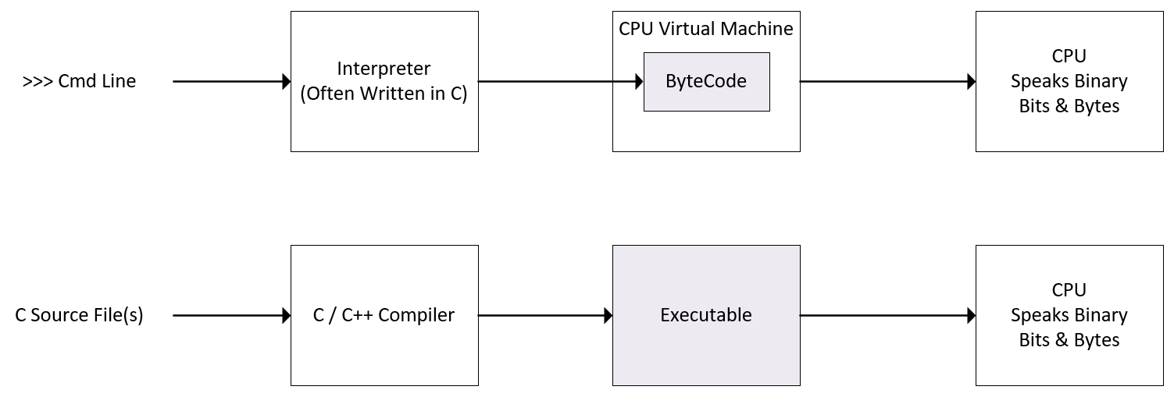
Architecture (Interpreted Languages)
Notes:
Interpreted languages are much slower than compiled languages. When performance matters, an interpreted language may not be the best solution. If that’s the case with you, Nvidia provides the Cuda development environment which supports the C and C++ languages. These are compiled languages as opposed to interpreted.

Slide 15
DataTypes

Slide 16
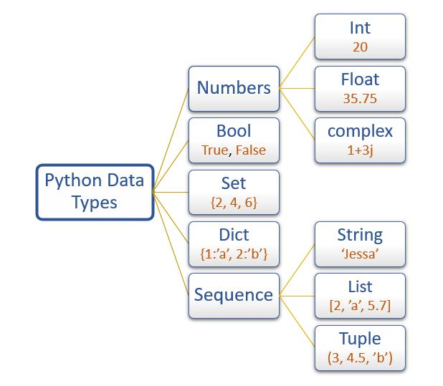
Image Credit: https://pynative.com/python-data-types/
Notes:
Python’s base datatypes are shown here.
Commonly used "scalar" data types in core Python
Integer (int)
Float (float) - double-precision only, 64-bit
String (str) – delimited by single OR double quotes
Boolean (bool) – True / False
=====
https://pynative.com/python-data-types/

Slide 17
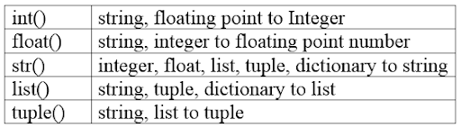

Image Credit: https://www.vectorstock.com/royalty-free-vector/cartoon-wizard-vector-1693529
Notes:
These functions allow you to typecast a variable of one type to another type.

Slide 18
Coding Style and Documentation

Slide 19

Image Credit: https://www.uncutmountainsupply.com/icons/of-saints/by-name/a/icon-of-adam-naming-the-animals-15th-c-meteora-1aa10/
Notes:
Adam naming the animals in the Biblical story. Variable naming and standards are critically important.

Slide 20
Python Comments
Inline comments
Precede with #
To quickly comment out a section, select the section and press <ctl-1>
Highlight and press again to uncomment
Multiline comments
Precede and end with triple single or double quotes – """
This is really a multiline string, but it works!
Use comments liberally!
If comments clarify what you are trying to accomplish, they can improve your score!
They are also good for debugging, by activating or deactivating parts of your code

Slide 21
Strings

Slide 22
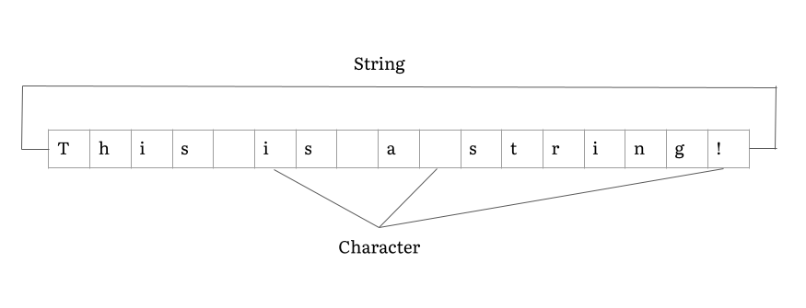

Slide 23


Slide 24
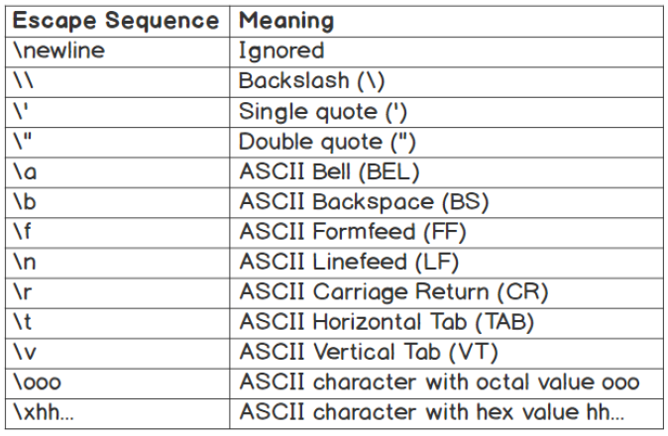

Slide 26

Notes:
Setup Instructions…

