Slide 1

Introduction to Python

Slide 2
Today’s Agenda
Python Intro (Part I)
Python Intro (Part II) & Libraries (Subhash Nerella)
Tomorrow
Loops, Conditionals, Functions
Data Wrangling
Notes:
The learning objectives for each Python session can be found here: https://github.com/PracticumAI/python

Slide 3

Audience
Image Credit: https://www.pinterest.com/pin/movie-audience-wearing-3d-glasses-print-cinema-spectators--1125829606821478194/

Slide 4
Learning Strategies
Focus
Avoid “Copy and Paste”
Study Code Block-by-Block / Line-by-Line
Use the Internet to Find Answers
Ask for Help
Take Your Time
Source: Valle, D.. (2016). How to learn a scripting language.
Notes:
Focus
So often, students think they can learn AI programming while multi-tasking on Facebook or texting friends on their cell phone. After programming for 30 years, I've learned one thing. You'll learn AI much faster if you can devote focused, uninterrupted time to practice.
Avoid the “copy and paste” approach to writing code
Although copying and pasting may help you to avoid typing errors, it can also interfere with your learning process for two reasons:
Typing errors can help you gain experience in writing code it provides informative feedback when you make mistakes. Making and correcting typing errors is an important skill to develop, particularly when you are typing a lot of code for your own data analysis.
Copying and pasting code may give you the impression that you know what you are doing when – in reality – you probably do not fully understand what the individual blocks of code are actually doing. Furthermore, this problem will just get worse as you deal with increasingly longer and more complicated scripts.
Study code block-by-block, line-by-line
This means running one block of code at a time and making sure that you understand why the output is what it is. If things are not clear, it is important to spend more time with that piece of the code. Here are some tricks that are often helpful to understand a particular piece of code:
Break a line of code into its components and try to understand the individual pieces. Sometimes functions are nested within functions.
Document what each block is doing. Clear documentation is critical as you may not remember what you did when you come back to a piece of code at some point in the future. As a wise programmer once said, “Write code for the future you.” Documentation is also useful when you want to adapt or reuse code in some other way. In situations like this, you will immediately know what a specific chunk of code does because it has been clearly documented. Donald Knuth – Literate Programming
Perform mini experiments: create a simpler example in which you can tinker with the code and see what happens to the output.
Use the internet to find answers
Everybody (from novice to more experienced users) relies on the internet when they don’t understand something. It is likely that other people have already asked (and received useful answers) for the problem that you are facing. However, finding the exact piece of information that you need might be hard, especially if you don’t use the correct terms/key words. Learning how to search for the information that you need is a skill that also takes practice. “Stackoverflow” and existing cheatsheets can be very helpful.
Ask for Help
We’re all learning. And some days, I feel like I’m the one who has the most to learn. Alcoa story.
Take your time
It is important to realize that it takes time to learn AI. What this implies is that you should not rush to get things done if you want to master this skill. In particular, everybody goes through some level of struggle and frustration when learning AI. However, once you have mastered it, you will be amazed by what this skill can do for you.

Slide 5
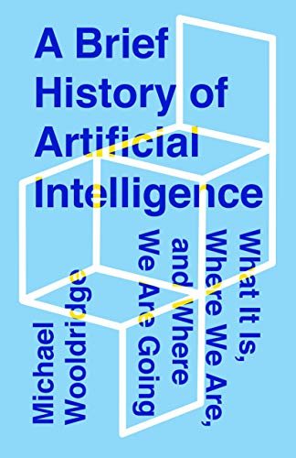
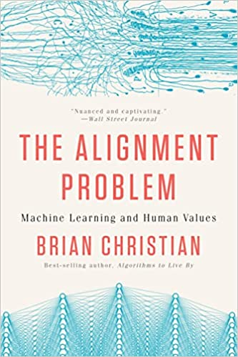

Slide 6

Notes:
Setup Instructions…

Slide 7

Variables
Notes:
In computer science, a variable is a named location in memory. Consider this clear plastic container with a variety of objects in it. Each object is a specific size and takes up a certain amount of space. Now think of this container as your computer’s memory. Each time you create and assign a specific value to a variable, the software allocates space in memory large enough to contain whatever you assign to it. Or using a container analogy, it creates a box to hold its value. The variable’s datatype determines the amount of memory required to hold it, just as we see in this picture. Behind the name you use for a variable, there’s a hidden address or pointer to its location or compartment in memory.

Slide 8
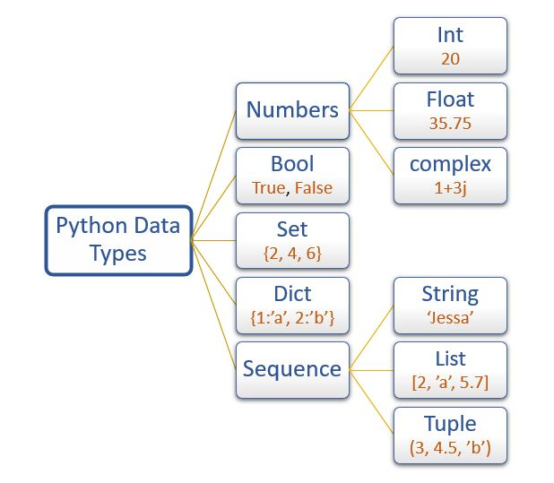
Image Credit: https://pynative.com/python-data-types/
Notes:
And this graphic shows Python’s datatypes.
https://pynative.com/python-data-types/

Slide 9

Image Credit: https://www.uncutmountainsupply.com/icons/of-saints/by-name/a/icon-of-adam-naming-the-animals-15th-c-meteora-1aa10/
Notes:
Adam naming the animals in the Biblical story. Variable naming and standards are critically important.

Slide 10
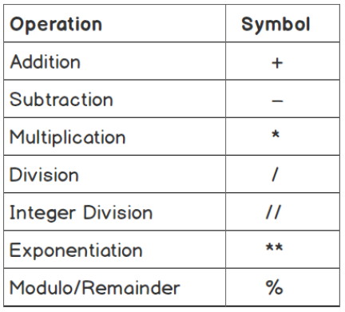

Slide 11
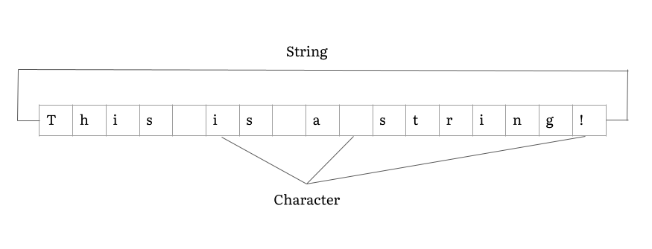

Slide 12


Slide 13
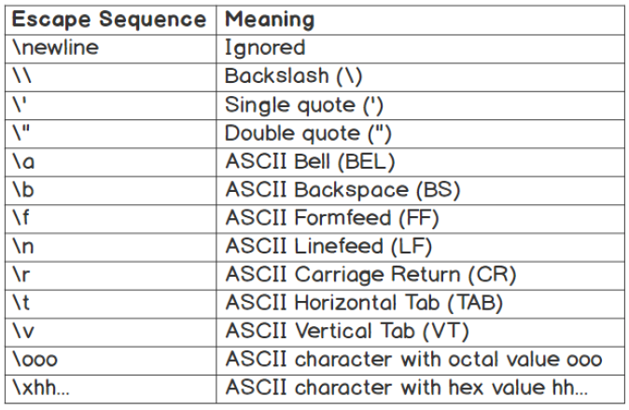

Slide 14
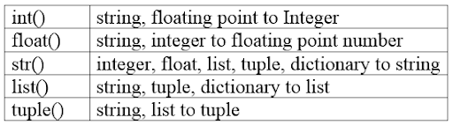

Image Credit: https://www.vectorstock.com/royalty-free-vector/cartoon-wizard-vector-1693529

Slide 15
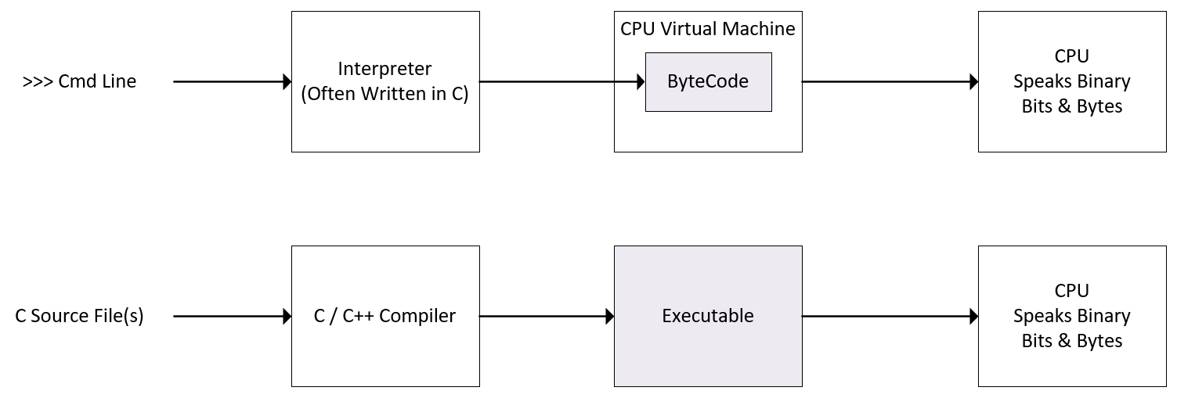
Architecture (Interpreted Languages)
Notes:
Interpreted languages are much slower than compiled languages. When performance matters, an interpreted language may not be the best solution. If that’s the case with you, Nvidia provides the Cuda development environment which supports the C and C++ languages. These are compiled languages as opposed to interpreted.

Slide 16
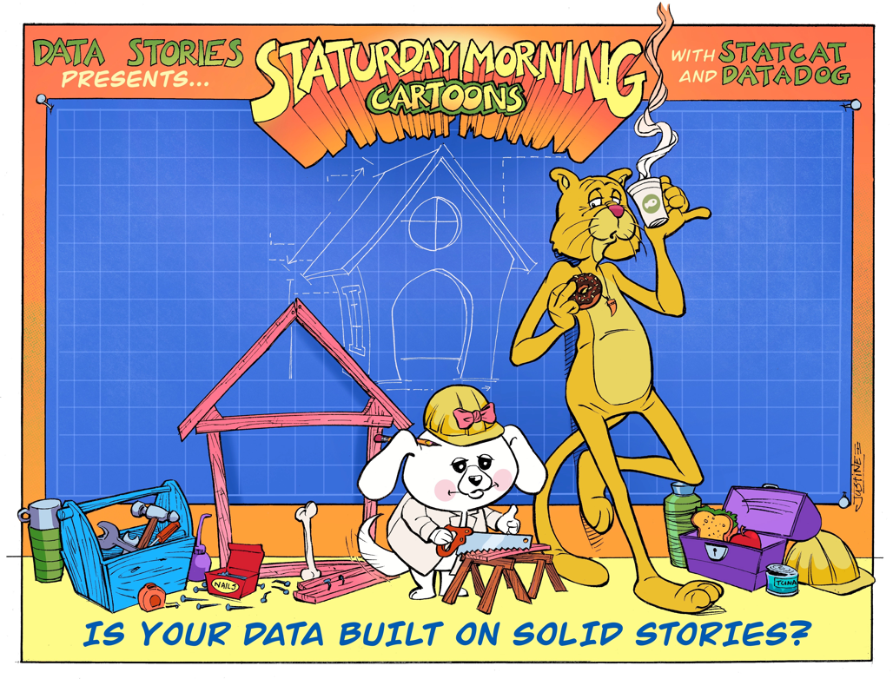

Slide 17




