Slide 1

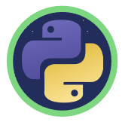
Python Loops

Slide 2
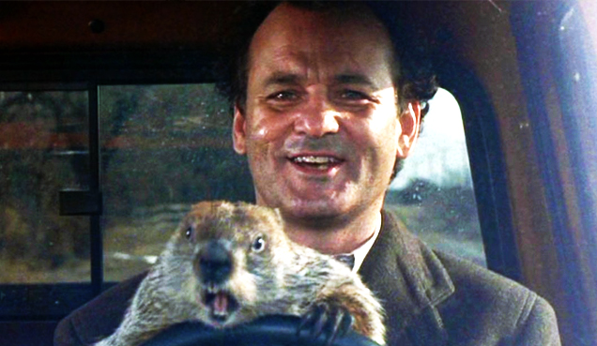

Image Credit: https://cadetcall.org/1258/features/groundhog-day-movie-review/
Notes:
In the comedy Groundhog Day, Bill Murray plays Phil Connors, a disgruntled TV weatherman who’s sent to Punxsutawney, PA to cover the story of Punxsutawney Phil, the town’s famous groundhog who can predict either an early spring or extended winter depending on whether he sees his shadow or not. While there, Phil Connors gets caught in a time warp, reliving the same day over and over again until he learns to value each moment and the people he works with. See the Reference section for links to the movie trailer as well as the film’s Wikipedia entry.
In a programming language, loops allow you to repeat a specific action over and over again. This grants you special powers as a programmer. For example, you could define a groundhog loop that repeats a specified number of times, forcing Phil Connors to relive the same day until the loop reaches a defined limit.

Slide 3
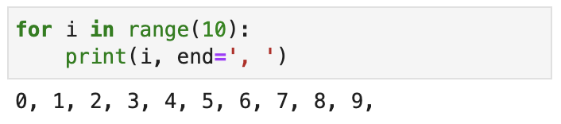
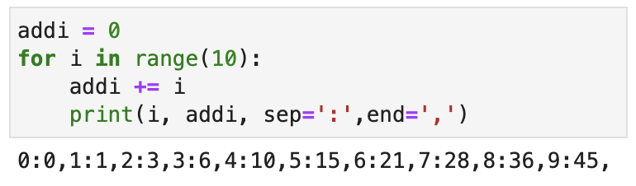
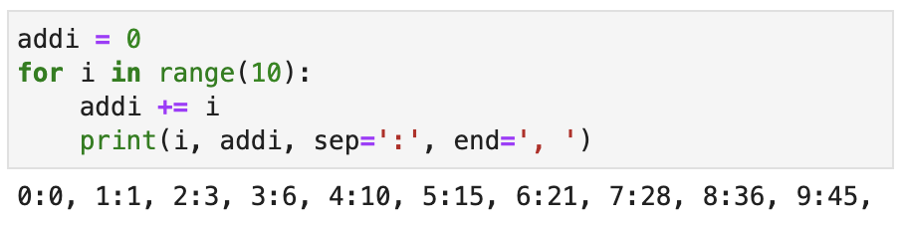
The Python "for" loop
The "for" loop in Python is different than most languages
"for" will iterate through an iterable object one item at a time
Similar to "For Each"
A colon (:) and indention indicates where the loop starts and ends
for <var> in <iterable>:
<statement>
<statement>
. . .
<statement after loop>
"for" will take care of the iterator for you!
Source: Randy Switt – University of Florida (Pythonista)

Slide 4
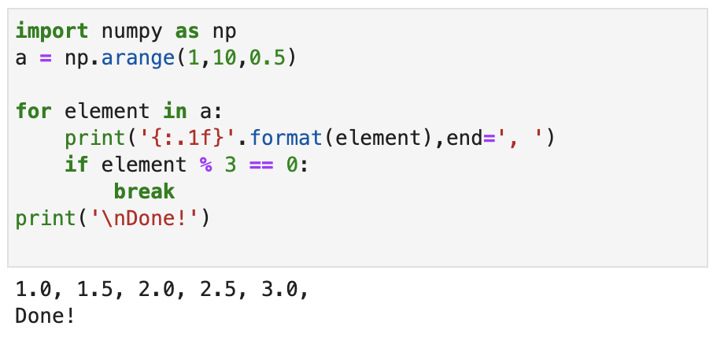
break
The break statement will immediately end a loop when executed
Source: Randy Switt – University of Florida (Pythonista)

Slide 5
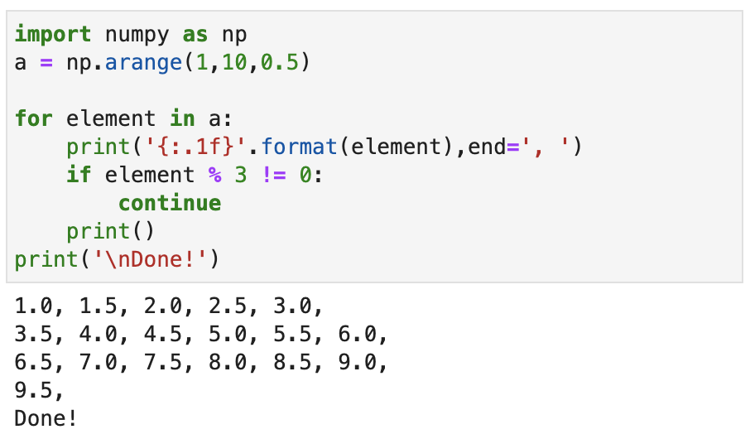
continue
The continue statement will immediately go back to the top of the loop when executed
Source: Randy Switt – University of Florida (Pythonista)

Slide 6
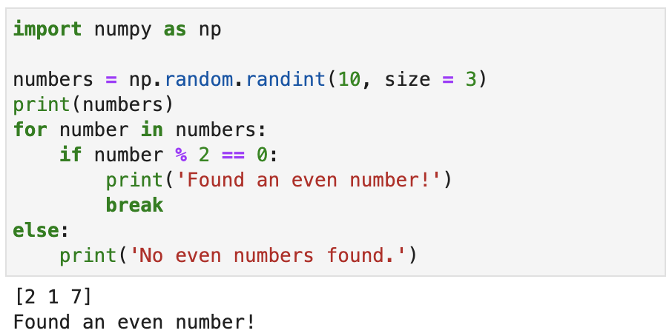
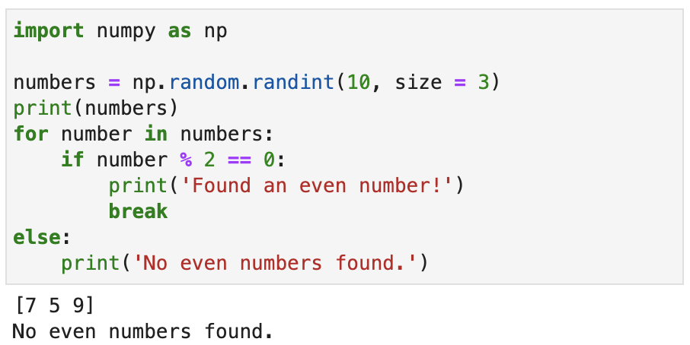
else
Most programming languages don't have an else statement with a for loop
In Python, any statements in a for else block will only execute if the for loop ended normally (i.e., not with break)
Source: Randy Switt – University of Florida (Pythonista)

Slide 7
Decision Controlled Loops
Decision Controlled Loops require a Decision with a <condition>
The <condition> is an expression evaluates to True or False
(just like an if statement)
If the <condition> is True the statements inside the loop are executed
Then execution returns to the top of the loop
If the <condition> is False
execution continues at the first statement after the loop end
FALSE
DECISION
TRUE
SEQUENCE
Source: Randy Switt – University of Florida (Pythonista)

Slide 8
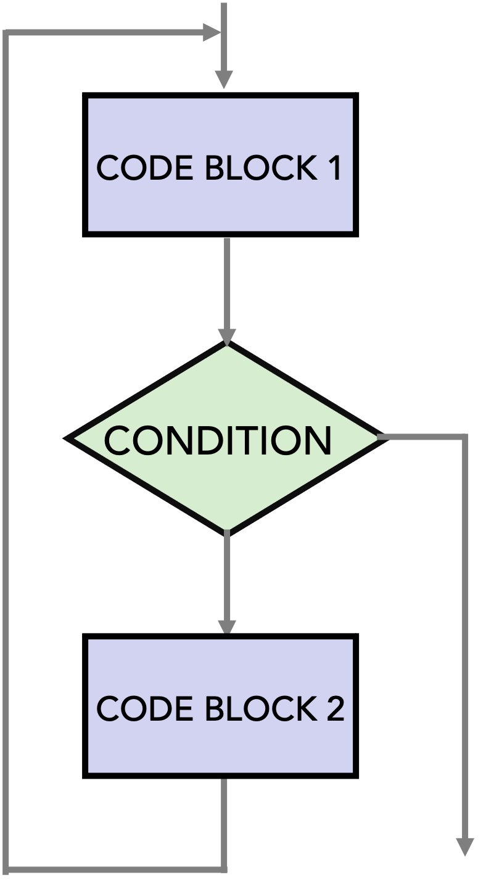
Decision Controlled Loop Structures
There are 3 different Decision Controlled Loop structures
Pre-test loop
Tests for ending condition at the beginning of the loop
Post-test loop
Tests for ending condition at the end of the loop
Mid-test loop
Tests for ending condition in the middle of the loop
CODE BLOCK 1
CODE BLOCK
CONDITION
CONDITION
CONDITION
CODE BLOCK
CODE BLOCK 2
Pre-Test Loop
Post-Test Loop
Mid-Test Loop
Source: Randy Switt – University of Florida (Pythonista)

Slide 9
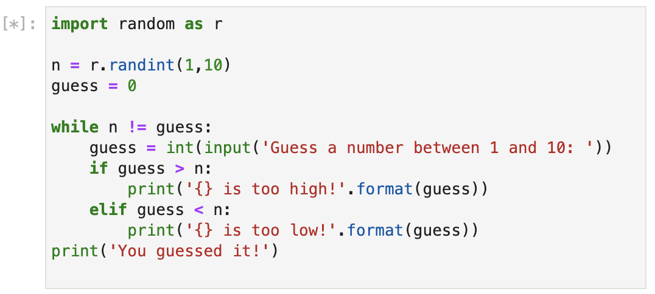
Python decision-controlled loop (while)
while statement syntax
while <condition>:
<statement>
<statement>
< . . . statements>
<statement after while loop>
Source: Randy Switt – University of Florida (Pythonista)
Notes:
<condition> evaluates to True or False
All indented statements are executed *if* <condition> is True
Execution returns to the top of the loop, and the <condition> is re-evaluated
If <condition> is False, execution resumes after indention ends
Note: this means that the statements in the while loop may never execute!

Slide 10
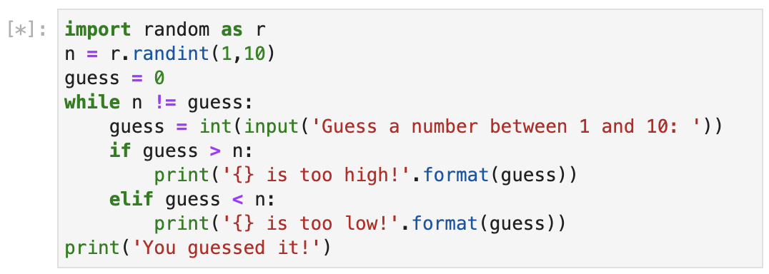
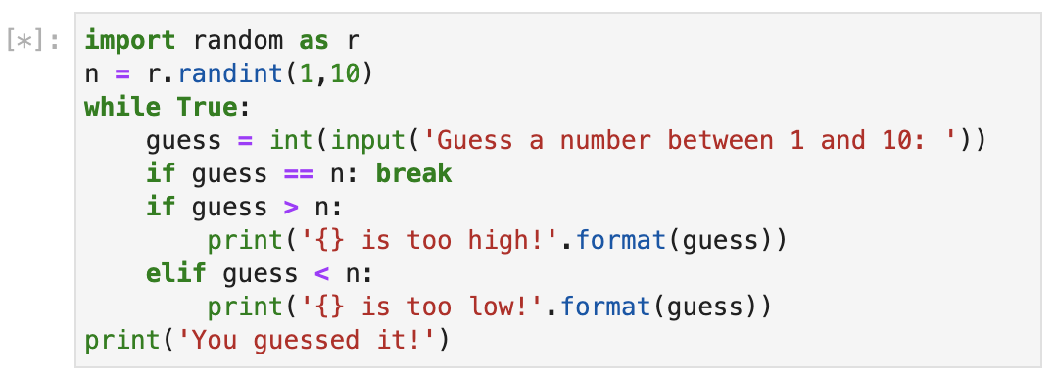
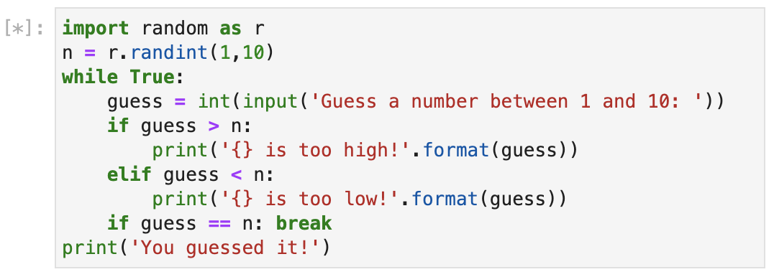
Pre-Test vs. Mid-Test vs. Post-Test Loop
break , continue and else can also be used with while loops
break can be used to create mid and post-test loops
Pre-Test Loop
Mid-Test Loop
Post-Test Loop
Source: Randy Switt – University of Florida (Pythonista)

