Slide 1


Practicum – Building AI knowledge
Introduction to Python
Notes:
Hello and welcome to this Practicum AI recording.
I’m Dan Maxwell, the AI Trainer / Consultant for Research Computing.
In this briefing, I will introduce you to our Python workshop series.
[NEXT SLIDE]

Slide 2

Python Workshop Series
Understanding Variables and Coding Style
Printing, Variable Types and Libraries
Loops, Conditionals, and Functions
Introduction to Data Wrangling
Notes:
Alright, let’s start off with an overview of what’s covered in our Python workshop series.
In our first session, we cover the basics – creating and working with variables. And developing a unique coding style.
We then turn our attention to printing, data types, and libraries in session two.
Loops, conditionals, and functions are featured in session three.
And finally, we conclude with an introduction to data wrangling.
If any of these words sound a bit mysterious, don’t worry. I will introduce you to the vocabulary of programming during these learning experiences.
Also, keep in mind that this series is not comparable to a full-semester, for-credit class. Our goal here is to teach the basic Python skills you need to execute a deep learning project.
[NEXT SLIDE]

Slide 3
Six Learning Strategies
Notes:
Now that I’ve talked about what you’ll learn in this workshop series, I’d like to take a couple minutes to talk about how to learn. Mastering a new skill can be hard. But the 6 learning strategies I’m going to share with you now will help!
[NEXT SLIDE]

Slide 4
1
Focus
Notes:
Strategy # 1: Focus
So often, students think they can learn to program while multi-tasking -- posting on Facebook, texting friends or watching TikTok. If anything, these kinds of activities will slow you down. Instead, you'll learn Python much faster if you can devote focused time to practice.
[NEXT SLIDE]

Slide 5
2
Avoid “Copy and Paste”
Notes:
Strategy # 2: Avoid the “copy and paste” approach to writing code
The copy and past approach to writing code may sound like a good idea, but it can impede learning for these two reasons:
When you type out a line of code, chances are you’re going to make a typing mistake or two. And that’s a good thing! You will learn much faster as you read, understand, and then fix errors. None of this will happen if you take a copy and paste approach to writing code.
When you copy and paste code, you may think you know what you are doing. When, in fact, you don’t. In the beginning, you want to avoid the illusion of mastery.
[NEXT SLIDE]

Slide 6
3
Study Code Block-by-Block / Line-by-Line
Notes:
Strategy # 3: Study code block-by-block, line-by-line
This means running one block of code at a time. Do you understand the output? If things aren’t clear, spend more time with the code. Consider these tips:
Break a line of code into its components and try to understand the individual pieces. Sometimes functions are nested within functions.
Document, document, document! Remember: the documentation you write today is for the future you. That’s the you who’s trying to figure out what this block of code is doing, six months or a year from now.
Perform mini experiments. Simplify the code and then tinker with it to see what happens.
[NEXT SLIDE]

Slide 7
4
Use the Internet to Find Answers
Notes:
Strategy # 4: Use the internet to find answers
When faced with a strange error, take a minute to search the internet because someone has probably asked (and received useful answers) to the problem you now face. Also, I recommend that you bookmark your trusted resources. Stack Overflow, for example, is the go-to place for programmers writing code in a wide variety of languages.
[NEXT SLIDE]

Slide 8
5
Ask for Help
Notes:
Strategy # 5: Ask for Help
There’s no shame in asking for help. We’re all learning. And some days, I feel like I’m the one who has the most to learn.
[NEXT SLIDE]

Slide 9
6
Take Your Time
Notes:
Strategy # 6: Take your time
It takes time to master any subject, including a programming language. Rome wasn’t built in a day. So, don’t rush to get things done. Expect some level of struggle and frustration. However, as your skill grows, you’ll be amazed at what you can do.
[NEXT SLIDE]

Slide 10
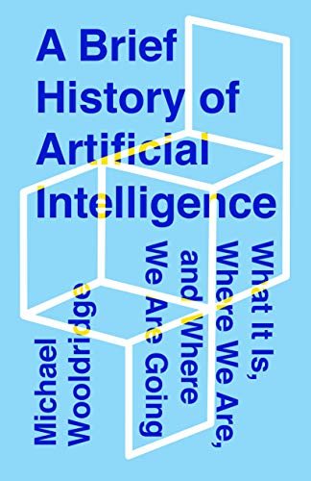
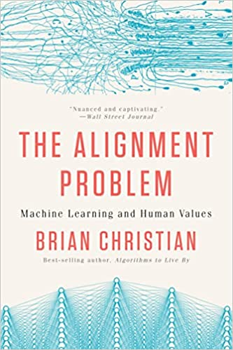
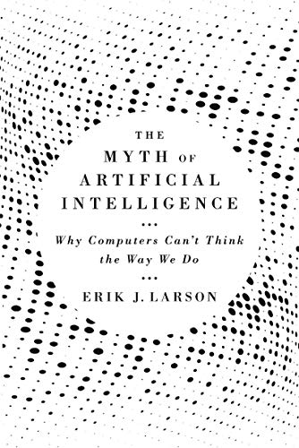
Additional Resources
Notes:
You’re now ready to start your learning journey. But before you do, I encourage you to go beyond the technical details. Take some time to see the big picture. These three books will help you do that.
A Brief History of Artificial Intelligence by Michael Wooldridge is a wonderful introduction to the field. I especially like Michael’s NO hype approach.
The Alignment Problem by Brian Christian is probably the best book I’ve ever read on AI ethics.
They Myth of Artificial Intelligence by my friend Erik Larson discusses the challenges of achieving artificial General Intelligence (AGI).

Slide 11
Slide intentionally left blank

Slide 12

Jupyter
Notes:
Follow JupyterLab presentation outline in 01_jupyterlab_presentation.md.

Slide 13
Learning Strategies
Focus
Avoid “Copy and Paste”
Study Code Block-by-Block / Line-by-Line
Use the Internet to Find Answers
Ask for Help
Take Your Time
Source: Valle, D.. (2016). How to learn a scripting language.
Notes:
Focus
So often, students think they can learn AI programming while multi-tasking -- posting on Facebook, texting friends or watching TikTok. If anything, these kinds of activities will slow you down. Instead, you'll learn Python much faster if you can devote focused time to practice.
Avoid the “copy and paste” approach to writing code
Although copying and pasting may help you avoid typing errors, it can also interfere with your learning process for the following two reasons:
Typing errors can help you gain experience writing code as it provides informative feedback when you make mistakes. Making and correcting typing errors is an important skill, particularly when you are typing a lot of code for your own data analysis.
Copying and pasting code may give you the impression that you know what you are doing when – in reality – you may not fully understand what the code is actually doing. This problem only gets worse as you work with longer and more complicated scripts.
Study code block-by-block, line-by-line
This means running one block of code at a time and making sure you understand the output. If things aren’t clear, spend more time with the code. Here are some helpful pointers:
Break a line of code into its components and try to understand the individual pieces. Sometimes functions are nested within functions.
Document what each block is doing. Clear documentation is critical as you may not remember what you did when you come back to a piece of code at some point in the future. As a wise programmer once said, “Write code for the future you.” Documentation is also useful when you want to adapt or reuse code in some other way. In situations like this, you will immediately know what a specific chunk of code does because it has been clearly documented. Donald Knuth – Literate Programming
Perform mini experiments. Simplify the code and then tinker with it to see what happens.
Use the internet to find answers
Everybody (from novice to master) searches the internet when they don’t understand something. It’s likely that other people have already asked (and received useful answers) for the problem you’re facing. However, finding useful answers can be hard, especially if you don’t use the correct terms/key words. All that to say, search is a skill that comes with practice.
Use trusted internet resources like Stack Overflow. I’ve also found that good cheat sheets from reputable sources can also be helpful.
Ask for Help
We’re all learning. And some days, I feel like I’m the one who has the most to learn. Alcoa story.
Take your time
Remember: it takes time to master any subject, including a programming language. So, don’t rush to get things done. Expect some level of struggle and frustration. However, as your skill grows, you’ll be amazed at what you can do.
[NEXT SLIDE]

